Slide 1
PodCraft: Agentic AI Podcast Episode Planning System
Student 1: Muhammad Awais Ashraf (FA23-BDS-053)
Student 2: Asna Hammad (FA23-BDS-051)
Supervisor: Tahseen Riaz Abbassi
Department: Department of Computer Science
Submission Date: March 18, 2026

Slide 2
Project Category
B- Web Application / Web Application based Information System
C- Problem Solving and Artificial Intelligence
K- Other: Agentic Artificial Intelligence System
E- Smartphone Application

Slide 3

PodCraft simplifies and automates podcast episode planning using intelligent autonomous agents.
Abstract
It addresses the gap in unified platforms by researching topics, generating structured questions, and designing episode outlines.
The system enhances time management with timestamped segments and guided content flow.
The goal is to improve productivity and raise production quality through intelligent automation.

Slide 4
Research Based Project
Yes
Papers to be Studied:
Software Engineering: A Practitioner's Approach (R. S. Pressman & B. R. Maxim)
Artificial Intelligence in Content Generation (S. B. Roy & A. Das)
Applications of Natural Language Processing in Digital Media (L. Zhang & M. Lee)
Automated Content Structuring Using Intelligent Agents (J. Kim & P. Robinson)
AI-Based Conversational Systems for Creative Industries (T. Williams)

Slide 5

Introduction
Purpose:
- To develop a smart platform that assists podcasters in preparing structured episodes with minimal manual effort.
Key Goals:
- Modernize podcast planning by combining AI automation with creative assistance.
- Provide intelligent research, content planning, and episode structuring support.
Impact:
- Supports creators in educational, entertainment, and professional fields globally.

Slide 6
Problem Statement
Problem & Solution
The Problem: Podcast creators struggle with "Information Overload" and "Structuring Fatigue“, spending more time researching and organizing than actually recording.
The Solution: PodCraft automates the research-to-script pipeline, transforming raw data into structured, timestamped episode plans.
Motivation (Why develop this system?)
To provide a "Digital Executive Producer" for independent creators who lack professional staff.
To explore the efficiency of Agentic Workflows where multiple AI agents collaborate to ensure factual accuracy and creative flow.
Existing Systems & Learning Value
Similar Systems: Tools like ChatGPT (General AI) or Descript (Post-production) exist but lack integrated, autonomous planning workflows.
Re-implementation Value: Building this system allows us to move beyond simple prompt-response models and master Multi-Agent Orchestration, ensuring more reliable and context-aware outputs.
Expected Skill Acquisition
Technical: Multi-Agent Frameworks (CrewAI/LangChain), Vector Databases for RAG, and Full-stack development.
Professional: Prompt Engineering, System Design, and Agile Project Management.

Slide 7
Problem Solution
The Solution:
PodCraft introduces an agent-based platform that automates planning from idea to outline.
Objectives:
BO-1: Reduce planning time by at least 50%.
BO-2: Improve content structure quality by 40%.
BO-3: Increase audience engagement through structured discussions.
BO-4: Automate topic research and question generation.

Slide 8
Related System Analysis (Literature Review)
Application Name | Weakness | Proposed Project Solution
Descript: | no research or planning support. | Provides automated topic research, structured planning, and complete episode outlines before recording begins
Buzzsprout | Only supports hosting and distribution; lacks content preparation tools. | Assists in pre-production through intelligent agents that generate interview questions, hooks, and timestamps.
Notion | Manual planning tool with no intelligent automation. | Uses autonomous AI agents to automatically convert raw ideas into structured, actionable episode plans.
ChatGPT | General-purpose AI requiring repeated prompts; no specialized or structured workflow. | Provides a dedicated, one-stop podcast planning workflow with specialized agents for each sub-task.

Slide 9
Advantages/Benefits of Proposed System
Time Efficiency
Accessibility:
Improved Content Quality:
Consistency:
Audience Engagement:
Automates research and planning tasks.
Ensures logical flow and professional presentation.
Maintains uniform structure for all productions.
Supports both web and smartphone platforms.
Generates compelling hooks and organized segments.

Slide 10

Podcast Planning System
Scope:
Includes: Web and smartphone platforms, autonomous agents for research, trend analysis, question generation, and timestamp allocation.
Functionalities: Secure user authentication, cloud storage, and editable/exportable episode plans.
Exclusions: Does not include audio recording, editing, or direct publishing.

Slide 11
Modules
01- User Authentication & Profile Management
02- User Intent & Guest Analyzer
05- Hook & Intro Suggestion Agent
03- Topic Research Agent
04- Question and Timestamp Generator
06- Episode Outline Planner

Slide 12

Module 1: User Authentication
Features:
Secure login/registration, profile creation with niche selection, and guest profile management.
System:
Uses secure cloud storage for all user data.
.

Slide 13
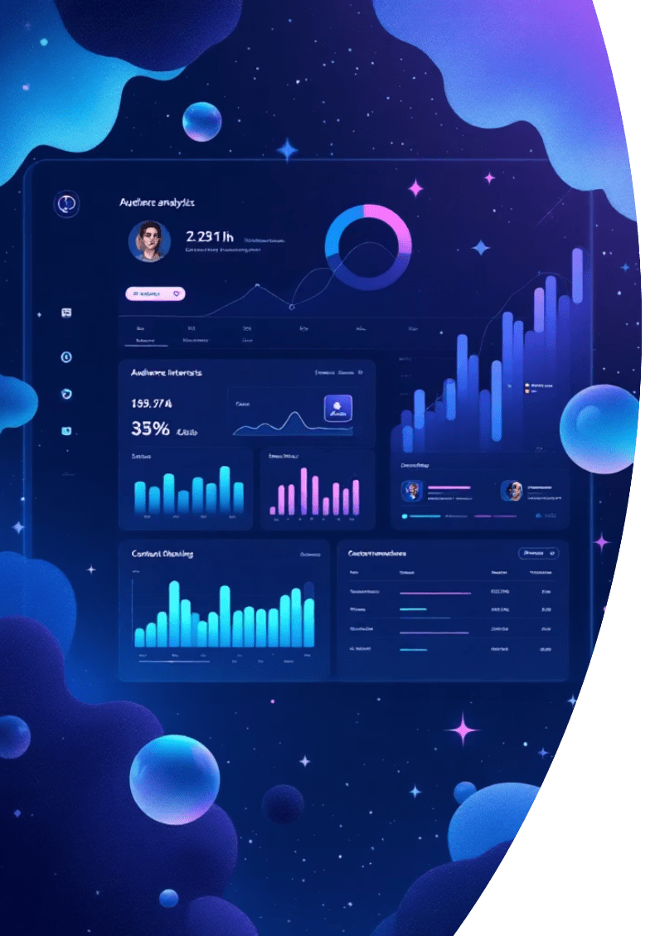
Module 2: User Intent & Guest Analyzer
Features:
Interprets niche and guest background inputs to determine audience interest.
Outcome:
Provides tailored content planning recommendations.

Slide 14

Module 3: Topic Research Agent
Features:
Discovers trending topics and collects background info related to the niche.
Outcome:
Provides summarized research insights for the creator.

Slide 15
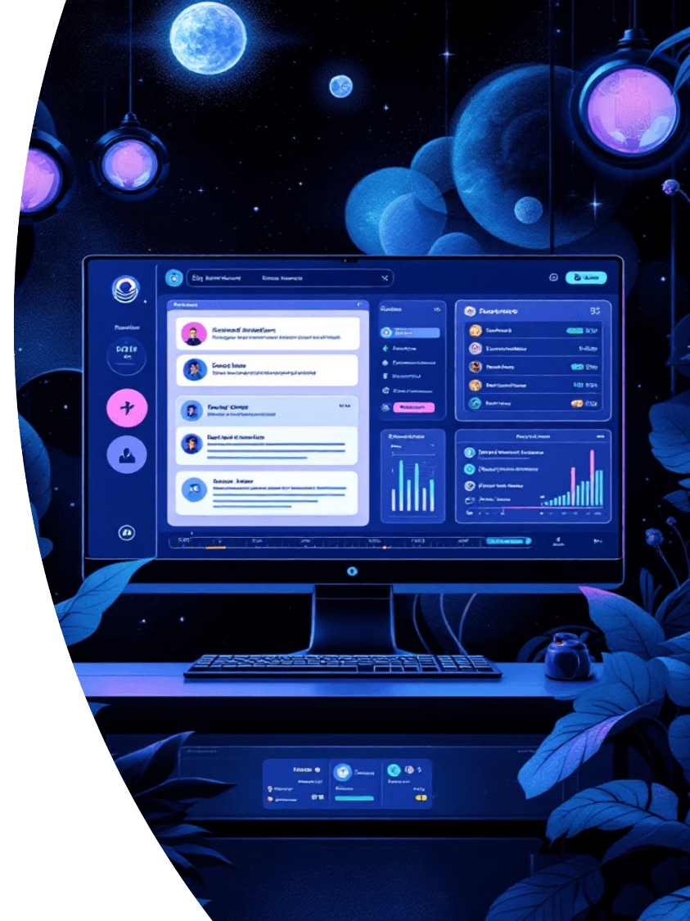
Module 4: Question & Timestamp Generator
Features:
Generates structured interview questions categorized by segment.
Outcome:
Allocates estimated timestamps to balance episode flow.

Slide 16
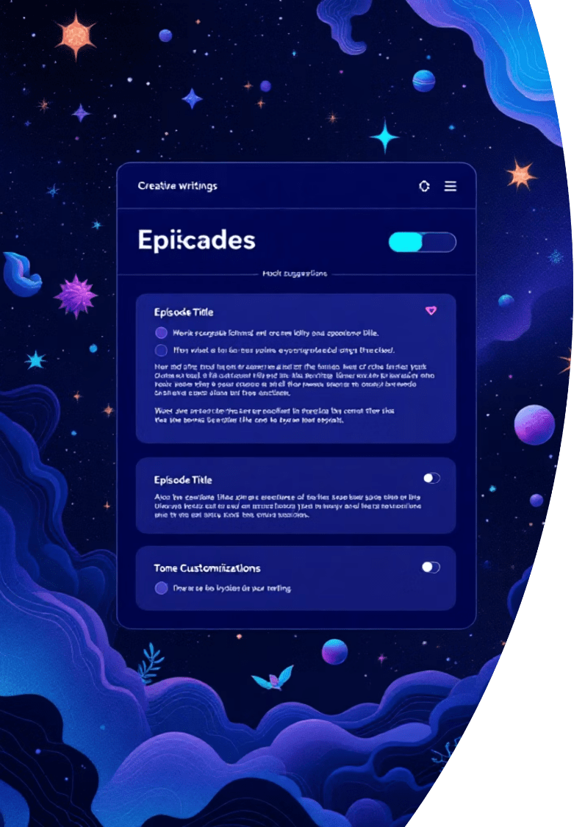
Module 5: Hook & Intro Suggestion Agent
Features:
Creates attention-grabbing hooks and suggests catchy episode titles.
Outcome:
Provides multiple tone options customized for target audiences.

Slide 17

Module 6: Episode Outline Planner
Features:
Organizes all data into a logical flow with editable templates.
Outcome:
Allows users to export the final plan in PDF or document format.

Slide 18
System Limitations/Constraints
LI-1
Depends on active internet connectivity.
LI-2
AI content may require manual review for accuracy.
LI-3
No support for audio recording or editing.
LI-4
Performance varies based on device and network speed.

Slide 19
Software Process & Design Methodology
Process Methodology: Incremental Development Model
Reason: Since PodCraft involves complex AI agent interactions, an incremental approach allows us to develop and test one agent (e.g., the Researcher) before moving to the next (e.g., the Scriptwriter). This ensures core functionality is stable before adding complexity.
Design Methodology: Object-Oriented Design (OOD)
Reason: We are using an Agentic framework where each AI Agent is treated as an autonomous "Object" with its own properties (tools, memory, role). OOD allows us to manage these interactions cleanly and scale the system easily.

Slide 20
Tools and Technologies
Tools | Versions | Rationale
Python | 3.11 | Backend development and AI processing
JavaScript | ES6 | Frontend and backend scripting
Typescript | 5.3 | Type-safe frontend development
React JS | 18.2 | Web frontend framework
React Native | 0.72 | Cross-platform mobile app development
Node JS | 20.10 | Server-side runtime environment
Express JS | 4.18 | Backend web framework
OpenAI API | Latest | AI content generation and intelligent agents
REST API | V1 | Communication between frontend and backend

Slide 21
Tools and Technologies
Tools | Versions | Rationale
HTML5 | Latest | Web page structure
CSS3 | Latest | Styling and responsive design
Tailwind CSS | 3.4 | Modern UI styling framework
JWT | Latest | Secure user authentication
Cloudinary API | Latest | Media storage and optimization

Slide 22
Project Stakeholders & Roles
Project Sponsor | COMSATS, Institute of Information Technology Islamabad
Stakeholders | Development Team (Awais & Asna): Responsible for design, development, testing, and deployment. Project Supervisor (Tahseen Riaz Abbassi): Provides technical guidance, monitors progress, and approves phases. Final Year Project Committee: Evaluates project quality and final implementation. End Users (Podcast Creators): Provide essential requirements and feedback for system improvement. System Administrator: Manages users, system operations, and AI services.

Slide 23
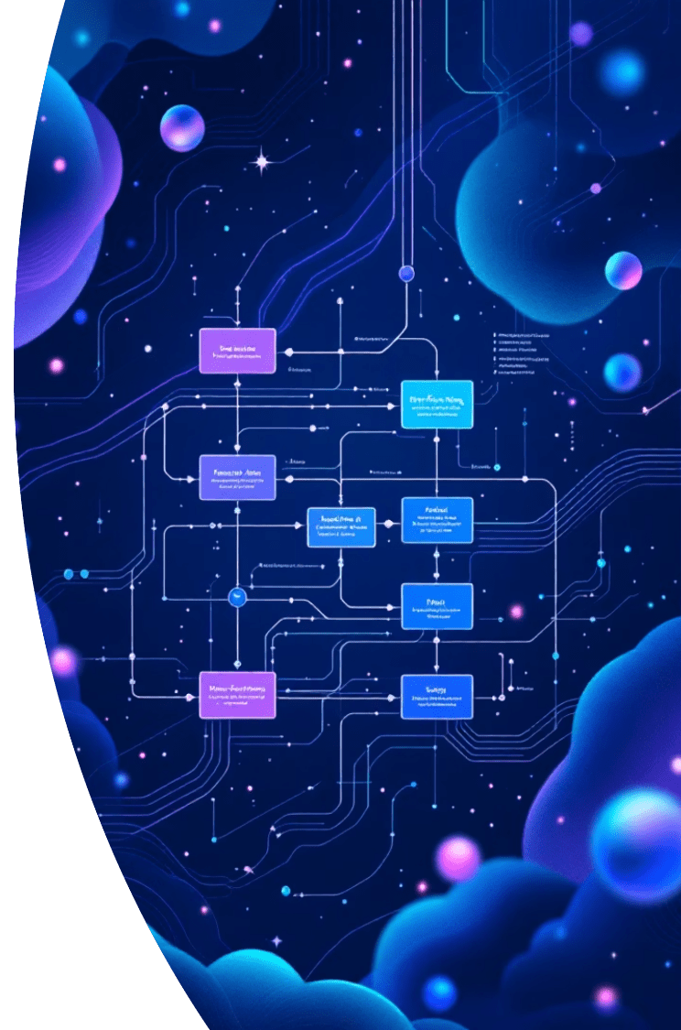
Work Division
Awais Ashraf | FA23-BDS-053 | Web/Mobile Development: User Authentication, Dashboard, and UI/UX implementation. Requirements: Leads Requirement Gathering and System Analysis
Asna Hammad | FA23-BDS-051 | Backend & AI: Database Management, Cloud Integration, and AI Agent development. Admin & Quality: Admin Panel development, Testing, and Feasibility Study.

Slide 24
Requirement Gathering Approaches
Interviews: Conducted with podcast creators to understand their specific workflows and challenges.
Questionnaires: Distributed to creators to gather quantitative data on preparation difficulties.
Observation: Studying how podcasters currently use existing tools like Notion or Descript for planning.
Online Research: Analyzing current podcast production trends and user expectations.
Reasoning: To ensure PodCraft aligns with real-world user needs and solves actual planning bottlenecks.

Slide 25
Concepts
Concept-1:
Agent-Based Architectures: Designing specialized AI agents that collaborate to produce complete episode plans.
Concept-2:
Intelligent Content Generation: Utilizing the OpenAI API for autonomous research and structuring of interview questions.
Concept-3:
Cross-Platform Development: Learning React Native and React JS for real-time synchronization between web and mobile platforms.
Concept-4:
NoSQL & Cloud Architecture: Implementing secure data storage and authentication using MongoDB and Firebase.

Slide 26
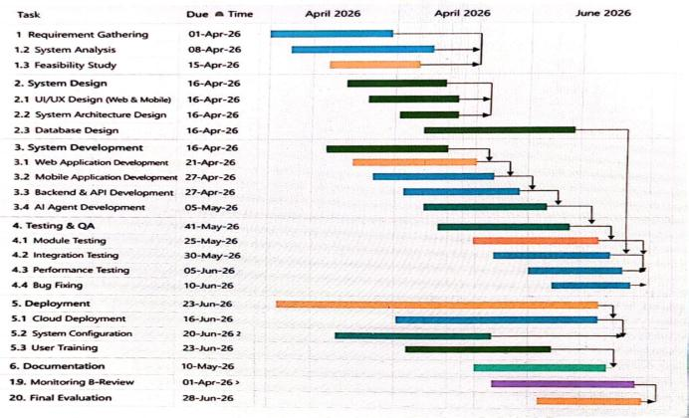
Gantt Chart

Slide 27

Project Timeline & Mockups

Slide 28
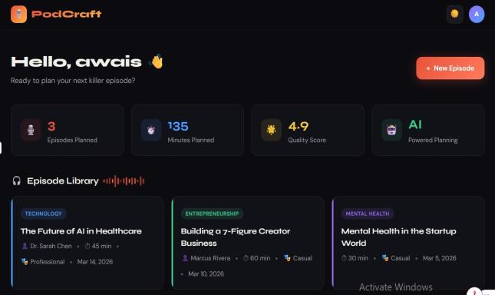
Mockup-1: User Dashboard

Slide 29
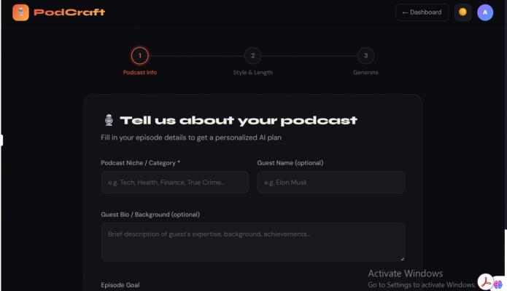
Mockup-2: Podcast Info

Slide 30
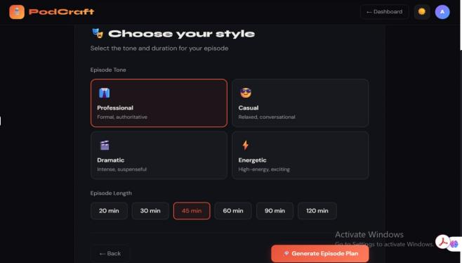
Mockup-3: Style & Length

Slide 31
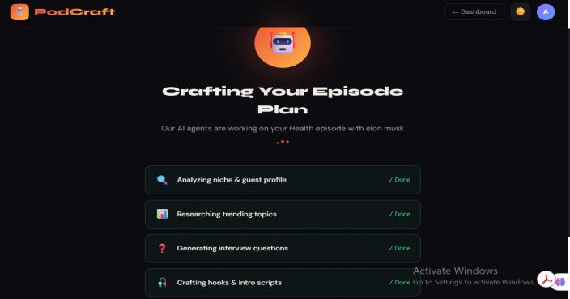
Mockup-4: Generation Screen

Slide 32
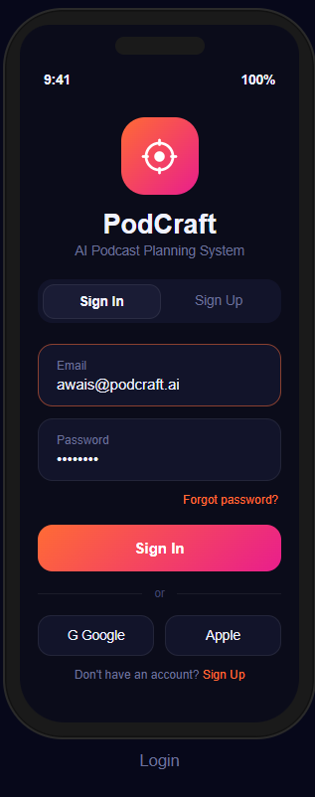
Mobile Mockups:
Mockup-1: User Authentication

Slide 33
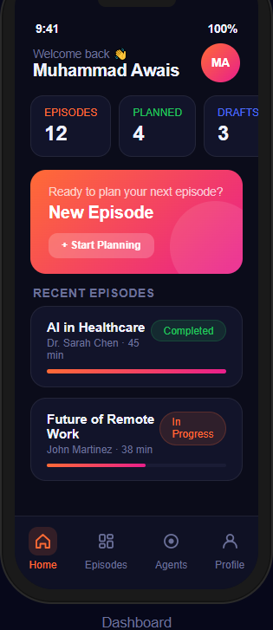
Mockup-2: User Dashboard

Slide 34
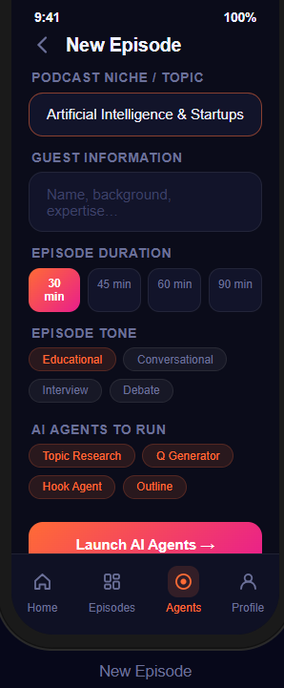
Mockup-3: Podcast Info

Slide 35
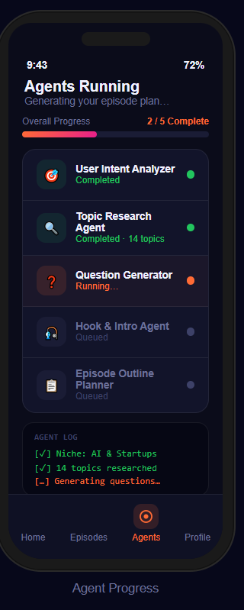
Mockup-4: Agents Running

Slide 36

Conclusion
PodCraft bridges the pre-production gap by automating the most time-consuming parts of podcasting.
By using collaborative AI agents, it ensures high-quality content structure and increased audience engagement.
It serves as a professional "Digital Producer" for both independent and professional creators.

Slide 37
References
R. S. Pressman and B. R. Maxim, Software Engineering: A Practitioner’s Approach, 2019.
S. B. Roy and A. Das, "Artificial Intelligence in Content Generation," Journal of Intelligent Systems, 2021.
L. Zhang and M. Lee, "NLP in Digital Media," IJCSIT, 2022.
OpenAI, "GPT Technology Overview," https://openai.com/research, 2024.
MongoDB Inc., "Documentation," https://www.mongodb.com/docs, 2024.

Slide 38
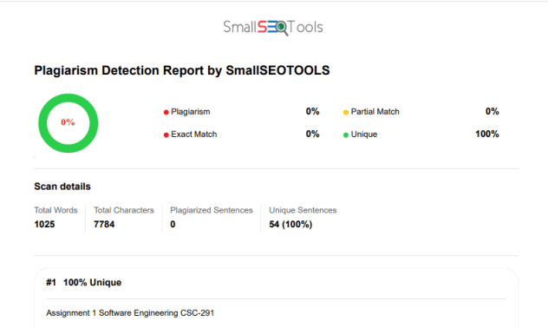
Plagiarism Report:

Slide 39
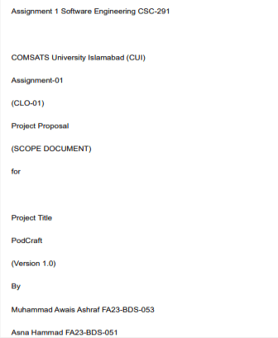
Plagiarism Report:

Slide 40
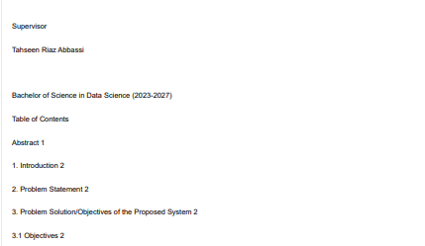
Plagiarism Report:

Slide 41
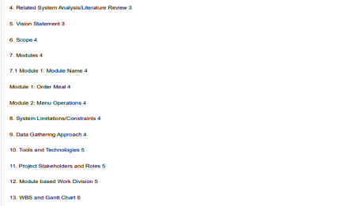
Plagiarism Report:

Slide 42
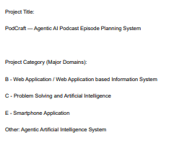
Plagiarism Report:

Slide 43
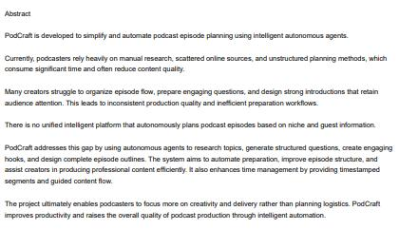
Plagiarism Report:

Slide 44
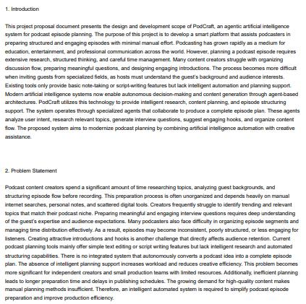
Plagiarism Report:

Slide 45
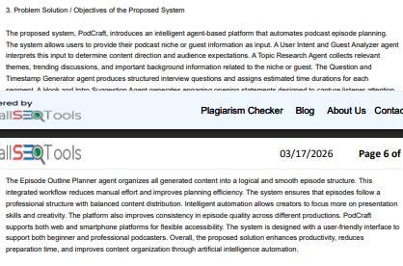
Plagiarism Report:

Slide 46
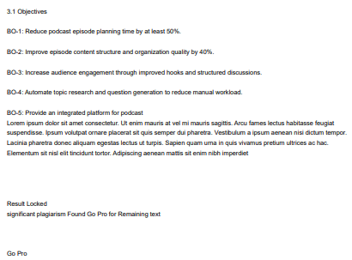
Plagiarism Report:

