Slide 1
Bone Fracture
Classification
Using EfficientNetV2 with Transfer Learning
📄 Paper: "Bone Fracture Classification Using Deep Learning Models with Transfer Learning"
🏛️ IEEE ISAS 2025 | DOI: 10.1109/ISAS66241.2025.11101746
📦 Dataset DOI: 10.17632/8d9kn57pdj.1
🎓 MSc Data Science & Computational Techniques — Capstone Project (2nd Evaluation)
-- ASNA ABBAS, 253108, DACS
Simple Fracture • Comminuted Fracture | 2,384 Original X-Ray Images

Slide 2
Project Overview
🎯 Objective
📊 Dataset
Classify bone X-rays into Simple Fracture or Comminuted Fracture using deep learning transfer learning with EfficientNetV2S.
2,384 original X-ray images — 1,211 Simple Fracture & 1,173 Comminuted Fracture. Balanced binary classification task.
🧠 Model
📝 Publication
EfficientNetV2S pre-trained on ImageNet. Custom classification head added. Two-phase training: feature extraction + fine-tuning.
Results published at IEEE ISAS 2025. Reproduction of methodology as MSc Capstone 2nd Evaluation project.

Slide 3
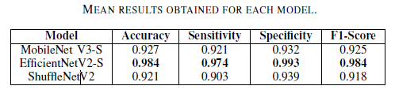
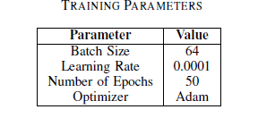
Project Overview

Slide 4
Dataset & Configuration
📦 Dataset Details
⚙️ Hyperparameters
Platform
Mendeley Data
Image Size
224 × 224
Total Images
2,384 (original only)
Batch Size
32 (16 for lighter mode)
Simple Fracture
1,211 images (50.8%)
Epochs
35 (Phase 1 + Phase 2)
Comminuted Fracture
1,173 images (49.2%)
Learning Rate
0.001 (Phase 1)
Image Type
X-Ray (grayscale/RGB)
Fine-Tune LR
0.0001 (Phase 2)
Input Size
224 × 224 pixels
Train / Val / Test
70% | 15% | 15%
Classes
Binary (2 classes)
Random Seed
42 (reproducibility)

Slide 5
Data Preprocessing & Augmentation Pipeline
🏋️ Training Augmentation
🔍 Validation & Test (No Aug)
Rescale
1/255 — normalize to [0.0, 1.0]
Only rescaling is applied — no geometric transforms.
This prevents data leakage and ensures fair evaluation.
Rotation Range
±20 degrees
Rescale: 1/255
Width Shift
±10%
Height Shift
±10%
💡 Why Augmentation?
Shear Range
10%
✓ Increases effective training set size artificially
Zoom Range
10%
✓ Reduces overfitting on small medical datasets
Horizontal Flip
Enabled
✓ Improves generalization to unseen X-ray views
Fill Mode
nearest
✓ Simulates natural variation in X-ray acquisition

Slide 6
Dataset Split Strategy
Train (70%)
Val (15%)
Test (15%)
~1,669 images
~357 images
~358 images
🏋️ Training Set
🔍 Validation Set
🧪 Test Set
70%
15%
15%
~1,669 images
~357 images
~358 images
Used to update model weights. Data augmentation applied: rotation ±20°, horizontal flip, zoom 10%, width/height shift, shear.
Monitors model performance during training. NO augmentation — only rescaling to [0,1]. Guides early stopping & LR reduction.
Held-out unseen data. Never touched during training. Final evaluation of Accuracy, AUC, Precision, Recall, F1-Score.
sklearn train_test_split with random_state=42 ensures reproducibility across all runs.

Slide 7
🧠 Model Architecture — EfficientNetV2S
Input
224×224
EfficientNetV2S
Backbone
(ImageNet)
Global
Average
Pooling
BatchNorm
+
Dense(256)
Dropout
0.5
+Dense(128)
Sigmoid
Output
(Binary)
🔒 FROZEN (Phase 1)
🔓 LAST 10 LAYERS (Phase 2)
Model Compilation Details
Loss Function:
Binary Cross-Entropy
Optimizer:
Adam
Output Activation:
Sigmoid (binary)
Trainable Params (P1):
~400K (head only)
Frozen Params:
~20M (backbone)
Metrics Tracked:
Accuracy, AUC, Precision, Recall

Slide 8
Two-Phase Transfer Learning Strategy
Phase 1 — Feature Extraction
Phase 2 — Fine-Tuning
Backbone
EfficientNetV2S (all layers FROZEN)
Backbone
Last 10 layers UNFROZEN
Trainable
Custom classification head only
Trainable
Head + last 10 backbone layers
→
Epochs
20 total (split into 2 runs)
Epochs
15 total (split into 2 runs)
Learning Rate
0.001
Learning Rate
0.0001 (10× smaller)
EarlyStopping
Patience = 5 epochs (val_loss)
EarlyStopping
Patience = 4 epochs (val_loss)
ReduceLROnPlateau
Factor 0.5, Patience 3
ReduceLROnPlateau
Factor 0.5, Patience 2
Checkpoint
best_phase1.keras
Checkpoint
best_phase2.keras

Slide 9
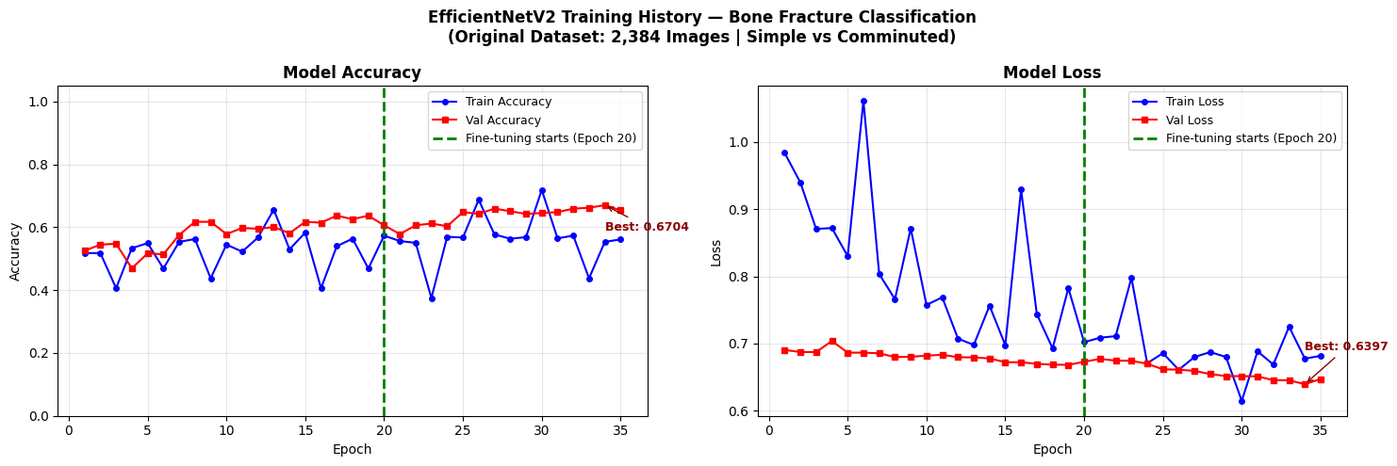
Training History — Accuracy & Loss Curves
Total epochs plotted : 35
Best Val Accuracy : 67.04%
Best Val Loss : 0.6397
↑ Vertical dashed line (Epoch ~20) marks start of Phase 2 fine-tuning in actual notebook output.

Slide 10
📊 Test Set Evaluation Results
62.01%
0.6789
0.5943
Accuracy
AUC (ROC)
Precision
0.7967
0.6808
79.7%
Recall
F1-Score
Sensitivity
Specificity: 43.8% | The model shows stronger recall for Simple Fractures but lower specificity for Comminuted Fractures — indicating room for improvement in distinguishing complex multi-fragment patterns.

Slide 11
🗂️ Confusion Matrix Analysis
Confusion Matrix (Normalized)
Metric Breakdown
Predicted →
True Negatives (TN)
Simple
Comminuted
Simple fractures correctly identified as Simple
Actual ↓
~56%
TN
~44%
FP
False Positives (FP)
Simple
Simple fractures misclassified as Comminuted
False Negatives (FN)
Comminuted misclassified as Simple fractures
Comm.
~20%
FN
~80%
TP
True Positives (TP)
Comminuted fractures correctly identified
Sensitivity (Recall)
79.7% — model detects most Simple Fractures
🟩 Correct predictions 🟥 Incorrect predictions
Specificity
43.8% — lower ability to confirm Comminuted

Slide 12
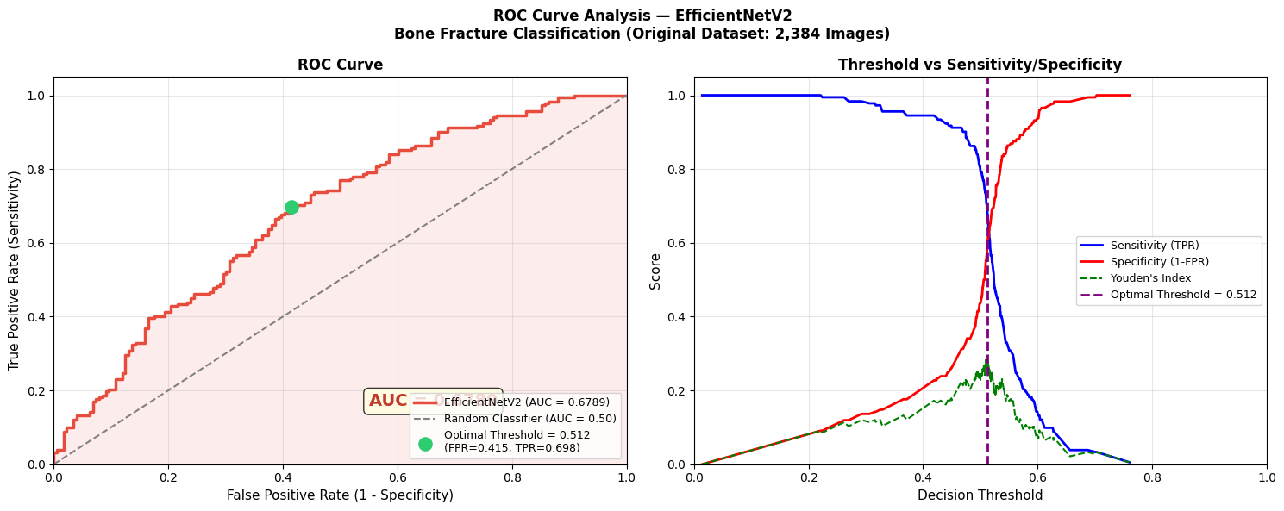
📉 ROC Curve & AUC Analysis
AUC Score
Optimal Threshold Analysis
Improvement over random:
+0.1789
0.6789
Optimal Threshold:
~0.5 (Youden's Index)
Specificity (1-FPR):
43.8%
Sensitivity (TPR):
79.7%
Random Baseline AUC:
0.50
💡 AUC of 0.6789 indicates moderate discriminative ability. Values closer to 1.0 indicate perfect separation between classes.

Slide 13
Simulation Workflow — Step by Step
Libraries & Config
Data Exploration
01
02
TensorFlow, Scikit-learn, Matplotlib imported. Paths and hyperparameters set.
2,384 images verified. Bar chart and pie chart of class distribution generated.
X-Ray Visualization
Dataset Split
03
04
5 sample images from each class displayed at 224×224 to confirm dataset readability.
70% Train | 15% Val | 15% Test using sklearn with random_state=42.
Augmentation Pipeline
Model Build
05
06
Training: rotation, flip, zoom, shift, shear. Val/Test: rescale only.
EfficientNetV2S + custom head (GAP → BN → Dense(256) → Dropout → Dense(1,sigmoid)).
Phase 1 Training
Phase 2 Fine-Tuning
07
08
Feature extraction: head only trained for 20 epochs (backbone frozen).
Last 10 backbone layers unfrozen, LR=0.0001, 15 more epochs.
Training Curves
Evaluation & Results
09
10
Accuracy & Loss plotted across both phases with phase transition marker.
Test accuracy, AUC, confusion matrix, ROC curve, classification report.

Slide 14
✨ Conclusions & Future Work
Transfer Learning Works
Two-Phase Approach
EfficientNetV2S with ImageNet pre-training successfully adapted to the medical X-ray domain without training from scratch.
Phase 1 (feature extraction) + Phase 2 (fine-tuning last 10 layers) is an effective and computationally efficient training strategy.
Moderate Performance
Dataset Limitations
62.01% accuracy and AUC of 0.6789 indicate moderate classification ability. The model is better at detecting Simple Fractures (recall 79.7%).
Only 2,384 original images. Medical image datasets are typically small — more data or augmentation could improve performance.
IEEE ISAS 2025 | DOI: 10.1109/ISAS66241.2025.11101746 | MSc Data Science — Capstone Project

