Slide 1
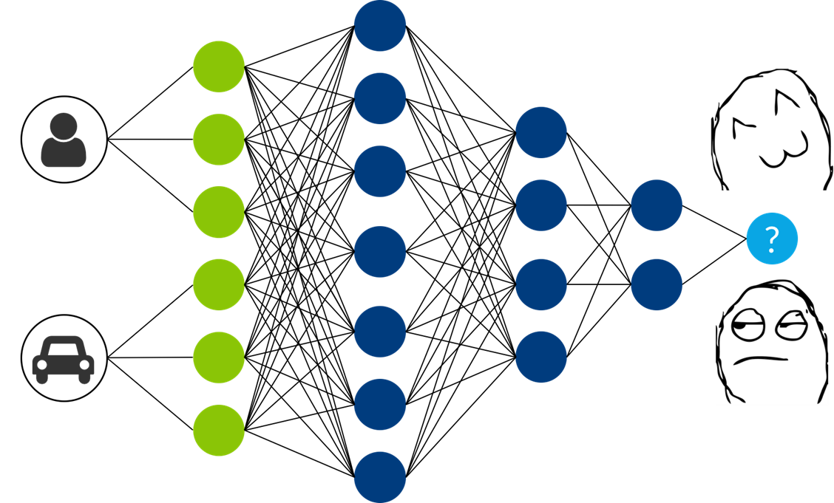
Deep Learning for Recommender System
Data Science Summit Israel 2018
Asi Messica, Guy Shtar : Ben Gurion University of the Negev
Supervisor: Prof. Lior Rokach

Slide 2
Agenda
Session Based Recommendation
Neural Collaborative Filtering
Notes:
We will cover two main use cases in this workshop – the first one is session based recommendation, and the second one is neural collaborative filtering.
For each use case, we will give an introduction, hands on exercise and some more advanced topics people are working on.

Slide 3

Motivation
Anonymous user recommendation is common in real-life (occasional user, privacy)
No user profile
Item-to-item recommendations is often used
Consumption probability prediction for effective promotion recommendation

Slide 4
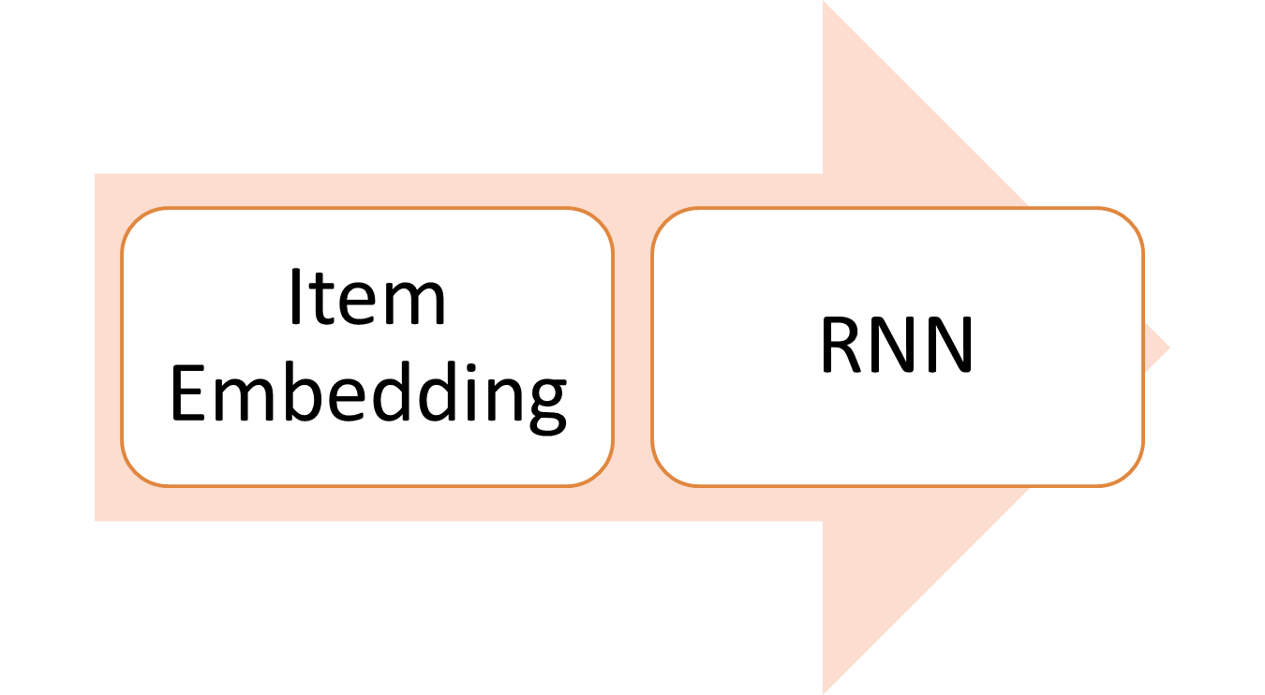
Approach
Item Similarity & Analogy
Clicks Prediction
* Greenstein-Messica, A., Rokach, L. and Friedman, M., 2017, March. Session-based recommendations using item embedding. In Proceedings of the 22nd International Conference on Intelligent User Interfaces (pp. 629-633). ACM.

Slide 5
Natural-Language Processing (NLP) Word Embedding
Vector space models: represent an item (or a word) as a vector of numbers.
One hot vector
Word embedding: low-dimensional word representations
V – size of vocabulary
…
Cat
[1,0,0..0]
…
Dog
[0,0,1..0]
…
Cat
[0.2,0.45,0,0.83,..0]
d (<<V)
Notes:
Reminds Matrix factorization? Dimensionality reduction?

Slide 6
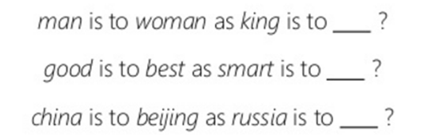
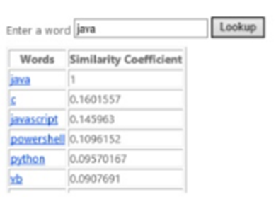

Word Embedding
Goal: Learning vector space representations of words capturing fine-grained semantic regularities among words
Word Analogy
Word Similarity

Slide 7
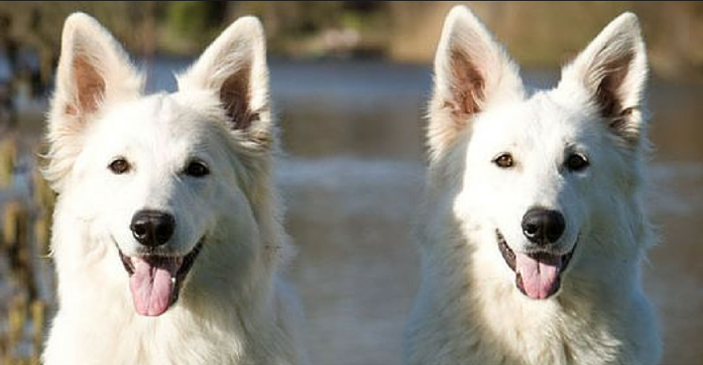
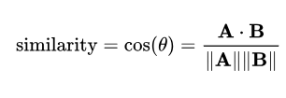
GloVe*: Global Vectors for Word Representation
Assumption: In the embedded plan the distance between words which frequently co-occur in a corpus should be small
Similarity?
* Pennington, J., Socher, R. and Manning, C., 2014. Glove: Global vectors for word representation. In Proceedings of the 2014 conference on empirical methods in natural language processing (EMNLP) (pp. 1532-1543).

Slide 8
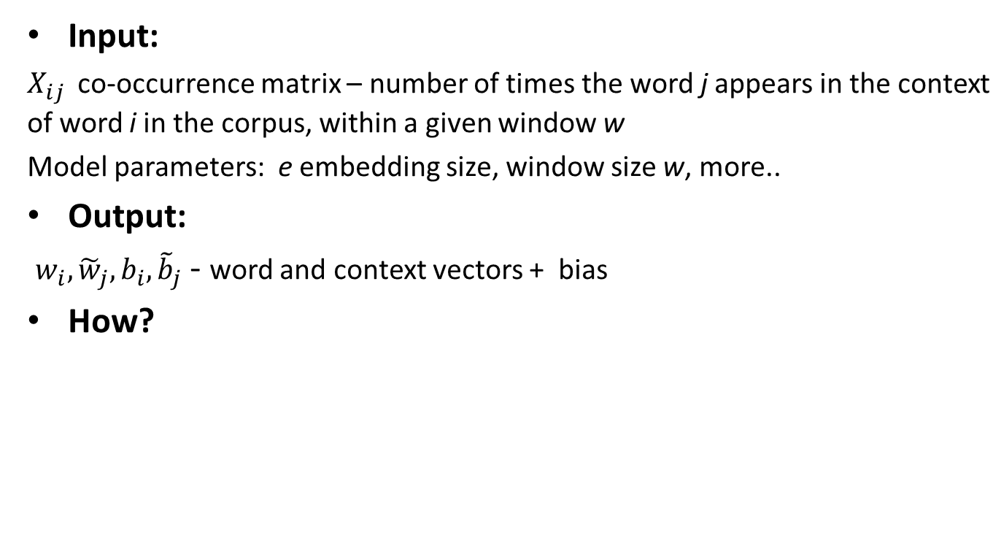
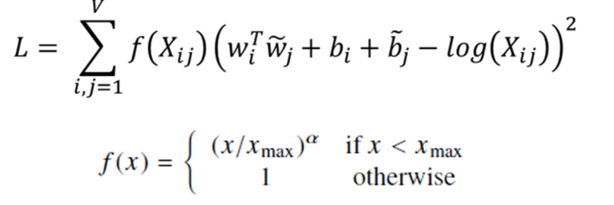
GloVe*: Global Vectors for Word Representation
* Pennington, J., Socher, R. and Manning, C., 2014. Glove: Global vectors for word representation. In Proceedings of the 2014 conference on empirical methods in natural language processing (EMNLP) (pp. 1532-1543).

Slide 9
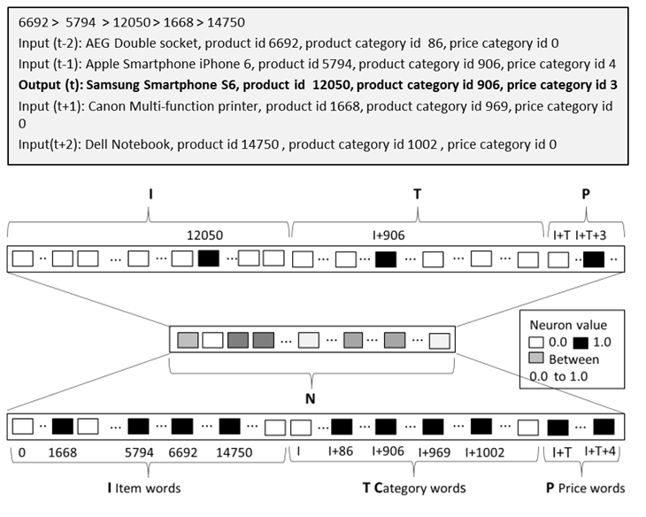
Word Embedding => Item Embedding
Item = Word, User’s Item Clicks = Document

Slide 10
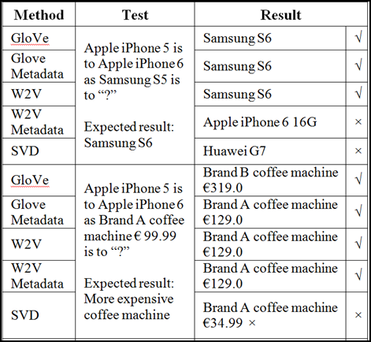
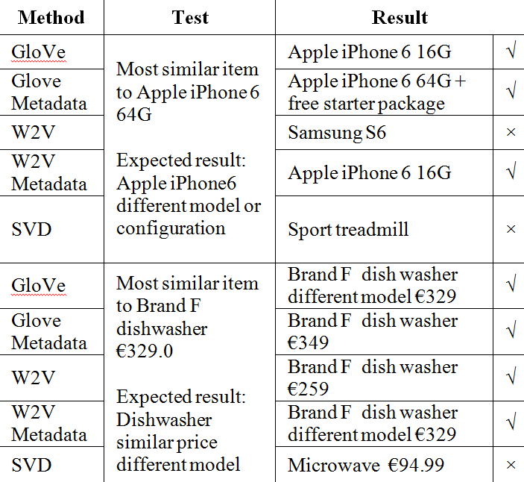
Item Similarity and Analogy
15,000 products, 999,000 filtered sessions, Embedded layer = 50

Slide 11
Session Based Recommendation
Train 945,000 Sessions, Test 16,600 Sessions
…
15,000 (# Products)
…
200 (RNN – GRU)
…
50 x 3

Slide 12
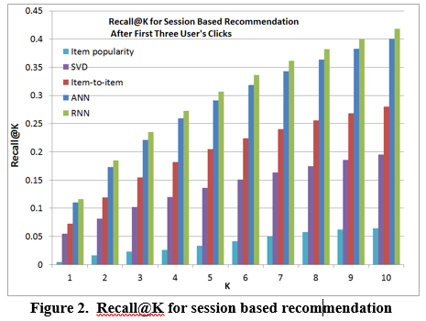
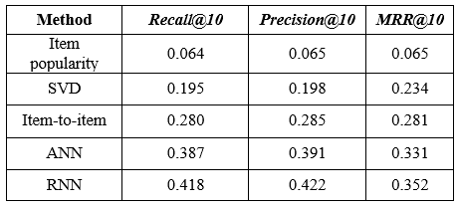
Session Based Recommendation
Results

Slide 13
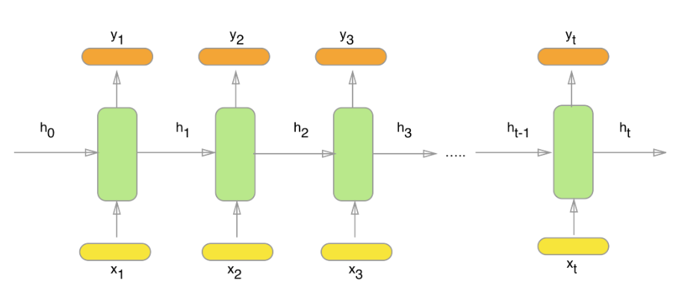
Recurrent Neural Network (RNN)
Memory, sequence pattern detection
Simple RNN vanishing gradient problem
LSTM: remember longer sequences
GRU: simpler

Slide 14
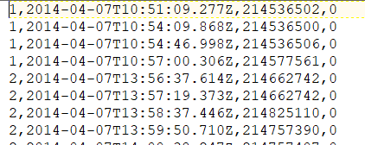
Hands On
Dataset: Recsys 15’ (yoochoose-clicks.dat) http://2015.recsyschallenge.com/challenge.html
Session id, time stamp, time stamp, category
Notes:
Unfortunately, I can’t share my customer’s data, so we can’t look at the embedding representation. We have here 6 months of data. More than 7M sessions and more than 37K products.
I filtered for the last 3 weeks of September 14’.

Slide 15
Keras
Sequential model structure
https://keras.io/getting-started/sequential-model-guide/
Layers https://keras.io/layers/about-keras-layers/
Loss https://keras.io/losses/
Optimizer https://keras.io/optimizers/
Activation https://keras.io/activations/
Custom

Slide 16
Steps
Pre-processing 1: train\test, corpus file to GloVe
GloVe : vocab, vectors files
Pre-processing 2: NN in - sequence format + word embedding, NN out – one hot by vocab
Train
Test (Recall)

Slide 17
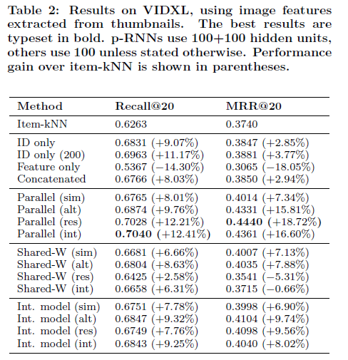
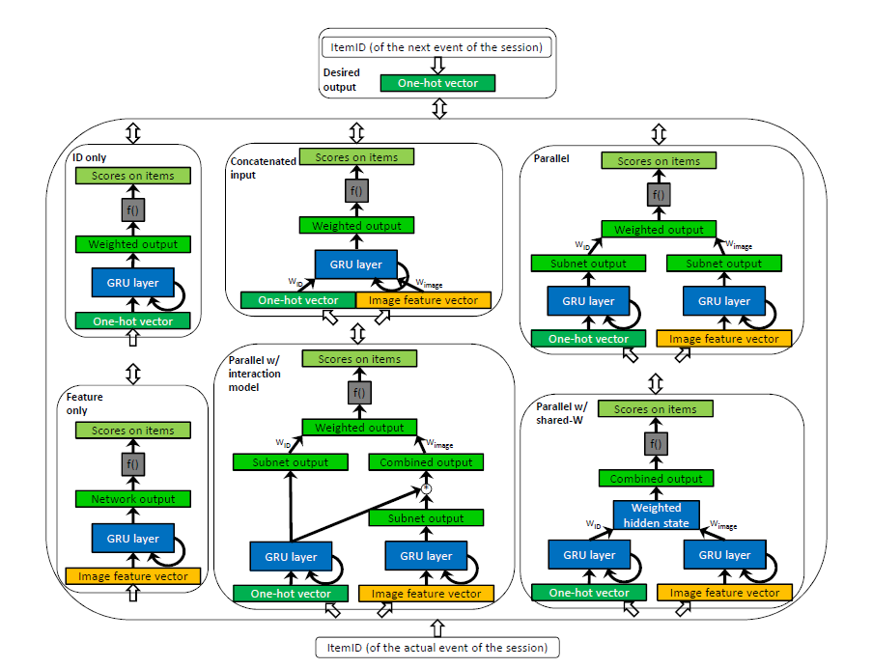
Feature Rich Session Base Recommendation
https://keras.io/getting-started/functional-api-guide/
Hidasi, B., Quadrana, M., Karatzoglou, A. and Tikk, D., 2016, September. Parallel recurrent neural network architectures for feature-rich session-based recommendations.
Notes:
VIDXL, you tube like website. Predict next click

Slide 18
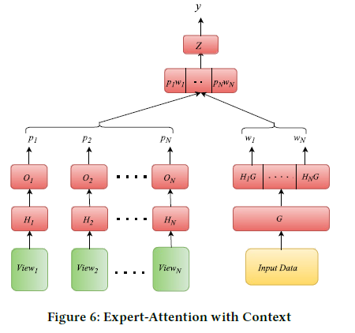
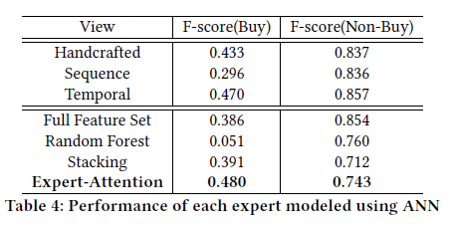
Neural Attention Based Approach for Session Intent Prediction
Ravindran, B., 2018, January. A neural attention based approach for clickstream mining. In Proceedings of the ACM India
Notes:
Predict buy\not buy. Recsys 15

Slide 19
Agenda
Session Based Recommendation
Neural Collaborative Filtering
Notes:
We will cover two main use cases in this workshop – the first one is session based recommendation, and the second one is neural collaborative filtering.
For each use case, we will give an introduction, hands on exercise and some more advanced topics people are working on.

Slide 20
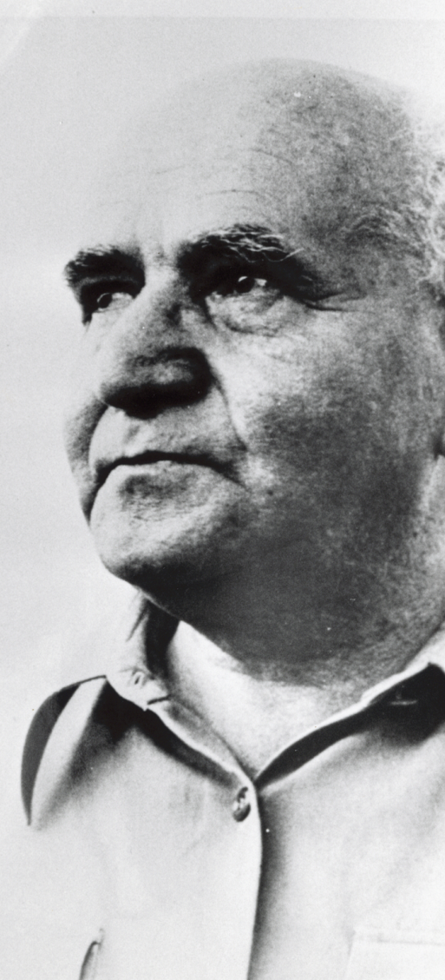

Thank You!
asi.messica@gmail.com
20

