Slide 1
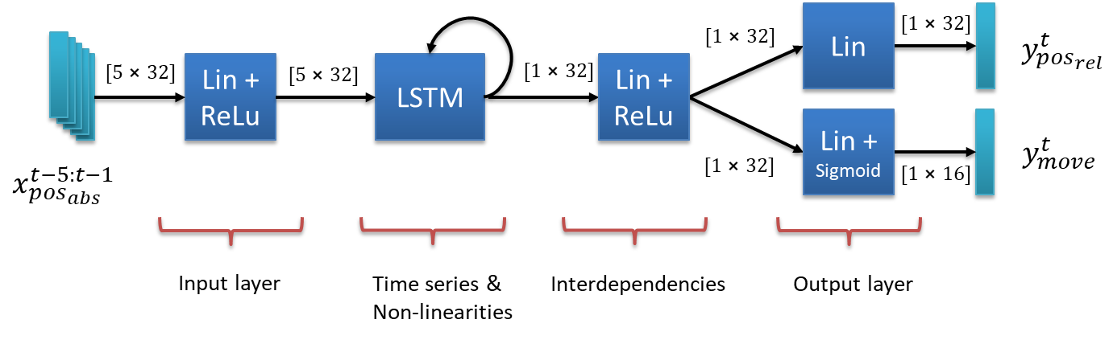








$$[1⨯32]$$
Lin
$$[1⨯32]$$
$$y_{pos_{rel}}^{t}$$
$$[5⨯32]$$
Lin + ReLu
$$[5⨯32]$$
LSTM
$$[1⨯32]$$
Lin + ReLu
Lin + Sigmoid
$$y_{move}^{t}$$
$$x_{pos_{abs}}^{t−5:t−1}$$
$$[1⨯32]$$
$$[1⨯16]$$
Input layer
Time series & Non-linearities
Interdependencies
Output layer

Slide 2
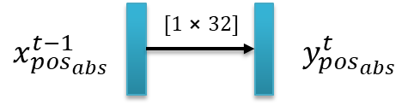


$$[1⨯32]$$
$$x_{pos_{abs}}^{t−1}$$
$$y_{pos_{abs}}^{t}$$

Slide 3
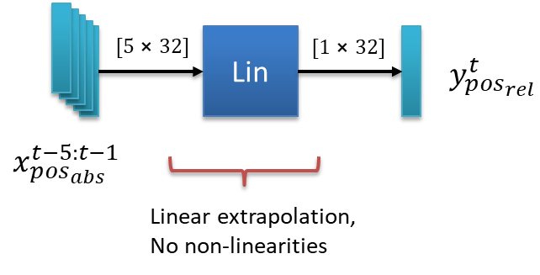



$$[5⨯32]$$
Lin
$$[1⨯32]$$
$$y_{pos_{rel}}^{t}$$
$$x_{pos_{abs}}^{t−5:t−1}$$
Linear extrapolation, No non-linearities

