Slide 1
Tech Fest Management System
Submitted by:
Nerusha A S

Slide 2
Abstract
Tech Fest Management System online registration web page. In Tech Fest we have 5 Admin
ADMIN
COLLEGE
STUDENT
EVENT HEAD
GUEST USER
ADMIN
Admin is Ilahia College Kothamangaalam. Ilahia college is host the Tech Fest. It contains the Event Registration that means all the events in the Tech Fest Tech Fest Registration; it means all the details about Tech Fest for example Registration closing date registration Starting date etc. Food & Accommodation Details, Media Details it contains the advertisement details. Sponsor details and Prize details

Slide 3
COLLEGE
College is another Admin, it is the colleges who participant in Ilahia college. It contains all the details of Participant College. College Registration that means Name, Address and other details. Student Registration contains all the details of student. Student name, Personal Details, Educational details.
STUDENT
Student is another Admin, here Event Registration and Food &Accommodation details
EVENT HEAD
Each event have separate event head.
GUEST USER
Guest user is another admin that contains audience registration, their feedback and complaint.

Slide 4
ABOUT THE ORGANIZATION
Ilahia College of Engineering and Technology, Ernakulum was established in 2002. It is a private self financing technical institution affiliated to KTU and approved by AICTE, New Delhi.
It has been managed by ILAHIA Trust. The vision of the college is to be an institution of international standards, a leader in technical education, rooted in traditional values yet global in perspective with a stress on technical and operational innovation.
The mission of the college is to be a centre of excellence committed to the perfection of human personality and dedicated to the development of engineering skills and attitudes to meet the demands and challenges of modern technology at the global level of mankind.
ICET, Muvattupuzha offers 18 courses across 3 streams namely Engineering, Management, IT and across 4 degrees like B.Tech, M.Tech, MBA, MCA. ICET campus is spread over 25 Acres. Hostel facility is not available for its students. Additional campus facilities such as Boys Hostel, Canteen, Computer Lab, Cultural zone, Mess, Library, Medical Facilities, Class. Room, Placement, Sports are also there

Slide 5
SYSTEM ANALYSIS
System analysis is connected with studying the existing system, identifying the problems and the creations of the requirements specifications.
To launch a system analysis, we need a master plan detailing the steps to be taken. Major steps are defining the performance expected by the proposed system.
The objective of the study is to design and implement a new automated system for ‘Tech Fest Management System’, to prepare a control flow of materials in the various activities likes generates reports based on those records.
The system handles a large amount of data and it saves all details about Tech Fest, College details, Event details, etc. The project has been captioned as ‘Tech Fest Management System ‘.

Slide 6
EXISTING SYSTEM
The study of existing system helps to gather as much information as possible about the system .The existing system runs under manual actions.
It includes a lot of paper works and calculations. Large amount of data and details about College details, Student details, Event details, etc. has to be recorded in different books. The calculations should also performed through paper works.
DISADVANTAGES OF EXISTING SYSTEM
Data storage
In manual system, paper file required a huge amount of storage space and paper storage create several problems like spoilage the deterioration by way of aging, humidity etc.
Speed of retrieval of information
Speed of retrieval the data is less and is relatively in accurate. Similarity speed of execution and execution is low. It is impossible to maintain the speed and accuracy together in manual system.

Slide 7
3. Accuracy
In the existing system the error rate is high and it is difficult to locate the error and correct them .On error message are not possible.
4. Time Consuming
Considerable amount of time required for recording
Claims in to the system. Preparing reports is a Herculean task in existing system. The each patients has to wait for more time.
5. User friendliness
In existing system, degree at user friendliness is considerably low operation effort is high.
6. Back up
Back of data cannot be done easy since all the data are in different files and are written on the paper.

Slide 8
PROPOSED SYSTEM
The objective of the proposed system is to make more efficient and less number some to storage and retrieval of data relating to advanced and to assistance in decision-making process. The system is menu driver and it has higher user friendliness online messages will be displayed on the screen so that the user can enter error free data. There are separate provisions for data entry and report generation.
The primary aim is to speed up the transactions. There is no room for error since accuracy is maintained in the proposed system through validation and verification from all the files. At every stage data processing messages are given and format of all the form itself is need simple for the benefit of the user.
The errors occur during calculation may lead to series imbalance in the reports. To avoid these errors provisions has been provided to automate the calculation and the user is only required to supply essential statistics to the system
This software is developed using Visual Basic 6.0 as the Front end and SQL Server as the Back end. The platform for this system is Windows XP.

Slide 9
ADVANTAGE OF PROPOSED SYSTEM
1. Accuracy
Once the details are added in to the system, it is not necessary to enter it again. This reduces the changes of error by reducing the human involved task. Accurate information can be made at time
2. Data storage
A data base allows centralized storage of date, thereby eliminating the redundancy of file. Searching can be fast. The stored data is portable and flexible for future enhancements. Move over book keeping can reduced.
3. Data Collection
Method for collecting data are faster and more efficient. Retrial of information is faster than the existing system manipulation of data is done in effective manner.
4. Speed of response
The tie for information to be available is greatly reduced without affecting the accuracy of system .Manual works involve wastage of time.

Slide 10
5. User friendliness
The user friendliness is high when compared to the existing system. The user can do the operations without the average of the complex of the inner details. New system screens are made user friendly. It reduces the workload of the employee

Slide 11
SYSTEM REQUIREMENT SPECIFICATION
HARDWARE REQUREMENTS
Processor :Intel Pentium 4 with 2GHz or higher
Memory
Primary :512.0MB RAM or higher
Secondary :2.0GB hard disc or higher
Monitor :14”CRT or TFT or higher
Keyboard :104 K
Pointing device :2 or 3 button mouse
Printer :Dot Matrix or Ink Jet or Laser Printer

Slide 12
SOFTWARE REQUAREMENTS
Operating System : Windows xp
Front End : PHP
Back End : MySQL
Server :Apache
Software Used :Adobe Dreamweaver Wamp Server 2.0

Slide 13
PHP
Hyper Text Pre-processor (PHP) is a server side scripting language that is used to create dynamic webpage, in the php acronym the p stands for personal home page which it was called originaly.It was created the Spanish programmer Rasmus lerdors, in the year 1995 an it was called Personal Home Page.

Slide 14
MySQL
MySQL is a database system used on the web
MySQL is a database system that runs on a server
MySQL is ideal for both small and large applications
MySQL is very fast, reliable, and easy to use
MySQL uses standard SQL
MySQL compiles on a number of platforms
MySQL is free to download and use
MySQL is developed, distributed, and supported by Oracle Corporation
MySQL is named after co-founder Monty Wideness's daughter: My
The data in a MySQL database are stored in tables. A table is a collection of related data, and it consists of column and rows.

Slide 15
About Wamp Server
WampServer refers to a software stack for the Microsoft Windows Operating System, created by Romain Bourdon and consisting of the Apache web, OpenSSL for SSL support, MySQL database and PHP programming language.

Slide 16
Bugzilla
Bugzilla is an open source bug tracking system that allows developers effectively to keep track of outstanding problems with their product
Features
Advanced search capabilities
E-mail Notification
Time tracking
Customization

Slide 17
TABLE DESIGN
Tbl_EventRegistration
Primary key: Event_id
Field Name | Data Type | Size | Description
Event _id | Int
Description | Nvarchar |  | Description
No-of-Student | nvarchar() | 20 | Total student
tbl_TechFestRegistration
Primary Key: TechFestReg_id
Field Name | Data Type | Size | Description
TechFestReg_id | Int
Name | nvarchar() | 20 | Name of the hospital
Title | nvarchar() | 20 | Address of the hospital
Regdate | Date | 20 | Contact number
TechFestdate | Date | 20 | Email id

Slide 18
Tbl_TechFestEvent
Primary key: TehFestEvent_id
Field Name | Data Type | Size | Description
TechFestEvent_id | Int |  | Organ_id
TechFestReg | Int |  | Tech Fest Details
Tbl_Venue
Primary key: venue_id
Field Name | Data Type | Size | Description
Venue_id | Int
TechFestEvent_id | Int
Venue | nvarchar() | 20 | Venue

Slide 19
Tbl_Accomadation
Primary key: Accomadation_id
Field Name | Data Type | Size | Description
Accomadation_id | Int
Venue | Nvarchar() | 20 | Venue
Gender | nvarchar() | 20 | Gender
Tbl_Food
Primary key: food_id
Field Name | Data type | Size | Description
Food_id | Int
Category | Nvarchar() | 20 | Food Category
Type | Nvarchar() | 20 | Veg or Non
Name | nvarchar() | 20 | Food Name

Slide 20
Tbl_FeeReg
Primary key: Feereg_id
Field Name | Data Type | Size | Description
Feereg_id | Int
Particulers | Nvarchar() | 20
Amount | Nvarchar() | 20
Tbl_EventHeadReg
Primary key: EventHeadReg_id
Field Name | Data Type | Size | Description
EventHeadReg_id | Int
Event_id | Int
TechFestReg_id | Int
Contact No | Nvarchar() | 20 | Contact NO
UserName | nvarchar() | 20 | UserName
Password | nvarchar() | 20 | Password

Slide 21
Tbl_Media
Primary key: Media_id
Field Name | Data Type | Size | Description
Media_id | int
TechFestReg_id | Int
Media Type | Nvarchar() | 20 | Media Type
Advertisement | Nvarchar() | 20 | Advertisement
Tbl_Sponser
Primary key: Sponser_id
Field Name | Data Type | Size | Description
Sponser_id | Int
TechFestReg_id | Int
Name | Nvarchar() | 20 | Name
Email | Nvarchar() | 20 | Email Address
Company | Nvarchar() | 20 | Company name
Prize_id | int |  | Doctor name
contactno | nvarchar() | 12 | Contact number

Slide 22
Tbl_login
Primary key:login_id
Field Name | Data Type | Size | Description
login_id | int
Paaword | nvarchar() | 20
username | nvarchar() | 20
Tbl_College Registration
Primary Key:College_id
Field Name | Data Type | Size | Description
College_id | Int
Name | Nvarchar() | 20 | Name
Address | Nvarchar() | 20 | Address
Contact No | Nvarchar() | 20 | Contact No
Email | Nvarchar() | 20 | Emaul Addres
UserName | Nvarchar() | 20
Password | Nvarchar() | 20

Slide 23
Tbl_Prize
PrimaryKey:Prize_id
Field Name | Data Type | Size | Description
Prize_id | Int
Event_id | Int
Category | Nvarchar() | 20 | Category
Prize | Nvarchar() | 20 | Prize Name
Tbl_StudentReg
Primary Key:Student_id
Field Name | Data Type | Size | Description
Student_id | int
College_id | Int
Name | Nvarchar() | 20 | Name
Address | Nvarchar() | 20 | Address
Course | Nvarchar() | 20 | Course Name
DOB | Nvarchar() | 20 | Date of Birth
Contact No | Nvarchar() | 20 | Contact No
Email | Nvarchar() | 20 | Email Id
Username | Nvarchar() | 20 | Username
Password | Nvarchar() | 20 | Password
Status | Nvarchar() | 20 | Status

Slide 24
Tbl_ParticipationRequest
Primary Key:PaRequest
Field Name | Data Type | Size | Description
PaRequest_id | int
College_id | Int
TechFestReg_id | Int
Status | Nvarchar() | 20 | Status
Tbl_StudentEventRequest
Primary Key:SERequest
Field Name | Data Type | Size | Description
SERequest_id | Int
Student_id | Int
Event_id TechFestReg_id | Int
Status | Varchar() | 20 | Status

Slide 25
Tbl_FARequest
Primary Key:FARequest_id
Field Name | Data Type | Size | Description
FARequest_id | int
TechFestReg_id | Int
Student_id | Int
Tbl_Notification
Primary Key:Notification_id
Field Name | Data Type | Size | Description
Notification_id | Int
Head_id | Int
Notification | Nvarchar() | 20 | Notification
Date | Date |  | Date

Slide 26
Tbl_ScoreEntry
Primary Key:Score_id
Field Name | Data Type | Size | Description
Score_id | Int
EventReg_id | Int
Score | Nvarchar() | 20
Tbl_guestuser
Primary Key:Guser_id
Field Name | Data Type | Size | Description
Guser_id | int
Name | Nvarchar() | 20 | Name
Gender | Nvarchar() | 20 | Gender
Address | Nvarchar() | 20 | Address
Email | Nvarchar() | 20 | Email
Contact No | Nvarchar() | 20s | Contact No

Slide 27
Tbl_Complaint
Primary Key:Com_id
Field Name | Data Type | Size | Description
Com_id | int
Guser_id | Int
Date | Date |  | Date
Complaint | Nvarchar() | 20 | Complaint
Tbl_FeedBack
Primary Key:FB_id
Field Name | Data Type | Size | Description
FB_id | int
Guser_id | Int
Date | Date |  | Date
FeedBack | Nvarchar() | 20 | FeedBack

Slide 28
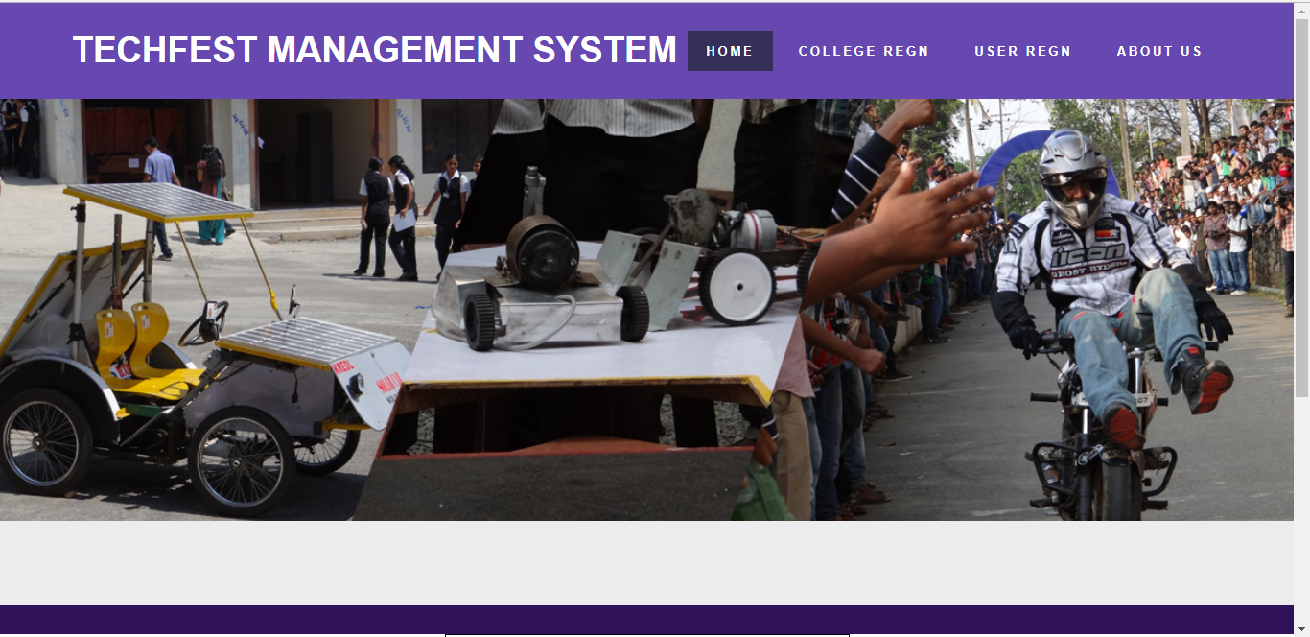
Home Page

Slide 29
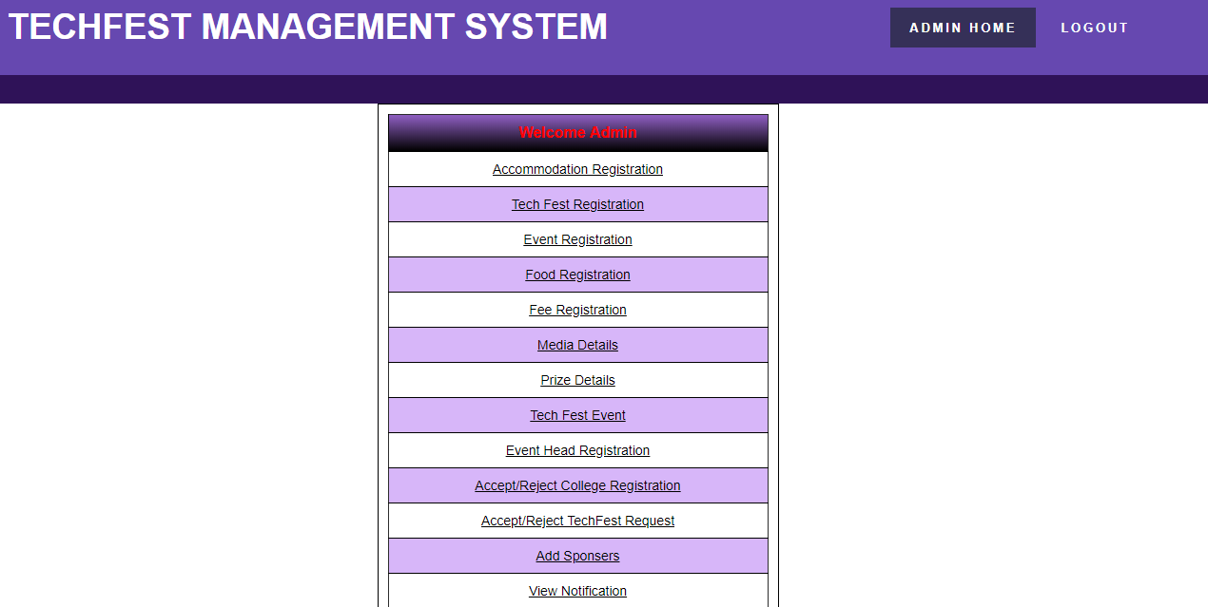
Admin home page

Slide 30
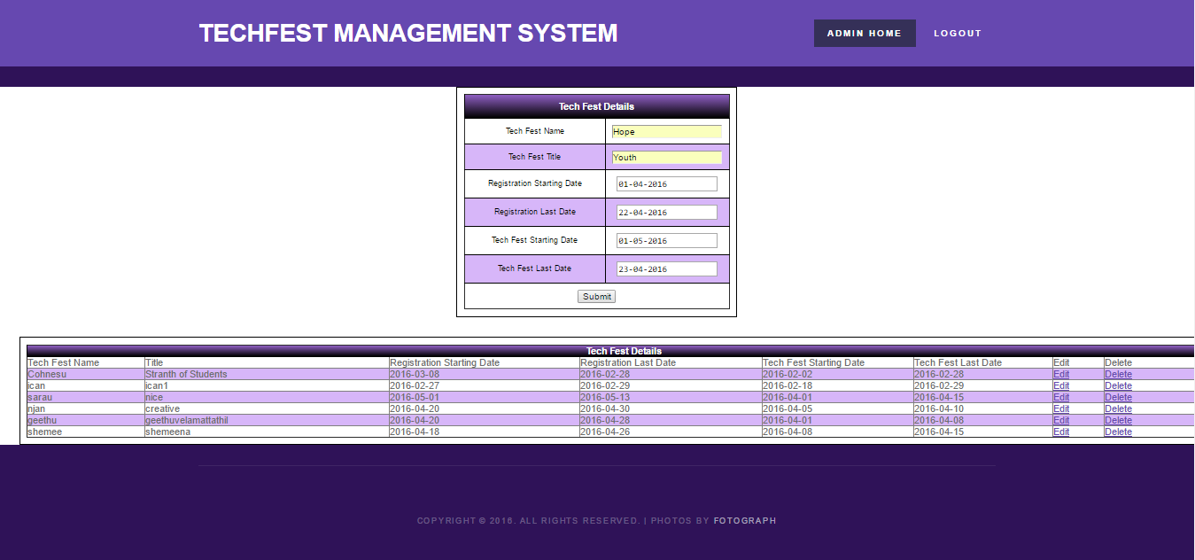
Tech Fest Details

Slide 31
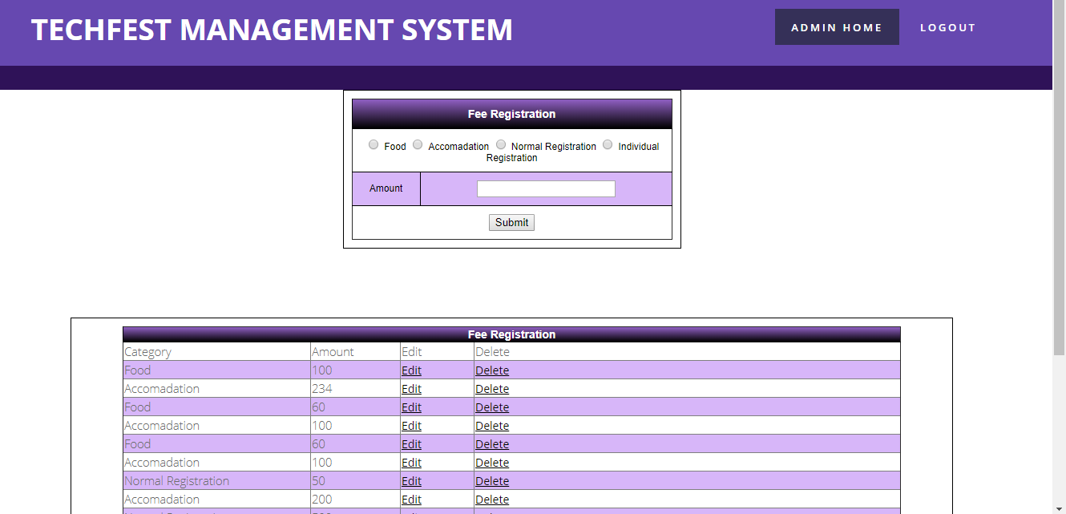
Fee registration

Slide 32
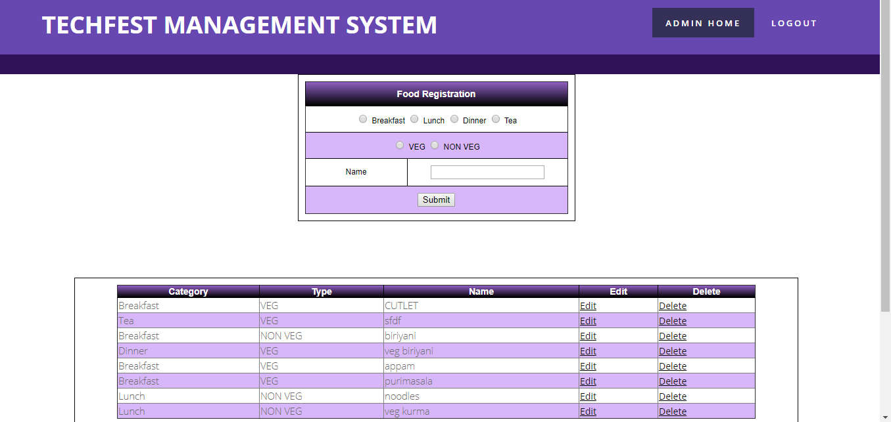
Food registration

Slide 33
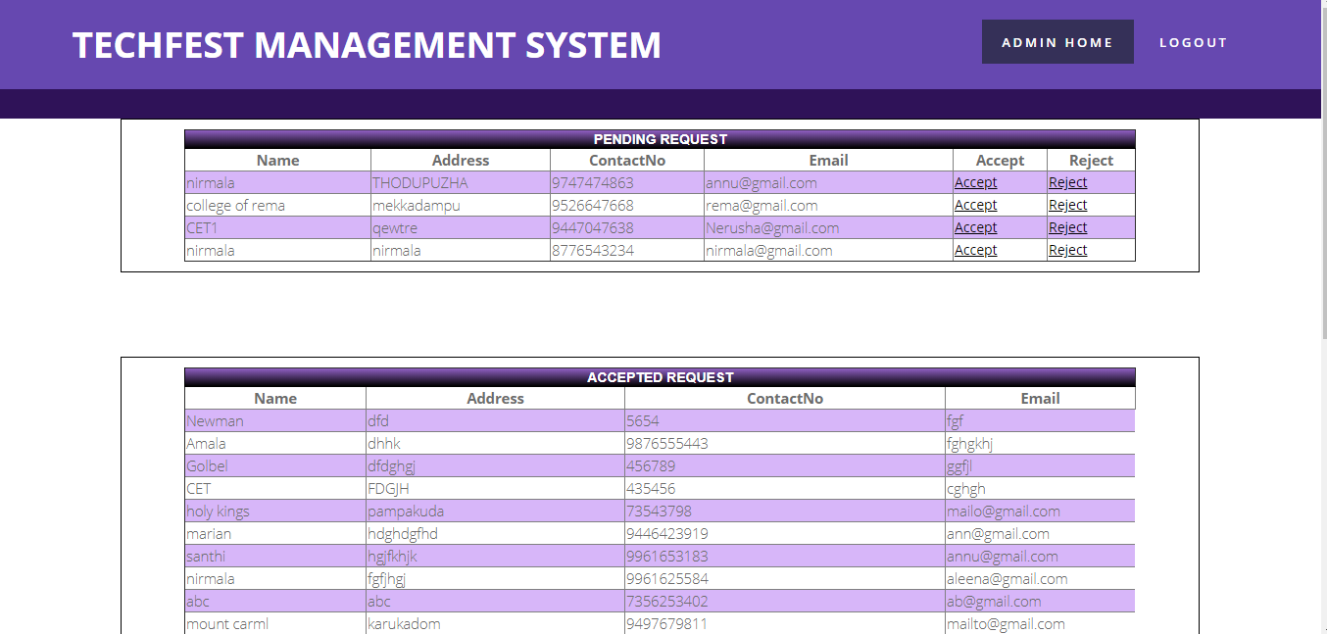
Accept or Reject college Request

Slide 34
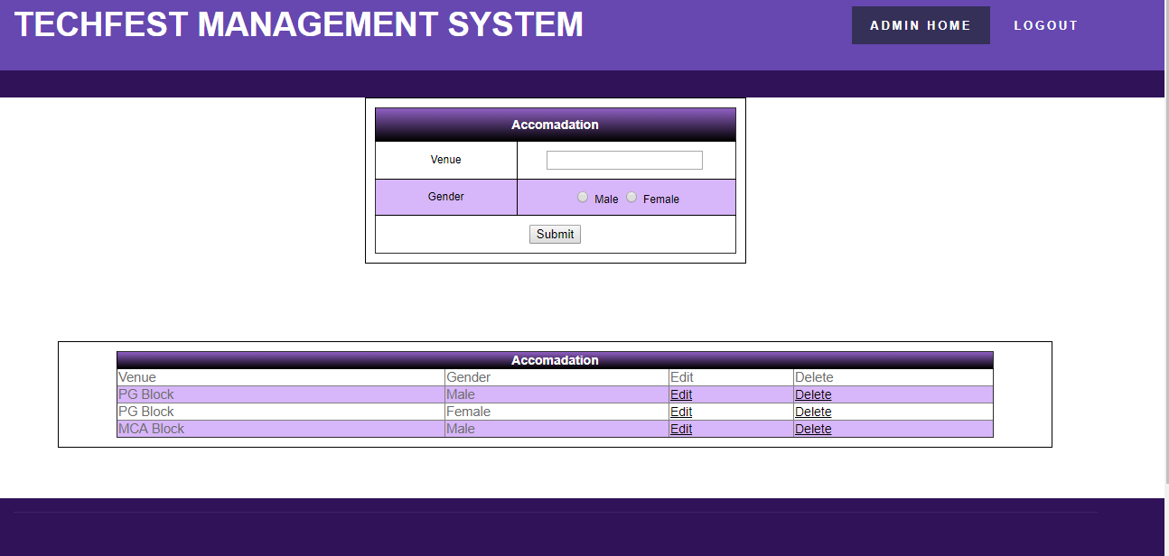
Accommodation

Slide 35
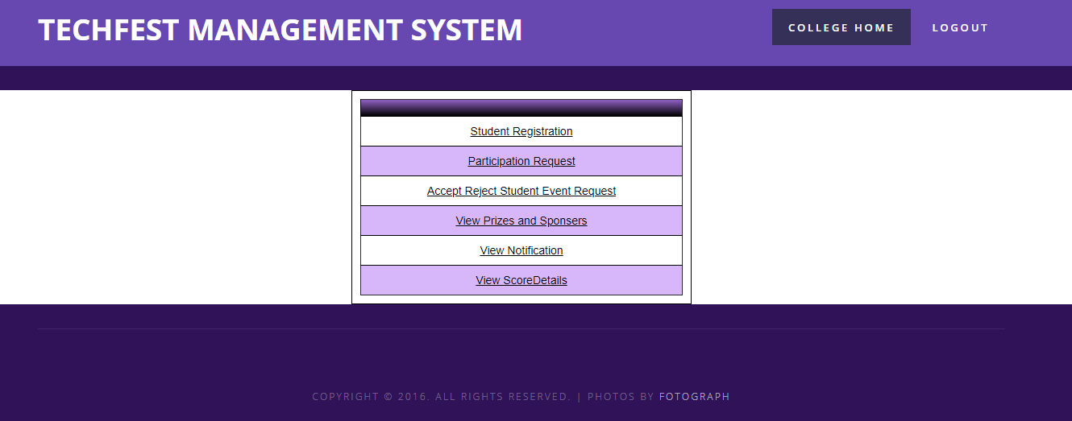
College home page

Slide 36
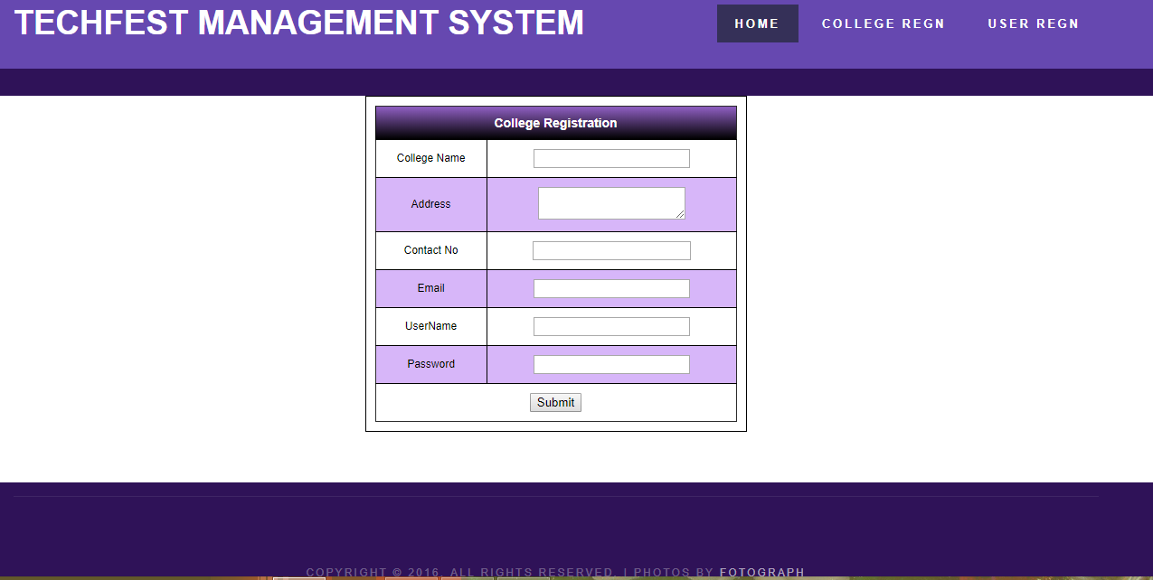
College Registration

Slide 37
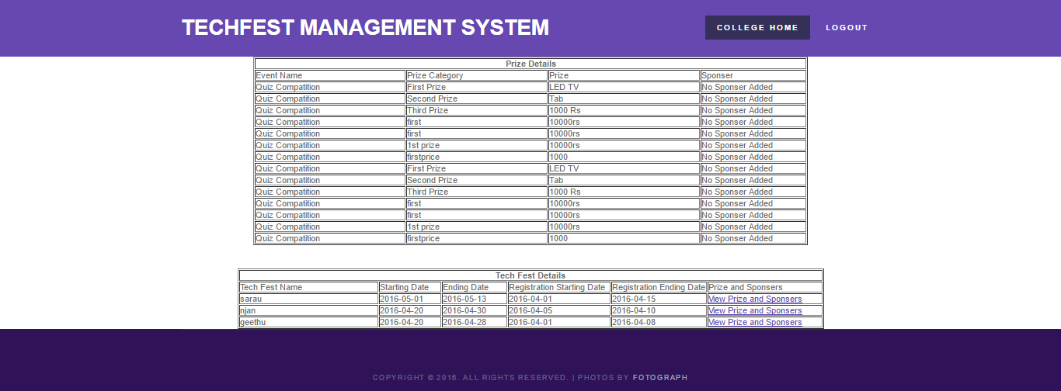
View prize and Sponsor

Slide 38
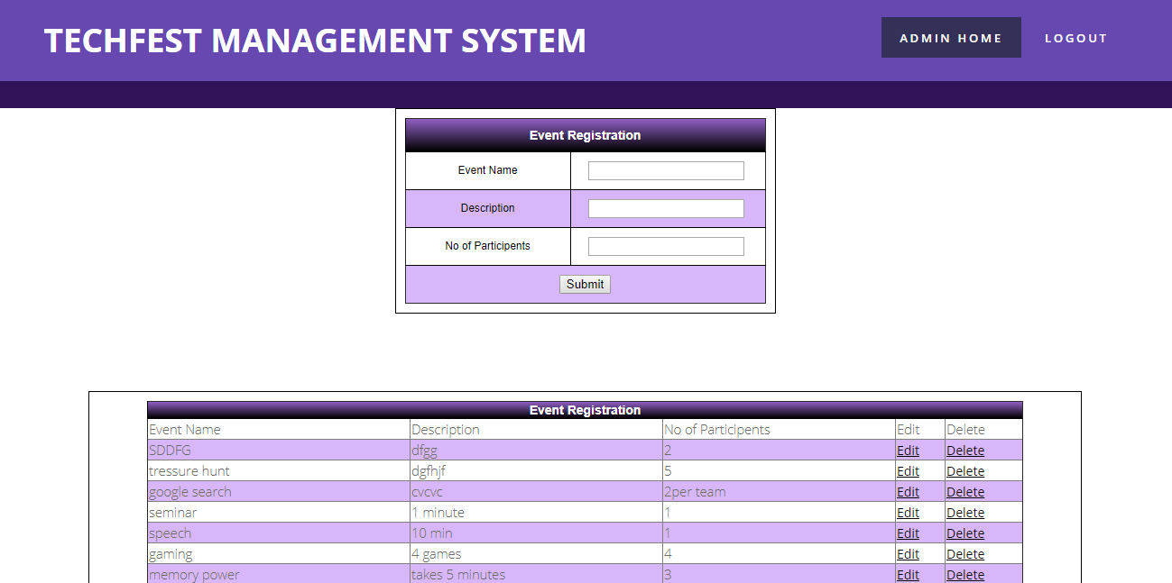
Event Registration

Slide 39
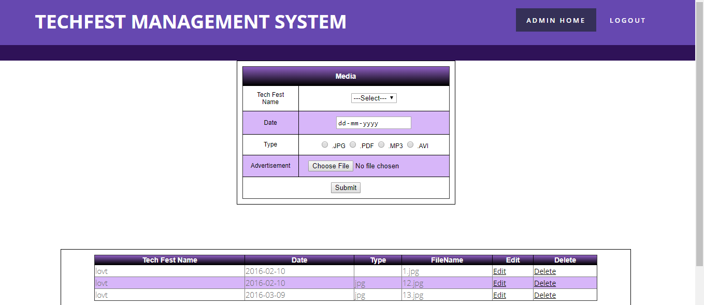
media

Slide 40
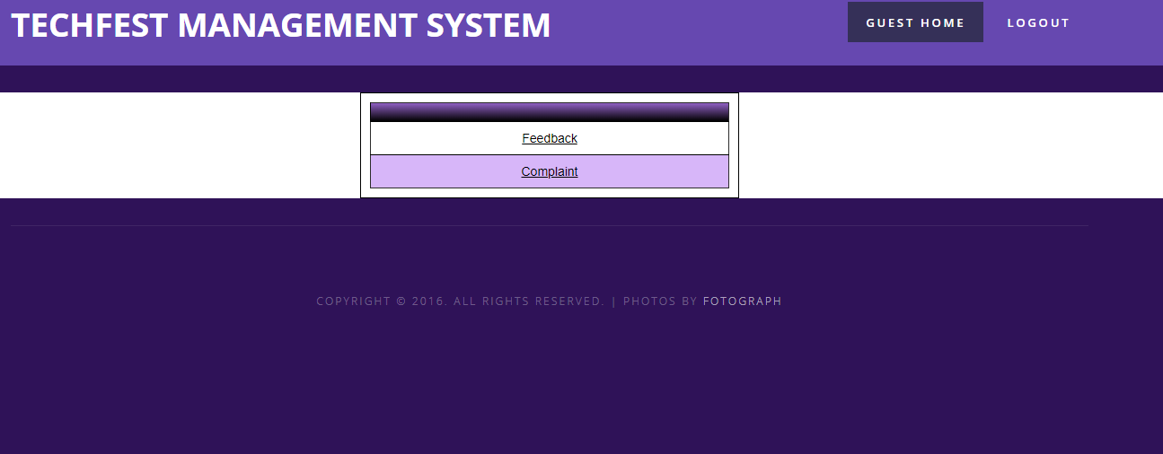
Guest User Homepage

Slide 41
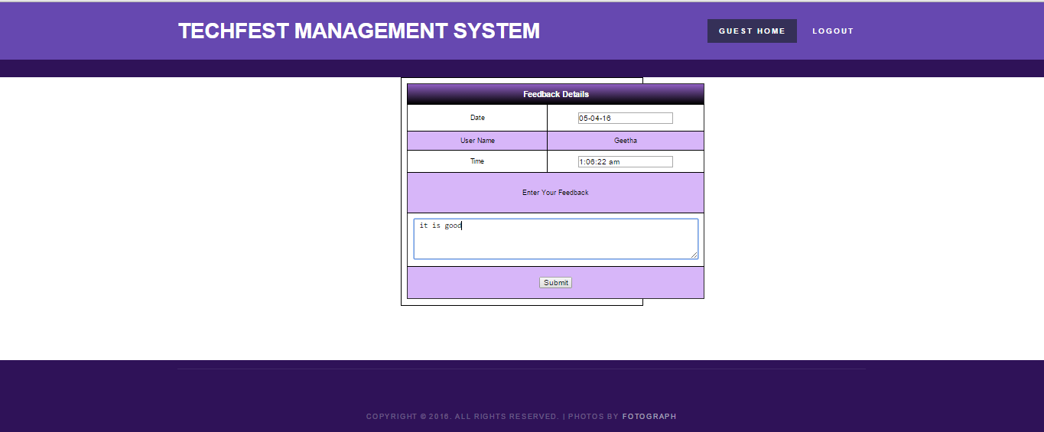
Guest FeedBack

Slide 42
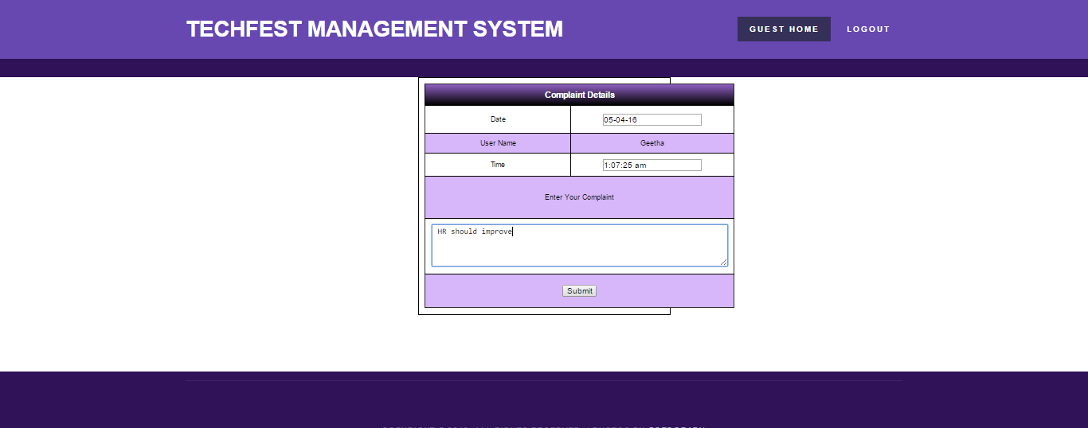
Guest Complaints

Slide 43
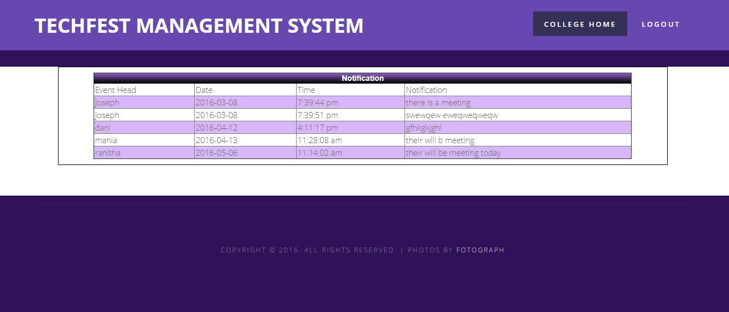
Notification

Slide 44
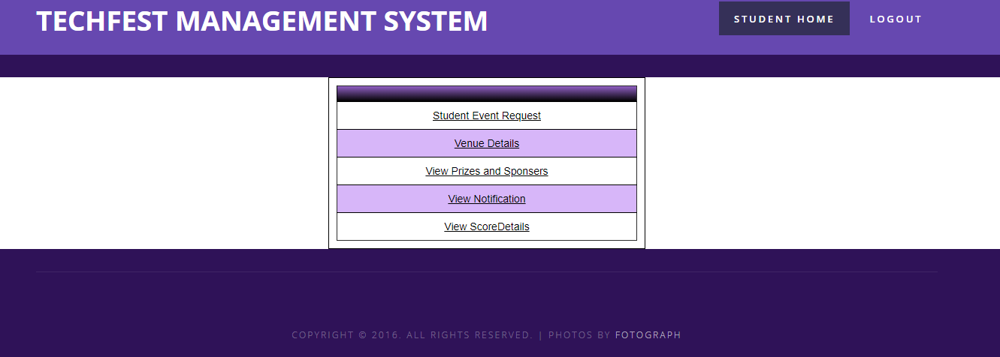
Student Home Page

Slide 45
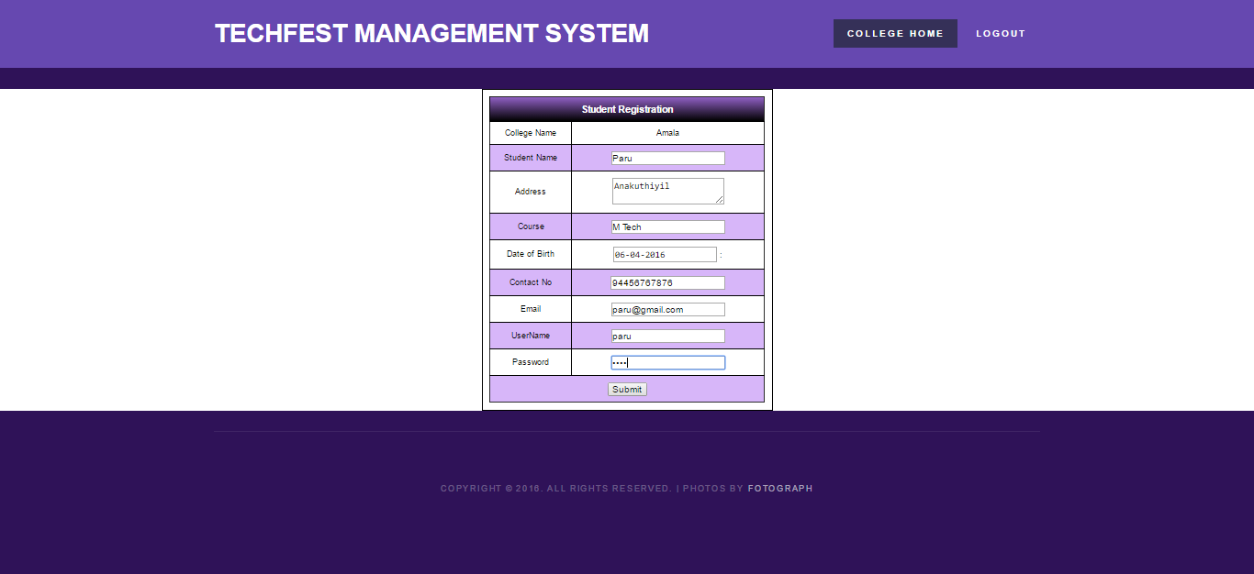
Student Registration

Slide 46
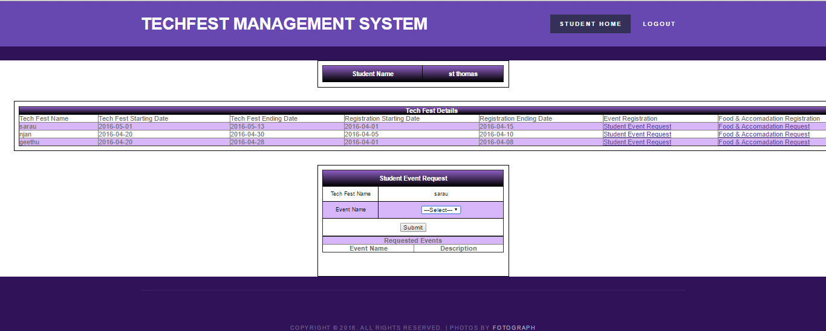
Student Details view

Slide 47
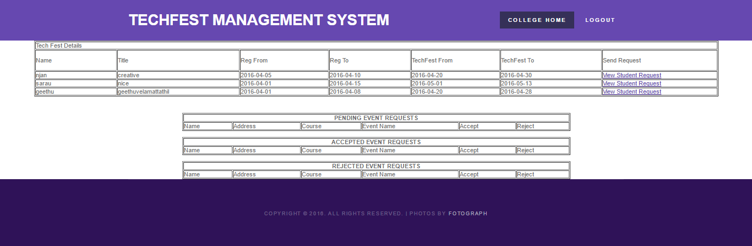
Student Request

Slide 48
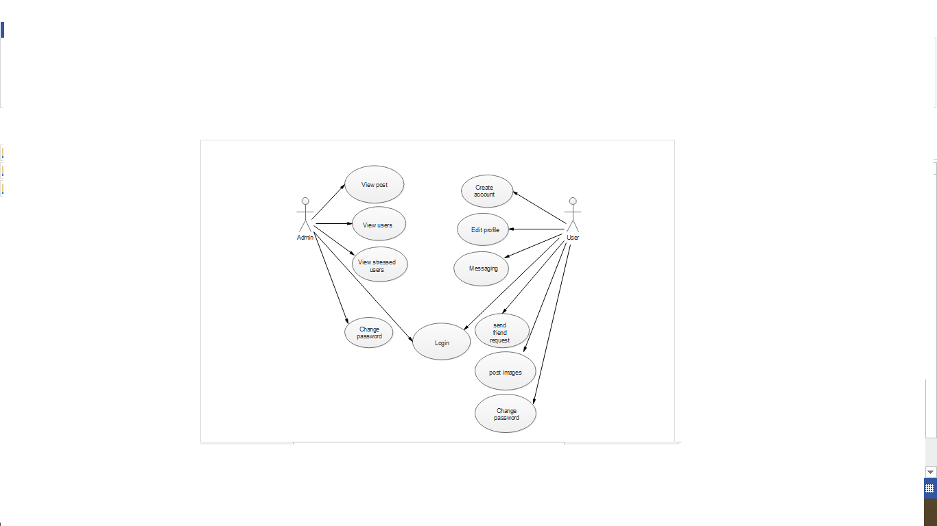
UML Diagram

Slide 49
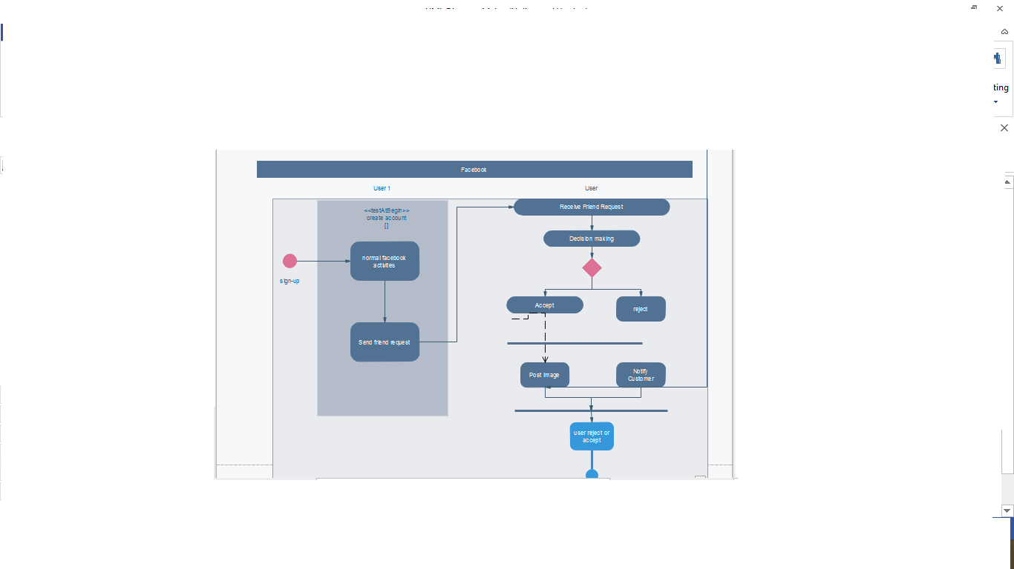
Sequence diagram

Slide 50
Thank You

