Slide 1
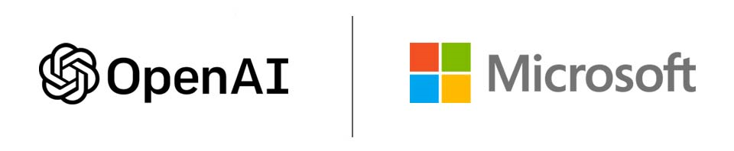
Use Case 1: Therapy Session Copilot
Team names: Adedapo Adeola, Amy Backes, Ariana Caminos, Ashwini Kale, Felix Tamakloe, Guy Caseneuve, Manny Melendez, Mehak, Rick Kubina Jr, Rishi Bhatnagar, Rob Reese, Felix Tamak, Yash Bhatnagar

Slide 2
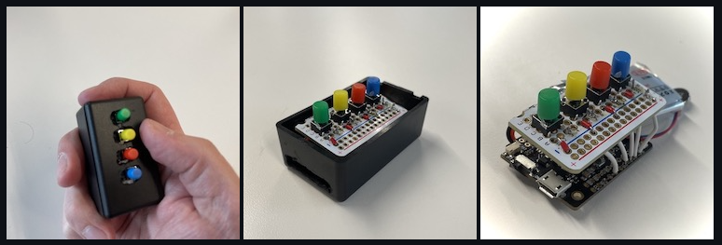
Use case 1: Therapy Session Co-Pilot
Objective: Assist the RBT and BCBA during or after a session with the child
An RBT (Registered Behavioral Technician) implements a session designed by the BCBA and looks to accomplish the goals and targets set by the BCBA.
Historically: A therapist uses an IoT device to capture their observations.
This device is a digital counter where the therapist would increment a counter by 1 each time a behavior is observed.
Challenges:
Splits the focus of the RBT between focusing on the child and capturing the observations
It’s a very one-dimnesional approach to capture the observations
This use case attempts to solve these challenges by providing multi-sensory approach to data capture.
Goal:
Analyze Video & Audio recorded during therapy sessions
Provide a summarization of the session and analytics around specific areas of interest of the patient
Actual IOT Device built during FSI Autism hackathon in years past.

Slide 3




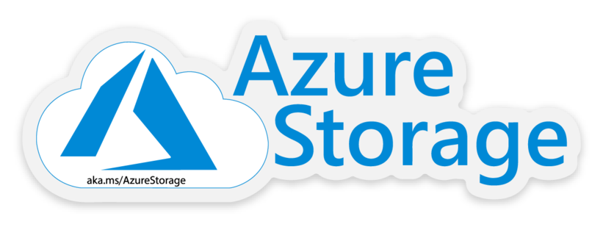
Technical Approaches
Azure Data Factory
Azure Speech Studio
Azure AI Studio​
Azure Blob Storage
Azure CosmosDB

Slide 4
Azure AI Studio
Deploy the appropriate model: gpt-4-vision Preview (GPT-4 Turbo with vision)
Upload the video in playground
Video is ingested and indexed
Add System message: Instructions to GPT-4 vision model
Add user prompt: This is the user's question to the GPT-4 vision model
Prompt engineering gives better results
Audio detection
Audio is not included by default
Transcript will not include vocal sounds that are not words – such as humming, music, groans, etc.
Transcription of the video
Transcript was not available
Used speech studio to get real-time captioning, and then downloaded that
Provided transcript for the video

Slide 5

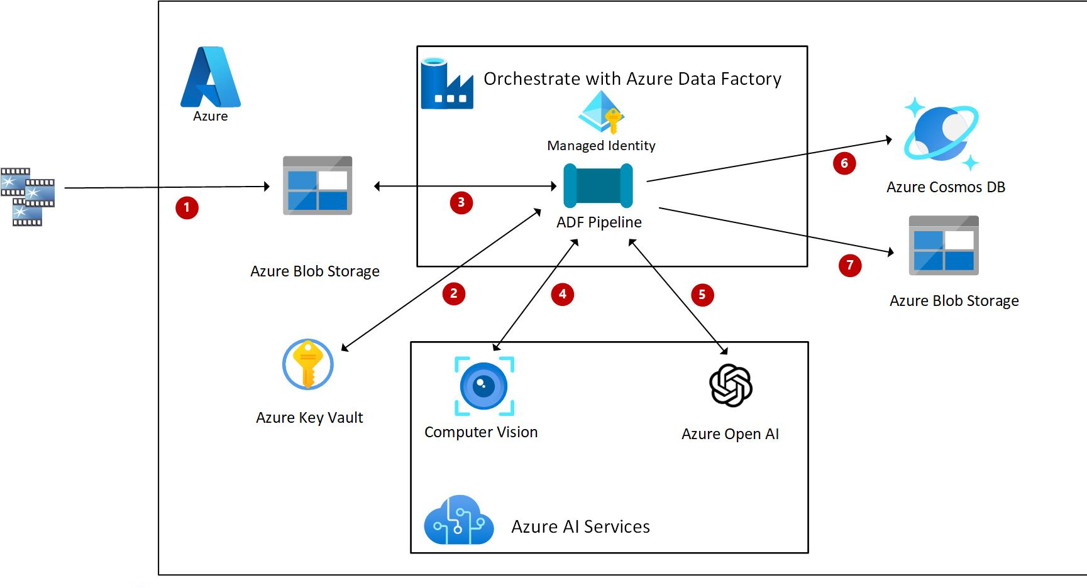
Azure Data Factory Pipeline
UI Built to allow uploading of videos to Blob Storage & return of prompt
Videos are uploaded into a blob storage container
An event grid picks up the event and triggers a data factory pipeline
The data factory pipeline
verifies parameters like Temperature and Top P
indexes and ingests the video
sends the ingested video to Computer Vision
Computer Vision leverages GPT-4v model
GPT-4v response is sent to Cosmos DB
Interpretation of the video includes both:
Audio Analysis
Video Analysis
Future Possibilities:
Integrate custom chat with CosmosDB dataset to interact with the data
Leverage custom CosmosDB dataset to perform analytics
At time of vision upload, allow user to selecting specific types of analysis to be performed on those videos
Fine tuning of LML to better integrate with the data the therapist is looking to analyze

Slide 6
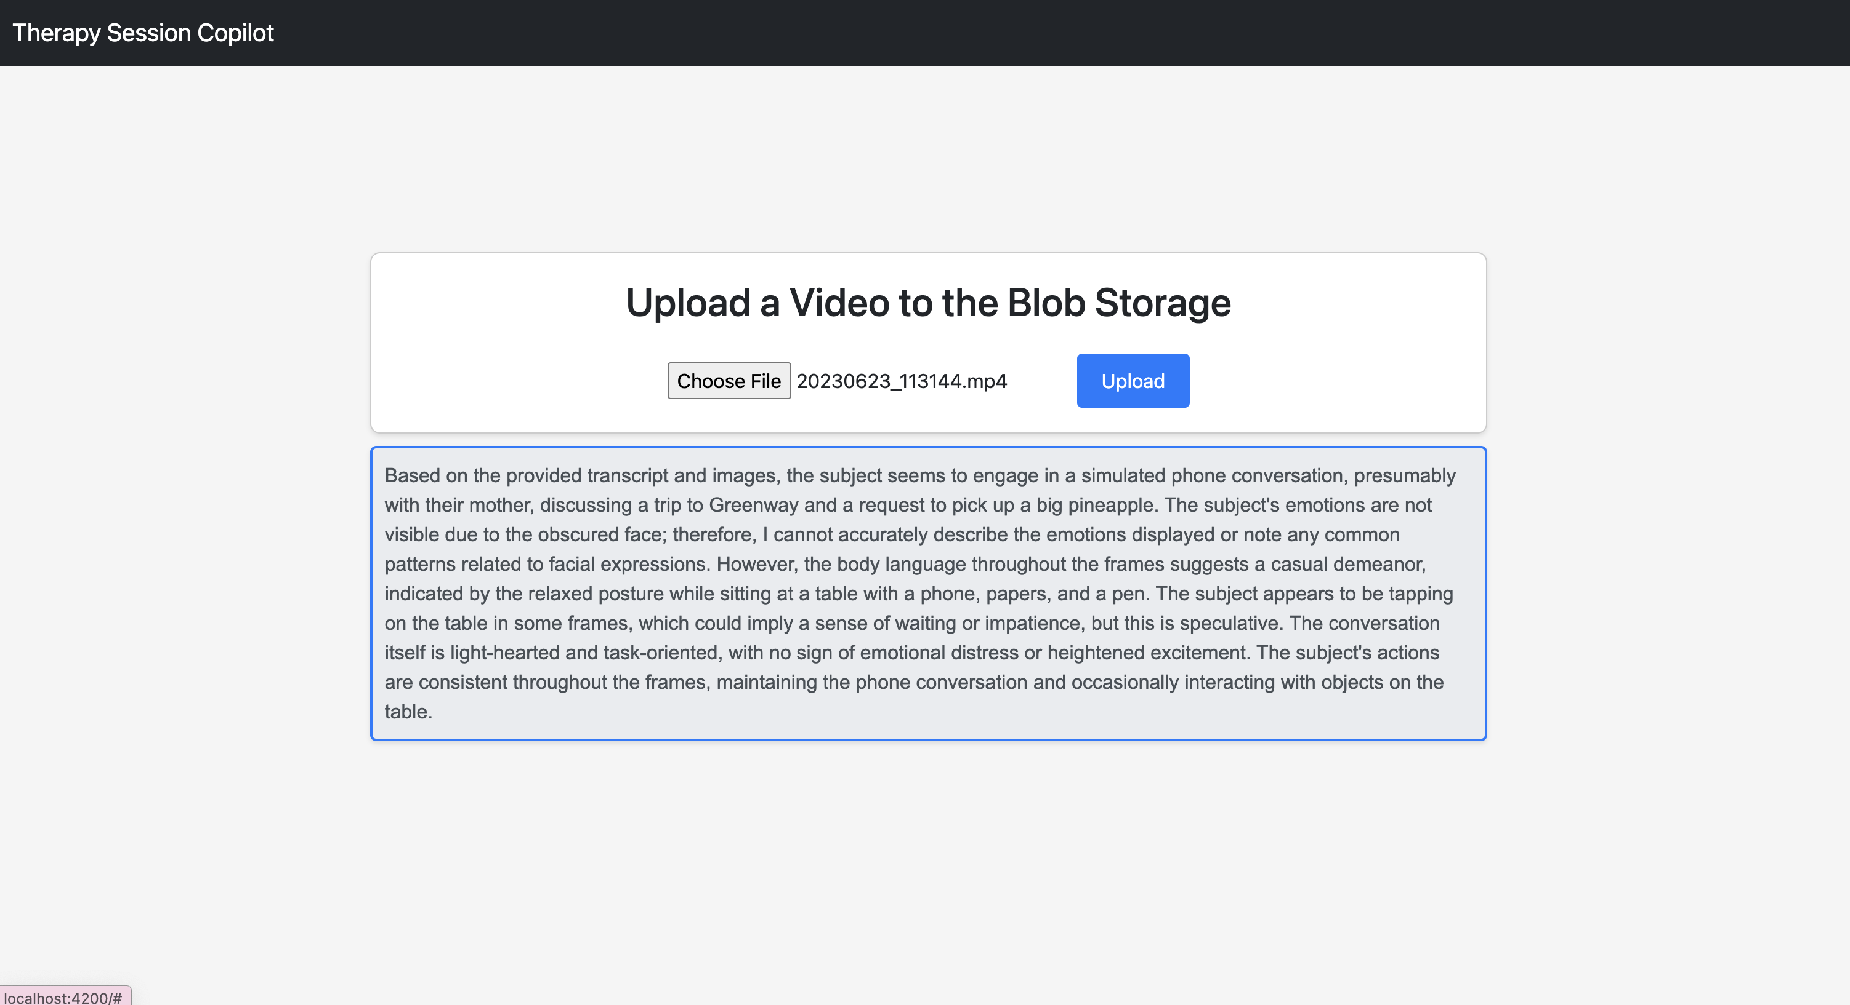
Proof of Concept: UI for Video Uploads

