Slide 1
PRESENTATION TIME
Jasmine Wong
IS590 ODM, Fall 2019

Slide 2
Intro

Slide 3
Research Question

Slide 4


EARLY ENGLISH BOOKS ONLINE
Collection Date: October 3, 2019
Records: 860
COLLECTION
CLEANING
Copy-paste into Excel spreadsheet
OpenRefine
Hand editing
Excel "text to column“ tool
Notes:
High level data source overview
Early English Books Online:

Slide 5


ENGLISH SHORT TITLE CATALOGUE
Collection Date: September 25, 2019
Records: 3,137
COLLECTION
CLEANING
Parsing JSON with Python
OpenRefine
Hand editing
Excel "text to column“ tool

Slide 6

OPEN SYLLABUS
PROJECT
Collection Date: September 15, 2019
Records: 5,000
COLLECTION
CLEANING
XPATH Helper
Copy-paste into Excel spreadsheet
Hand editing
Excel "text to column“ tool

Slide 7

OXFORD TEXT ARCHIVE
Collection Date: September 15, 2019
Records: 600
COLLECTION
CLEANING
XPATH Helper
Copy-paste into Excel spreadsheet
OpenRefine
Hand editing
Excel "text to column“ tool

Slide 8

PROJECT
GUTENBERG
Collection Date: October 8, 2019
Records: 20,801
COLLECTION
CLEANING
Parsing RDF XML with Python
OpenRefine
Hand editing
Excel "text to column“ tool

Slide 9
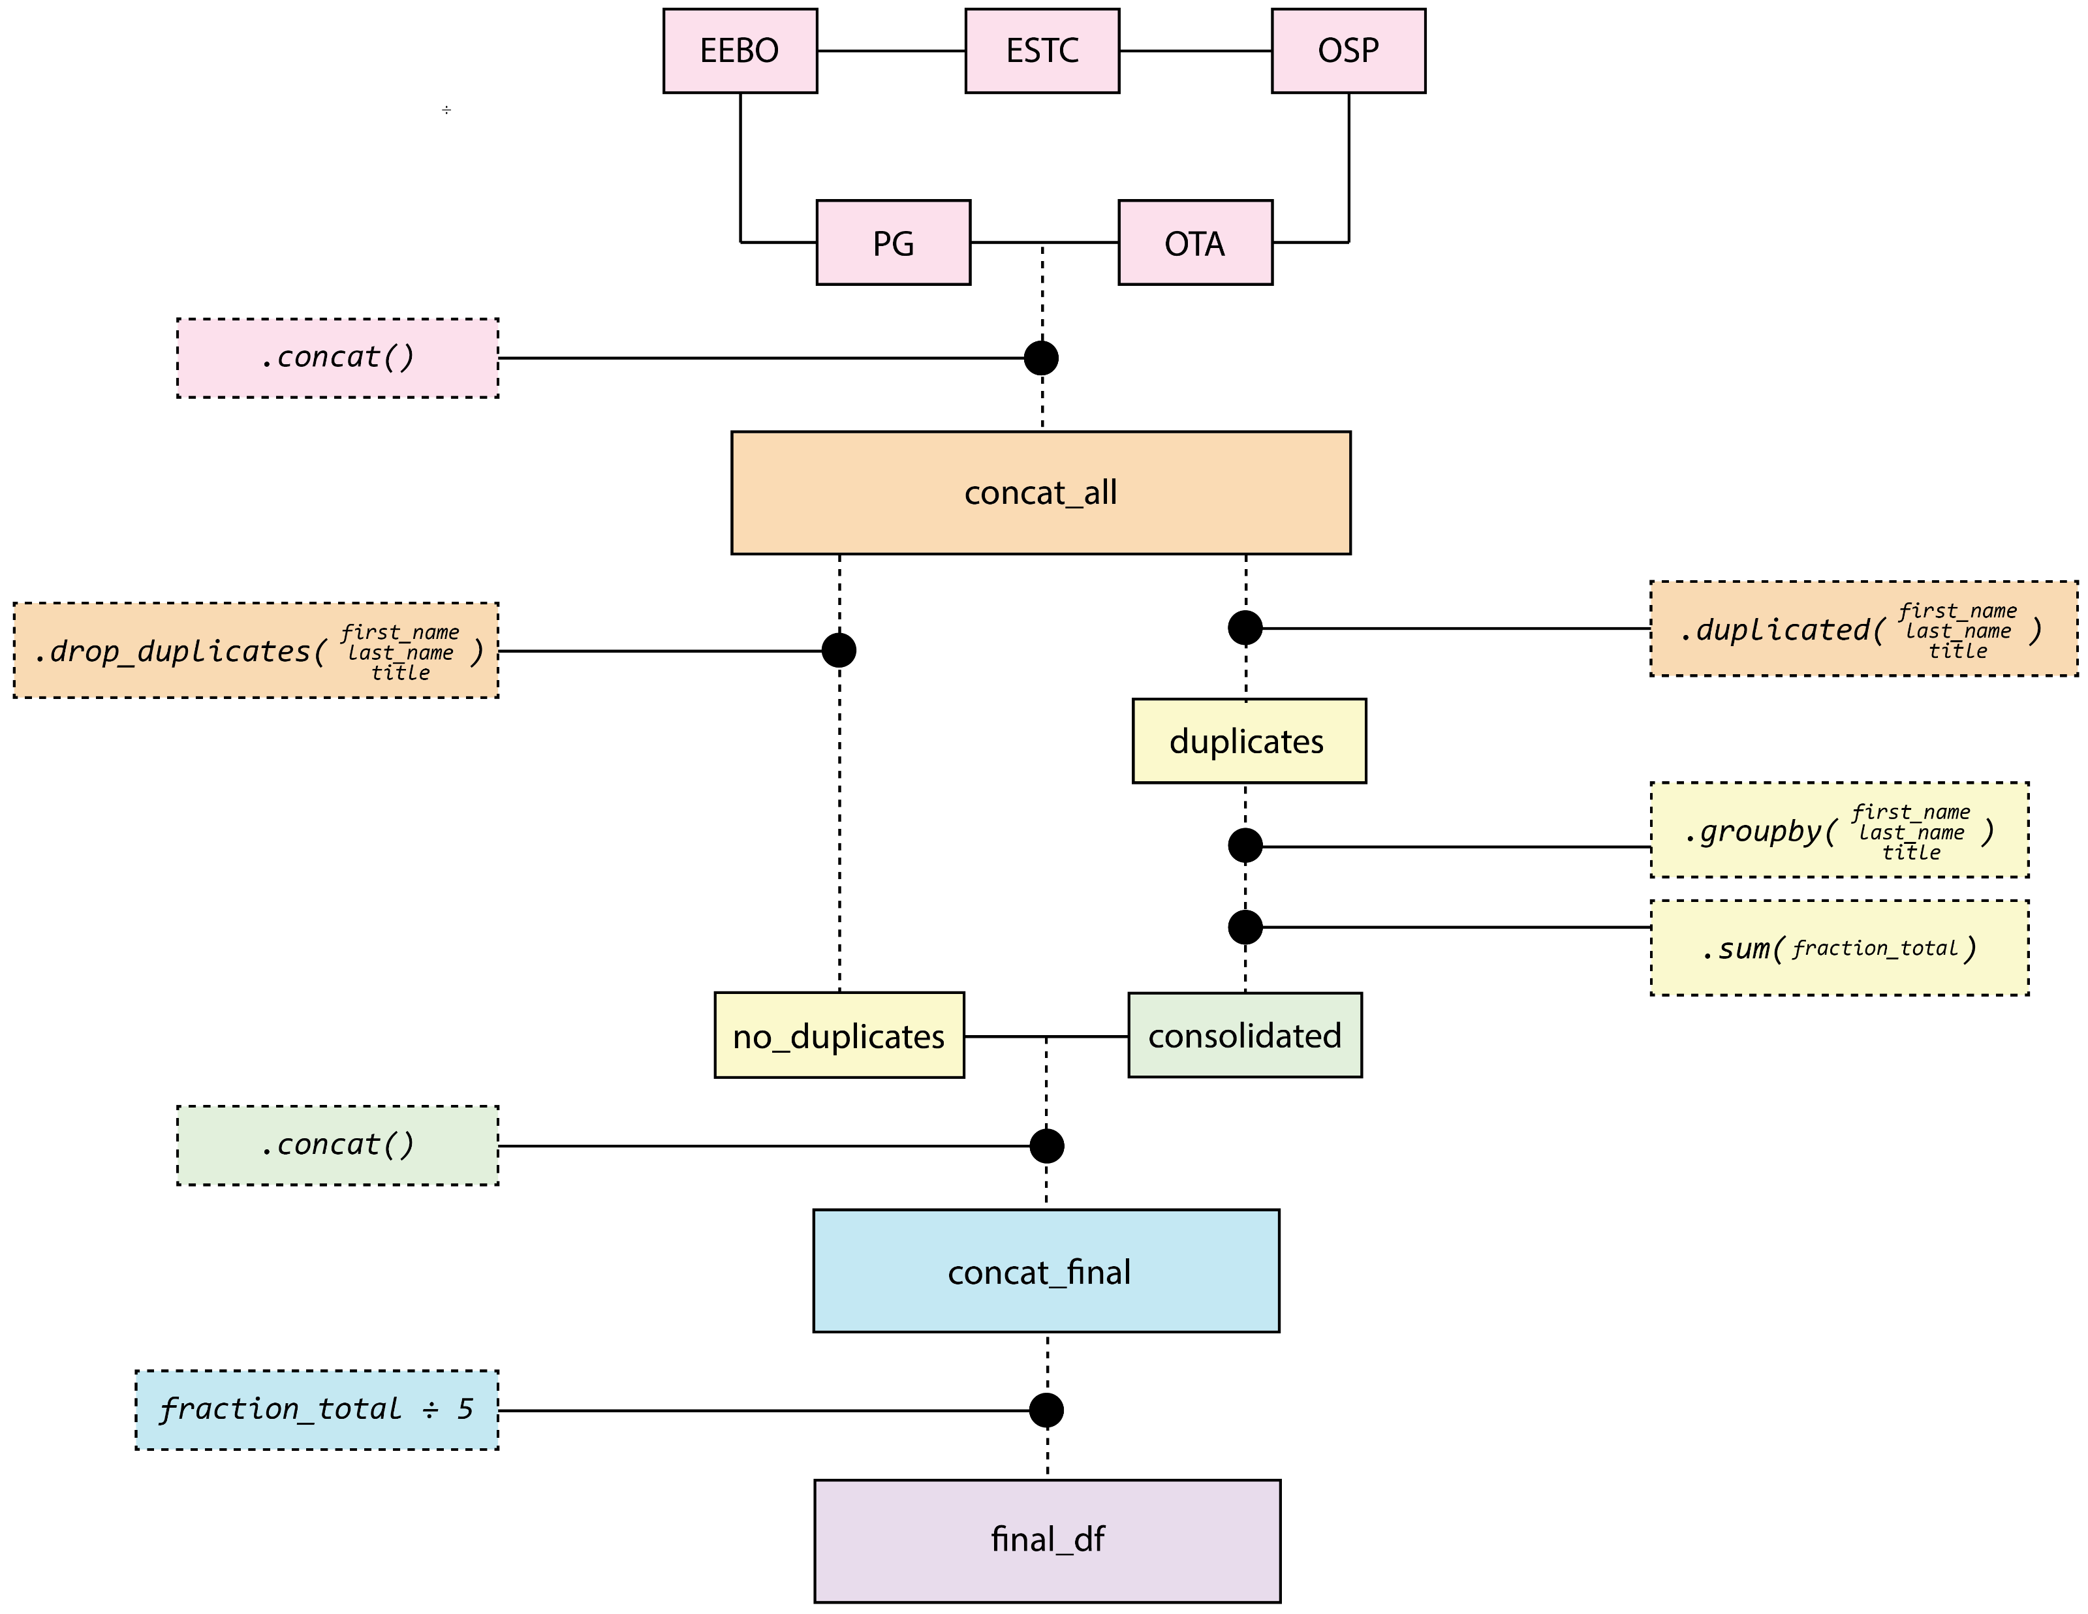

Slide 10
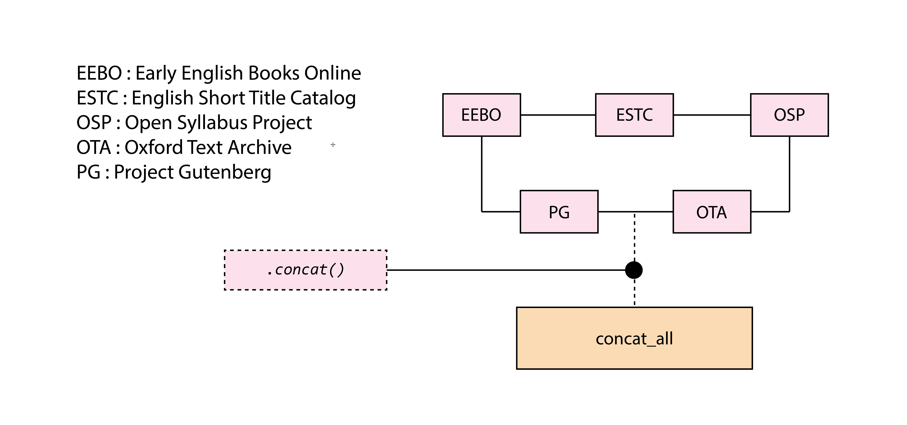

Slide 11
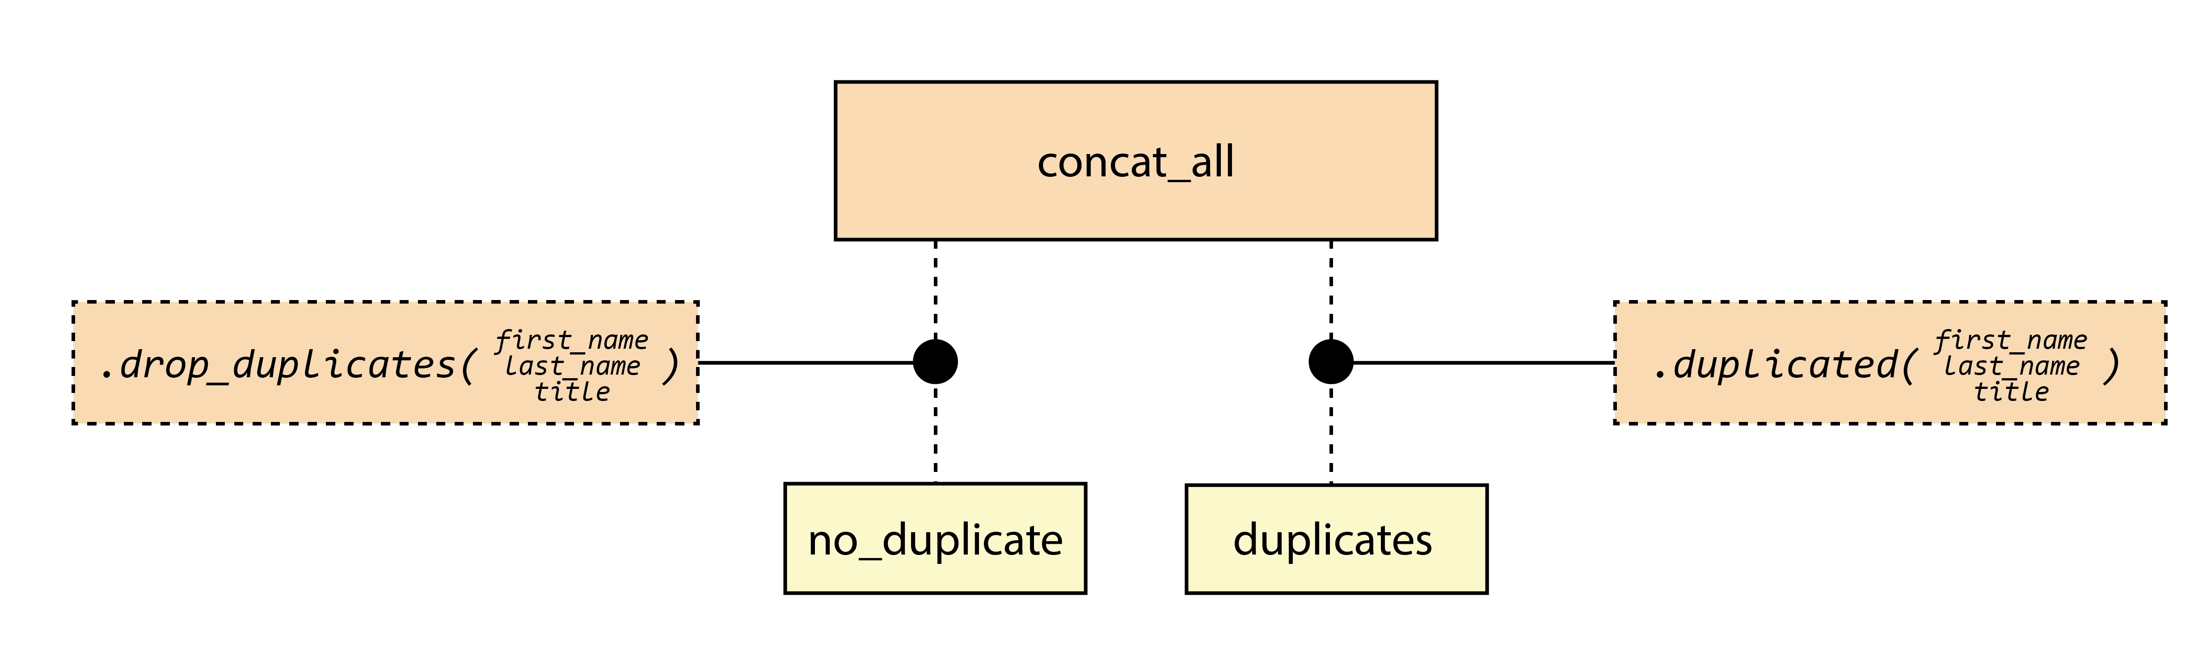

Slide 12
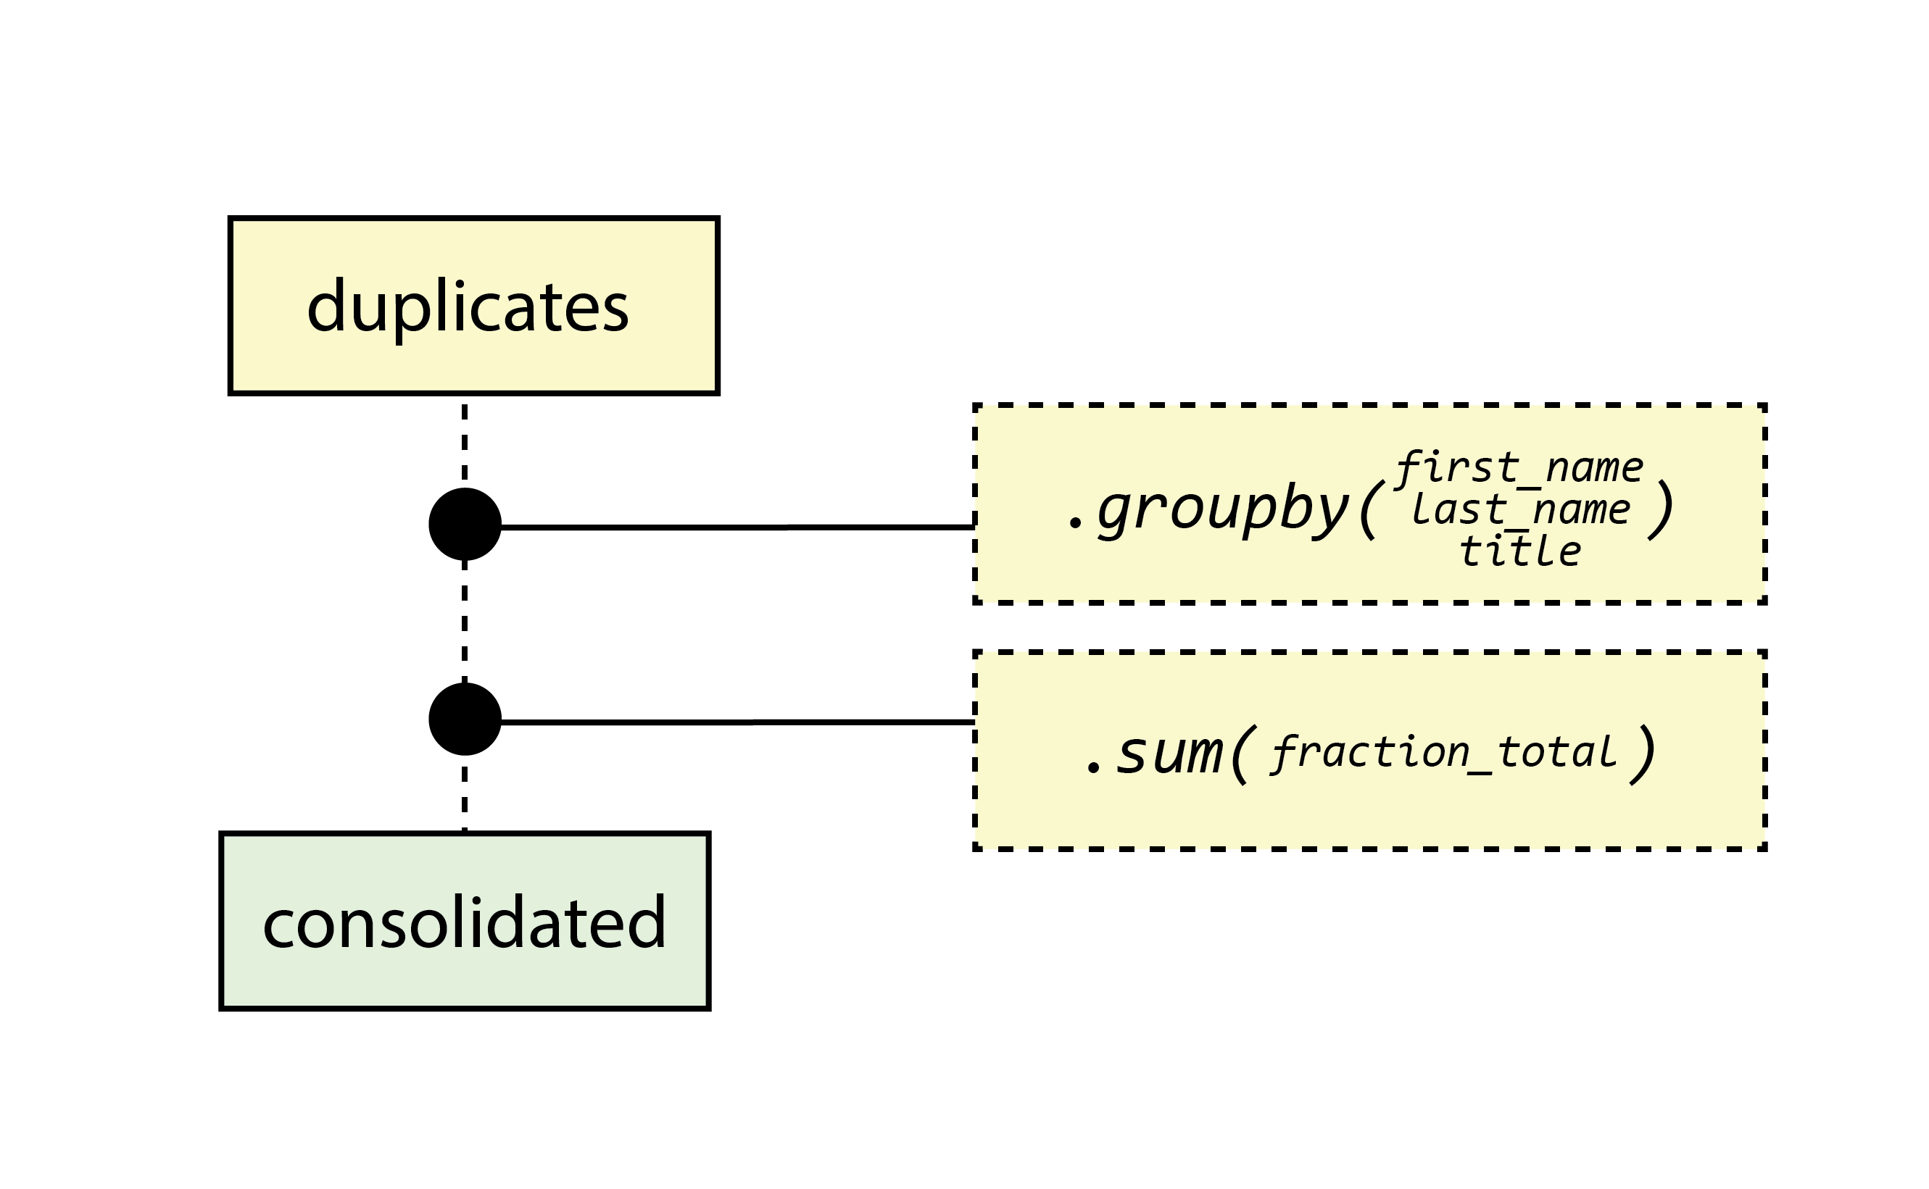

Slide 13
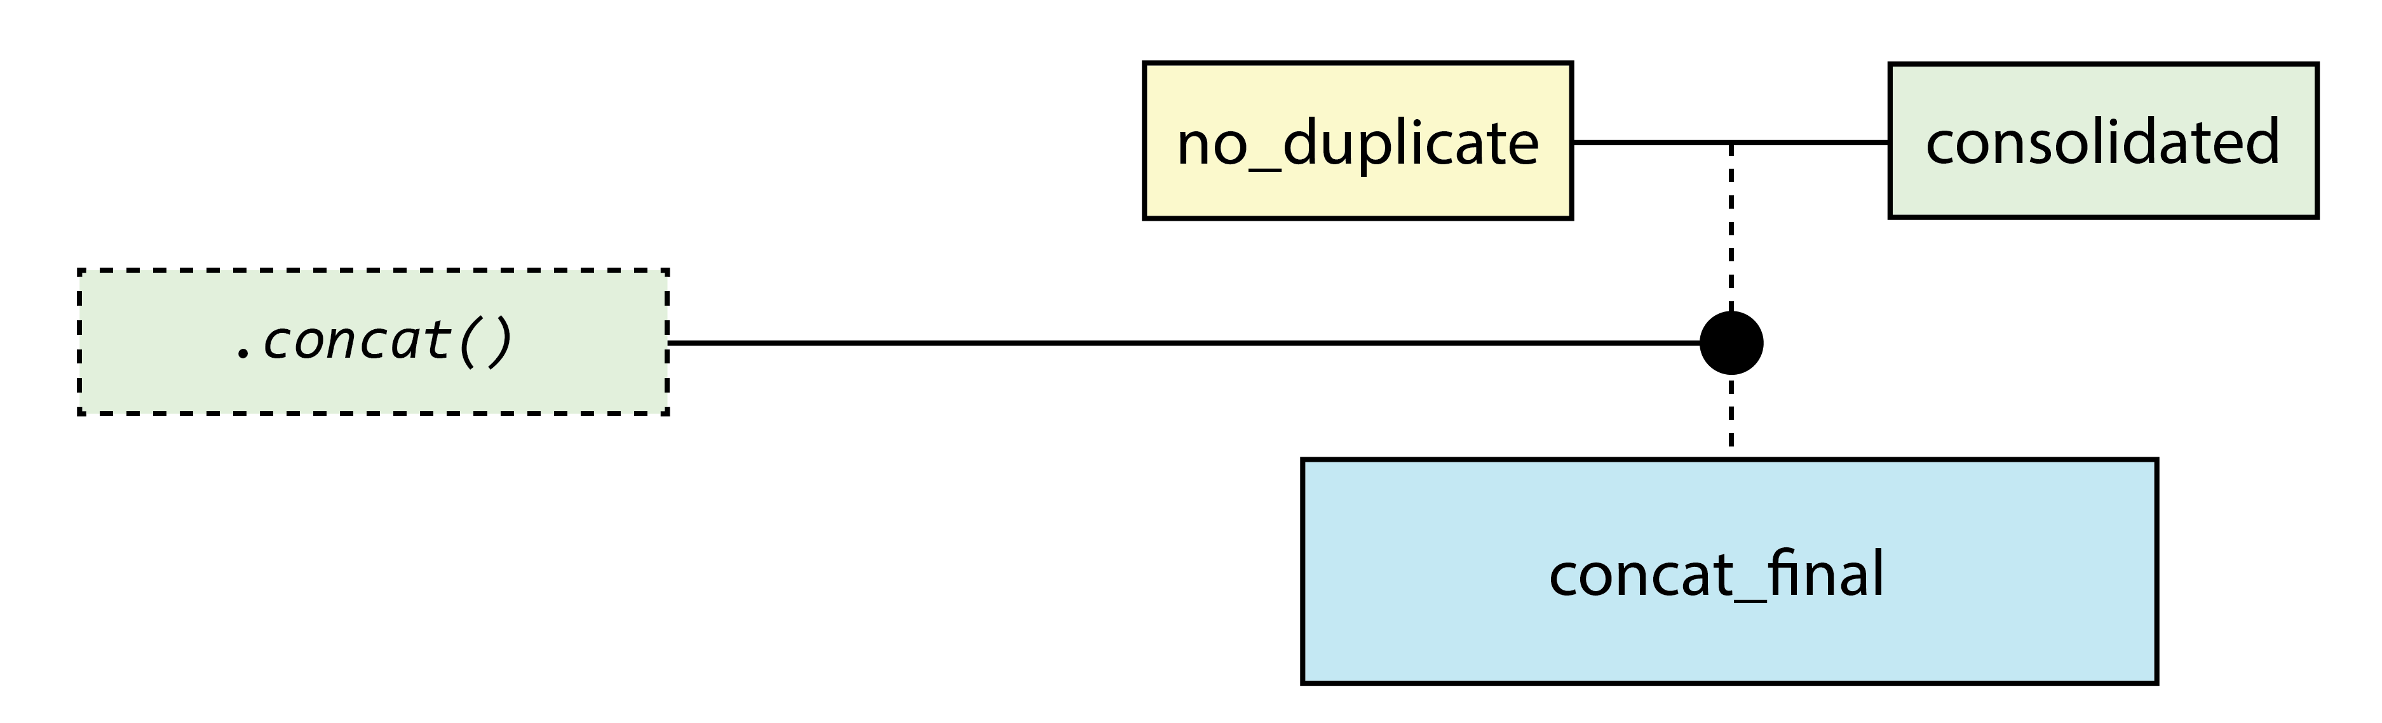

Slide 14
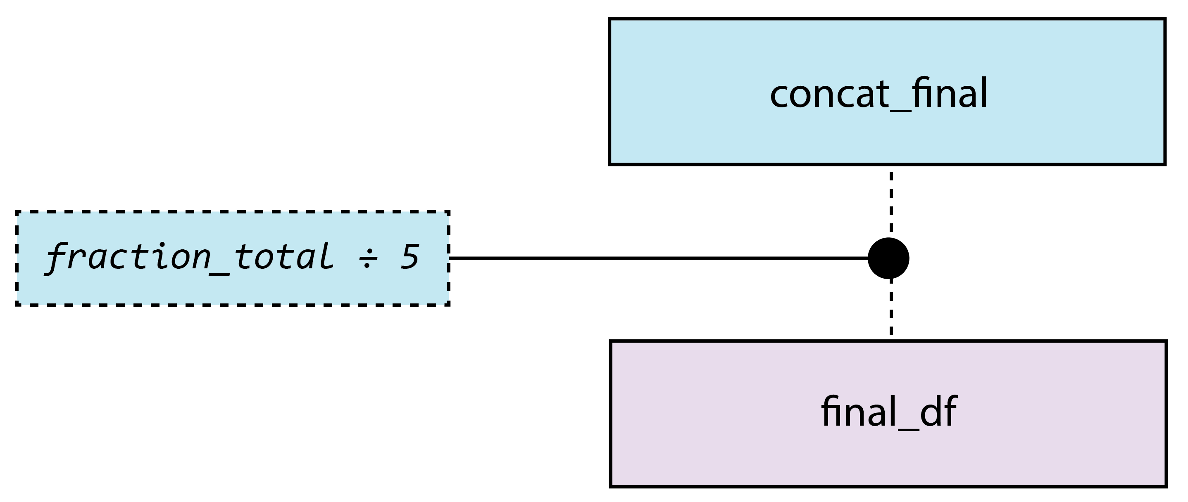

Slide 15
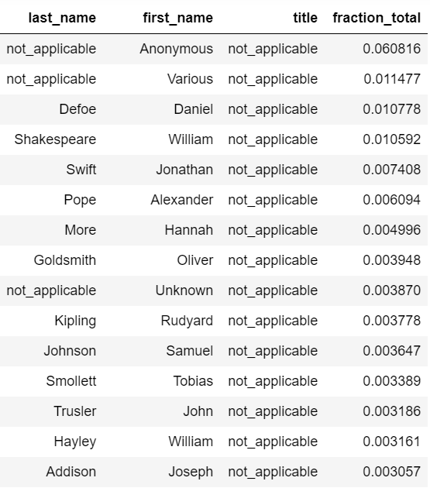
Prelim results

Slide 16
Problems overcome

Slide 17
Discussion of value
Value limited by scope – I would need to mash up significantly more datasets to use the corpus in the way I was hoping for my future research

