Slide 1
FINAL PROJECT PRESENTATION
Jasmine Wong
IS590 ODM, Fall 2019

Slide 2
Project Intro
Data Sources
Workflow
Preliminary Results
Reflections

Slide 3
INTRO

Slide 4
Research Questions
Who is cited in English-language dictionaries? How does this citation corpus compare to the English literary canon?
Will aggregated digital literature repositories form a recognizable literary canon dataset?

Slide 5
Objectives
Aggregate author citation metadata from literary databases to explore prevalence of individual authors
Build a corpus of author citations for use in literary history research

Slide 6
DATA SOURCES

Slide 7

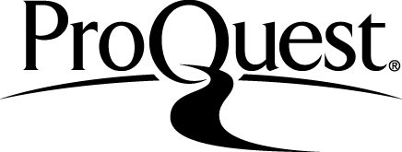
EARLY ENGLISH BOOKS ONLINE
Records: 860
COLLECTION
CLEANING
Copy-paste into Excel spreadsheet
OpenRefine
Hand editing
Excel "text to column“ tool
Notes:
High level data source overview
Early English Books Online:

Slide 8

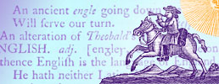
ENGLISH SHORT TITLE CATALOG
Records: 3,137
COLLECTION
CLEANING
Parsing JSON with Python
OpenRefine
Hand editing
Excel "text to column“ tool

Slide 9

OPEN SYLLABUS
PROJECT
Records: 5,000
COLLECTION
CLEANING
XPATH Helper
Copy-paste into Excel spreadsheet
Hand editing
Excel "text to column“ tool

Slide 10

OXFORD TEXT ARCHIVE
Records: 600
COLLECTION
CLEANING
XPATH Helper
Copy-paste into Excel spreadsheet
OpenRefine
Hand editing
Excel "text to column“ tool

Slide 11

PROJECT
GUTENBERG
Records: 20,801
COLLECTION
CLEANING
Parsing RDF XML with Python
OpenRefine
Hand editing
Excel "text to column“ tool

Slide 12
WORKFLOW

Slide 13
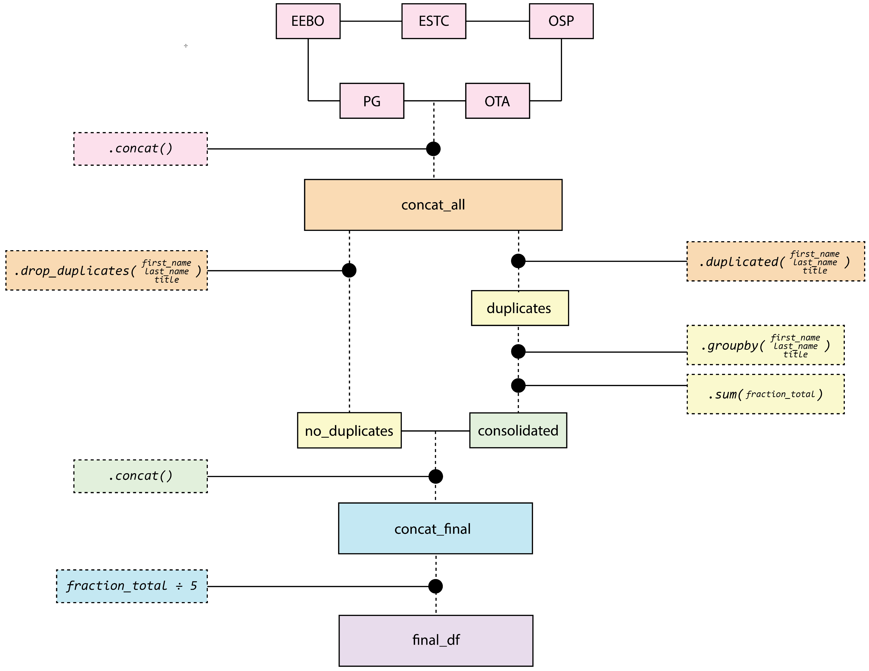

Slide 14
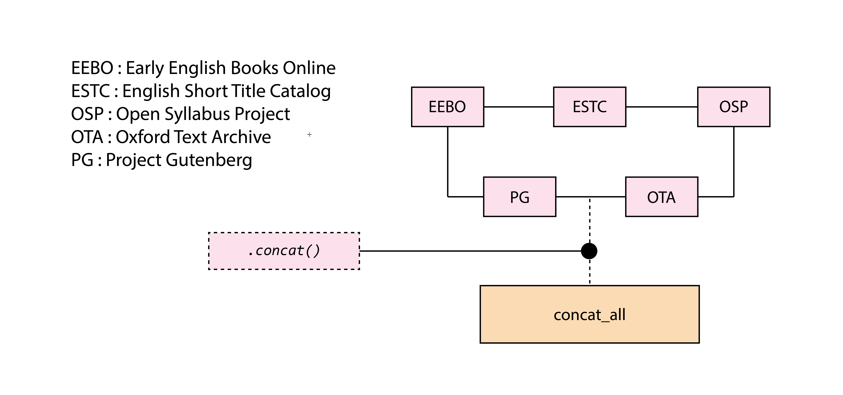

Slide 15
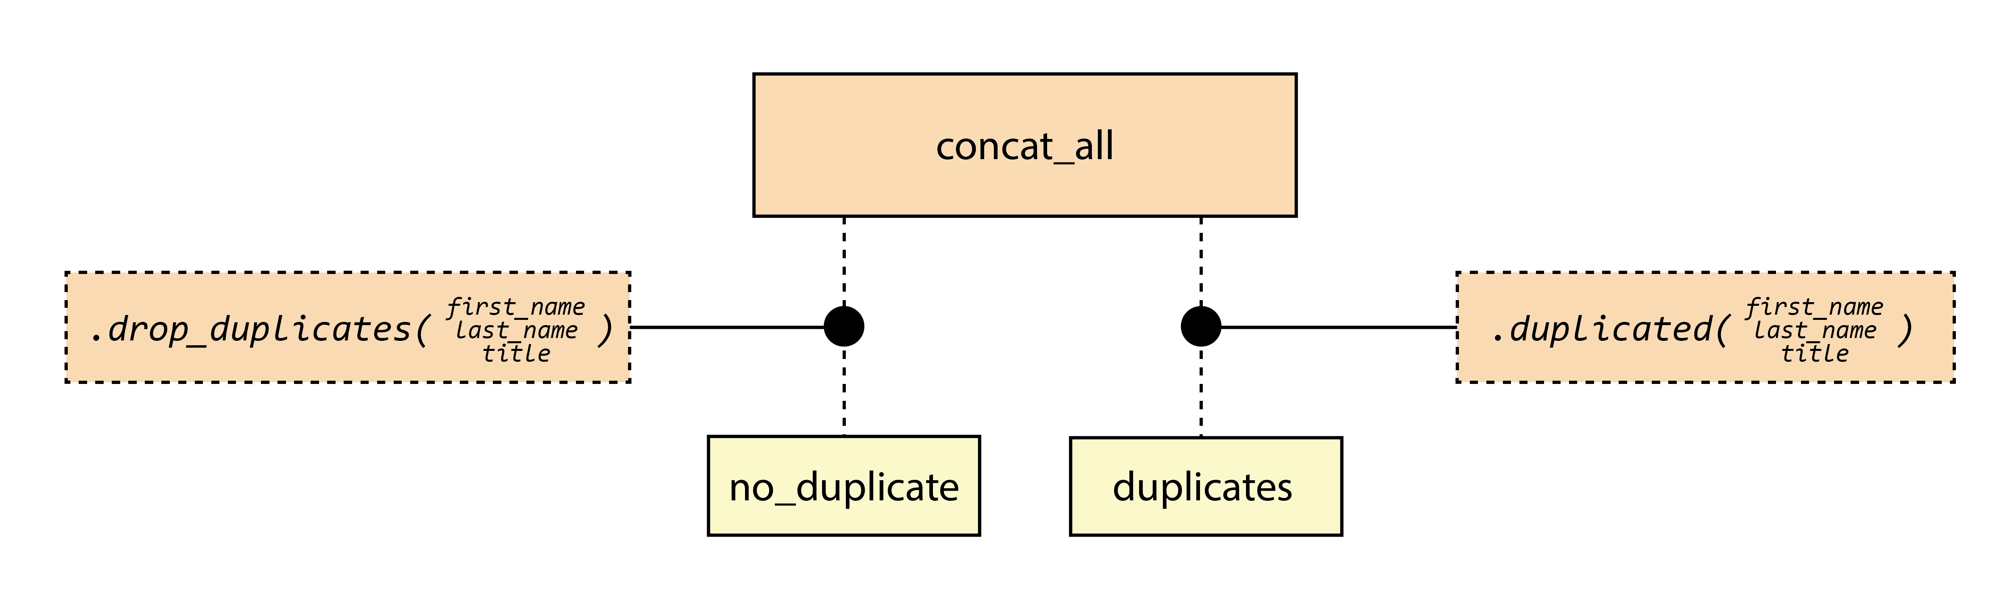
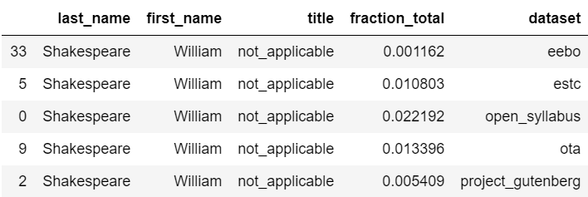

Slide 16
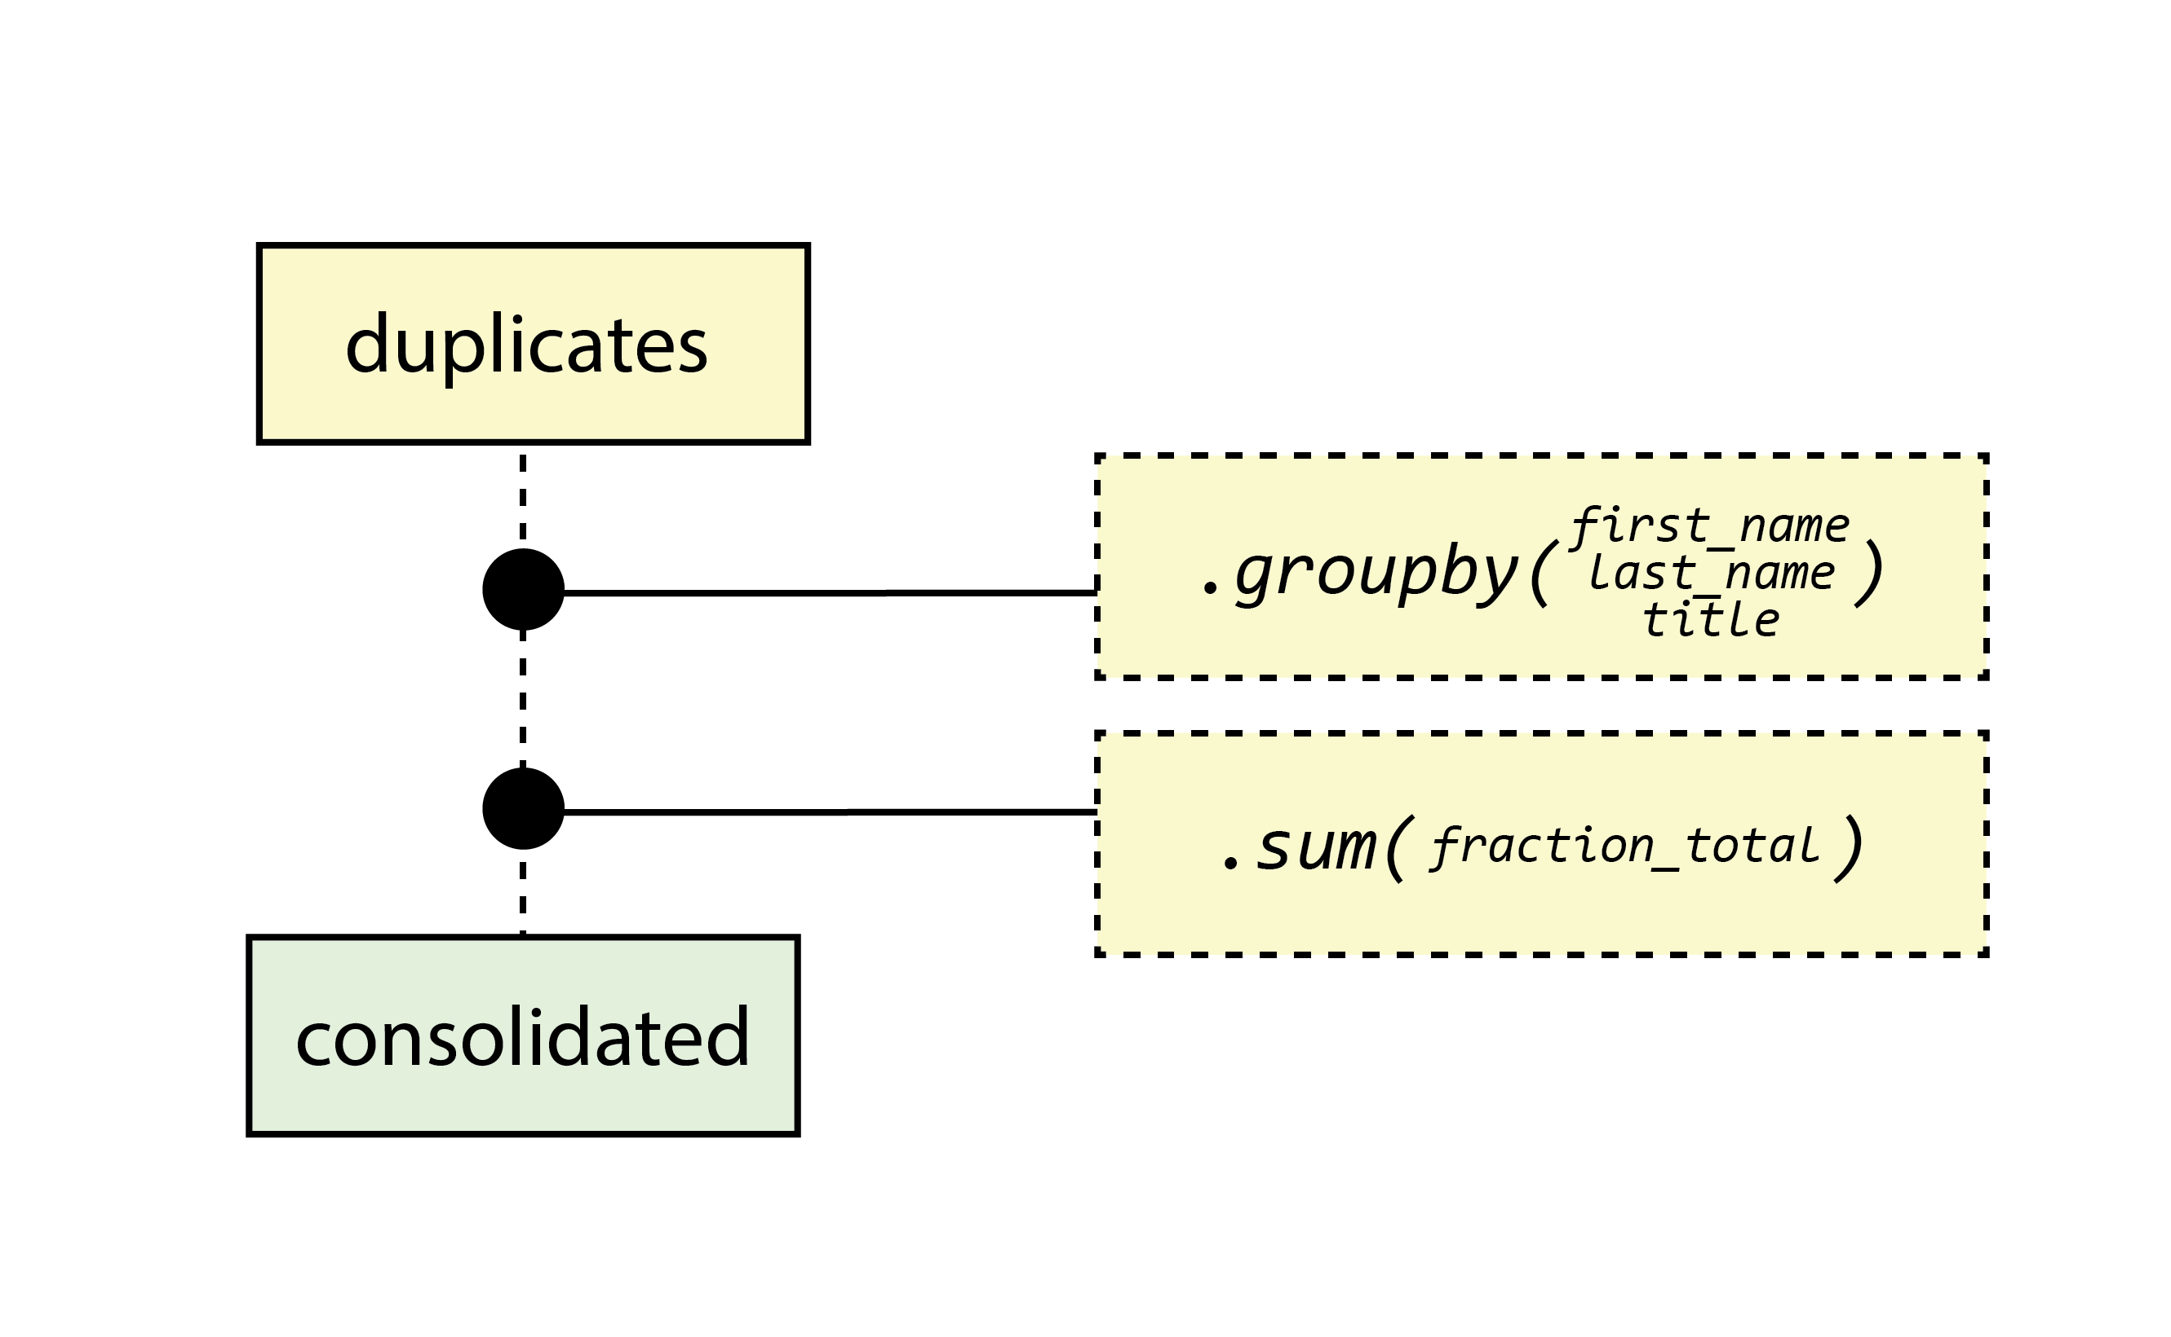


Slide 17
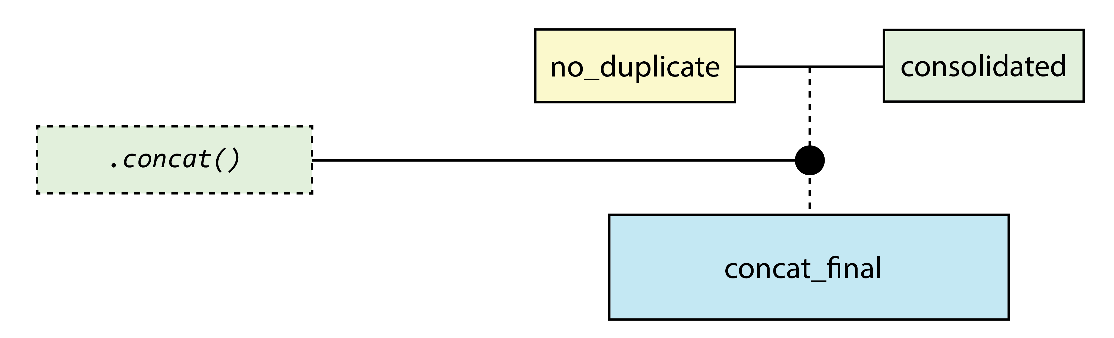

Slide 18
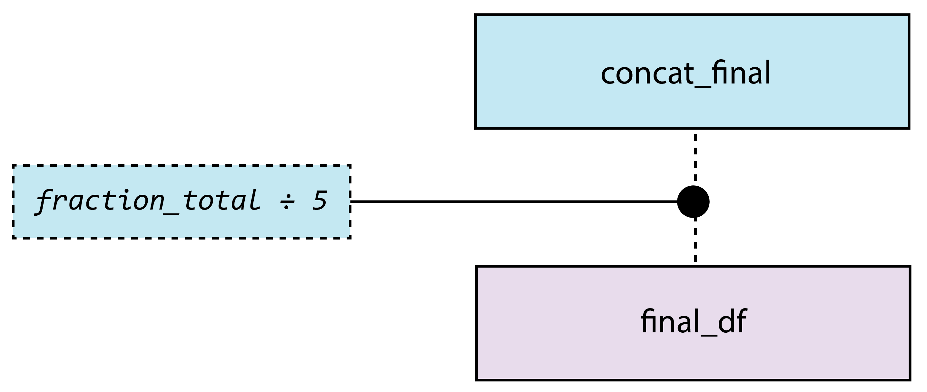


Slide 19
RESULTS

Slide 20
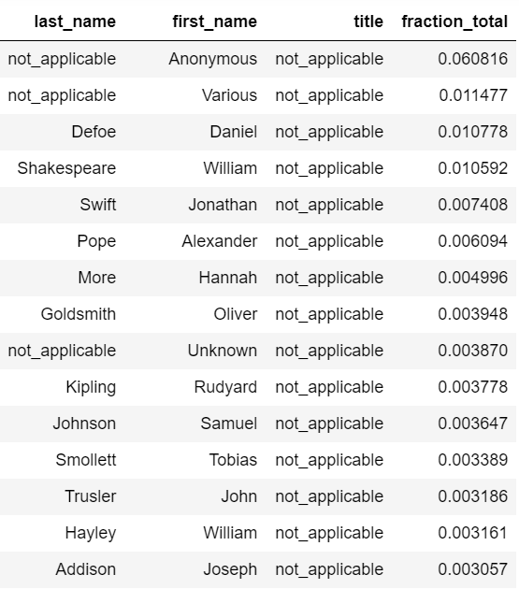
Results
Top 3 (named) authors
1. Daniel Defoe (1660 – 1731)
2. William Shakespeare (1564 – 1616)
3. Jonathan Swift (1667 – 1745)
Total corpus: 1,427 authors

Slide 21
CONCLUSIONS

Slide 22
Discussion of value
Value limited by scope – more datasets!
Pilot program, with potential for broader application
Useful exercise in working with data and datasets

