Slide 1
PRESENTATION TIME
Jasmine Wong
IS590 ODM, Fall 2019

Slide 2
INTRO

Slide 3
Research Questions
Who is cited in English-language dictionaries? How does this citation corpus compare to the English literary canon?
Can digital literature repositories be aggregated to build a recognizable literary canon dataset?

Slide 4
Objectives
Aggregate author citation metadata from literary databases to explore prevalence of individual authors
Build a corpus of author citations for use in literary history research

Slide 5
DATA SOURCES

Slide 6

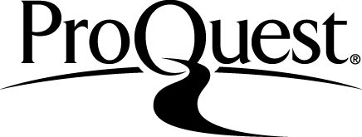
EARLY ENGLISH BOOKS ONLINE
Collection Date: October 3, 2019
Records: 860
COLLECTION
CLEANING
Copy-paste into Excel spreadsheet
OpenRefine
Hand editing
Excel "text to column“ tool
Notes:
High level data source overview
Early English Books Online:

Slide 7

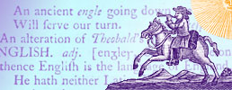
ENGLISH SHORT TITLE CATALOGUE
Collection Date: September 25, 2019
Records: 3,137
COLLECTION
CLEANING
Parsing JSON with Python
OpenRefine
Hand editing
Excel "text to column“ tool

Slide 8

OPEN SYLLABUS
PROJECT
Collection Date: September 15, 2019
Records: 5,000
COLLECTION
CLEANING
XPATH Helper
Copy-paste into Excel spreadsheet
Hand editing
Excel "text to column“ tool

Slide 9

OXFORD TEXT ARCHIVE
Collection Date: September 15, 2019
Records: 600
COLLECTION
CLEANING
XPATH Helper
Copy-paste into Excel spreadsheet
OpenRefine
Hand editing
Excel "text to column“ tool

Slide 10

PROJECT
GUTENBERG
Collection Date: October 8, 2019
Records: 20,801
COLLECTION
CLEANING
Parsing RDF XML with Python
OpenRefine
Hand editing
Excel "text to column“ tool

Slide 11
WORKFLOW

Slide 12
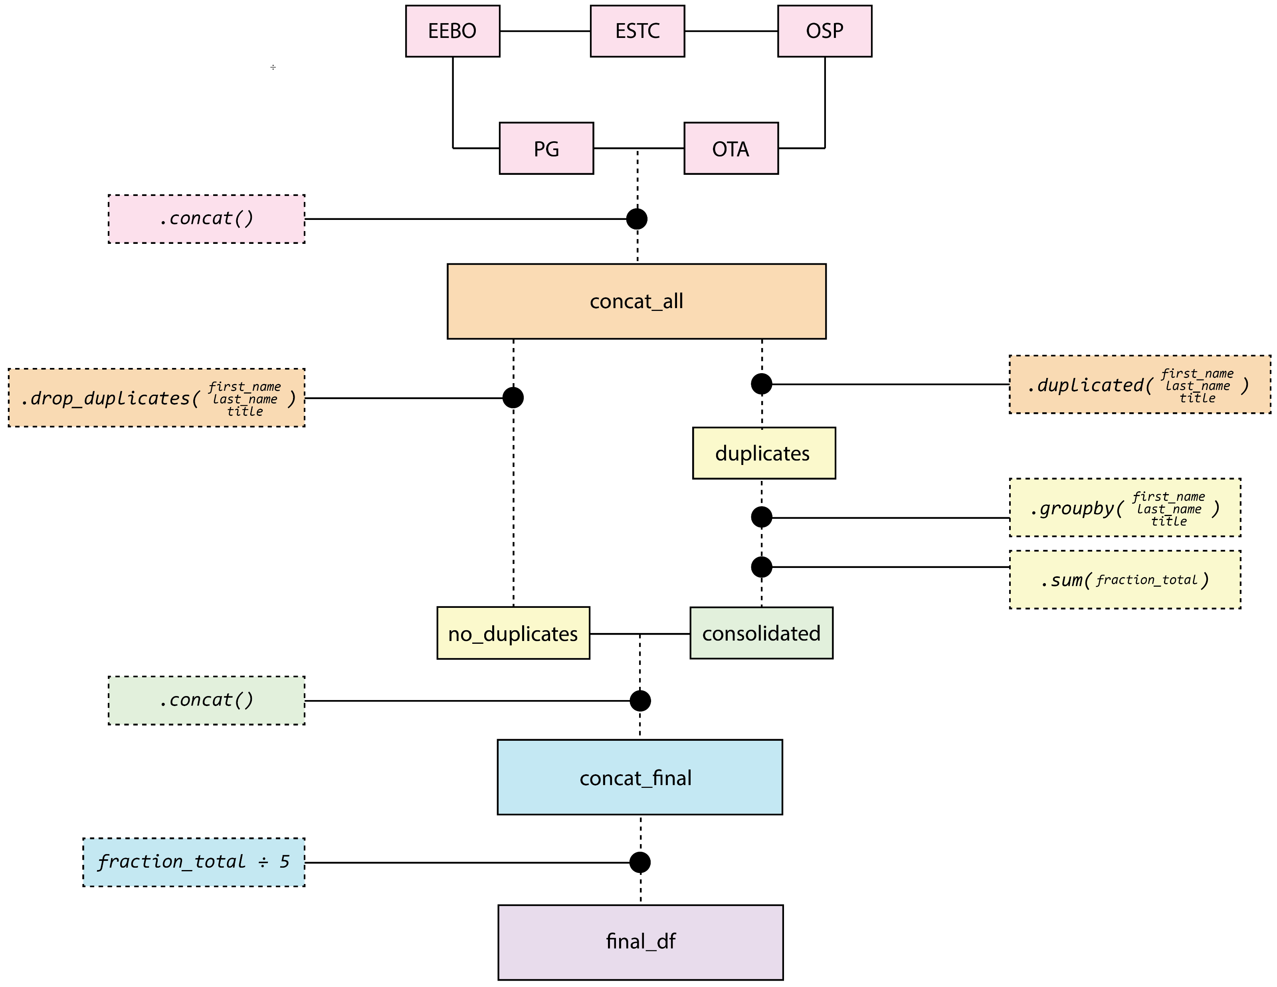

Slide 13
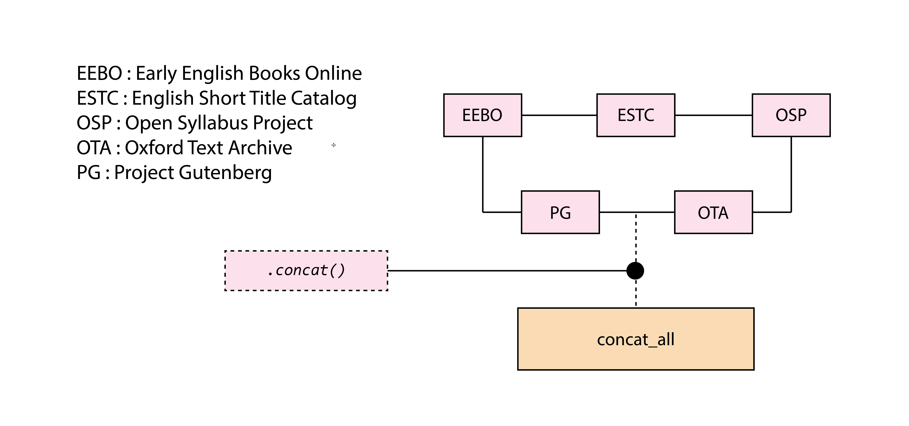

Slide 14
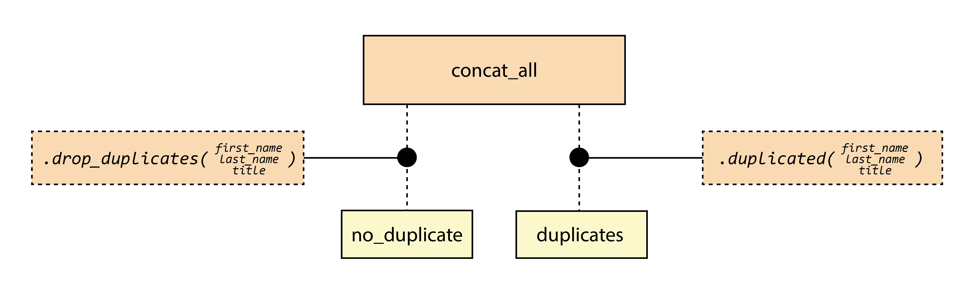

Slide 15
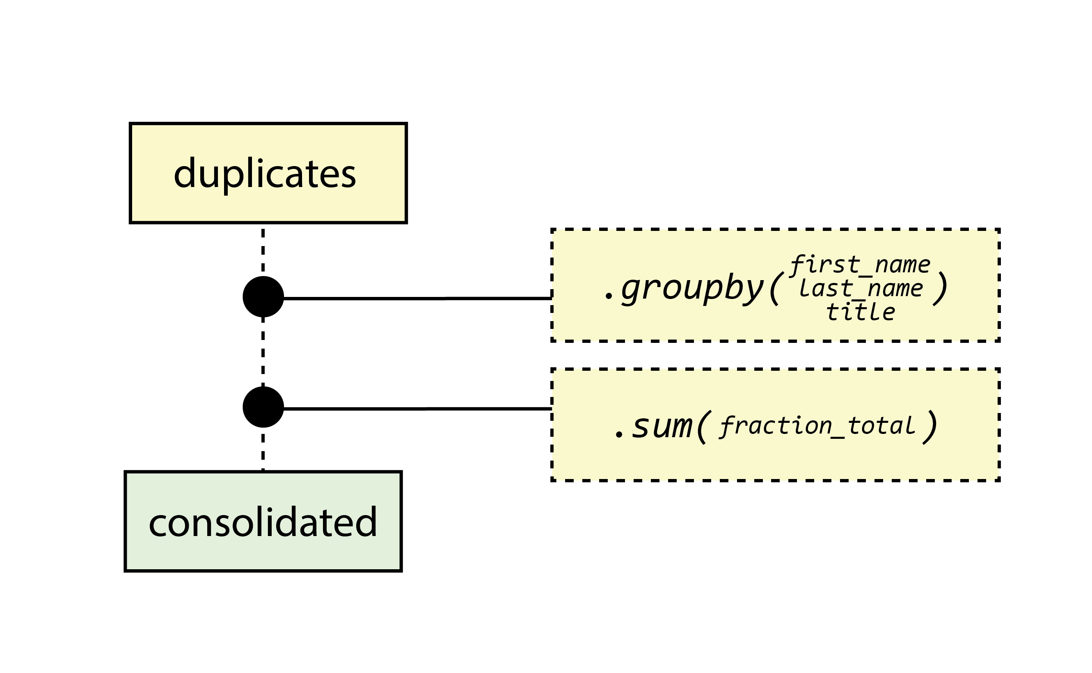

Slide 16
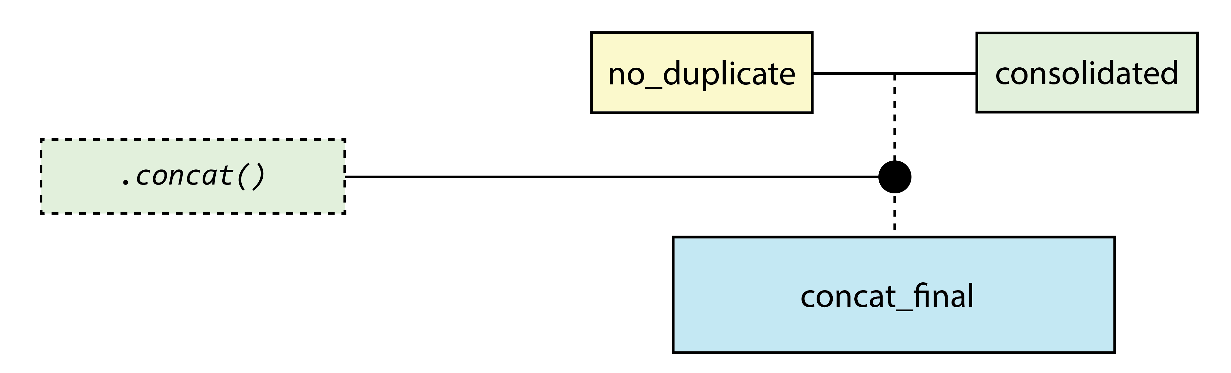

Slide 17
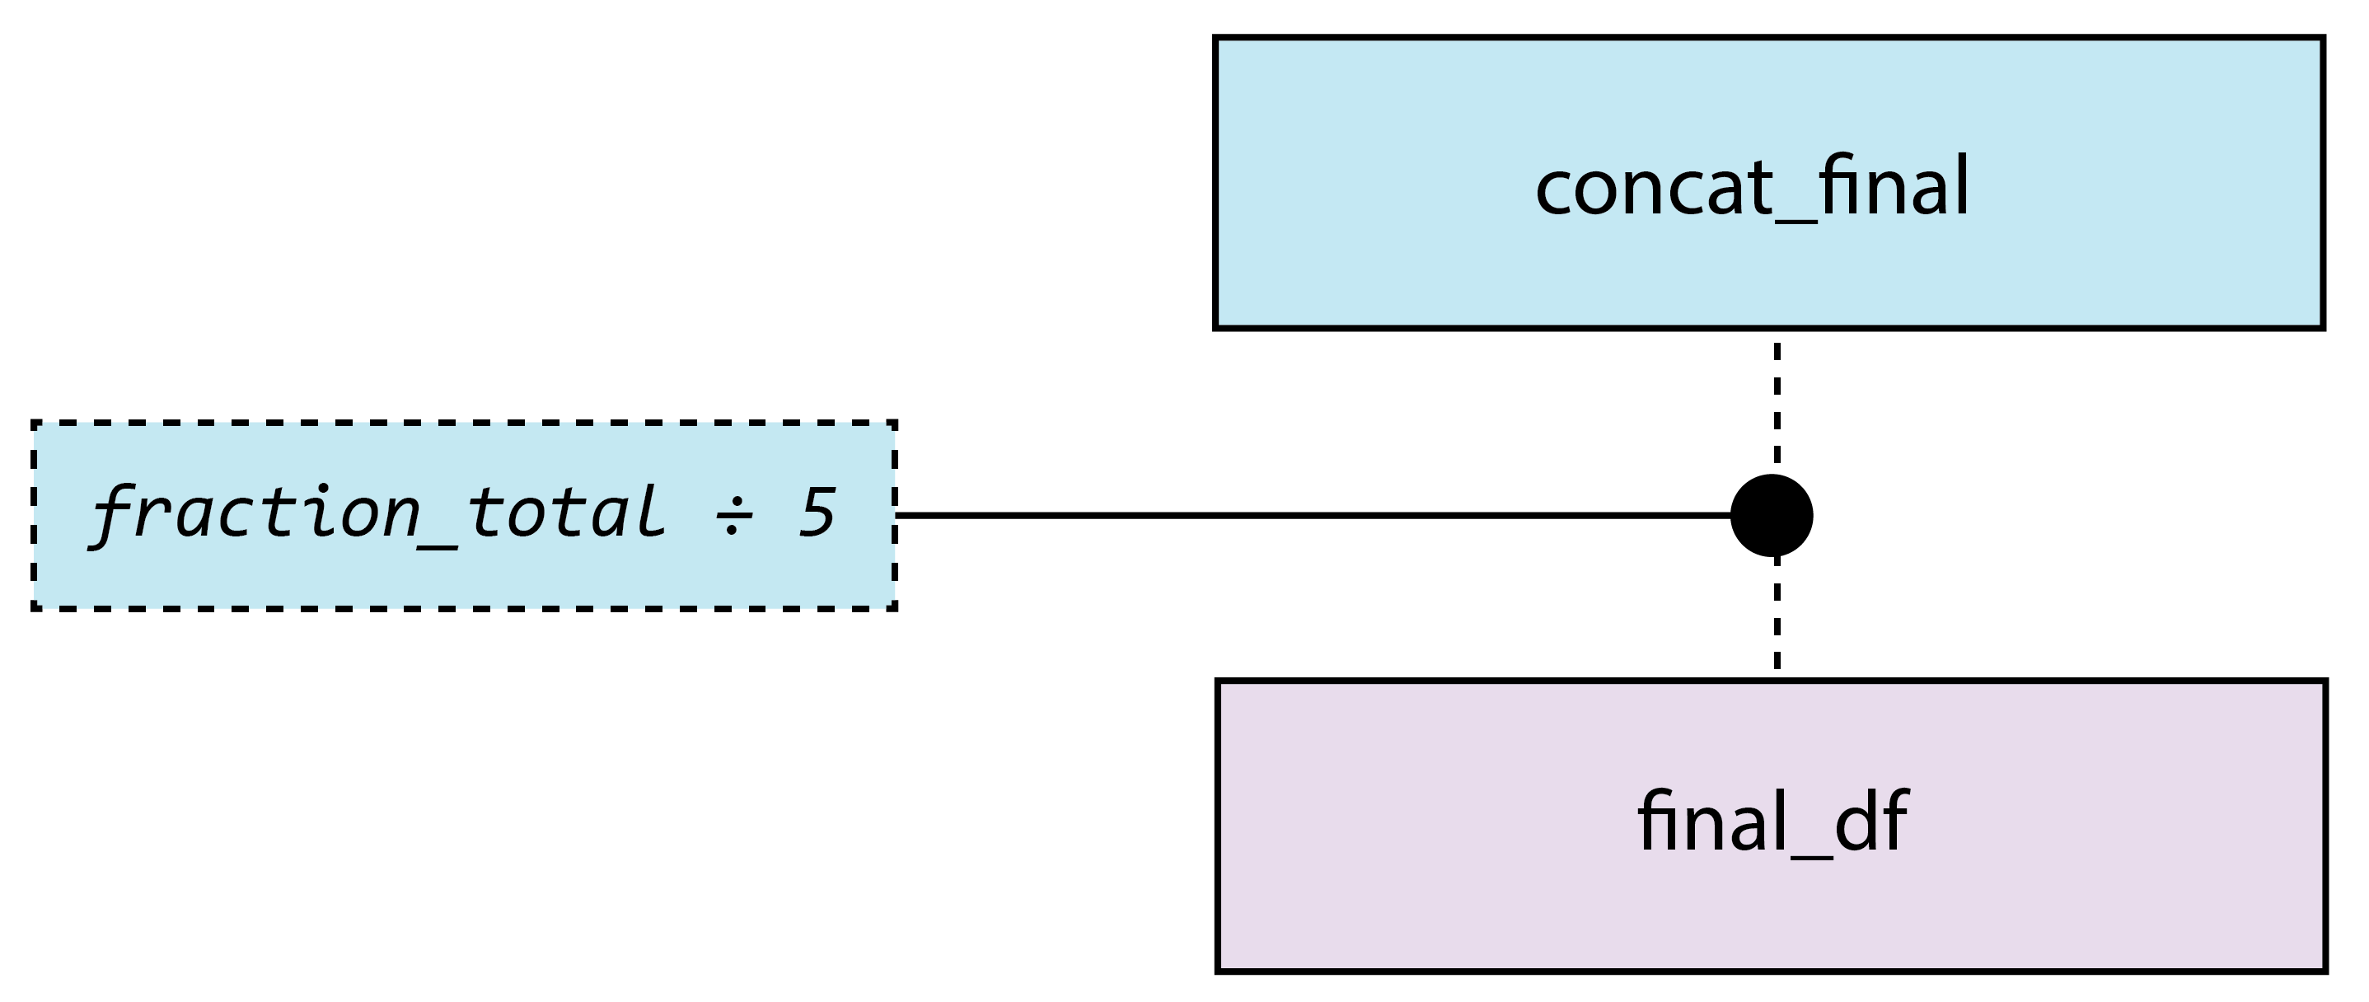

Slide 18
RESULTS

Slide 19
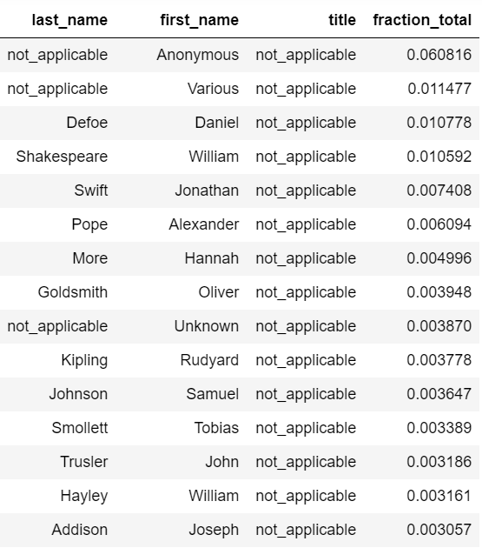
Results
Top 3 (named) authors
1. Daniel Defoe (1660 – 1731)
2. William Shakespeare (1564 – 1616)
3. Jonathan Swift (1667 – 1745)
Total corpus: 1,427 authors

Slide 20
CONCLUSIONS

Slide 21
Problems overcome

Slide 22
Discussion of value
Value limited by scope – more datasets!
Pilot program, with potential for broader application
Useful exercise in working with data and datasets

