Slide 1
BMI RATE
Bustics
Correlation with gender, income level during 2002 to 2013

Slide 2
GROUP MEMBERS
2009312105 Youngsung Kim
2011313039 Jungeun Yun
2011314008 Yeseul Hwang
2011314500 Gwiyoung Lee
2012310320 Jinpyo Lee
2012310375 Jiyoung Choi
71%
61%

Slide 3
CONTENT
1.
Background of our project
2.
Research Questions & Plan of Analysis
3.
Methods & Results
4.
Discussion
5.
Conclusion & Future directions

Slide 4
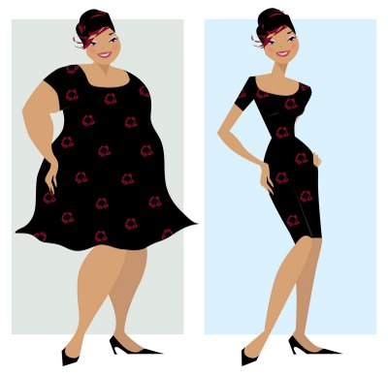
BACKGROUND
BUT…
IN THE MIDDLE AGES…
“OBESITY”
WAS CONSIDERED ATTRACTIVE!!
“
LOOKS ARE EVERYTHING
”
THIN
WELL - DEVELOPED
CLEAR SKIN

Slide 5

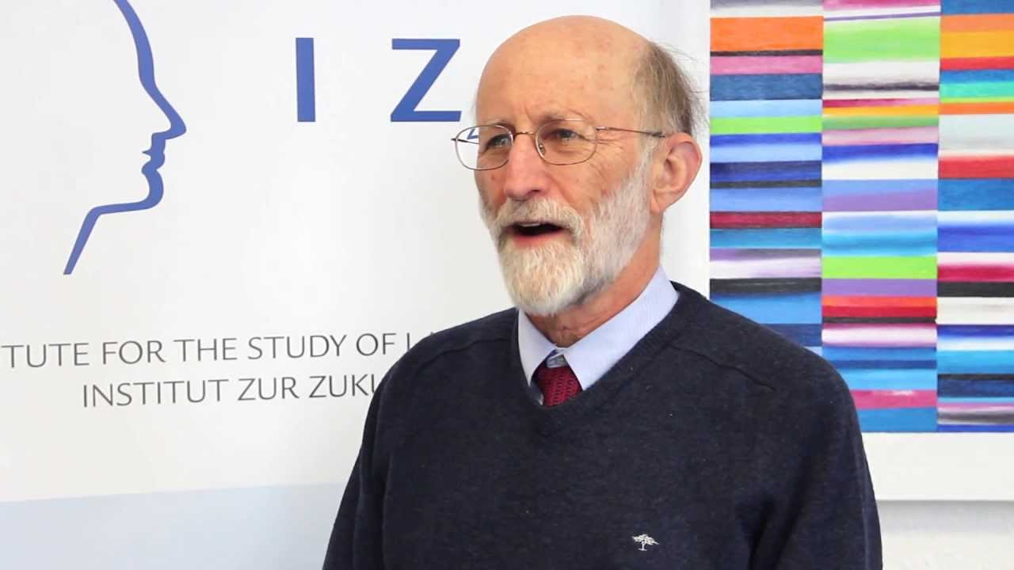
BACKGROUND
“
Lookism is the new racism.
Ugliness is now no different
from race or a disability.
”
DANIEL HAMERMESH

Slide 6
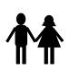
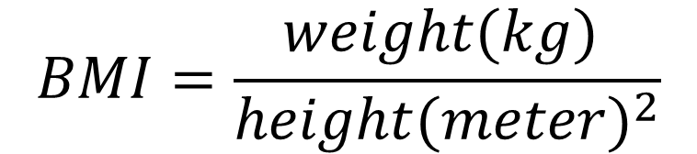
BACKGROUND
$$BMI=\frac{weight(kg) }{height(meter)^{2}}$$
OVERWEIGHT
NORMAL WEIGHT
71%
61%
UNDERWEIGHT

Slide 7
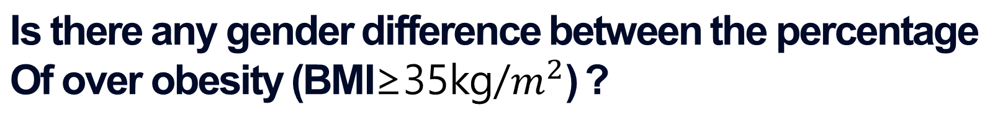
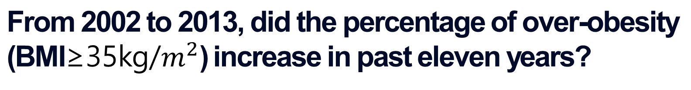
RESEARCH QUESTION
From 2002 to 2013, did the percentage of over-obesity
(BMI≥35kg/$m^{2}$) increase in past eleven years?
1.
Did the percentage of over-obesity of people in
different income level increase?
2.
Is there any gender difference between the percentage
Of over obesity (BMI≥35kg/$m^{2}$) ?
3.
61%

Slide 8
PLAN OF ANALYSIS
SPECIFICED VARIABLES ACCORDING TO…
1. GENDER – MALE/FEMALE
2. TIME – 2002~2013
71%
61%
3. INCOME LEVEL – 20 LEVELS

Slide 9
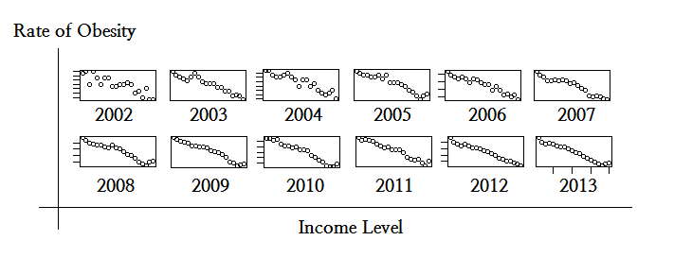
METHODS & RESULTS
71%
61%
∴ NEGATIVE CORRELATION WITH INCOME LEVEL

Slide 10
METHODS & RESULTS
Year | 2002 | 2003 | 2004 | 2005 | 2006 | 2007 | 2008 | 2009 | 2010 | 2011 | 2012 | 2013
Corr | -0.87 | -0.95 | -0.93 | -0.95 | -0.96 | -0.96 | -0.96 | -0.98 | -0.98 | -0.98 | -0.98 | -0.98
Year | 2002 | 2003 | 2004 | 2005 | 2006 | 2007 | 2008 | 2009 | 2010 | 2011 | 2012 | 2013
VIF | 10.9 | 57.7 | 28.1 | 72.4 | 49.3 | 100.8 | 379.6 | 186.0 | 150.3 | 177.2 | 113.9 | 207.4
71%
61%

Slide 11
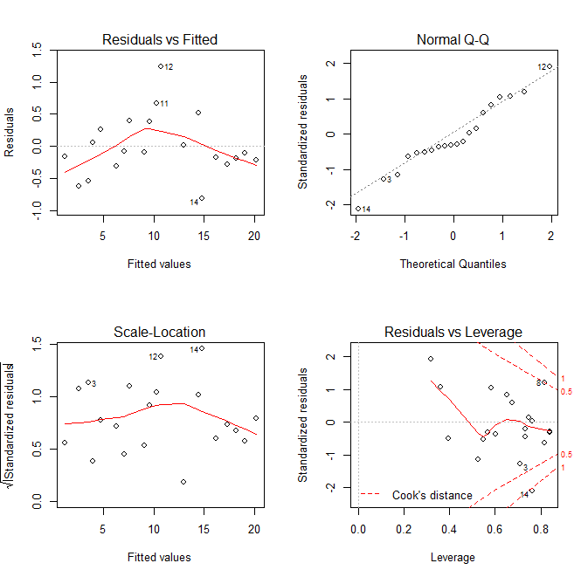
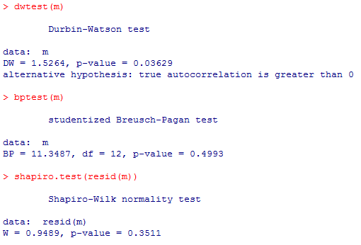
METHODS & RESULTS
71%
61%

Slide 12
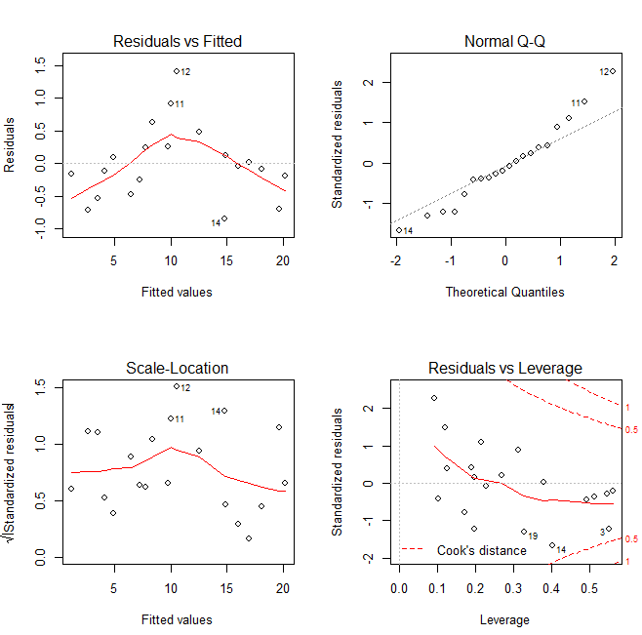
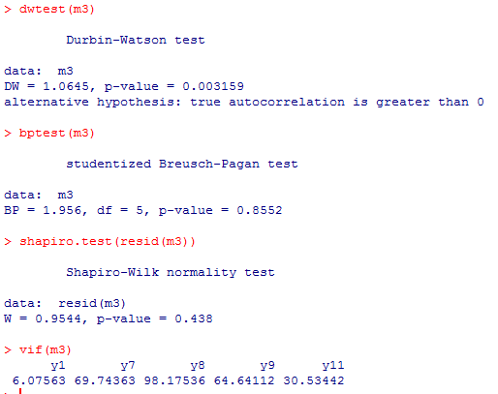
METHODS & RESULTS
71%
61%

Slide 13
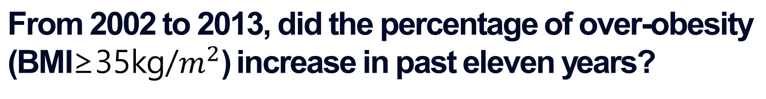
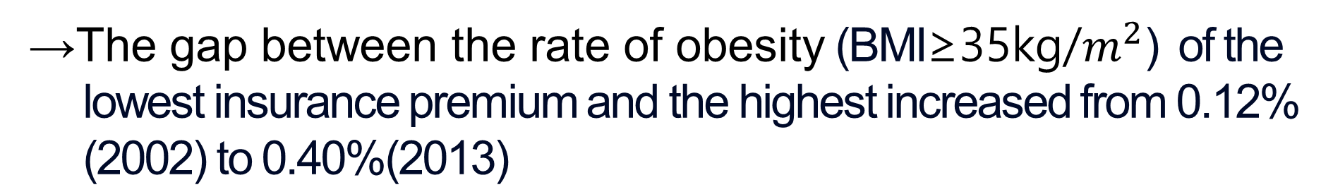
DISCUSSION
From 2002 to 2013, did the percentage of over-obesity
(BMI≥35kg/$m^{2}$) increase in past eleven years?
1.
→The rate of over obesity (BMI≥35kg/$m^{2}$) reached 0.49%
which is about three(2.9) times higher than that of past eleven years.
Did the percentage of over-obesity of people in
different income level increase?
2.
71%
→The gap between the rate of obesity (BMI≥35kg/$m^{2}$) of the
lowest insurance premium and the highest increased from 0.12%
(2002) to 0.40%(2013)
61%

Slide 14

DISCUSSION
Is there any gender difference between the percentage
Of over obesity (BMI≥35kg/$m^{2}$) ?
3.
→In the lowest insurance premium, gender difference
between the percentage of over-obesity (BMI ≥ 35kg/m2)
is increased from 0.02% in 2002 to 0.16% in 2013.

Slide 15
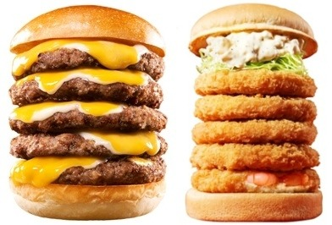
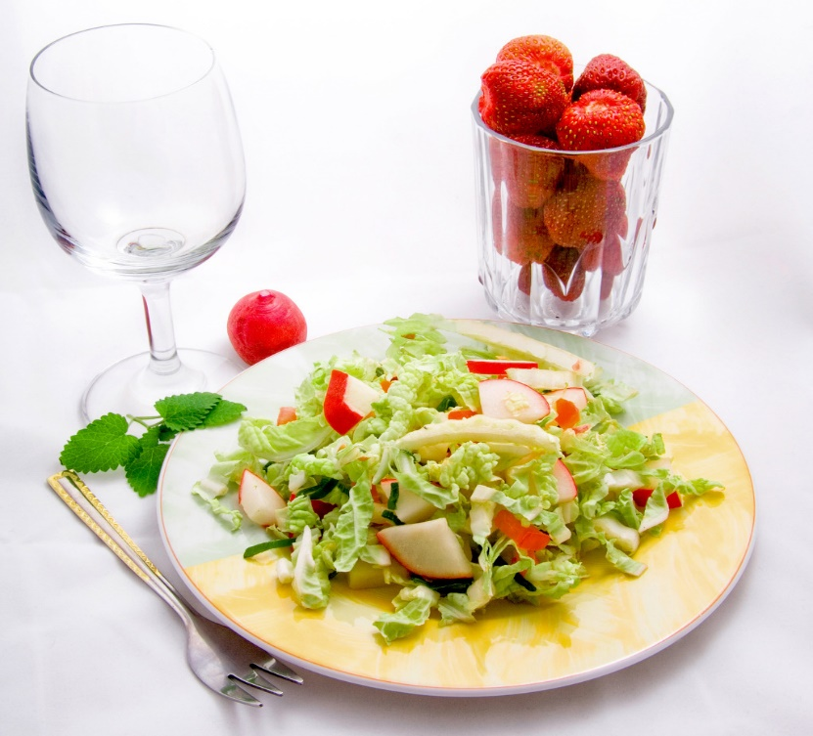
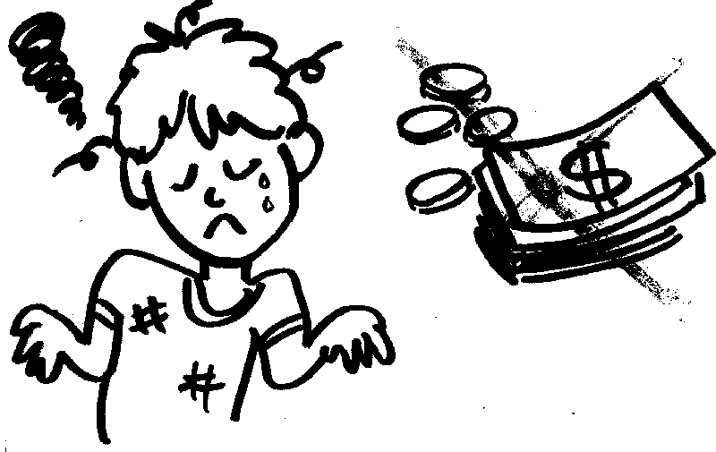

CONTENT
JUNK FOOD
WELL-BALANCED DIET

Slide 16
CONCLUSION
TO SOLVE THIS PROBLEM…
GOVERNMENT SHOULD SUPPORT FOR THE POOR
SOCIAL PERCEPTION OF “IDEAL BODY” NEEDS TO CHANGE
“
71%
SURVIVAL OR THE FITTEST
”
61%

Slide 17
- THE END -
THANK YOU FOR LISTENING

