Slide 1
Basics on Computer Vision
Jikai Wang

Slide 2
3D Transformation

Slide 3
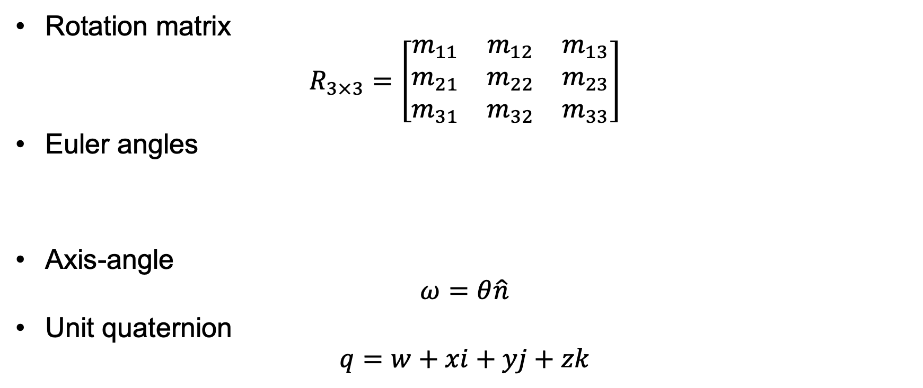
3D Rotation Representations
Rotation matrix
$$R_{3×3}=\left[\begin{matrix}m_{11} & m_{12} & m_{13} \\ m_{21} & m_{22} & m_{23} \\ m_{31} & m_{32} & m_{33}\end{matrix}\right]$$
Euler angles
Axis-angle
$$ω=θ\hat{n}$$
Unit quaternion
$$q=w+xi+yj+zk$$

Slide 4

3D Euclidean Transformation SE(3)
3D Rotation + 3D translation
$$x^{′}=Rx+t$$
$$x^{′}=\left[R|t\right]\overline{x}$$
$$\overline{x}=(x,y,z,1)$$

Slide 5
Perspective Camera Model

Slide 6
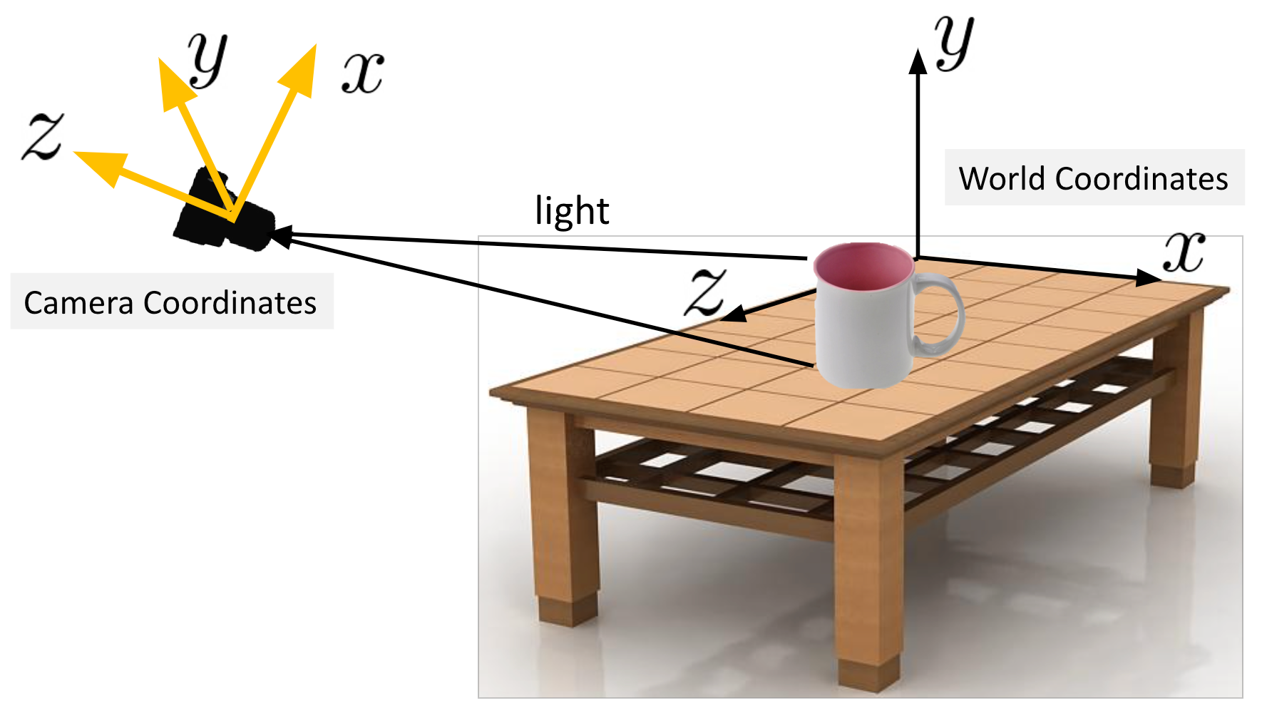
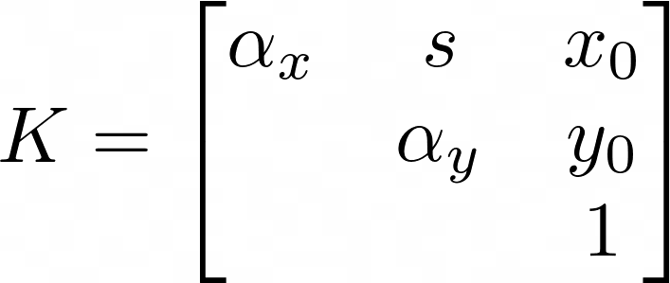
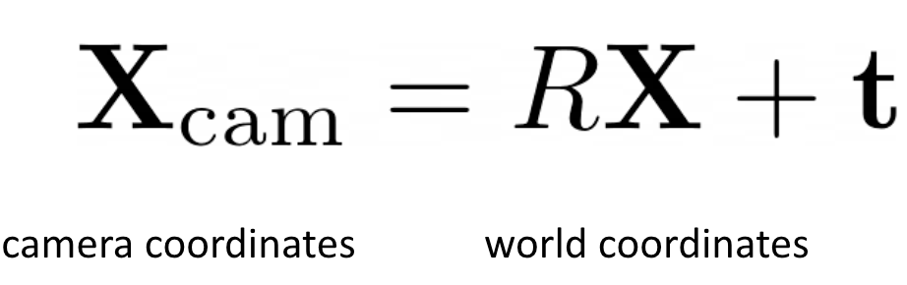



Perspective Camera Model
Camera intrinsics
Camera extrinsics
Camera Projection Matrix
World space point to image plane pixel
Camera space point to image plane pixel

Slide 7
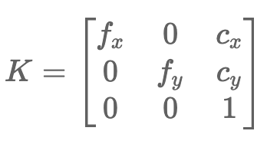
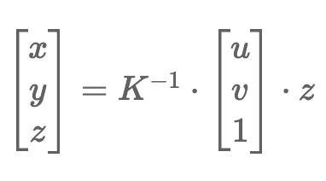
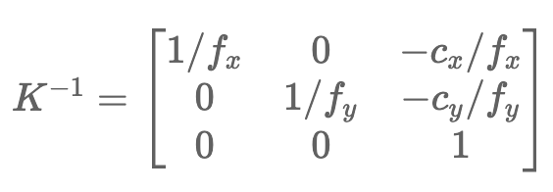
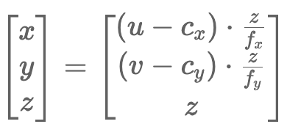
Back-projection to a 3D Point in Camera Coordinates

Slide 8
Triangulation

Slide 9
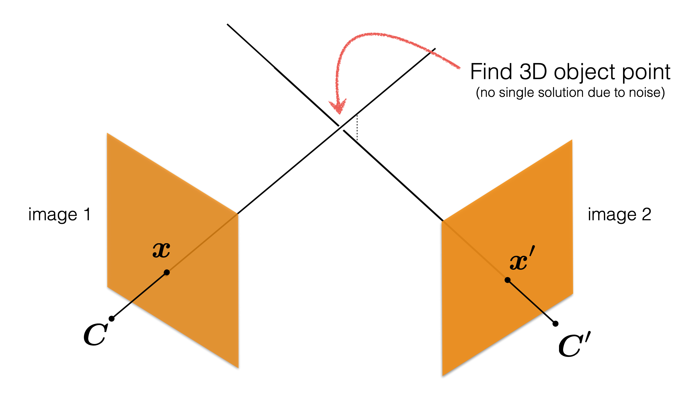
Triangulation

Slide 10

Triangulation
Given:
A set of matched points $\{x_{i}, x_{i}^{′}\}$
And camera matrices $P, P^{′}$
Estimate:
The 3D point $X$

Slide 11
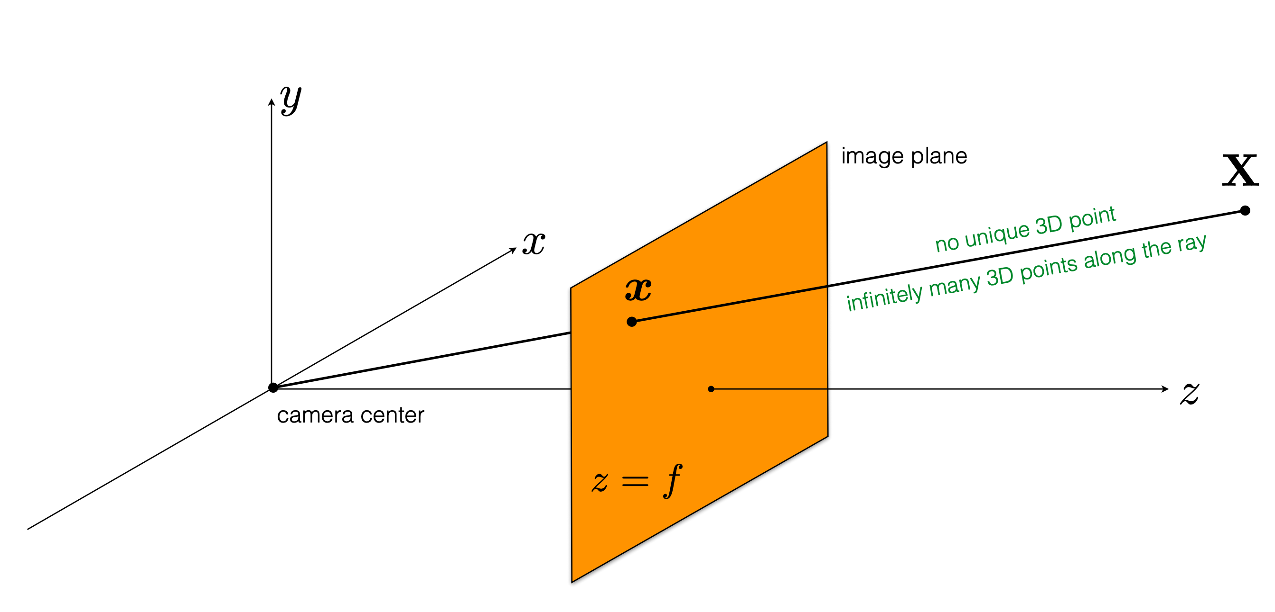

Triangulation
Q1: Can we compute $X$ from a single correspondence $x$? No!
$$x=PX$$

Slide 12
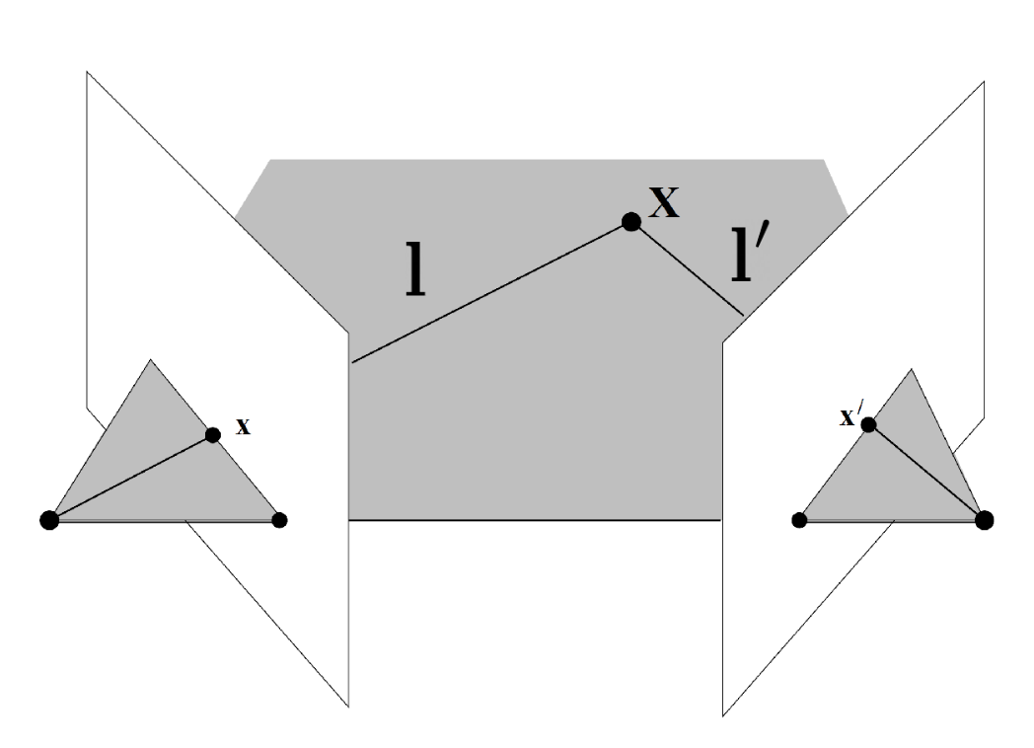
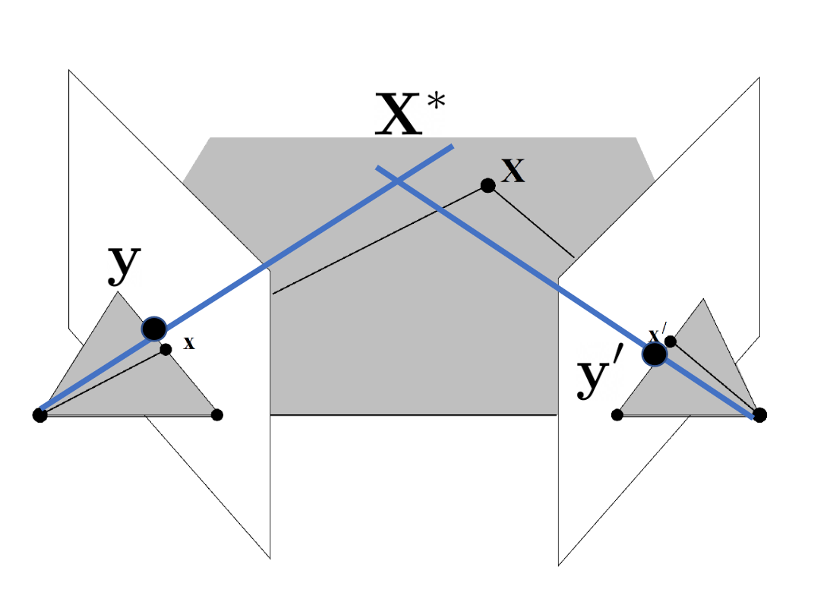
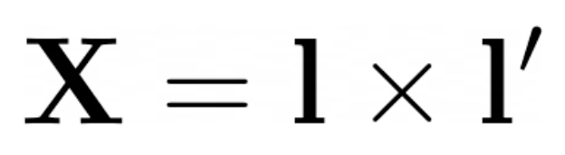

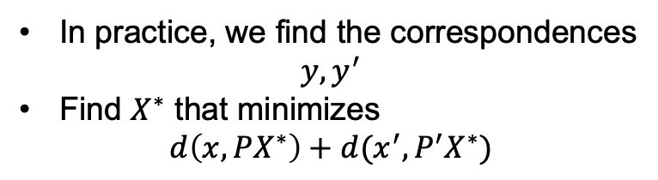
Triangulation
Q2: Can we compute $X$ from a two correspondences $x$ and $x^{′}$? Maybe
$$x=PX$$
There will not be a point that satisfies both constraints because the measurements are usually noisy
$x^{′}=P^{′}X$ $x=PX$
Need to find the best fit
In practice, we find the correspondences
$$y, y^{′}$$
Find $X^{∗}$ that minimizes
$$d\left(x, PX^{∗}\right)+d(x^{′},{P^{′}X}^{∗})$$
Perfect measurements
Noisy measurements

Slide 13
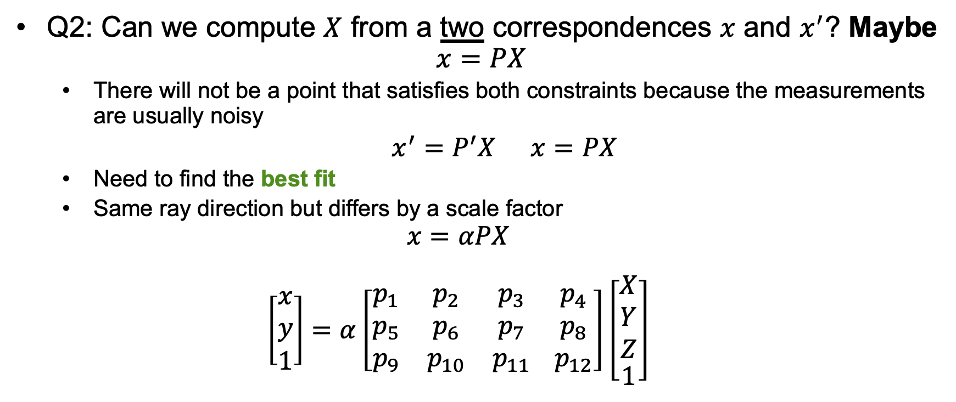
Triangulation
Q2: Can we compute $X$ from a two correspondences $x$ and $x^{′}$? Maybe
$$x=PX$$
There will not be a point that satisfies both constraints because the measurements are usually noisy
$x^{′}=P^{′}X$ $x=PX$
Need to find the best fit
Same ray direction but differs by a scale factor
$$x=αPX$$
$$\left[\begin{matrix}x \\ y \\ 1\end{matrix}\right]=α\left[\begin{matrix}p_{1} & p_{2} & p_{3} \\ p_{5} & p_{6} & p_{7} \\ p_{9} & p_{10} & p_{11}\end{matrix} \begin{matrix}p_{4} \\ p_{8} \\ p_{12}\end{matrix}\right]\left[\begin{aligned}\begin{matrix}X \\ Y \\ Z\end{matrix} \\ 1\end{aligned}\right]$$

Slide 14
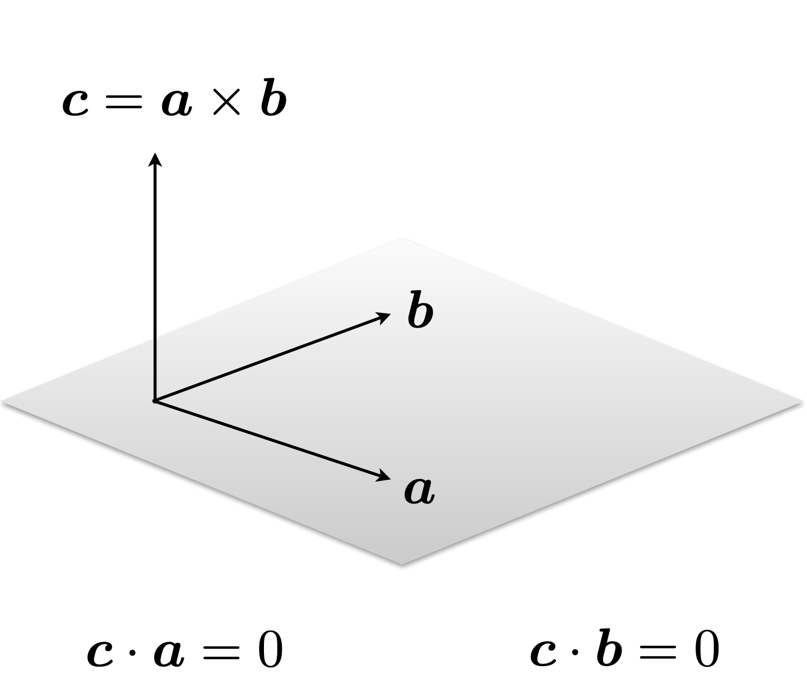
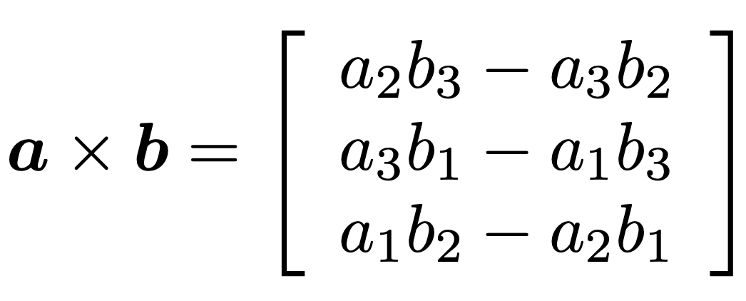
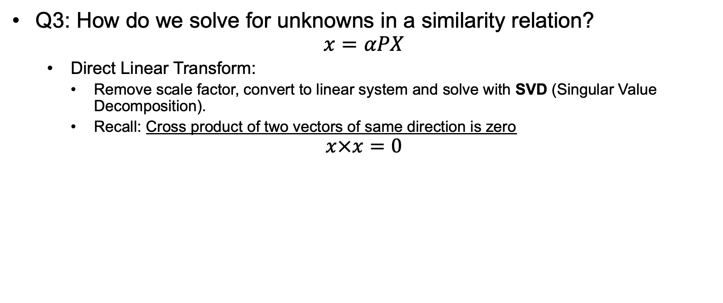
Triangulation
Q3: How do we solve for unknowns in a similarity relation?
$$x=αPX$$
Direct Linear Transform:
Remove scale factor, convert to linear system and solve with SVD (Singular Value Decomposition).
Recall: Cross product of two vectors of same direction is zero
$$x×x=0$$

Slide 15
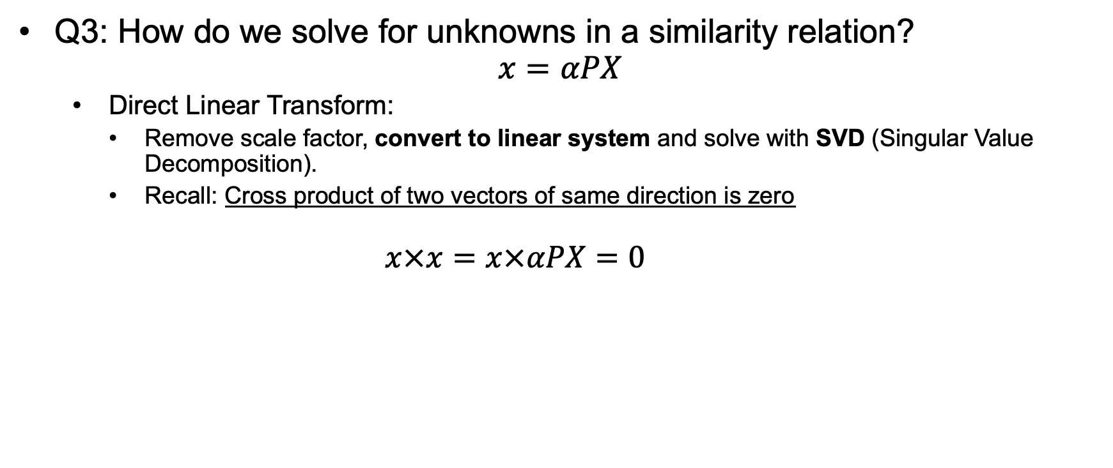
Triangulation
Q3: How do we solve for unknowns in a similarity relation?
$$x=αPX$$
Direct Linear Transform:
Remove scale factor, convert to linear system and solve with SVD (Singular Value Decomposition).
Recall: Cross product of two vectors of same direction is zero
$$x×x=x×αPX=0$$

Slide 16
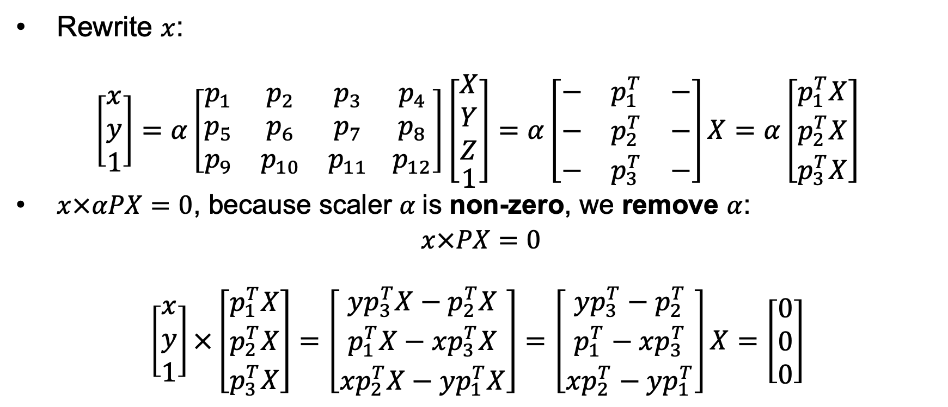
Triangulation - Convert to Linear System
Rewrite $x$:
$$\left[\begin{matrix}x \\ y \\ 1\end{matrix}\right]=α\left[\begin{matrix}p_{1} & p_{2} & p_{3} \\ p_{5} & p_{6} & p_{7} \\ p_{9} & p_{10} & p_{11}\end{matrix} \begin{matrix}p_{4} \\ p_{8} \\ p_{12}\end{matrix}\right]\left[\begin{aligned}\begin{matrix}X \\ Y \\ Z\end{matrix} \\ 1\end{aligned}\right]=α\left[\begin{matrix}− & p_{1}^{T} & − \\ − & p_{2}^{T} & − \\ − & p_{3}^{T} & −\end{matrix}\right]X=α\left[\begin{matrix}p_{1}^{T}X \\ p_{2}^{T}X \\ p_{3}^{T}X\end{matrix}\right]$$
$x×αPX=0$, because scaler $α$is non-zero, we remove $α$:
$x×PX=0$
$$\left[\begin{matrix}x \\ y \\ 1\end{matrix}\right]×\left[\begin{matrix}p_{1}^{T}X \\ p_{2}^{T}X \\ p_{3}^{T}X\end{matrix}\right]=\left[\begin{matrix}yp_{3}^{T}X−p_{2}^{T}X \\ p_{1}^{T}X−xp_{3}^{T}X \\ xp_{2}^{T}X−yp_{1}^{T}X\end{matrix}\right]=\left[\begin{matrix}yp_{3}^{T}−p_{2}^{T} \\ p_{1}^{T}−xp_{3}^{T} \\ xp_{2}^{T}−yp_{1}^{T}\end{matrix}\right]X=\left[\begin{matrix}0 \\ 0 \\ 0\end{matrix}\right]$$

Slide 17
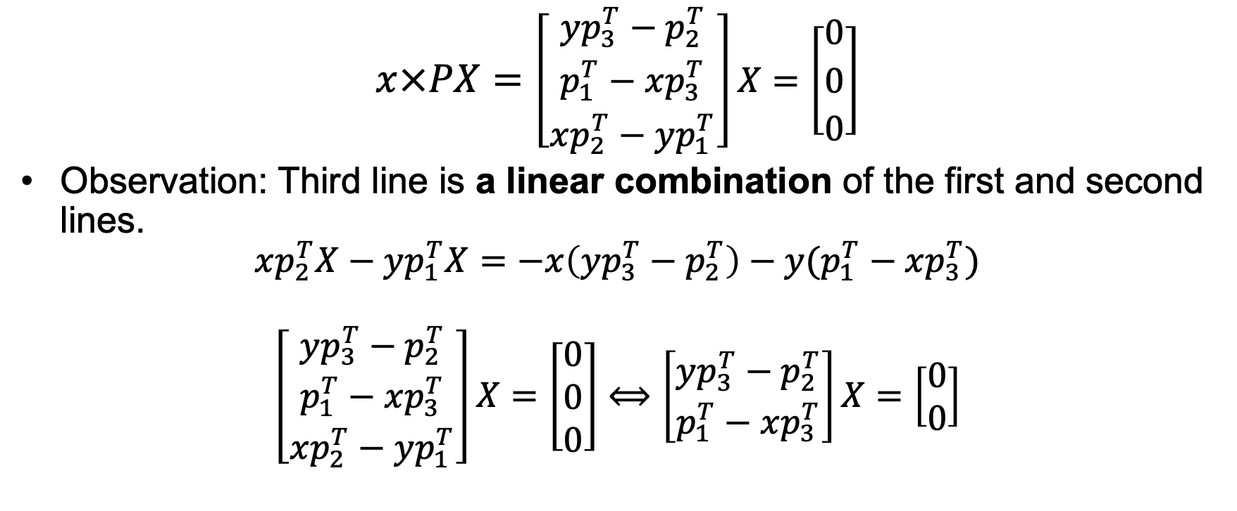
Triangulation - Convert to Linear System
$$x×PX=\left[\begin{matrix}yp_{3}^{T}−p_{2}^{T} \\ p_{1}^{T}−xp_{3}^{T} \\ xp_{2}^{T}−yp_{1}^{T}\end{matrix}\right]X=\left[\begin{matrix}0 \\ 0 \\ 0\end{matrix}\right]$$
Observation: Third line is a linear combination of the first and second lines.
$$xp_{2}^{T}X−yp_{1}^{T}X=−x\left(yp_{3}^{T}−p_{2}^{T}\right)−y(p_{1}^{T}−xp_{3}^{T})$$
$$\left[\begin{matrix}yp_{3}^{T}−p_{2}^{T} \\ p_{1}^{T}−xp_{3}^{T} \\ xp_{2}^{T}−yp_{1}^{T}\end{matrix}\right]X=\left[\begin{matrix}0 \\ 0 \\ 0\end{matrix}\right]⟺\left[\begin{matrix}yp_{3}^{T}−p_{2}^{T} \\ p_{1}^{T}−xp_{3}^{T}\end{matrix}\right]X=\left[\begin{matrix}0 \\ 0\end{matrix}\right]$$

Slide 18
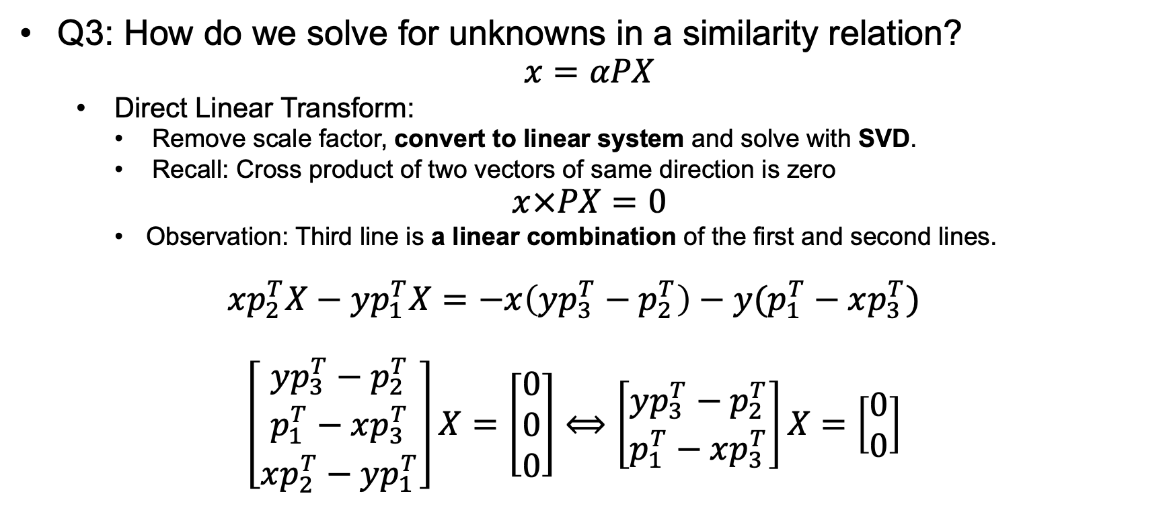
Triangulation
Q3: How do we solve for unknowns in a similarity relation?
$$x=αPX$$
Direct Linear Transform:
Remove scale factor, convert to linear system and solve with SVD.
Recall: Cross product of two vectors of same direction is zero
$$x×PX=0$$
Observation: Third line is a linear combination of the first and second lines.
$$xp_{2}^{T}X−yp_{1}^{T}X=−x\left(yp_{3}^{T}−p_{2}^{T}\right)−y(p_{1}^{T}−xp_{3}^{T})$$
$$\left[\begin{matrix}yp_{3}^{T}−p_{2}^{T} \\ p_{1}^{T}−xp_{3}^{T} \\ xp_{2}^{T}−yp_{1}^{T}\end{matrix}\right]X=\left[\begin{matrix}0 \\ 0 \\ 0\end{matrix}\right]⟺\left[\begin{matrix}yp_{3}^{T}−p_{2}^{T} \\ p_{1}^{T}−xp_{3}^{T}\end{matrix}\right]X=\left[\begin{matrix}0 \\ 0\end{matrix}\right]$$
linear equations

Slide 19
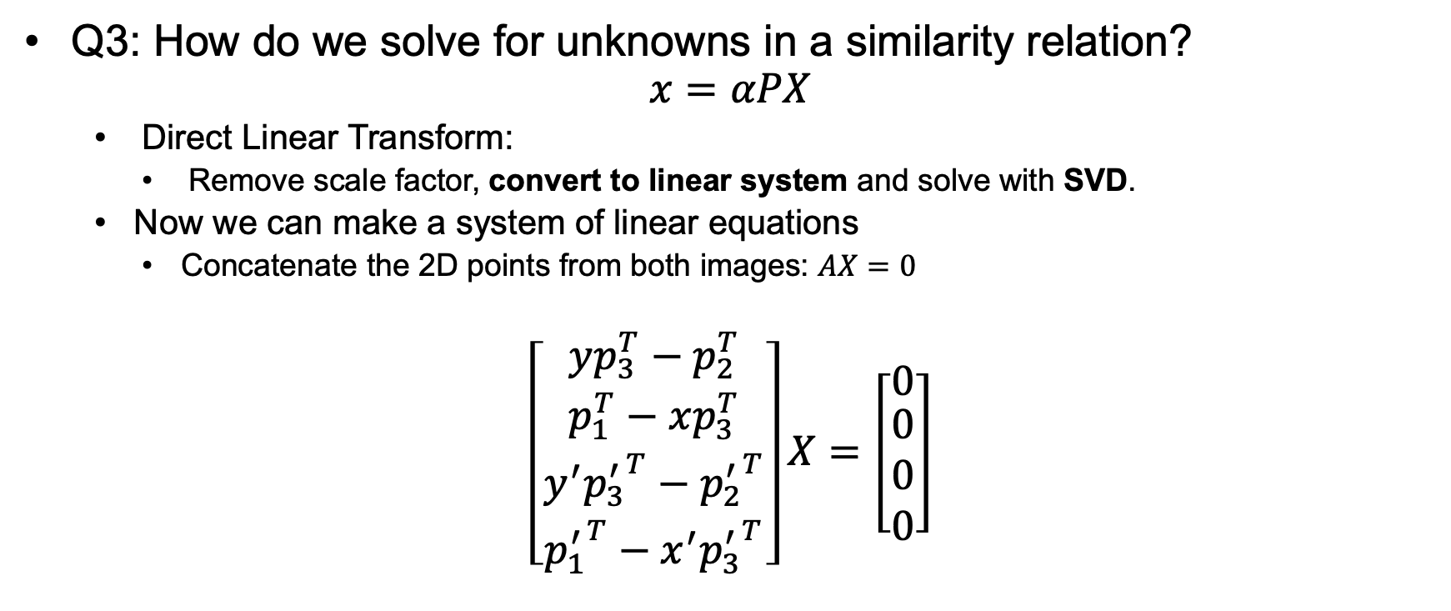
Triangulation
Q3: How do we solve for unknowns in a similarity relation?
$$x=αPX$$
Direct Linear Transform:
Remove scale factor, convert to linear system and solve with SVD.
Now we can make a system of linear equations
Concatenate the 2D points from both images: $AX=0$
$$\left[\begin{matrix}yp_{3}^{T}−p_{2}^{T} \\ \begin{aligned}p_{1}^{T}−xp_{3}^{T} \\ y^{′}{p_{3}^{′}}^{T}−{p_{2}^{′}}^{T} \\ {p_{1}^{′}}^{T}−{x^{′}p_{3}^{′}}^{T}\end{aligned}\end{matrix}\right]X=\left[\begin{matrix}0 \\ \begin{aligned}0 \\ 0 \\ 0\end{aligned}\end{matrix}\right]$$
Homogeneous linear system!!!
Camera1
Camera2

Slide 20
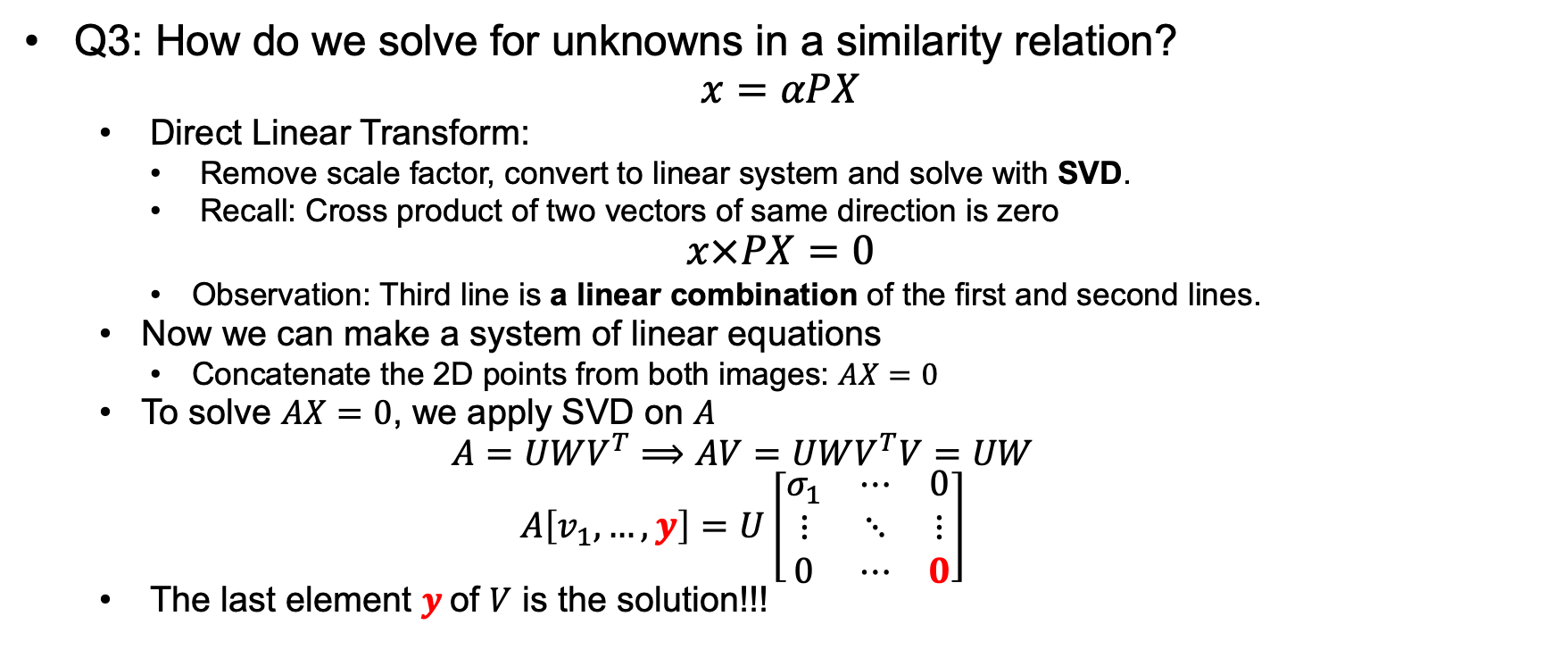
Triangulation
Q3: How do we solve for unknowns in a similarity relation?
$$x=αPX$$
Direct Linear Transform:
Remove scale factor, convert to linear system and solve with SVD.
Recall: Cross product of two vectors of same direction is zero
$$x×PX=0$$
Observation: Third line is a linear combination of the first and second lines.
Now we can make a system of linear equations
Concatenate the 2D points from both images: $AX=0$
To solve $AX=0$, we apply SVD on $A$
$$A=UWV^{T}⟹AV=UWV^{T}V=UW$$
$$A\left[v_{1},…,y\right]=U\left[\begin{matrix}σ_{1} & ⋯ & 0 \\ ⋮ & ⋱ & ⋮ \\ 0 & ⋯ & 0\end{matrix}\right]$$
The last element $y$of $V$ is the solution!!!

