Slide 1
Introduction to ROS (Robot Operating System)
Jikai Wang

Slide 2
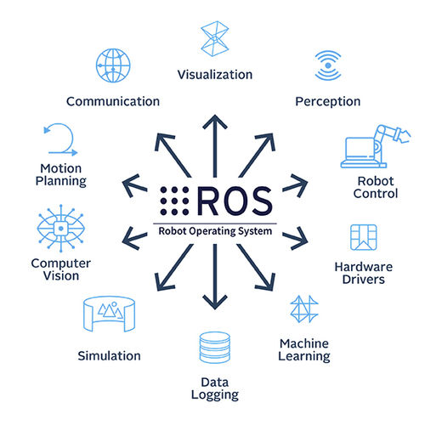
What is ROS?
ROS (Robot Operating System) is an open source software development kit for robotics applications.
ROS offers a standard software platform to developers across industries that will carry them from research and prototyping all the way through to deployment and production.

Slide 3
Why ROS?
Standardization:
Offers a common platform for robotics research and development.
Flexibility:
Supports a wide range of robot hardware and software.
Community:
Large and active community contributing to its development and improvement.

Slide 4
Key Features of ROS
Middleware:
Facilitates communication between different components of a robot.
Reusable Code:
Enables code sharing and reuse through a package system.
Simulation:
Allows testing and development in virtual environments before deploying on actual robots.

Slide 5
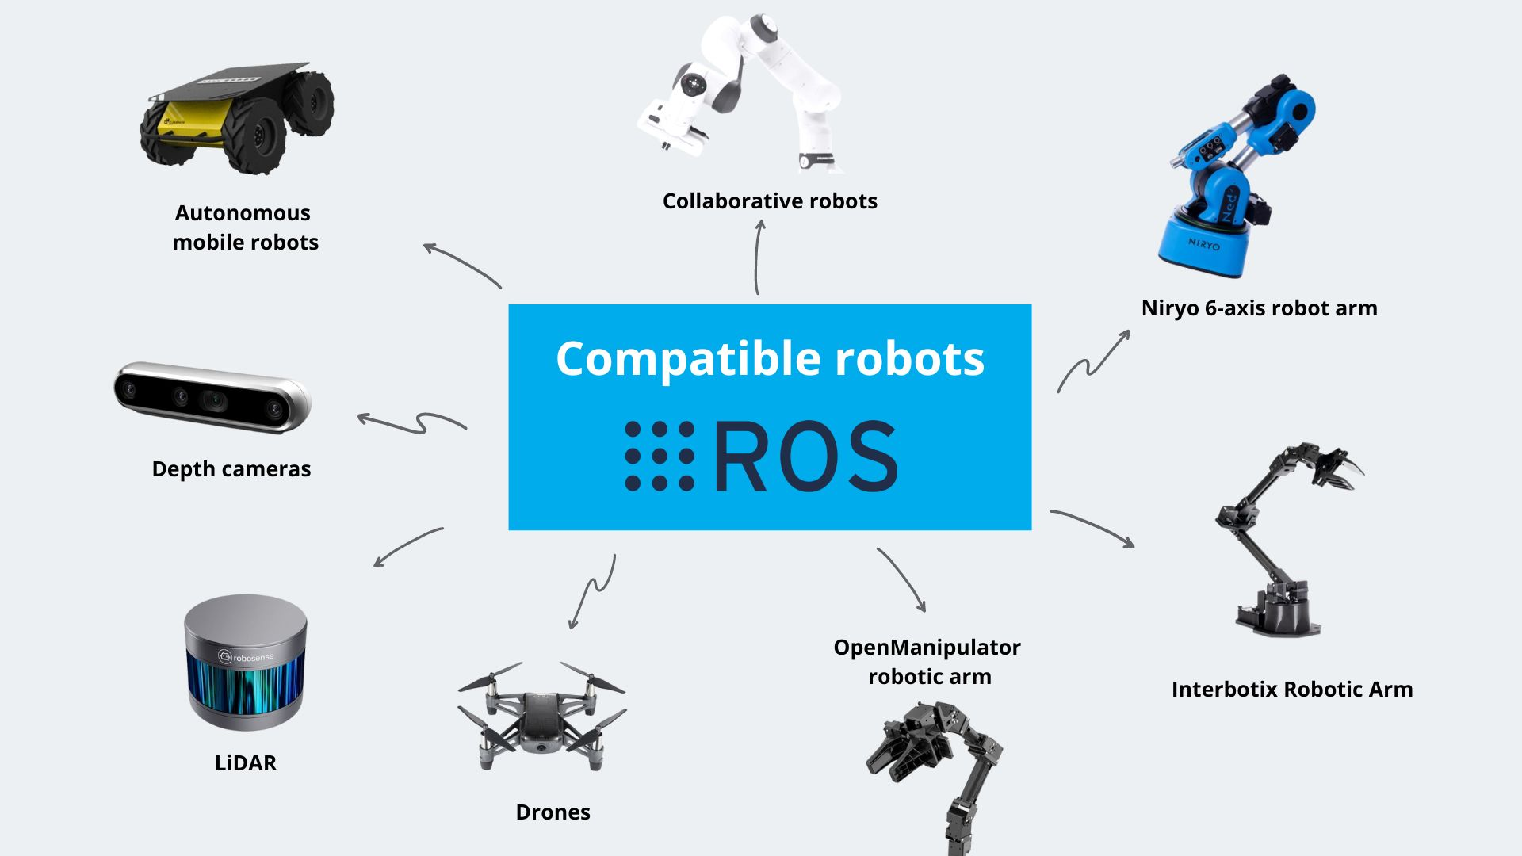
Robotics using ROS

Slide 6
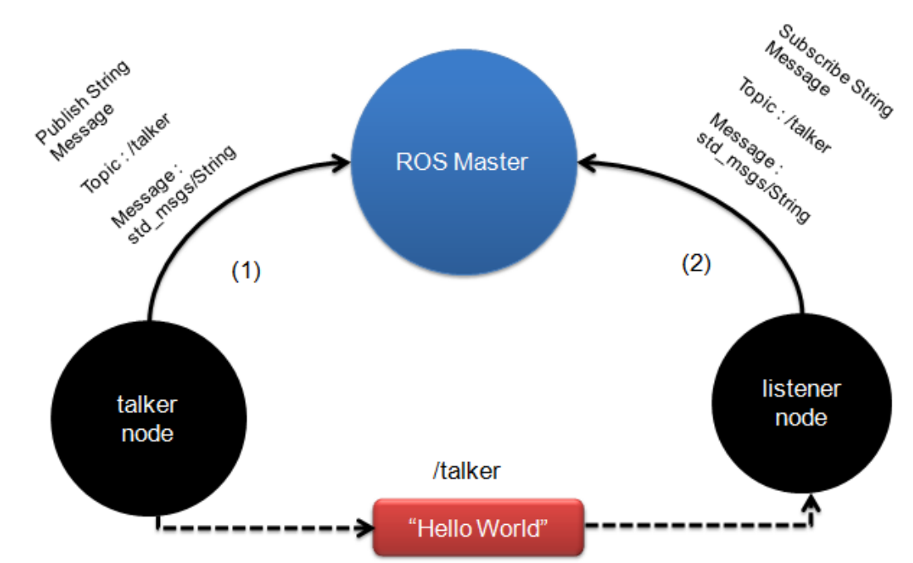
ROS Core Concepts
Nodes
Topics
Messages
Services

Slide 7
ROS Nodes
Single-purposed executable programs
e.g. sensor driver(s), actuator driver(s), mapper, planner, UI, etc.
Individually compiled, executed, and managed
Nodes are written using a ROS client library
roscpp: C++ client library
rospy: python client library
Nodes can publish or subscribe to a Topic
Nodes can also provide or use a Service

Slide 8
ROS Topics
A topic is a name for a stream of messages with a defined type
e.g., data from a laser range-finder might be sent on a topic called scan, with a message type of LaserScan
Nodes communicate with each other by publishing messages to topics
Publish/Subscribe model: 1-to-N broadcasting

Slide 9
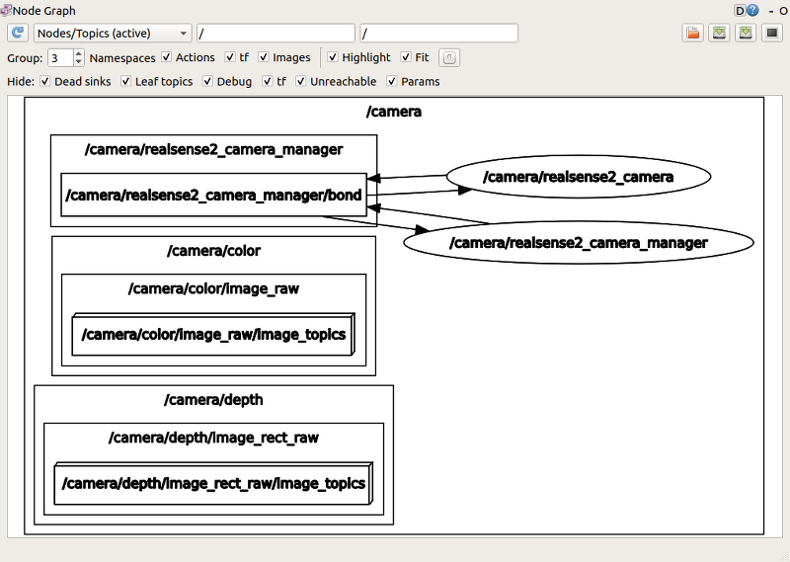
ROS Topics

Slide 10
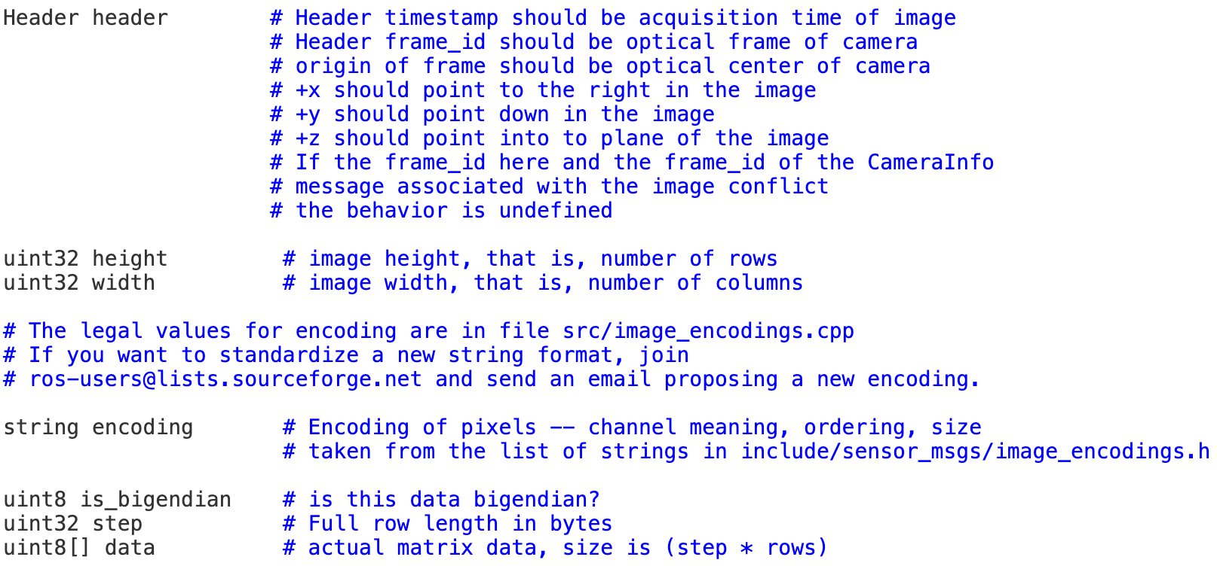
ROS Messages
Data sent between nodes.
Strictly-typed data structures for inter-node communication.
Example:
sensor_msgs/Image

Slide 11
ROS Services
Request/reply communication between nodes.
Synchronous inter-node transactions
Service/Client model: 1-to-1 request-response
Service roles:
carry out remote computation
trigger functionality / behavior
Example:
map_server/static_map: retrieves the current grid map used by the robot for navigation

Slide 13
ROS Basic Commands
roscore
roscore is the first thing you should run when using ROS
roscore will start up:
a ROS Master
a ROS Parameter Server
a rosout logging node
rosnode
Displays debugging information about ROS nodes
rostopic
Gives information about a topic and allows to publish messages on a topic
rosmsg
Displaying information about ROS Message types

Slide 14
ROS Basic Commands
roslaunch
a tool for easily launching multiple ROS nodes as well as setting parameters on the Parameter Server
rosbag
for recording from and playing back to ROS topics
rviz
rviz is a ROS 3D visualization tool that lets you see the world from a robot's perspective

Slide 15
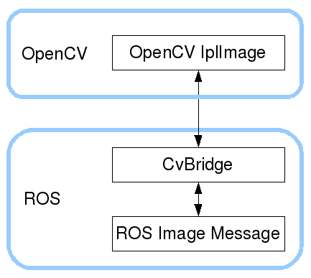
ROS and OpenCV
ROS passes images in its own sensor_msgs/Image message
cv_bridge is a ROS package that provides functions to convert between ROS sensor_msgs/Image messages and the objects used by OpenCV

Slide 16
Synchronize Messages across all Cameras
message_filters.ApproximateTimeSynchronizer()
Algorithms: https://wiki.ros.org/message_filters/ApproximateTime
Example: https://gist.github.com/zxf8665905/2d09d25da823b0f7390cab83c64d631a

Slide 17
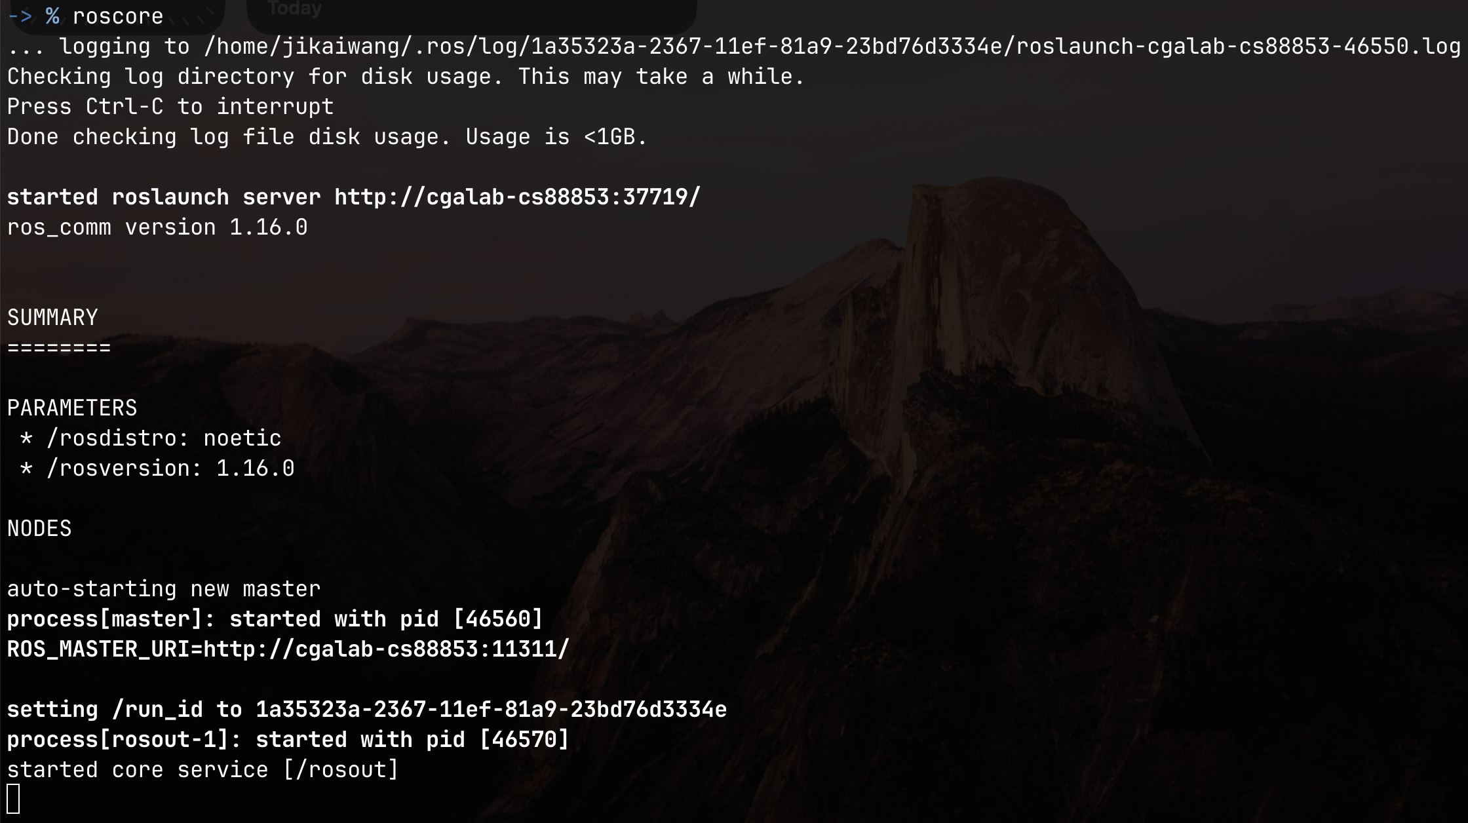
Record Rosbag from Multiple Cameras
Run roscore to start the Master Node

Slide 18
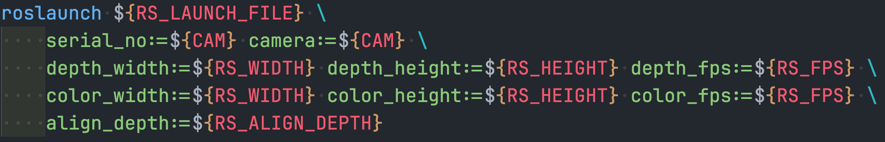
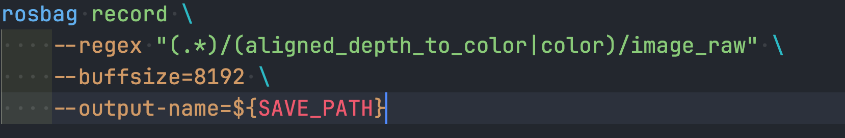
Record Rosbag from Multiple Cameras
Run roslaunch to start the Camera Nodes
Run rosbag to start the Camera Nodes

Slide 19
Reference
ROS commands
rosnode: https://wiki.ros.org/rosnode?distro=noetic
rostopic: https://wiki.ros.org/rostopic
rosbag: https://wiki.ros.org/rosbag?distro=noetic
roslaunch: https://wiki.ros.org/roslaunch?distro=noetic
cv_bridge: https://wiki.ros.org/cv_bridge
Example to use ApproximateTimeSynchronizer for message synchronization
https://gist.github.com/zxf8665905/2d09d25da823b0f7390cab83c64d631a

Slide 20
Thank You

