Slide 1
The ‘Un’free Electron Limit in Metals
T V Ramakrishnan
Indian Institute of Science, Bengaluru
JNCASR, Jakkur, Bengaluru

Slide 2
Very thankful for an opportunity to offer this at a meeting to remember
Professor Mitra.
Professor Mitra was an inspirational figure for people of my generation
His personal example as a physicist, his values in physics and in life were ideals
Two reminiscences
I would like to share recent preliminary work on a possibly paradigmatic limit describing some generic aspects of the behaviour of electrons in metals. In this limit, electrons are mobile, but have infinitely strong local repulsion. To put it in perspective, we start with the opposite, familiar, ‘free’ electron limit for metals.

Slide 3
What is the ‘free' electron model of metals?
Drude proposed in 1900 ( completely unreasonably) that
metals should be thought of as consisting of a free classical gas of electrons
(three years after J J Thomson established the electron as a
common ingredient of matter, in 1897)
Drude was able to successfully explain many electrical and optical
properties of metals using this picture (and the kinetic theory of gases).
e.g. Ohm’s law, with j = σ E and conductivity σ = (ne²𝜏/m)
Skin effect
Wiedemann Franz law ; (𝜅/σT) is a universal constant { quantum
mechanically (π²/3)(k_{B}² /e²), but he got (3/2) )(k_{B}² /e²) through a
fortuitous cancellation of two factors ~100, and through a factor of
two mistake; nearly the empirically observed value. }

Slide 4
Some major problems :
Not knowing which electrons are these (he assumed valence electrons(?); now we know that these are electrons in unfilled shells and are indeed valence electrons!….. )
2. Assuming that the electrons form a classical gas ( they form a degenerate quantum gas of fermions.
e.g. C_{v} ⍺ k_{B} (classical); C_{v} ⍺ k_{B} (T/T_{F}) quantum, and observed).
3. Pretending that they do not interact, and form an ideal gas
(they interact with the lattice ions and with each other).
There are very sophisticated , adiabatically connected
very successful theories of interacting electrons with
interaction effects describable by a few parameters ; Fermi liquid).

Slide 5
These problems have been faced successfully.
Electrons in metal form an interacting Fermi liquid ( coherent for T<<T_{F} ~ 10⁴K for most metals); well defined quasiparticles, well recognized collective effects, superconductive instability for effective attraction……
There is a large class of systems and phenomena in metals where the interaction between electrons dominates.
(repulsive) potential energy of interaction>> the kinetic energy of motion
but the thing is a metal with mobile, kinetic electrons.
Electrons move, while strongly avoiding each other.
‘Strongly correlated’ electron systems.
Is there an opposite paradigmatic limit which is natural for such a situation, one in which electrons are locally ‘un’free but globally free?
I will describe a tentative attempt to understand and describe this limit, in a simple lattice model for electrons ( work done with SR Hassan (Institute of Mathematical Sciences, Chennai) and N S Vidhyadhiraja (JNCASR, Jakkur, Bengaluru and published last year).

Slide 6
Consider a model for electrons at sites on a lattice:
H = 𝛴 { (ε_{i} – μ)n_{iσ} + Un_{iσ}n_{i-σ}} + 𝛴 t_{ij} a_{iσ}⁺ a_{jσ}
At site i, energy of an electron is ε_{i ;} the chemical potential is μ
(determines electron density or filling).
If two electrons ( have to be of opposite spin because of Pauli exclusion principle) are on the same site, there is repulsion U.
(U is an oversimplified representation of the qualitative fact that the effective repulsion is short ranged because of screening).
Electrons ‘hop’ from site i to site j with amplitude t_{ij .}
(Due to overlap of quantum wavefunctions; tight binding model)

Slide 7
This is the very well known Hubbard model. Exactly soluble in d=1 and for all d if U=0.
U =0; independent electrons ( tight binding version of free electron gas).
Nonzero U. Metal for all filling. But this cannot always be right. For example, half filling and large U
Ground state is an insulator (Mott insulator)
(Qualitatively different many body wave function).
But what if filling is not half, and U is large. Has to be a metal. What kind of metal?
Seems to be a rather strange metal.
1. Has characteristic (coherent) Fermi liquid behaviour, but only at very low temperatures
2. Incoherent Fermi liquid over a very wide range of temperatures, manifested in
lack of quasiparticle peak; broad single particle spectral density (not a delta function)
linear in T resistivity for clean metals
( properties most extensively studied in cuprates ; effective large U Hubbard system [(U/t)>10] )
We have explored, in a somewhat naieve way, the U=∞ limit.
Is this a paradigmatic
‘un’ free electron limit relevant to the large family of strange metals?
Can one start from here and do a (1/U) perturbation theory to access large but finite U ?.

Slide 8
Use the Hubbard X operator representation:
X_{i}^{ab} = |ia><ib|. The complete set of states at site i is |i0>,|i↑>,Ii↓> for U=∞
The Hamiltonian H = Σ_{i,σ} (-μ X_{i} ^{σσ}) + Σ_{ij,σ} t_{ij} X_{i} ^{σ0} X_{j} ^{0σ}
(would have been exactly soluble if X_{i} ^{σ0} were a canonical fermion creation operator a⁺_{iσ} )
Assume t_{ij} = t (real, positive) for i, j nearest neighbour.
= 0 otherwise ( hopping only to nearest neighbour)
( basically one number; namely electron density or filling , e.g. average number of electrons per site ; all energy is in units of t).
There is no small parameter.
The model has been studied extensively in pioneering work by B S Shastry for more than a decade since 2010, using the Schwinger source method.
B. S. Shastry, Extremely correlated quantum liquids, Phys. Rev.B 81, 045121 (2010)
S. Shears, E. Perepelitsky, M. Arciniaga, and B. S. Shastry, Extremely correlated Fermi liquid theory for the u=∞, d =∞, Hubbard model to o(λ3 ), Phys. Rev. B 106, 035108(2022) ( a relatively recent paper).
We use an equation of motion method. Find the equation of motion of correlation functions (XX correlation functions) . Use the d=∞ approximation to decouple them. Solve them self consistently.

Slide 9
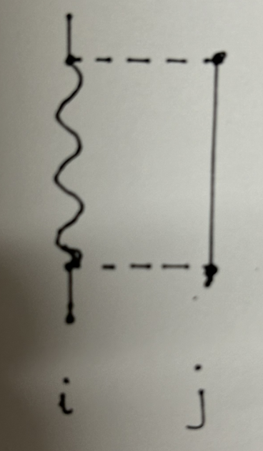
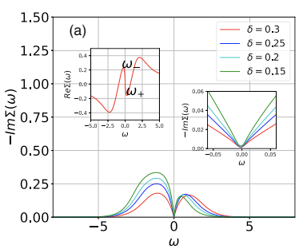
Electron moving necessarily gives rise to
local bosonic fluctuations, namely local charge or
spin changes.
The (diffusive) propagation of bosonic fluctuations
depends on electrons. Self consistency crucial.
-ImΣ(⍵) ~ ⍵² for a coherent Fermi liquid .
It is a coherent Fermi liquid at very low temperatures.
(This can also be shown analytically, formally, from symmetry properties of the spectral f unction).

Slide 10
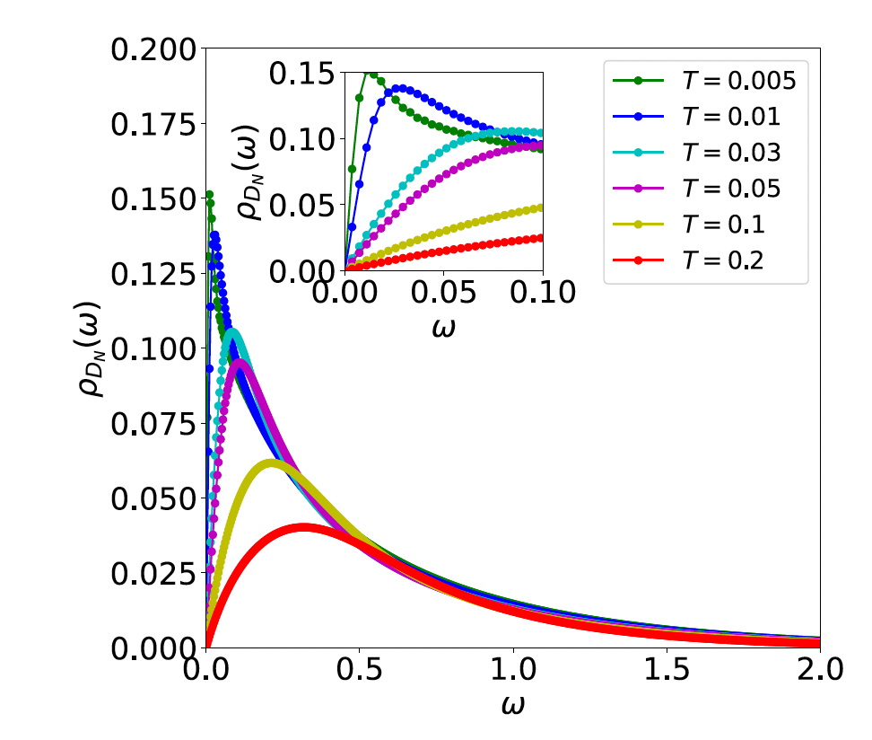
Spectrum of local bosonic fluctuations
(both charge and spin, but finally number or charge)
Diffusive; local quantum noise?

Slide 11
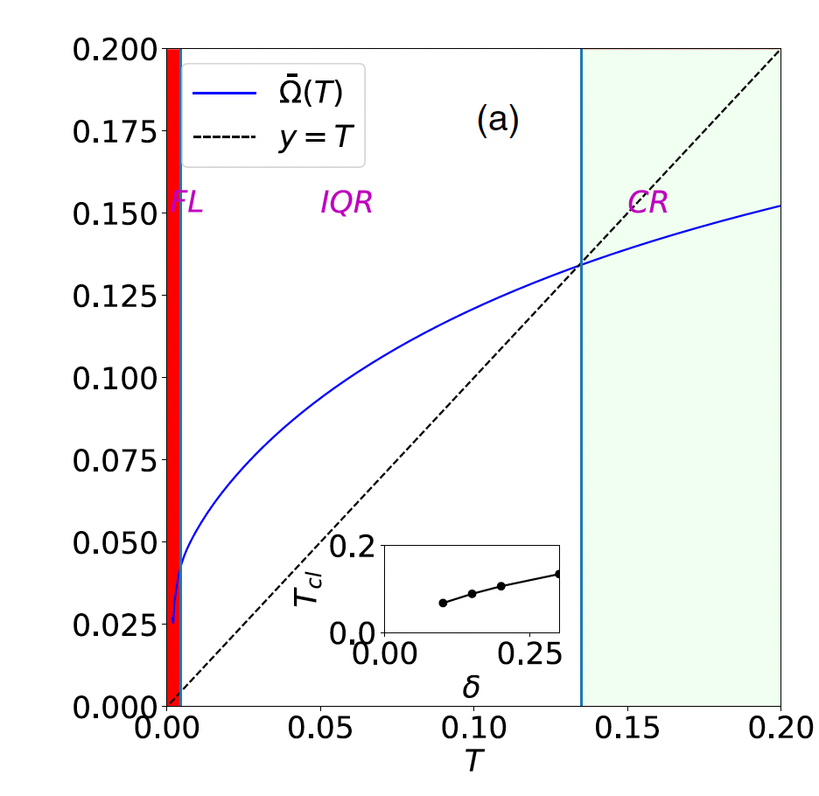
If we use one number to characterize the noise spectrum, it is perhaps the mean Ω(T). We show this as a function of T.
Quantum: Ω(T) >T.
This seems to have two subregimes
Coherent Quantum or
Fermi Liquid(FL)
( We can show its existence from exact properties of spectral functions for low ω)
e.g. Im Σ(ω) ~ ω²
Incoherent Quantum Regime (IQR)
Why is the FL-IQR crossover at such low T? Why is the IQR regime so large? (do not know)
There is evidence for relatively low crossover T above which one can think of electrons as sitting on lattice sites, not hopping (classical regime) from data on thermopower of strongly correlated systems
Classical : Ω(T) < T

Slide 12
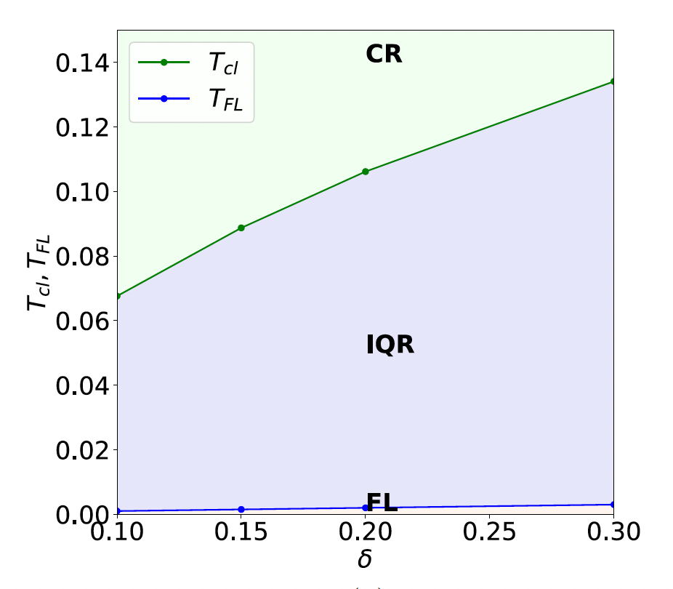
Crossover temperatures as a function
of hole density per site δ

Slide 13
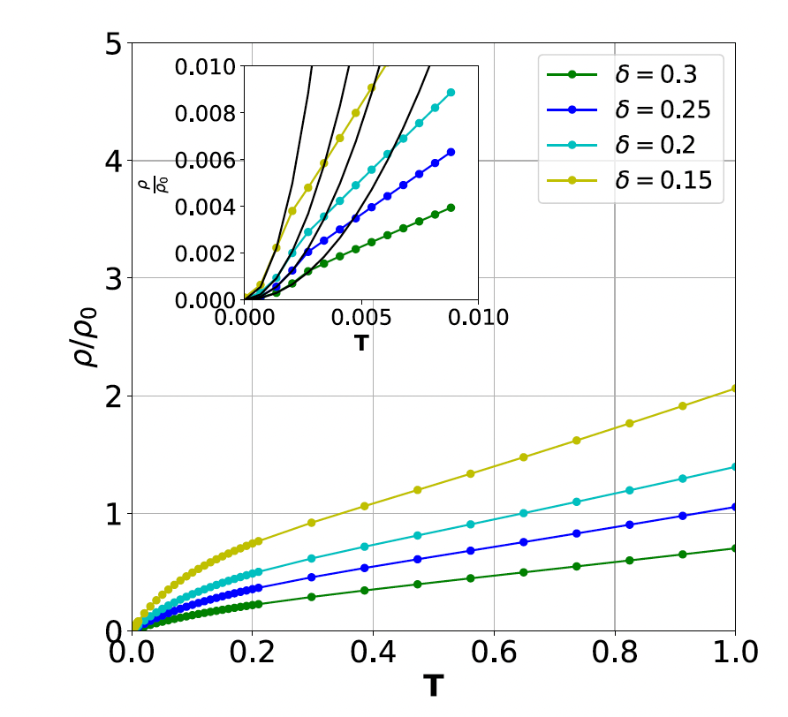
(Intrinsic) DC resistivity as a function
of temperature for different values of
doping
1. T² dependence at very low temperatures
(FL)
2. Linear in T ; two slopes (ICR and Classical?)
Linear resistivity is a strong correlation feature.
Does it persist for large but finite U ?
(Need a perturbation theory in (t/U)< 0.1 for
Cuprates. Working on this.
J ~ (t²/U). T-J model with U=∞
A new low energy scale J(Intrinsic)

Slide 14
We believe that we have unearthed two crucial features of ECFL:
Strong, local, diffusive, self generated, bosonic fluctuations coupled to electrons
Large incoherent quantum regime
Nothing really new. Coupled electron boson models for strongly interacting systems have been around for long. The difficulty has been in taking proper account of local constraints, since the same degrees of freedom are bosonic and fermionic!
The theory is still too opaque and complicated. Need simpler, clearer versions.
Nature of low FL-IQR scale not clear. Two slopes for linear resistivity(?)
Universal incoherent quantum electrical noise at each site. Planckian…. ?
In real systems, there is d-wave superconductivity, and they have unusual features .
So, cannot and do not compare results of the U= ∞ theory with real systems yet. (Maybe with a theory upto O(1/U), one can confront experiments).

Slide 15
Starting to develop a (1/U) perturbation theory. (with Apoorv Srivastav, MSc student, presently JNCASR)
There is a (1/U) expansion (Schrieffer-Wolff like; one develops an effective low energy theory by eliminating the high energy ( two particles at a site) states (higher in energy by ~U). Such a theory has been around for long, in the form of the t-J model. ( e.g. AH Macdonald, SM Girvin, D.Yoshioka Phys.Rev.B37,9753(1988)).
** Find the effects of the (1/U) or J term in perturbation theory with the U=∞ Hamiltonian as H_{o}
( One route: use the J term as an intersite pair attraction term, do Hubbard Stratonovich transformation to describe the system in terms of coupled X and ѱ(pair) fields. For example, can have a microscopically determined G-L like Hamiltonian , functional of ψ for strong coupling on integrating out the effect of X fields and evaluating them in U=∞).
Describes intersite Cooper pairs, and with t’ term, strong coupling d wave superconductivity
(e.g. phenomenological GL like theory of Banerjee, TVR, Dasgupta. (~2011) )
Thank you

