Slide 1
Capstone Project Daily Energy Utilization Prediction
Asoke Rathnayake

Slide 2
Introduction
ABC Company [pvt.] ltd is a retail supermarket chain.
They are spending huge portion on operational cost for power and energy
They have provided a 1 year data set of daily energy usage.
They are expecting a model to build to forecast their daily energy usage.
This presentation describe how we implementing ML model for daily energy prediction.
Solution can be integrated with their energy monitoring solution and offers Realtime energy prediction.

Slide 3
How the solution built
Identify the data set and what represent
Identify the validity of the data set
Clean or cleanse the data set
Identify the field / columns data distribution
Identify the core relation of the fields with Daily energy usage
Build the solution
Define the function to evaluate different models
Check and select the most suitable model
Save, test and publish the model as API

Slide 4
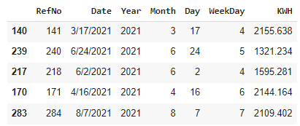
Dataset for Analytics
Field of the data set, definitions and sample data are explained in the below table.
As this data set extracted from energy management solution, there wasn’t any outliers or null values.
Field Name | Description | Sample
RefNo | Record number of the data set | 1
Date | Date | 10/28/2020
Year | Year 2020 - 2021 | 2020
Month | Month 1 to 12 | 10
Day | Day of the month 1 t o31 | 28
WeekDay | day of the week 1 to 7 | 4
KWH | Kilo watt hours / number of units consumed in the relevant day- Unit of measure is Kwh | 1140.169

Slide 5
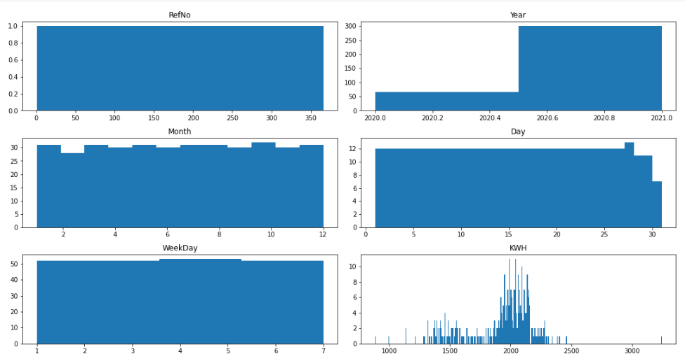
Exploratory Data Analysis
Distribution of each data field / column illustrated below

Slide 6
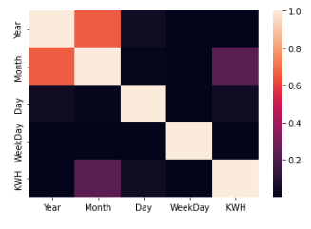
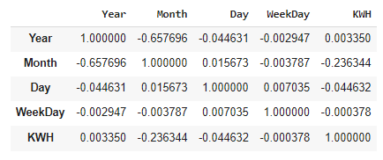
Exploratory Data Analysis
Core relation of the fields

Slide 7
Feature Engineering
Date field related to Year, Month and Date . So Date field had been dropped
Dropping unwanted columns would help to build a better ML model
If the data set is having categorical variable, it would be recommended to convert that to numerical values
Ie: WeedDay – Sun. Mon , Tue…. Would be better to convert to 1,2,3 so on.
However, this data set already having WeekDay and it was already consisting with numerical values. 1,2,… 7

Slide 8

Model Evaluation
Create a function for model evaluations
Added those evaluation result and select the best model
Liner Regression MSE, RMSE and R2 result
Noe : Due to some errors I couldn’t evaluate modes from the function which built for model evaluation.
So assuming the best model is Liner Regression which I tested without the function.

