Slide 1



How to become a master
Andrei Solntsev

Slide 2
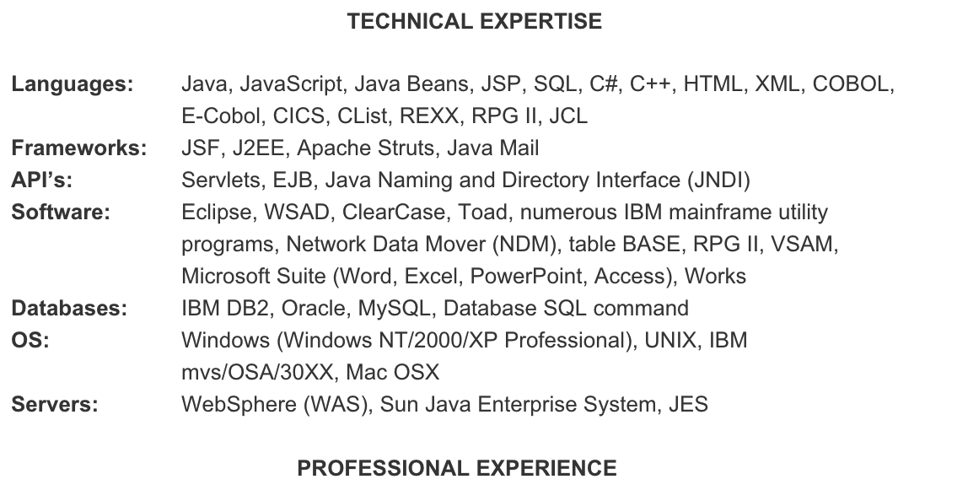
Typical CV

Slide 3
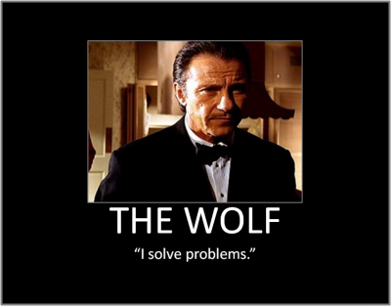
The right CV

Slide 4


Use simple tools
Rifle is
weapon of beginner
Choice of master is
knife!

Slide 5
What differs master

Slide 6
Master is not
the one who can write lot of code
Master is
who can write as few as possible

Slide 7
Achieving simplicity
Achieving simplicity
is
not simple

Slide 8

Good luck!
selenide.org
andrei.solntsev@gmail.com
twitter.com/asolntsev

