Slide 1



Real life unit tests
Mocking databases, web services etc.
Andrei Solntsev

Slide 2

How unit-tests are taught
Bowling score
Triangle
assertEquals(5,
Triangle.hypotenuse(3, 4));

Slide 3

Real-life project
I don’t write bowling!
My software is different
Unit-tests don’t suite for my projects

Slide 4
What’s the problem?
Databases
Web services
Bad architecture
External
dependencies

Slide 5
What’s the solution?
int: 3, 4
jdbc
db
int: 5
code
client

Slide 6
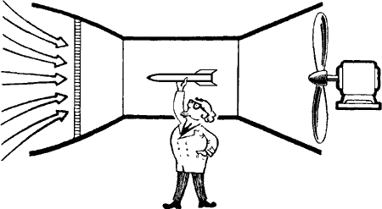
What is mock?
When wind speed is 100 km/h
Lift of wing should be 150 kN
How would you test it?
Tested object
Mocked wind

Slide 7
What is mock?
Live code:
WindService wind = new WindServiceImpl();
public void run() {
wind.blow();
…
}
Unit-test:
WindService wind = mock(WindService.class);
when(wind.getSpeed()).thenReturn(100);
wing.run();
assertThat(wing.getLift(), equalTo(150));

Slide 8


