Slide 1


Test Driven Development
Andrei Solntsev

Slide 2

It's not about tests
It's about development

Slide 3


Slide 4
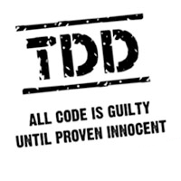

Slide 5
TDD pros
1. Better code design!
- You are forced to think
before coding

Slide 6
TDD pros
2. Test coverage
- All logic is tested
- Executable documentation
- No fear of change!

Slide 7
TDD pros
3. Predictable process
- No bugs explosion
- No “99% ready” problem

Slide 8
Without unit-tests
With unit-tests

Slide 9
Without unit-tests
Development
test
bugfix
test
With unit-tests
Development
test
bugfix
live

Slide 10

We don't have time for unit-tests,
we are late with tasks.
You are late with tasks,
because you don't have tests!

Slide 11

Let's do practice!

Slide 12
Ping-pong programming
- A writes test
- B satisfies test
- B writes test2
- A satisfies test2

Slide 13
TDD in JavaScript
describe("Cart", function() {
var cart;
beforeEach(function() {
cart = new Cart();
});
describe("total amount", function() {
it("is zero for empty cart", function() {
expect(cart.getTotalAmount()).toEqual(0.0);
});
});
});

Slide 14
The store
1. I want to add products to cart and get the total amount to be paid.
2. I want to specify the quantity of product that is added to the cart.
3. I want to get a receipt: “product name \t quantity x price = total price”

Slide 15
The store
4. I want to specify the quantity in kilograms for some items. I want to see the unit on the receipt after the quantity if applicable. The quantity should have 3 decimal places if unit exists, no decimal places otherwise.
5. I want to see each product only once on the receipt even if i have added it multiple times. The quantitites must be added together.
6. I want to see another item added automatically when I add specific items (e.g. bottle with drinks).

Slide 16

Write unit-tests!

Slide 17
You code it
-
You test it!

Slide 18


Andrei Solntsev
selenide.org
andrei.solntsev@gmail.com
twitter.com/asolntsev

Slide 19




Exponent grow!

Slide 20
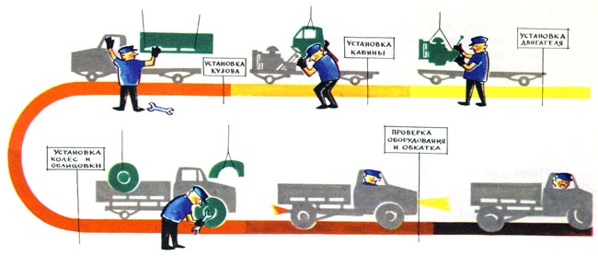
Analytics –> developer -> QA

