Slide 1


You code it – you test it!
Andrei Solntsev

Slide 2

It's not about tests
It's about development

Slide 3


Slide 4
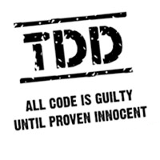

Slide 5
TDD pros
1. Better code design!
- You are forced to think
before coding

Slide 6
TDD pros
2. Test coverage
- All logic is tested
- Executable documentation
- No fear of change!

Slide 7
TDD pros
3. Predictable process
- No bugs explosion
- No “99% ready” problem

Slide 8
Without unit-tests
With unit-tests

Slide 9
Without unit-tests
Development
test
bugfix
test
With unit-tests
Development
test
bugfix
live

Slide 10

We don't have time for unit-tests,
we are late with tasks.
You are late with tasks,
because you don't have tests!

Slide 11

Let's do practice!

Slide 12
Ping-pong programming
- A writes test
- B satisfies test
- B writes test2
- A satisfies test2

Slide 13
TDD in JavaScript
describe("Cart", function() {
var cart;
beforeEach(function() {
cart = new Cart();
});
describe("total amount", function() {
it("is zero for empty cart", function() {
expect(cart.getTotalAmount()).toEqual(0.0);
});
});
});

Slide 14

Write unit-tests!

Slide 15
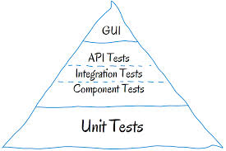
Testing pyramid

Slide 16
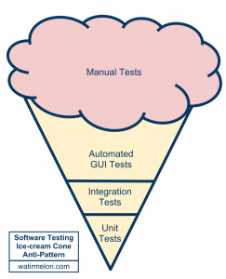
Testing pyramid

Slide 17
You code it
-
You test it!

Slide 18


Andrei Solntsev
selenide.org
andrei.solntsev@gmail.com
twitter.com/asolntsev

