Slide 1

LiquiBase vs Flyway
12.05.2015
Tallinn
Baltic DevOps
Andrei Solntsev

Slide 2
Agile
Change -
it
should be
easy

Slide 3

Database
Change is complex
Tables
Live data!

Slide 4
Database
Change is complex
Tables
Live data!
Stored procedures
Pl/Sql packages
Materialized views
Triggers
DB Links

Slide 5
Life BEFORE liquibase
CREATE TABLE PERSON (
first_name VARCHAR2(16),
last_name VARCHAR2(16)
);

Slide 6

Life BEFORE liquibase
CREATE TABLE PERSON (
first_name VARCHAR2(16),
middle_name VARCHAR2(2),
last_name VARCHAR2(16)
);

Slide 7
Life BEFORE liquibase
CREATE TABLE PERSON (
first_name VARCHAR2(32),
middle_name VARCHAR2(32),
last_name VARCHAR2(32)
);

Slide 8
Solution: small steps
1.sql CREATE TABLE PERSON
(first_name, last_name)
2.sql ALTER TABLE PERSON
ADD COLUMN middle_name
3.sql ALTER TABLE PERSON
DROP COLUMN middle_name
That's evolution!

Slide 9




Tools
Flyway DB - simple
- powerful
DBDeploy

Slide 10
Flyway: just files
V1__blah.sql
V2_blah.sql
V3_blah.sql

Slide 11
LiquiBase: XML
<sqlFile path="1.sql"/>
<sqlFile path="2.sql"/>
<sqlFile path="3.sql"/>
changelog.xml

Slide 12

LiquiBase: XML
<changeSet id="1">
<sqlFile path="1.sql"/>
</changeSet>
<changeSet id="2">
<sqlFile path="2.sql"/>
</changeSet>
<changeSet id="3">
<sqlFile path="3.sql"/>
</changeSet>

Slide 13
LiquiBase: XML
<changeSet id="1">
<sqlFile path="1.sql"/>
</changeSet>
<changeSet id="2" runAlways="true">
<sqlFile path="2.sql"/>
</changeSet>
<changeSet id="3">
<sqlFile path="3.sql"/>
</changeSet>

Slide 14
LiquiBase: XML
<changeSet id="1">
<sqlFile path="1.sql"/>
</changeSet>
<changeSet id="2" runAlways="true">
<sqlFile path="2.sql"/>
</changeSet>
<changeSet id="3" runOnChange="true">
<sqlFile path="3.sql"/>
</changeSet>

Slide 15
LiquiBase: XML
<changeSet id="4" dbms="oracle">
<sqlFile path="5.sql"/>
</changeSet>
<changeSet id="5" context="test">
<sqlFile path="5.sql"/>
</changeSet>
<changeSet id="6" failOnError="false">
<sqlFile path="6.sql"/>
</changeSet>

Slide 16
LiquiBase DSL
<changeSet id="1" author="andrei">
<createTable tableName="person">
<column name="id" type="int" autoIncrement="true"/>
<column name="firstname" type="varchar(50)"/>
<column name="lastname" type="varchar(50)"/>
</createTable>
</changeSet>

Slide 17
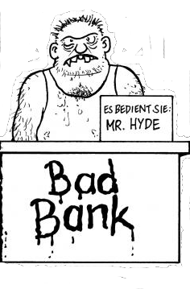
DEMO
https://github.com/asolntsev/liquibase-ee

Slide 18
LiquiBase DSL
<changeSet id="1" author="andrei">
<createTable tableName="person">
<column name="id" type="int" autoIncrement="true"/>
<column name="firstname" type="varchar(50)"/>
<column name="lastname" type="varchar(50)"/>
</createTable>
</changeSet>
Supports all Dbs
IDE autocompletion
Rollback out-of-the-box
Built-in refactorings

Slide 19

LiquiBase refactorings
<changeSet>
<renameColumn
tableName="order_comment"
oldColumnName="author_id"
newColumnName="employee_id"
/>
</changeSet>

Slide 20
LiquiBase refactorings
<modifyDataType
tableName="customer"
columnName="middle_name"
newDataType="VARCHAR2(100)"
/>

Slide 21
Data loading
<changeSet runOnChange="true">
<loadData tableName="CLIENT" file="clt.csv">
<column header="id"
name="ENTITYID"/>
<column header="DESCRIPTION"
name="DESCRIPTION"/>
</loadData>
</changeSet>

Slide 22
Why it's needed?

Slide 23
Oppa Agile style
Local development
  Oracle XE (dev servers must die!)
Easy run
  ant start
In-memory DB for tests/demo
  ant test

Slide 24
3 DBs
Oracle - in production
Oracle XE - in development
H2 in-memory
- for demo
- for tests
- for designer

Slide 25
DB configuration in GIT
conf/
dev.properties
db.url=jdbc:oracle:thin:@server1:1521:devdb
local.properties
db.url=jdbc:oracle:thin:@127.0.0.1:1521:xe
inmemory.properties
db.url=jdbc:h2:out/liquibase-ee

Slide 26
Run
ant
ant -Denv=dev
ant -Denv=live
ant start - runs demo

Slide 27


Opposition
SQL men: it works only for Java
CVS men: we already have scripts
Admins: we wanna see SQL!

Slide 28
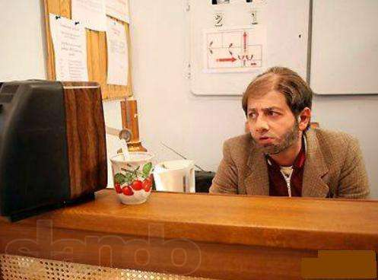
SQL preview
ant show-sql
LiquiBase
generates,
but
does not run SQL
Admins are satisfied

Slide 29
Procedures
<changeSet runOnChange="true" dbms="oracle">
<sqlFile
path="procedures/log_message.sql"
splitStatements="false"/>
<rollback>
DROP procedure log_message
</rollback>
</changeSet>

Slide 30
Simple DB refactorings
My favorite - having
“CREATE OR REPLACE”:
Procedures
Functions
Pl/Sql
VIEWs
Triggers
<changeSet runOnChange="true">
<sqlFile path="another.sql"/>
</changeSet>

Slide 31
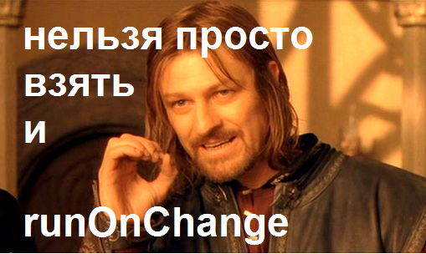
Nontrivial refactorings
Those without
CREATE OR REPLACE

Slide 32
Materialized view
<changeSet id="002">
<sql>
CREATE MATERIALIZED VIEW currency_mv ...
</sql>
</changeSet>

Slide 33
Materialized view
<changeSet id="001" failOnError="false">
<sql>
DROP MATERIALIZED VIEW currency_mv;
</sql>
</changeSet>
<changeSet id="002">
<sql>
CREATE MATERIALIZED VIEW currency_mv ...
</sql>
</changeSet>

Slide 34
We are happy
It's easy to develop DB

Slide 35

We are happy
It's easy to develop DB
Jenkins tests DB scripts

Slide 36

We are happy
It's easy to develop DB
Jenkins tests DB scripts
Designer edits HTML

Slide 37
We are happy
It's easy to develop DB
Jenkins tests DB scripts
Designer edits HTML
Admin sleeps at night

Slide 38

We are happy
It's easy to develop DB
Jenkins tests DB scripts
Designer edits HTML
Admin sleeps at night
UI-tests run on localhost

Slide 39
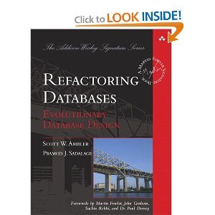
To read

Slide 40


commit & push
@asolntsev
Andrei Solntsev
andrei.solntsev@gmail.com

Slide 41
Behind the scenes

Slide 42
changelog.xml releases
<databaseChangeLog>
<include file="changelog_001.xml"/>
<include file="changelog_002.xml"/>
<include file="changelog_003.xml"/>
</databaseChangeLog>

Slide 43
Raw SQL
<changeSet id="201308181029">
<sql>
CREATE TABLE payment (
id NUMBER NOT NULL,
description VARCHAR2(100 CHAR),
url VARCHAR2(500 CHAR),
upd_dttm TIMESTAMP)
</sql>
<rollback>
DROP TABLE payment
</rollback>
</changeSet>

Slide 44
Constraints
<changeSet>
<addColumn tableName="payment">
<column name="customer_id" type="NUMBER"/>
</addColumn>
<addForeignKeyConstraint
baseTableName="payment"
baseColumnNames="customer_id"
constraintName="payment_customer_fk"
referencedTableName="customer"
referencedColumnNames="id"/>
</changeSet>

Slide 45
Some DB-specific
(e.g. Oracle)
<changeSet dbms="oracle">
<createSequence
sequenceName="order_file_id_seq"/>
</changeSet>

Slide 46
Materialized view
<changeSet dbms="oracle">
<sql>
CREATE MATERIALIZED VIEW currency_mv
REFRESH COMPLETE
as select * from (select * from
currency_xa_pos2@${db.dblink.core})
</sql>
<rollback>
DROP MATERIALIZED VIEW currency_mv;
</rollback>
</changeSet>

Slide 47
Refresh Mat View
<changeSet dbms="oracle">
<sqlFile path="mviews/refresh_mv.sql"/>
<rollback><sql>
BEGIN
dbms_refresh.destroy('CUR_GRP');
END;
</sql></rollback>
</changeSet>

Slide 48
Refresh Mat View
<changeSet dbms="oracle">
<sqlFile path="mviews/refresh_mv.sql"/>
<rollback><sql>
BEGIN
dbms_refresh.destroy('CUR_GRP');
END;
</sql></rollback>
</changeSet>

Slide 49
LiquiNinja
How to re-run changesets:
<changeSet id="115">
<sql>
update databasechangelog
set filename = 'db/static_data_001.xml',
md5sum = null
where id = '201309261214'
</sql>
</changeSet>

Slide 50
commit & push
@asolntsev
Andrei Solntsev
andrei.solntsev@gmail.com

