Slide 1


The fast and the continuous
Andrei Solntsev

Slide 2

UI-tests
are
evil

Slide 3
5 things
that you are doing wrong
in
test automation

Slide 4

Oops #1
Dream of
parallelizing
tests?

Slide 5
Oops #1
And run tests in
ONLY
a few hours?

Slide 6
Oops #2
Love
PageObjects
and
Steps?

Slide 7
Oops #3
TestNG
is better than
JUnit?

Slide 8
Oops #4
“How to tell
webdriver
to ignore
invalid SSL certs?”

Slide 9
Oops #5
How to overcome
StaleElementException?

Slide 10
These questions
are
basically wrong

Slide 11
And that's why:

Slide 12
Integration tests are
SCAM!
J. B. Rainsberger

Slide 13
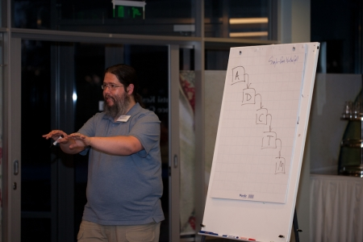
Integration tests are SCAM
J. B. Rainsberger
http://devconfu.eu/video/239

Slide 14
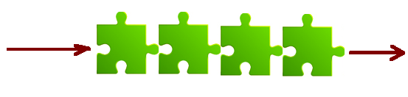
Integrations tests are SCAM

Slide 15

Integrations tests are SCAM

Slide 16
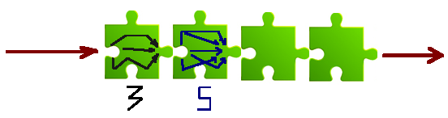
Integrations tests are SCAM

Slide 17
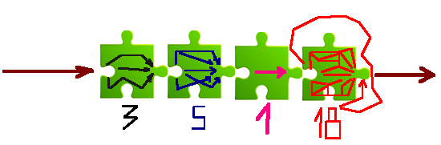
Integrations tests are SCAM

Slide 18

Integrations tests are SCAM
Exponential growth!

Slide 19
What is the cure?

Slide 20
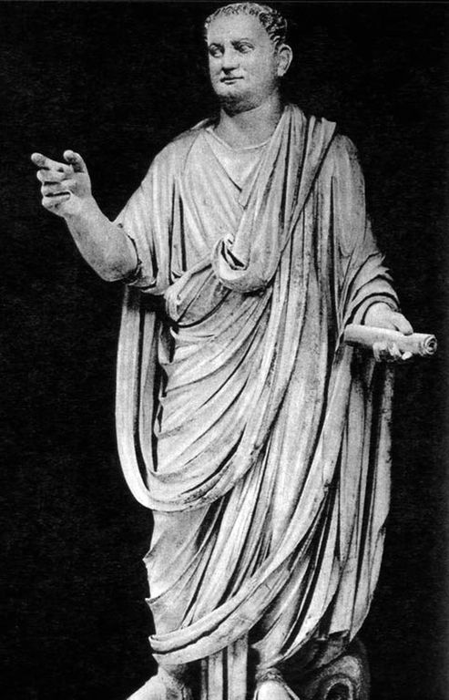
Divide
and
conquer test!

Slide 21
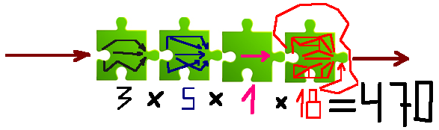
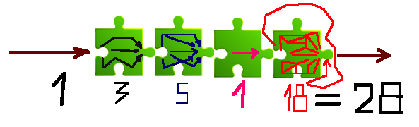
Divide and conquer
Linear growth!

Slide 22



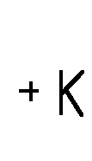
Divide and conquer
UI-tests are evil
If you have only UI-tests

Slide 23
Divide and conquer
This is general principle
Unit-tests
UI-tests

Slide 24
It's profitable
to write
unit-tests

Slide 25
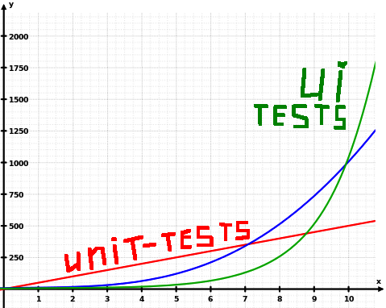
Unit-tests are profitable
For managers

Slide 26

Unit-tests are profitable
For developers

Slide 27

We have no time for unit-tests,
we are in a hurry.
You are in a hurry
because you don't have unit-tests!

Slide 28
Without unit-tests
With unit-tests

Slide 29
Without unit-tests
dev
test
bugfix
test
With unit-tests
dev
test
bugfix
live!

Slide 30
And what about UI-tests?
The same!

Slide 31
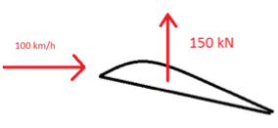
Rocket science
Requirements:
Wind speed 100 km/h
Lift wing should be 150 kN
How would you test that?

Slide 32
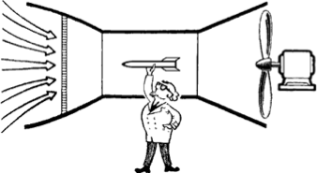
Rocket science
Run THE WHOLE plane
Test the wing SEPARATELY
Testable
Emulator

Slide 33

The problem of our generation
WebDriver allows
too easily
running
THE WHOLE
plane

Slide 34
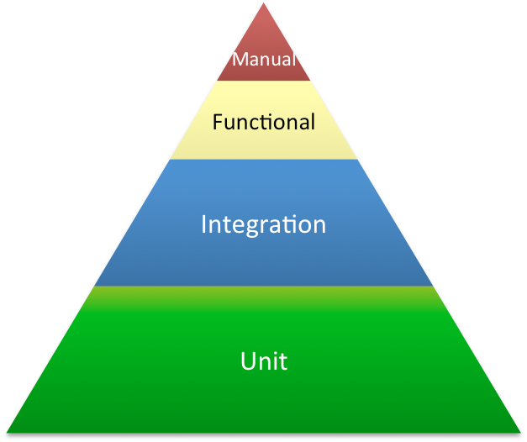
The testing pyramid
Новый
Отослан

Slide 35
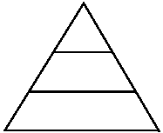
The testing matryoshka
Новый
Отослан

Slide 36
Split and conquer!
Логин
Заказы
Новый
Отослан
LoginTest
- 1
- 2
- 3

Slide 37
Split and conquer
Логин
Заказы
Новый
Отослан
NewOrderTest
- 1
- 2
/fastLogin?user=bob&url=/orders/new

Slide 38
Isn't it dangerous?
No!
Only in tests
Benefit over risk
/fastLogin?user=bob&url=/orders/new

Slide 39

Fast tests
DB
Services
WEB
Server

Slide 40

Fast tests
In-memory – H2, Sqlite
DB
Services
WEB
Emulators
Server
- Jetty
- Play!

Slide 41

Server
@BeforeClass
public static void startServer() {
Server server = new Server(8080);
WebAppContext shop =
new WebAppContext("webapp",
"/shop");
server.setHandlers(shop);
server.start();
}

Slide 42
Server has started!
Without installation
In few seconds
Directly from tests
@Test
public void loginTest() {
open(“http://localhost:8080/shop”);
}

Slide 43
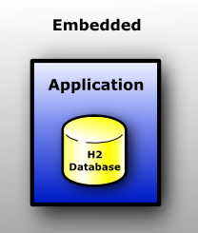

In-memory DB
db.url=jdbc:oracle:thin:@ip:1521:SID
db.driver=oracle.jdbc.OracleDriver
%test.db.url=jdbc:h2:mem:shop
%test.db.driver=org.h2.Driver
For DB structure:

Slide 44
5 things
that you are doing wrong
in test automation

Slide 45
Parallelize tests

Slide 46
We have 300 UI Tests that run for 4 minutes!
In-memory DB
Test data
Emulated services fastLogin
Run tests
ONLY in few hours

Slide 47
Video:
https://vimeo.com/73128965

Slide 48
An element should not be used in 50 tests!
PageObjects

Slide 49
Order of tests
Bad! - fastLogin
Parametrized tests
UI-tests – only 1-2 green path
Other 10010 combinations - unit-tests
TestNG vs JUnit

Slide 50

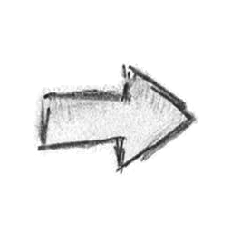

https:// test.my.com
dev
admin
QA
Invalid SSL certs

Slide 51



http:// localhost:8080
http:// localhost:8080
dev
admin
QA
Invalid SSL certs

Slide 52
Run tests BEFORE commit!
Run tests on http://localhost:8080
Commit tests with code in one GIT repo
> ant unit-tests
> ant ui-tests
Invalid SSL certs

Slide 53
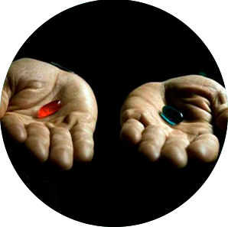
Use right tools!
Tool solves my problems
Tool can do many things
How to win
StaleElementException?

Slide 54

StaleElementException
WebDriverWait.presenceOfElementLocated
Implicit timeout
selenide.org

Slide 55

Use right tools!
Rifle -
Is a newbie weapon
Weapon of professional...
Is knife!

Slide 56
To be master
Video:
https://dl.dropboxusercontent.com/u/2856647/aikido.mp4
Master is not
who knows 10010 frameworks
Master is who can solve problems easily,
using minimum energy.

Slide 57

Andrei Solntsev
selenide.org
andrei.solntsev@gmail.com
twitter.com/asolntsev

