Slide 1




Scalable Network-Driven Proof of Notification for Blockchain Systems
Signet
Elham Ehsani · Marc Wyss · Jonghoon Kwon
Marc Frei · Yih-Chun Hu · Adrian Perrig · Alberto Sonnino
Notes:
My name is Elham Ehsani.
I will present my paper titled “”. It is a work together with ….

Slide 2
Motivation: Blockchain Notification Ecosystem
Polling (Traditional)
✗ Light client repeatedly queries full node
✗ Burdens full nodes with high read volumes
✗ Tragedy of the commons: no compensation
✗ Misses events between polls
Push / Subscription (Target)
✓ Full node pushes events when they occur
✓ Timely: critical for DeFi & latency-sensitive apps
✓ Paid subscription
✓ Requires verifiable proof of notification
Notifier
Recipient
Full blockchain node
Light client / wallet
Notes:
Let’s start with our motivation for designing Signet.
In Blockchain Notification Ecosystem, the traditional way of light clients getting notified about on-chain events is that they repeatedly query full nodes. Either do it not frequently, then miss events between polls, or the more frequent they do it it will burden full nodes … while they do not get compensated for that.
However, the target notification approach for signet is a push-based notification system, where full nodes ..
It is timely as the result, critical for a certain type of applications. Enabling full nodes to get paid for it, it requires verifiable proof of notification.
Before getting into details, lets introduce two terms, generally for a notification system: Notifier and Recipient. In Blockchains systems, a notifier can be a full node, while a recipient is for example a light client or a wallet.

Slide 3


Motivation: use case
High-stakes, ultra-low-latency
a dedicated full node
mid-value, low-latency
Signet
Low-value, less latency-sensitive
Occasional polling
Notes:
Blockchain apps that need notifications are on a spectrum.
one extreme is High-stakes, ultra-low-latency (e.g., arbitrage scenarios) that operate a dedicated full node, regardless of cost.
The other end is Low-value, less latency-sensitive (e.g., retail investors monitoring their wallet balances or users awaiting confirmation of non-urgent transactions) might be content to occasionally poll public RPC (Remote Procedure Call) endpoints tolerating delays or occasional missed events.
However, many practical users fall between these extremes. Examples of such scenarios include delayed order execution on a decentralized exchange, missing the settlement of an NFT auction, submitting collateral deposits too late to avoid liquidation, or failing to promptly confirm business payments conducted in cryptocurrency.
For example, consider Alice, a blockchain light client user who operates an automated trading bot on a decentralized exchange.
Alice relies on timely notifications about asset price changes and transaction finalizations to execute profitable trades and protect her positions from potential liquidation events.

Slide 4
Design Goals
For a practical proof-of-notification protocol:
Accountability: verifiable, unforgeable, and non-repudiable cryptographic proofs.
High Throughput: gigabit-scale workloads.
Low Latency: negligible latency (μs) to the critical path.
High Scalability: Scale with participants.
Compatibility and incremental deployment.
Notes:
Design goals for a practical proof-of-notification system includes
Accountability …, while preserving high throughput on routers. introducing negligible latency to the critical path of message delivery. High scalability, such as the witness handling on the order of≈ 100M packets per second. Alignment with the trust assumptions of modern blockchain systems.

Slide 5
Key Insight: Network as the witness
Autonomous Systems (ASes) are already trusted with forwarding.
Leverage ASes as impartial witnesses.
Witnesses are on the forwarding path: no extra round-trips, no mediated delivery
However,
Not every AS is trusted by both parties; how to route via the mutually trusted ASes?
How to generate proofs at line rate without becoming a bottleneck?
Notes:
The key insight in designing Signet is to use the network as the witness.

Slide 6




Key Building Blocks
Path-Aware Networking, e.g., SCION
Select paths through mutually trusted ASes.
Broadcast Authentication, e.g., TESLA
Symmetric MACs: lightweight, no public-key bottleneck.
On-chain Anchoring
Proofs committed before key release: non-repudiation.
Notes:
The key buliding blocks include PANs, …
Also, the TESLA Broadcast Authentication Protocol. TESLA stands for Timed Efficient Stream Loss-tolerant Authentication, used for generating notification proofs.
And, on-chain anchotring of these proofs.
While TESLA provides delayed authentication, we combine it with on-chain submission of the proofs to provide the required level of accountability.

Slide 7



Signet Components
Notifier
Witness AS
Recipient
Smart Contract
Border router on path
· Observes notifications
· Returns proof to notifier
Light client / wallet
· Pays subscription fee
· Initiates challenges
On-chain
· Stores SLAs & deposits
· Resolves disputes
Full blockchain node
· Monitors on-chain events
· Locks deposit on-chain
· Sends push notifications
Notes:
Signet includes four main components. The notifier and recipient as any notification system. ASes with their border routers as witnesses. And signet smart contract for dispute resolution.

Slide 8
TESLA: Efficient Broadcast Authentication
Time is divided into intervals: each has a secret key Kᵢ, disclosed only after a delay.
Delayed disclosure = delayed verification, but lightweight and fast.
Limitation: no inherent non-repudiation: anyone can forge MACs after key disclosure.
Fix: commit messages on-chain before key disclosure.
Notes:
As a background, I give a brief description of how TESLA works.
The TESLA protocol is an authentication scheme designed for environments where computational and bandwidth efficiency are critical. Instead of relying on expensive public-key operations, TESLA uses symmetric message authentication codes (MACs).

Slide 9
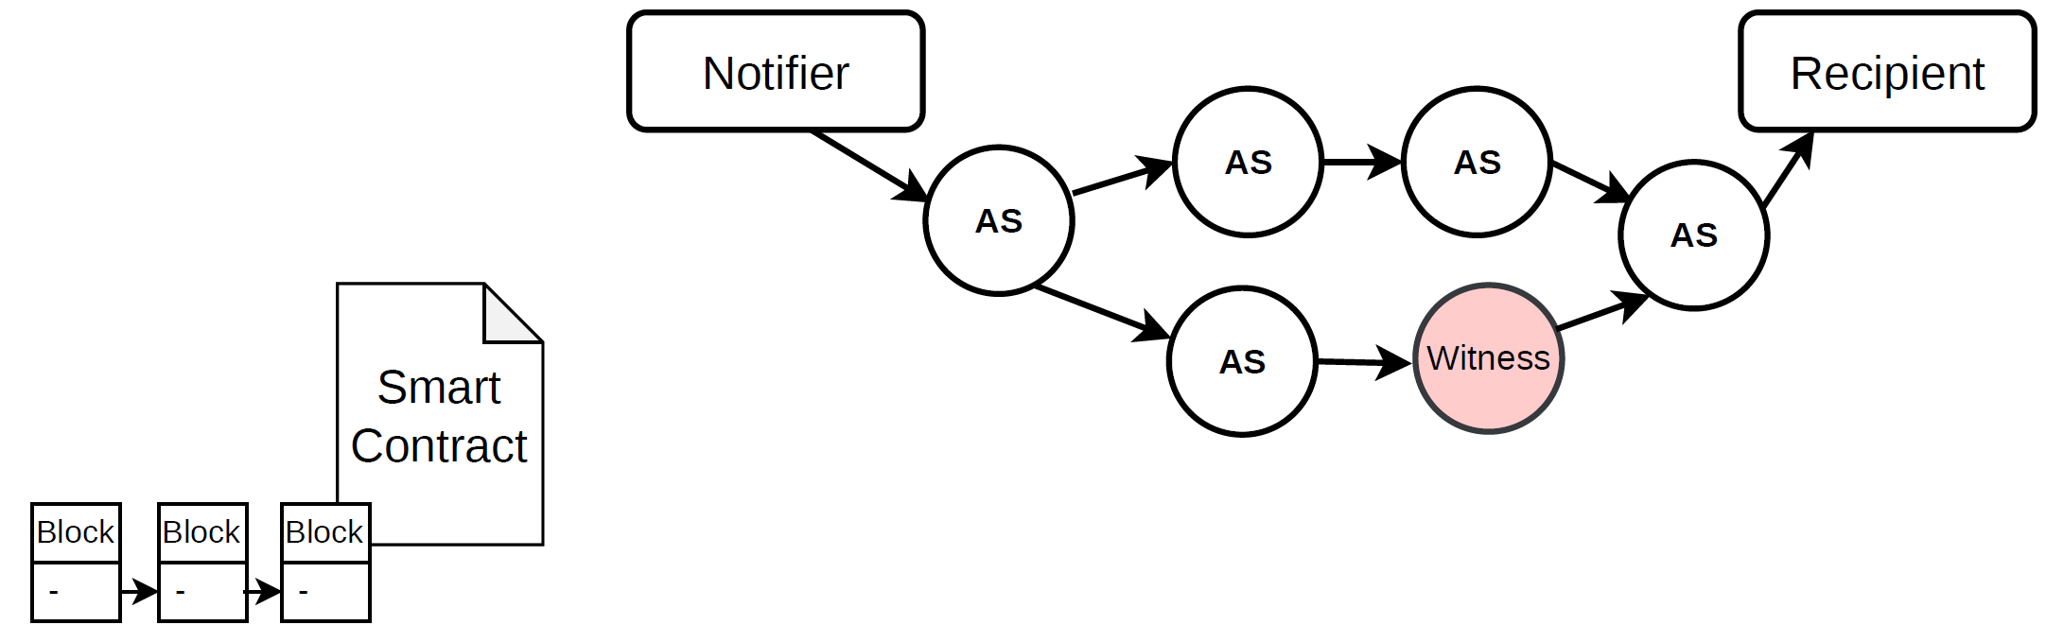
Protocol Flow
Notes:
Now, I explain Signet’s protocol flow.
There are ASes constituting the network between the Notifier and the recipient. Note that there can be multiple recipients for one notifier and multiple notifiers for one recipient. Here, for simplicity and without loss of generality, we explain by one notifier and one recipient.
And there is a Signet smart contract on-chain.

Slide 10
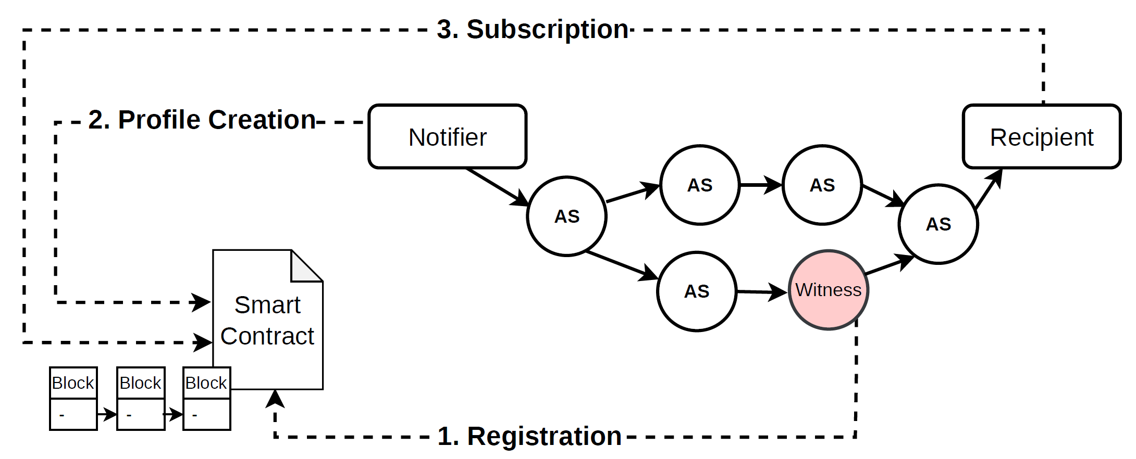
Protocol Flow
1. Witnesses register TESLA keys on-chain.
Notes:
1. Witness ASes register on-chain with the Signet smart contract, and, at each key-release interval, append their current released key.

Slide 11
Protocol Flow
2. Notifier creates a profile with SLA and deposit.
Notes:
2. A notifier creates an on-chain profile that records its SLA, trusted witnesses, and the deposit.

Slide 12
Protocol Flow
3. Recipient subscribes and selects trusted witnesses.
Notes:
3 A recipient subscribes to that profile, specifying its address, events of interest, and its trusted subset of the profile witnesses.

Slide 13
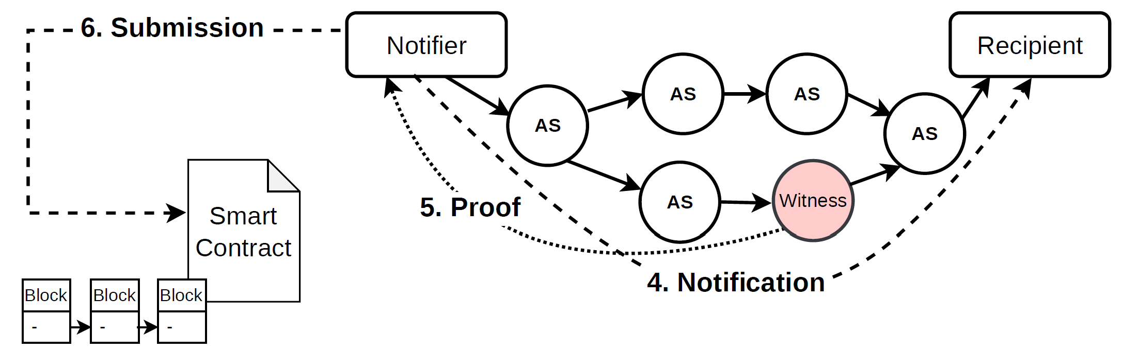
Protocol Flow
4. Notifier sends notification along a path through a witness AS.
Notes:
4. When a subscribed event occurs, the notifier emits a notification packet along a
path that traverses at least one of the mutually trusted witness ASes, leveraging the path control of PANs.

Slide 14
Protocol Flow
5. Witness creates a MAC-based proof and returns it to the notifier.
Notes:
5. A router in a witness AS observes the packet, timestamps it, computes a MAC using its current TESLA key, and returns that proof to the notifier.

Slide 15
Protocol Flow
6. Notifier batches proofs into a Merkle tree and commits the root on-chain.
Notes:
6. The notifier aggregates proofs from each AS within a batching window, computes each batch’s Merkle root, and commits the roots on-chain before the corresponding keys are disclosed.

Slide 16
Proof Generation with TESLA Authenticator
During interval i
Before disclosure
After key release
AS computes
MAC(Kᵢ, m, ts)
Key Kᵢ is still secret.
The notifier commits the proof on-chain.
Anyone can verify
MAC authenticity and freshness.
No public-key operations on the critical path, Symmetric MACs instead → wire-speed proof generation
Notes:
Upon observing the notification packet, a border router in a designated witness AS records the current time as the observation timestamp.
It then calculates the MAC, with its current TESLA key and sends it back to the notifier.
The notifier …
After key …
The on-chain anchoring allows everyone to verify that proofs were generated before key release.
The timestamp on the proof is to verify the freshness of the notification (the time that the notification was observed). When submitting on-chain the time is also recorded to verify the key validity in the future.

Slide 17
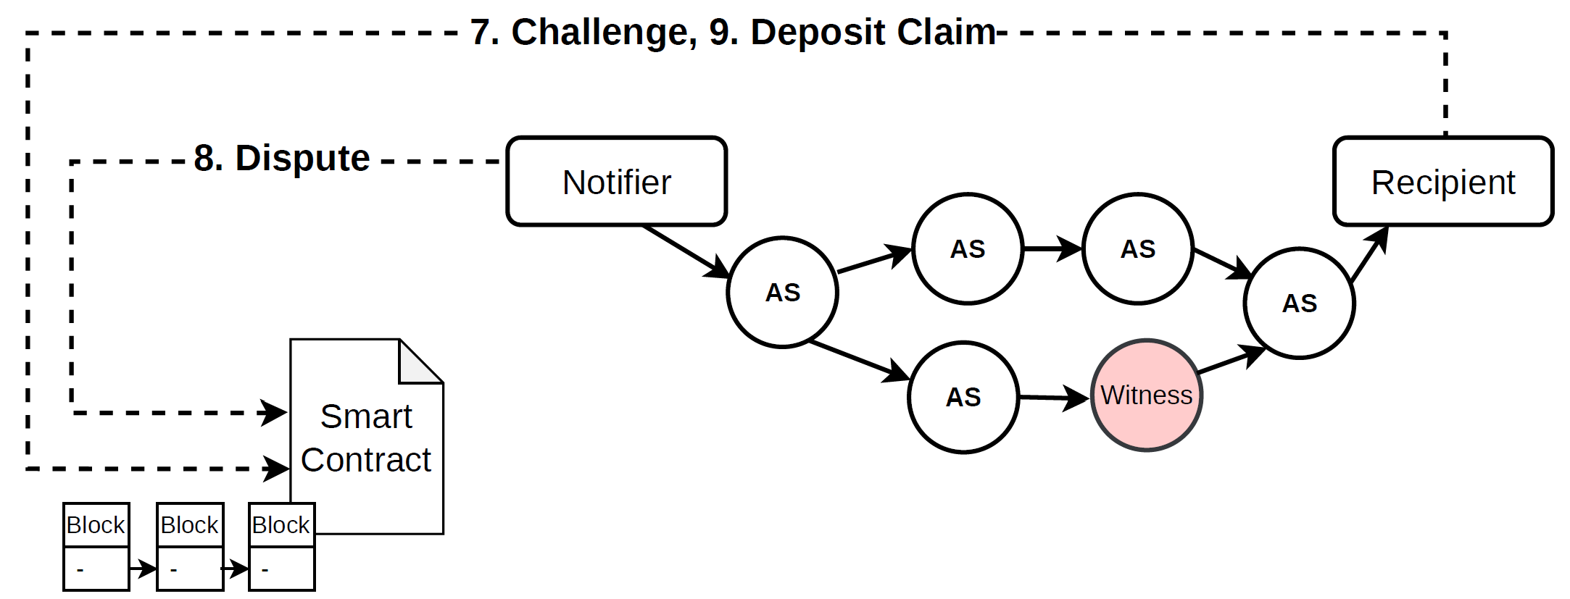
Protocol Flow
7. If notification is missed, recipient raises a challenge.
Notes:
7. If the recipient detects a missed or delayed notification, it can create a challenge to claim the notifier’s deposit.

Slide 18
Protocol Flow
8. Notifier disputes with the Merkle proof.
Notes:
8. The notifier has a limited time window to dispute by
presenting the proof and the Merkle path.

Slide 19
Protocol Flow
9. Smart contract verifies and either drops the challenge or transfers the deposit.
Notes:
9. The smart contract verifies the proof against its stored states. The challenge will be either rejected (if the dispute is valid) or the deposit will be claimed and collected by the recipient.

Slide 20
Security Analysis: Properties
I
No Byzantine recipient can claim the deposit of an honest notifier.
▸ False challenge: smart contract rejects non-existent events; valid proof MAC disputes any real event.
▸ Impersonation: source authentication blocks fabricated proofs from fake witnesses.
II
An honest recipient can always claim the deposit of a misbehaving Byzantine notifier.
▸ Omitted notification: notifier cannot forge a MAC without sending; deposit lost.
▸ Delayed notification: observation timestamp, non-repudiable via key anchoring.
III
A faulty witness is detectable by notifiers.
▸ After key disclosure, notifier verifies all MACs of that interval: invalid proofs identified.
▸ Misbehaving witnesses are detected and excluded.
IV
A false notification is detectable by recipients.
▸ Recipient queries indexer for blockchain inclusion proof of the event.
▸ Double notifications harmless: recipients not charged per notification.
Notes:
Signet ensures the following security properties in the presence of arbitrarily Byzantine notifiers and recipients.

Slide 21
Evaluation: Data Plane (Router Throughput)
Setup: Intel Xeon 2.1 GHz · Spirent SPT-N4U · 40 Gbps bidirectional · DPDK · SCION/EPIC router
1.6M
16B packets
1 core
pps
17.4M
16B packets
16 cores
pps
0.6µs
per packet (16B)
overhead
1.4µs
per packet (300B)
overhead
Linear
throughput ∝ cores
Proof generation (hashing + timestamping + HMAC-SHA2
scaling
Notes:
Among, PANs, we selected SCION for the implementation. SCION has the advantage of being already deployed and operational in real-world production networks, with a mature implementation We evaluated Signet with DPDK implementation of a SCION router conducting Signet proof generation including hashing and timestamping.
The results highlight the high throughput and scalability of the design: 1.6 Mpps for 16B packets per single core and 17.4 M per 16 cores. With microsecond latency linear scaling with the number of cores.

Slide 22
Evaluation: Smart Contract
Implemented in Sui Move.*
Deployed on Sui testnet.
Each contract call costs less than 0.007 SUI (<$0.03).
* Open source: github.com/asonnino/signet-contract
Notes:
We also evaluated the Signet smart contract by implementing it on Sui blockchain’s testnet.
Each contract call costs less than 0.007 SUI (costs less than $0.03 in 2025).
Signet smart contract enables high scalability, as the operations are parallelized across notifiers, recipients, and witnesses.
The regular operations, such as proof (Merkle root) submission and key updates, are lightweight, and other operations, such as challenge or dispute, are infrequent.

Slide 23
Conclusion
Signet, a novel protocol for verifiable proof of notification.
Mutually trusted Transit ASes as impartial witnesses.
Integrating TESLA with AS witnessing enables:
Efficient proof generation by ASes.
Asynchronous on-chain verification.
Alignment with the trust assumptions of modern blockchain systems.
Evaluation results:
negligible latency (μs).
>1M packets/sec per core.
Notes:
Now, we come to conclusion:
Is a …
Uses …

Slide 24
Thank you for your attention​!
Elham Ehsani, ETH Zurich, NetSec​
eehsani@ethz.ch​

