Slide 1
Auto-Generation of Smart Contracts from Domain-Speciﬁc Ontologies and Semantic Rules
Presented By:
Nidhi Goenka
Amal Sony

Slide 2
Introduction
Smart contracts are self-executing programs that are embedded in the network to automate and validate interactions between involved parties.
A majority of blockchain frameworks rely on smart contracts to deﬁne their business logics by encoding rules and processes that govern transactions.
There is an essential need to facilitate translation of constraints from legal agreements or protocols to smart contracts.
Automatic generation of smart contracts can reduce the level of expertise required for, along with the time and cost incurred in specifying them.

Slide 3
Proposed Framework
Designing domain-speciﬁc ontologies and semantic rules to represent the underlying system and constraints, respectively.
From a well-deﬁned ontology, we can gather information about the classes, their data properties, and the relationships between them. And use this to devise a smart contract template.
The template is then translated into an abstract syntax tree(AST). The AST can be walked through and manipulated to insert the instance-speciﬁc restrictions in the appropriate functions.
This modiﬁed AST is used to produce a new source code ﬁle, thus generating a new smart contract.
It encapsulates the rules and processes governing all future transactions.

Slide 4
Background
Ontologies:
It conceptualizes and represents the knowledge of a domain into machine readable format.
The primary components of an ontology are:-
Classes – these represents concepts in a domain, abstraction for grouping objects with similar characteristics. A subclass is a subset of a class with some unique characteristics. Hence, classes can be organized in a hierarchical format through inheritance. For instance, Class = Staff, subclass = Professor.
Individuals – these are instances of a class.
Properties - describe the common characteristics of individuals belonging to a class. They are used to specify relationships in ontologies. An object property (hasStudent) deﬁnes the relationship between individuals. A data property (hasID) relates an individual to a literal or data value.
Relations .
Although ontologies can be represented in various formats, the most widely accepted language is the Web Ontology Language or OWL.
It is modeled with an object-oriented understanding where a domain is described by classes and their properties.

Slide 5
Semantic Rules:
The Semantic Web Rule Language (SWRL) is a rule language designed to expand the expressiveness of OWL.
It provides powerful deductive reasoning capabilities by allowing users to write Horn-like rules that are built on OWL concepts.
A SWRL rule is a form of an implication between an antecedent, known as the body, and a consequent, known as the head. Whenever the conditions speciﬁed in the body are true, the conditions speciﬁed in the head must also be true.
The body and head consist of positive conjunctions of atoms, such as: (atom ∧ atom ... → atom ∧ atom)
An atom is an expression of the form: p(arg1,arg2, ... argn), where p is a predicate symbol and arg1, arg2, ... argn are the arguments of the expression.

Slide 6
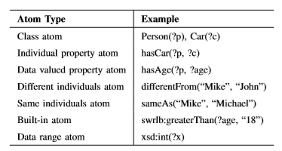
SWRL provides seven types of atoms as shown in the table below:
Based on these atoms, the following SWRL rule can be written to deﬁne the constraint for considering a person as an adult.
Person(?p) ∧ hasAge(?p,?age) ∧ swrlb : greaterThan(?age,17) → Adult(?p)

Slide 7
Abstract Syntax Tree:
The source code of a computer program can be represented as an abstract syntax tree (AST).
This structural representation is often built by a parser and serves as an intermediate step before the ﬁnal output of a compiler.
The parser reads a ﬁle character by character, generating tokens which in turn become nodes of the syntax tree.
These nodes and their relationships denote assignment statements, control structures, and other essential elements of a program.

Slide 8
Method
Design domain specific ontologies
Define semantic rules to reflect the constraints
Identify grammar for accurate parsing
Design a smart contract template incorporating expected functionalities and transactions in a given domain
Manipulate AST of the template based on the description of the ontology and rules to meet the requirements

Slide 9
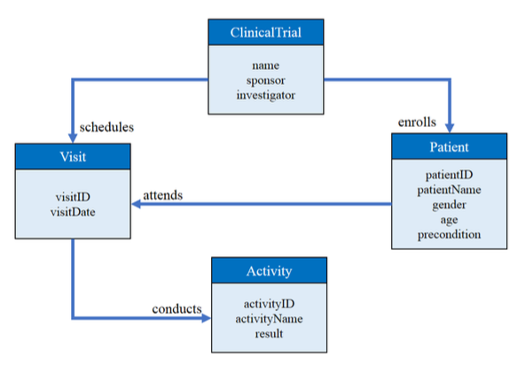
Designing a domain specific Ontology Case 1: Clinical Trial

Slide 10
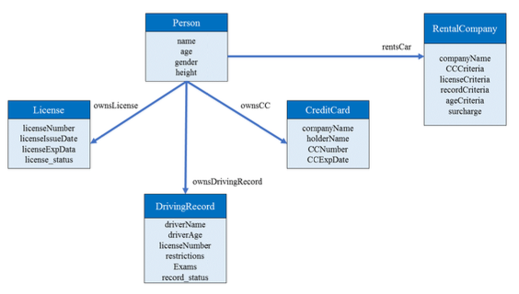
Case 2: Renting a car

Slide 11
Defining semantic rules
Followed SWRL.
Rules are positive conjunction of atoms.
For the ease of subsequent parsing, we place a class atom, its individual properties, and its data value properties as contiguous atoms. This is followed by the other atom types, such as built-in atom and data range atom.

Slide 12
Example Rule/Constraint for Clinical Trial
Only female patients of age six or higher to be eligible for a clinical trial.
Patient(?patient) ∧ hasGender(?patient,?gender) ∧ swrlb:equal(?gender,“Female”) ∧ hasAge(?patient,?age) ∧ swrlb:greaterThanOrEqual(?age,6)→Eligible(?patient)

Slide 13
Identifying Grammar
Determine the rule productions that could be derived based on the collection of SWRL rules.
The rule productions can be categorized into patient property constraint checks or assertions of activities which are supposed to have transpired.
This is represented by clauses such as hasProperty(?object,?property), and conducts(?visit1,?activity), respectively.

Slide 14
Example
< rule − seq >::=< rule > | < rule > ∧ < rule − seq > < rule >::=< activity check > | < patient property check > < activity check >::= attends(?patient, ? < visit index >)∧ < visit property check > < patient property check >::= has < patient property > (?patient, ? < patient property >)∧ < patient constraint >
< patient constraint >::= swrlb :< operator > (? < patient property >, ? < value >) < patient property >::= Age|Gender|P recondition < operator >::= equal|greaterThanOrEqual < value >::= int|string
Above grammar is LL(1). A recursive descent could be built to parse it.

Slide 15
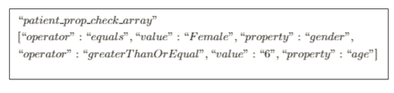
As it parses, the program identifies values for every rule which will be used in further processing and organizes them into objects.
Upon the successful completion of parsing, the program writes these objects to an array according to property category and outputs a JavaScript Object Notation (JSON) file for later ingestion.

Slide 16
Creating a Smart Contract Template
Using the Ontology information, abstract structures could be created as part of the template, to represent classes, such as patients and activities.
The functionalities are anticipated from the protocol, which details a wide range of guidelines, from eligibility for participants, exclusion criteria, data to be collected, to the schedule of activities to take place for the duration of a trial.

Slide 17
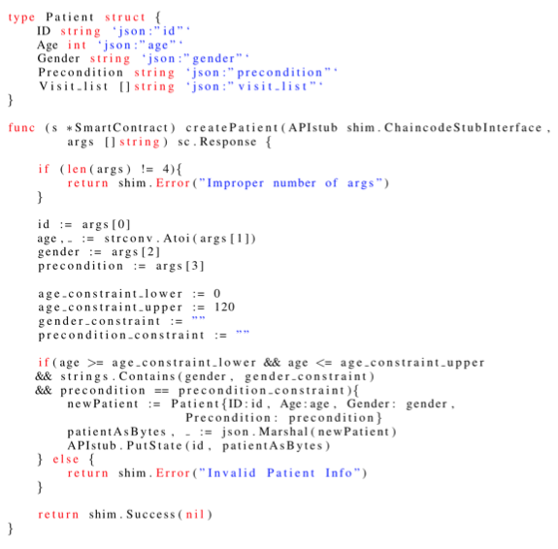

Slide 18
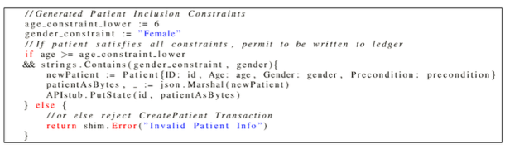

Slide 19
Manipulating AST
Go language offers good functionalities to update of source code through the manipulation of the AST.
During the smart contract generation, we convert the template into its AST representation and traverse the tree to find the constraint variable, and update it to the appropriate value per the parsed rules.
The newly generated smart contract file is placed in the directory the blockchain network expects to find it, so that the start-up of the network will now instantiate this new smart contract without any manual intervention from the network administrator.

Slide 20
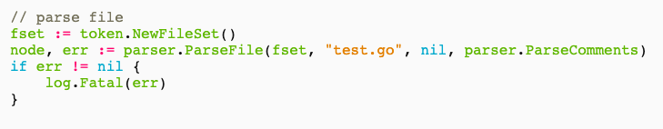
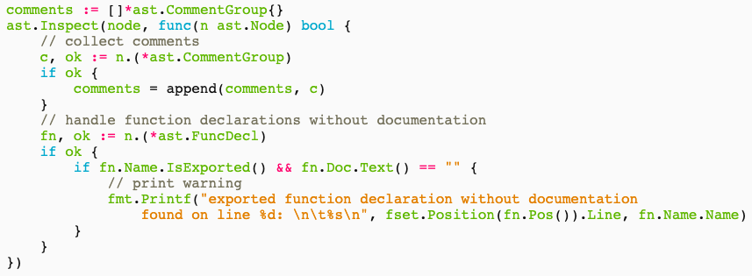

Slide 21
Thank You

