Slide 1
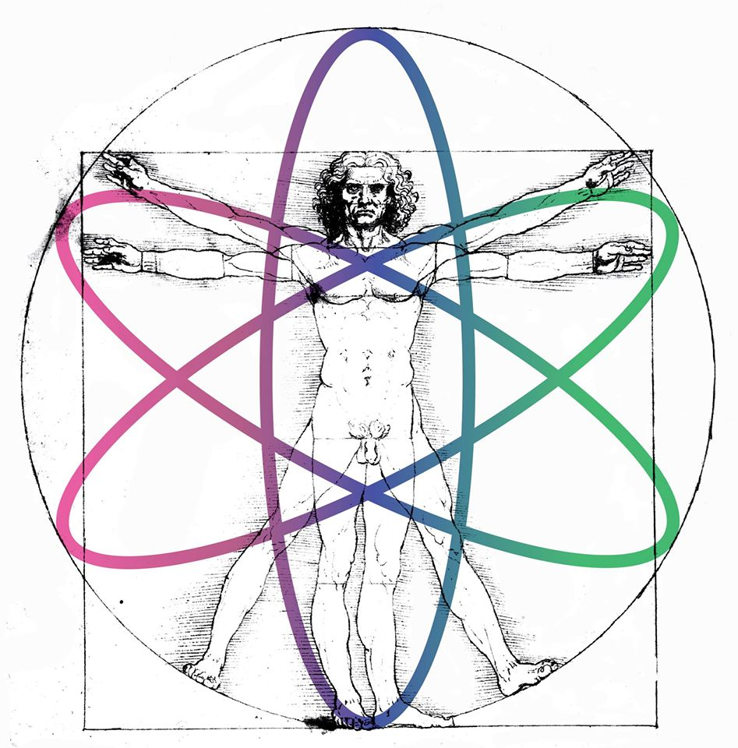
Escuela José Antonio Balseiro 2016
Nuevas Tendencias en Investigación en Física Médica
High energy simulations and (ultra) fast
particle detection
A (personal) compilation made by
Hernán Asorey
asoreyh@cab.cnea.gov.ar
Laboratorio Detección Partículas y Radiación
Centro Atómico Bariloche

Slide 2


Slide 3
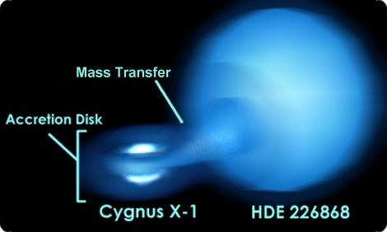

Slide 4
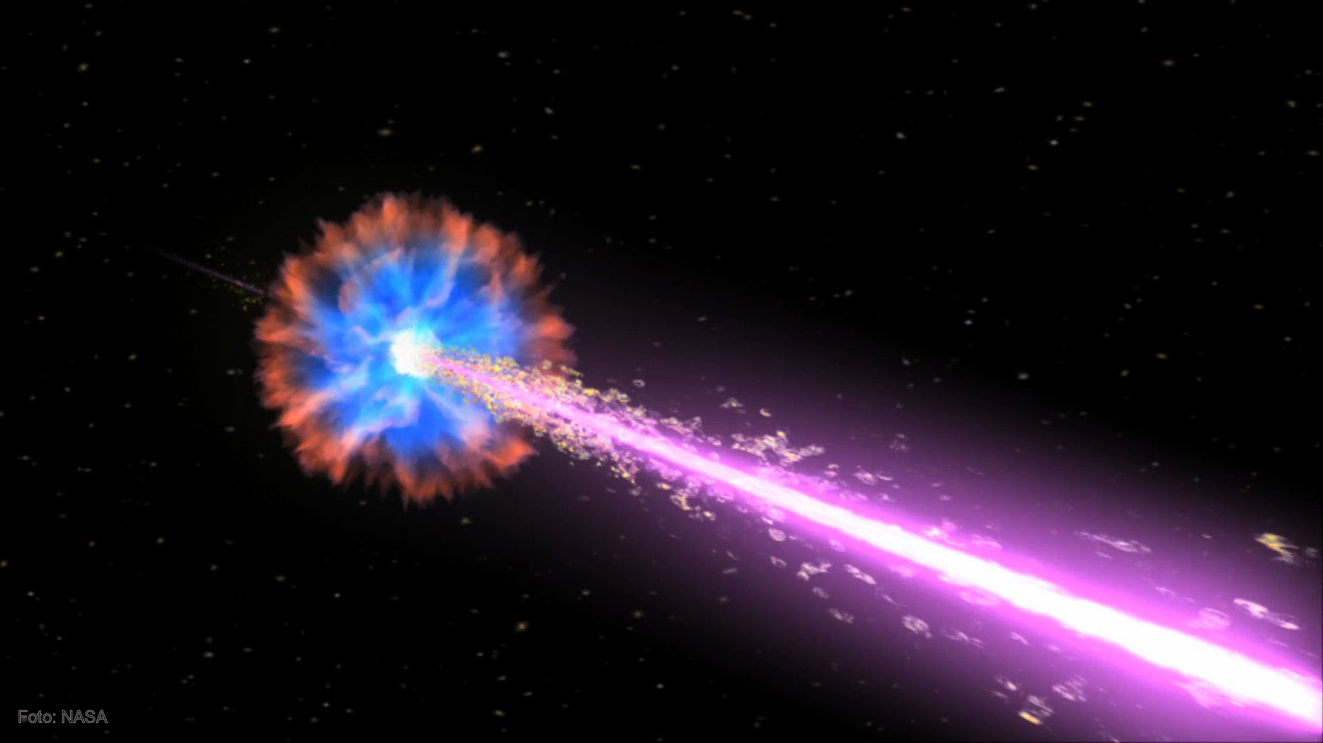

Slide 5
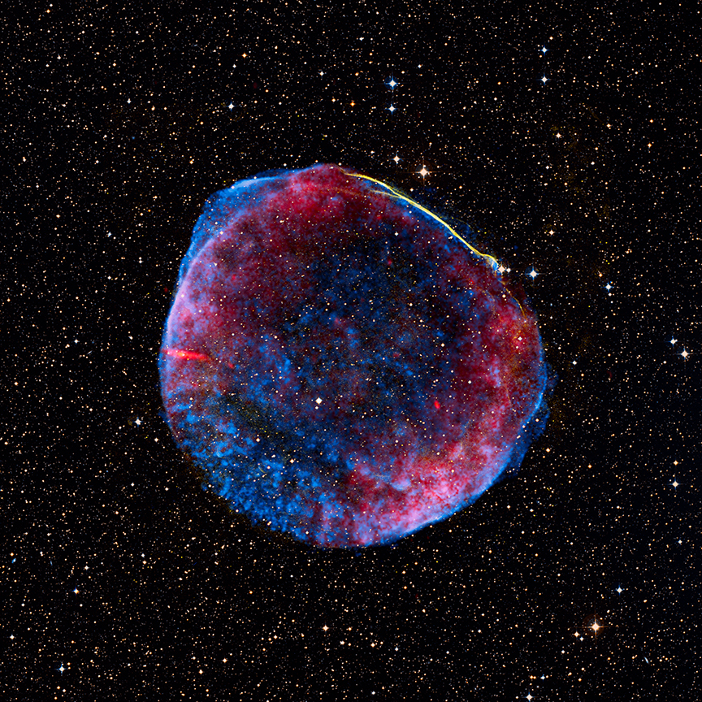

Slide 6
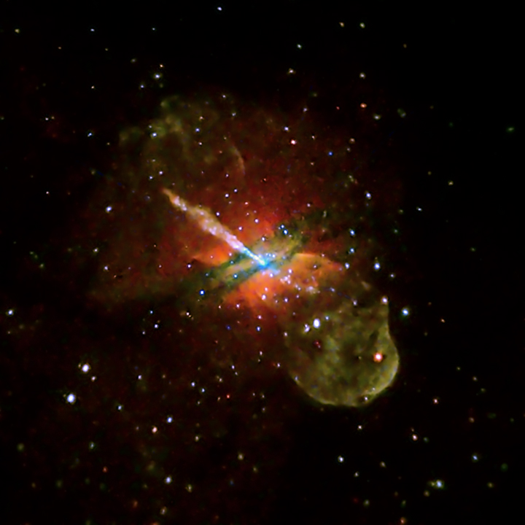

Slide 7
Astroparticles are “witnesses” of the
most extreme phenomena
of the Universe

Slide 8
Scopes
Relativistic
Astrophysics
Stellar (Solar)
Physics
Particle
transport
Extreme Data Analysis
Atmospheric
Physics
Nuclear &
Particle Physics
Radiation
Interaction

Slide 9

Scopes
It begins at a Supernova remanent

Slide 10

Scopes
It begins at a Supernova remanent
And it ends with complex analysis of complex data
50 50 50
61 49 54
139 49 602
91 51 454
59 50 236
60 50 151
53 50 87
53 50 61
50 50 57
51 51 57
50 50 52
51 49 51
51 50 50
50 49 51
51 50 52
50 50 51
# t 4 30008562
# c 663486982
50 50 50
49 51 51
62 50 106
53 50 117
51 51 62
50 50 55
50 50 51
53 51 51
51 50 51
49 49 52
51 50 51
51 49 51
51 50 52
50 49 50
50 51 50
52 50 51
# t 4 30008646
# c 663486983

Slide 11
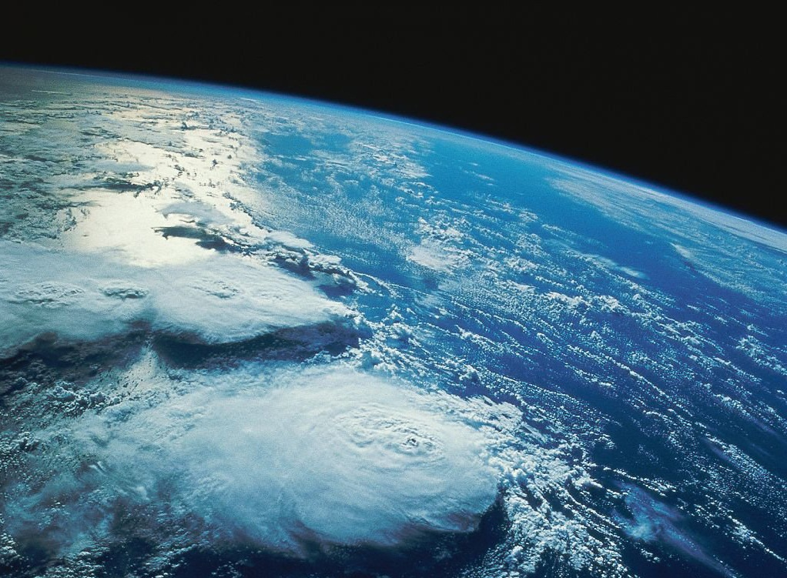
Extreme medium for the extreme Universe
Cosmic Rays interact with the atmosphere, producing cascades of particles (secondaries) moving toward ground level at near the speed of light and in the direction of the incident (primary) particle

Slide 12
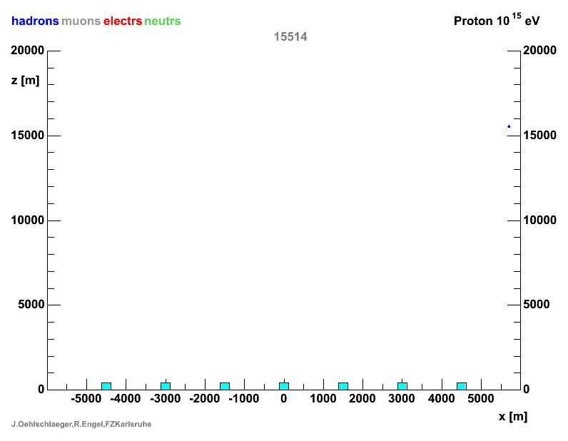
Particle interaction

Slide 13
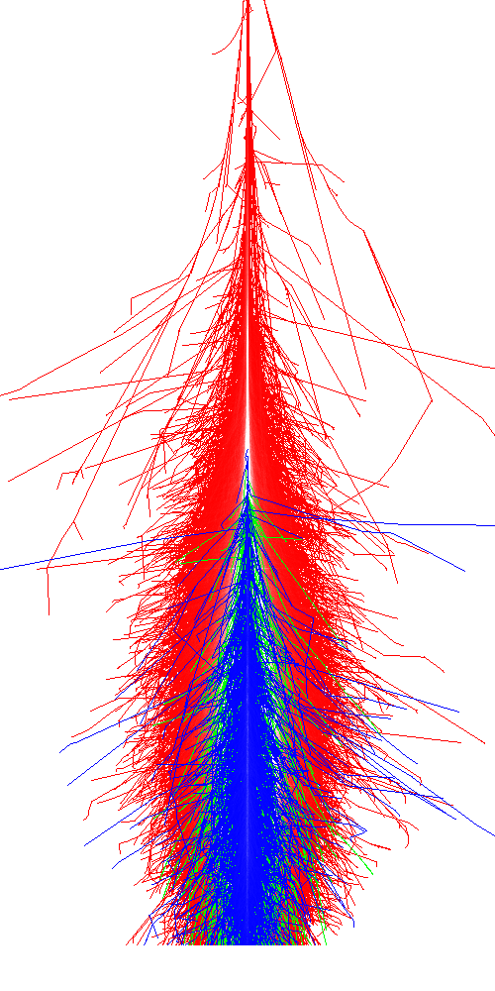
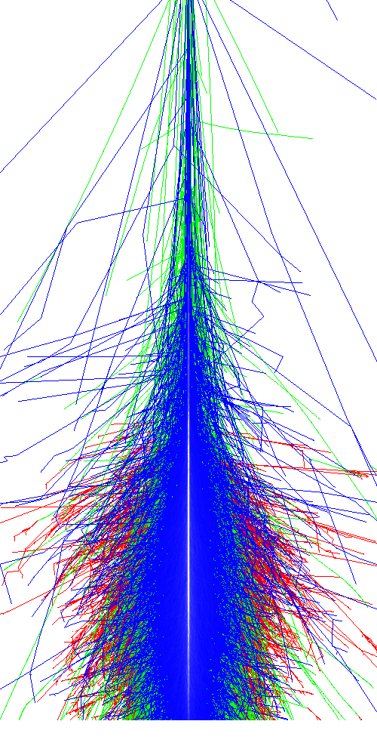
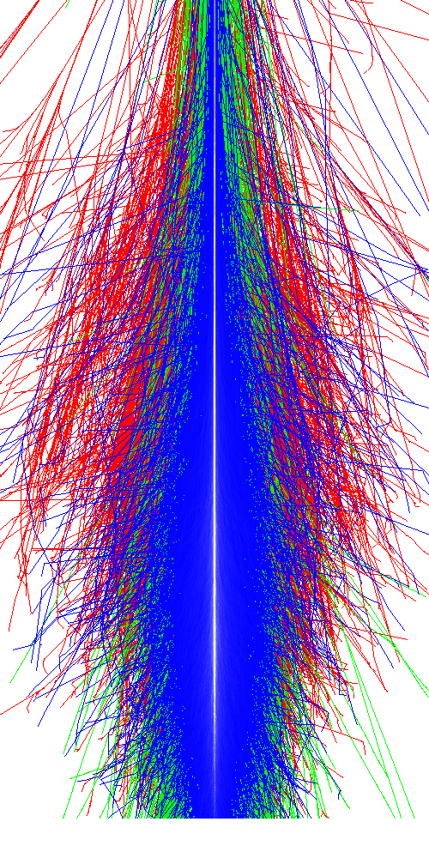
EAS: Extensive Air Showers
E=5x10¹⁴ eV
Primary
γ
p
Fe
em
mu
Secondaries
hd
Composition dependent development

Slide 14
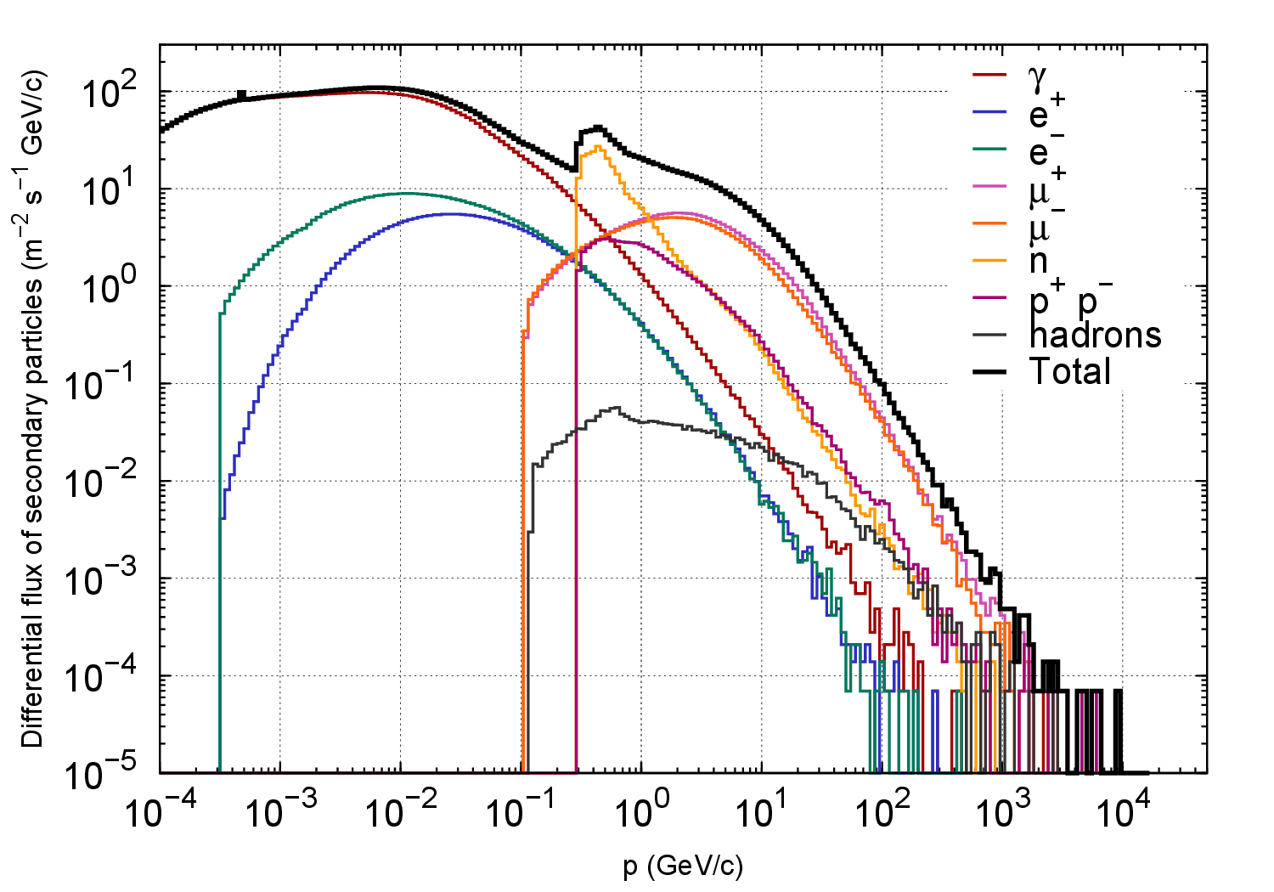
Chacaltaya, Bolivia, 5300 msnm

Slide 15
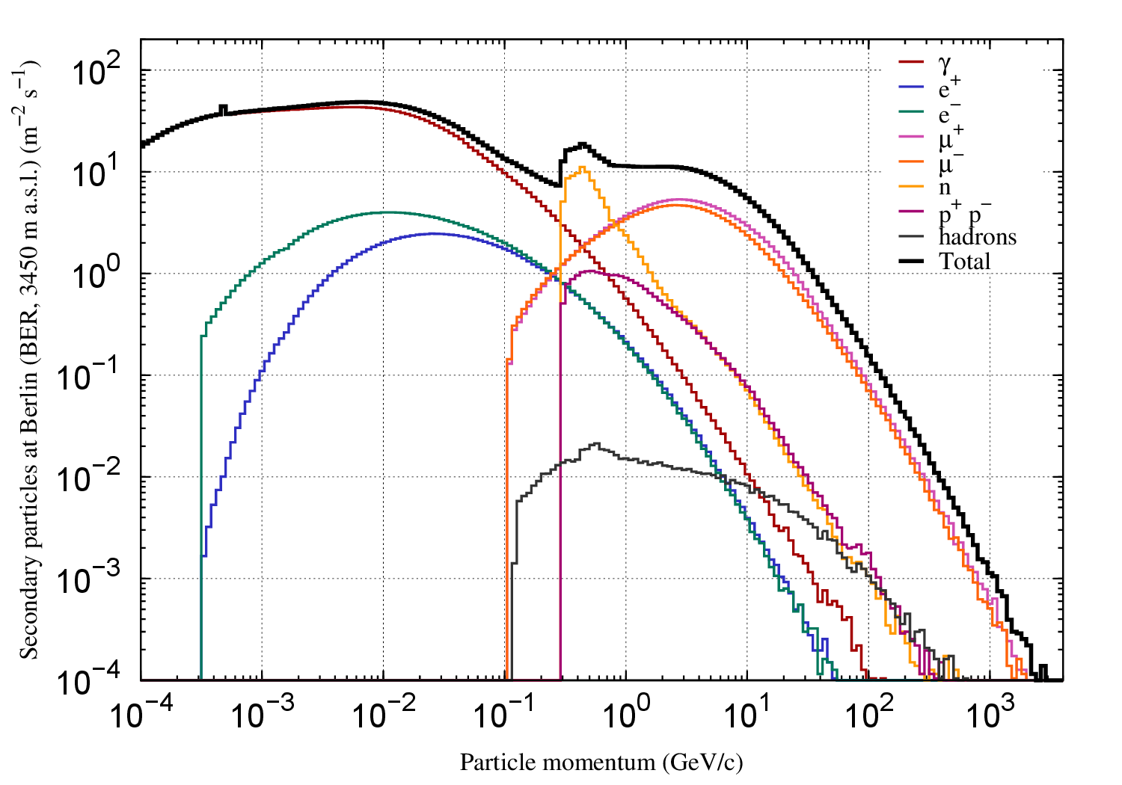
Berlín, Colombia, 3450 msnm

Slide 16
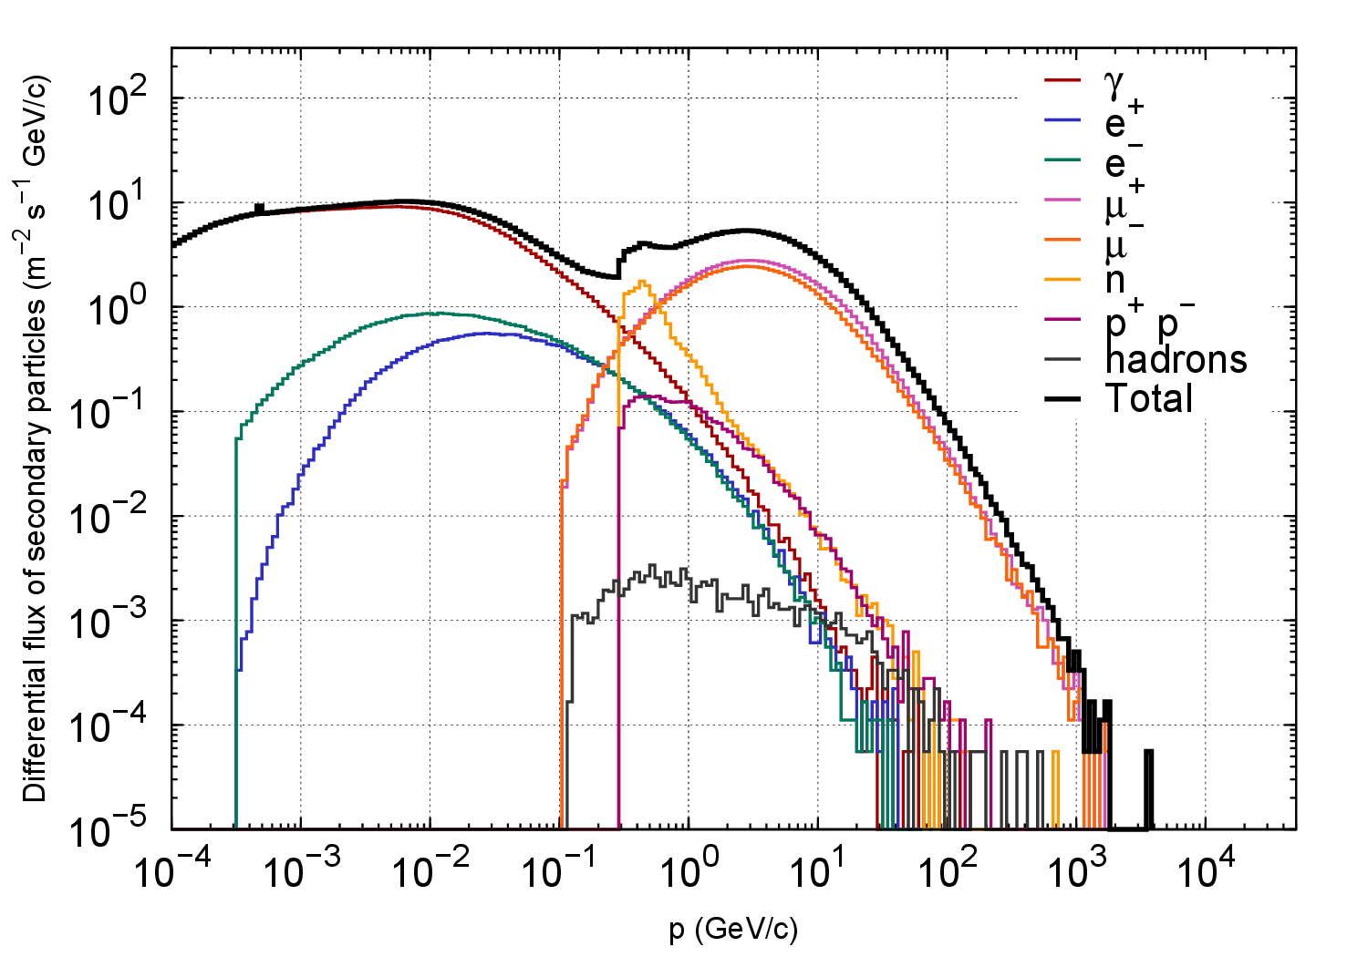
Bariloche, Argentina, 850 msnm

Slide 17
Shielding: 1 atm ~ 90 cm of Lead
Airplane
78000 particles/m² s
Chacaltaya (BO)
7100 particles/m² s
Quito (EC)
3350 particles/m² s
Bogotá (CO)
2900 particles/m² s
Bariloche (AR)
1050 particles/m² s
Buenos Aires (AR)
750 particles/m² s

Slide 18
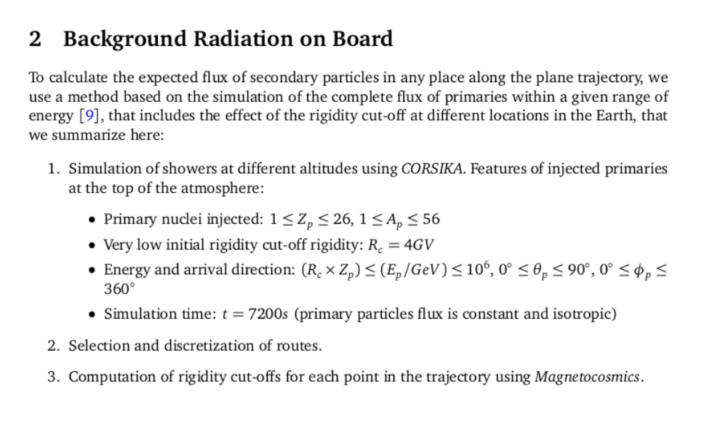
Extreme simulations for extreme calculations

Slide 19
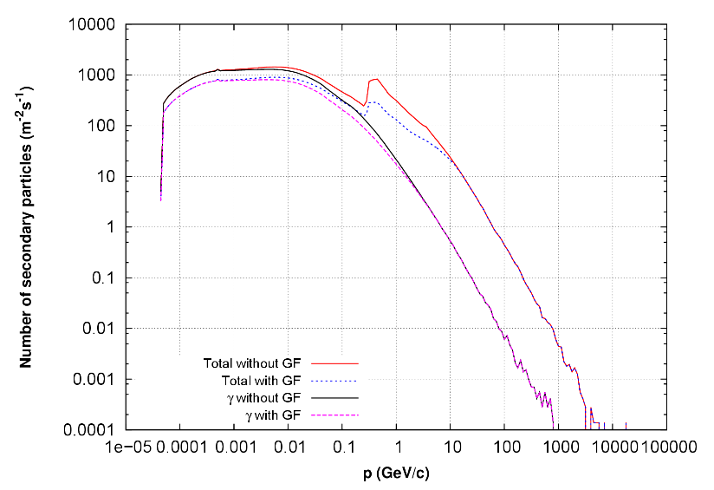
Secondary particles at flight level
Integrated radiation levels
Is maximum at h~14 km

Slide 20
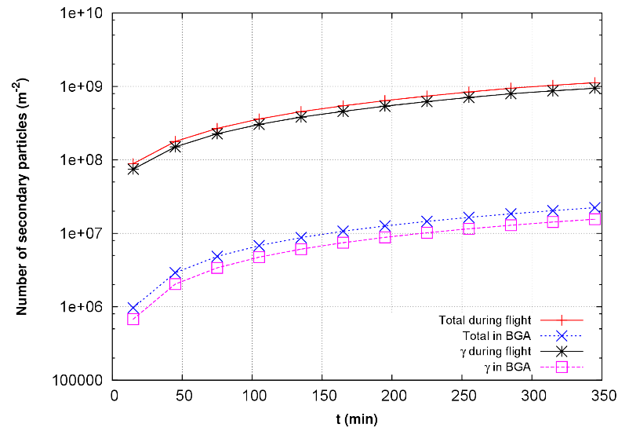
Integrated number of particles

Slide 21
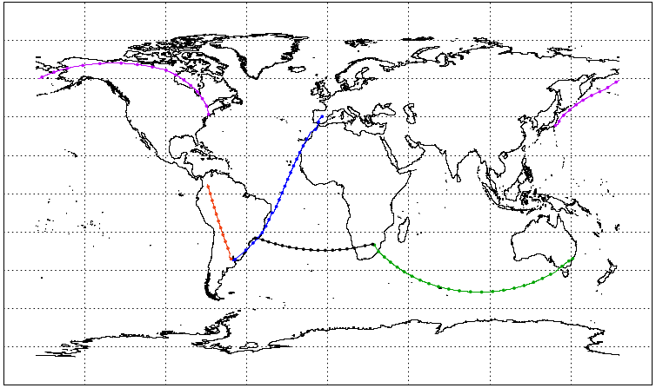
Five commercial routes at h=11km
S. Pinilla, H. Asorey, F. Quiñonez, M. Suarez, L. Núñez, 2015, 2016

Slide 22
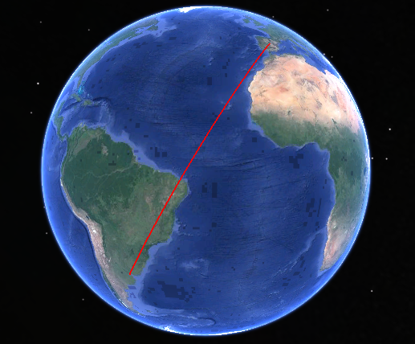
Buenos Aires-Madrid

Slide 23
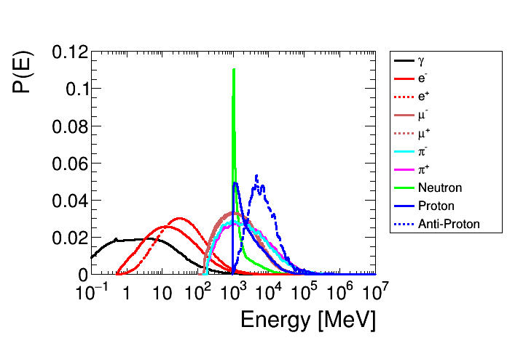
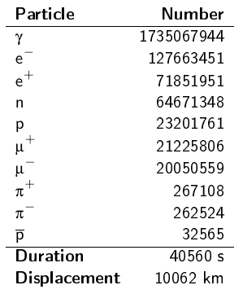
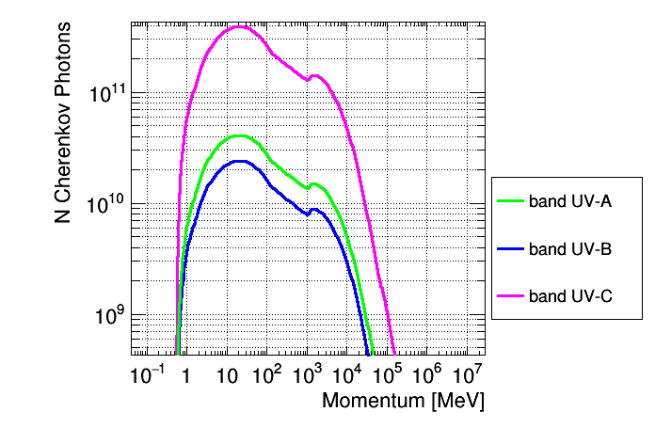
Buenos Aires-Madrid

Slide 24
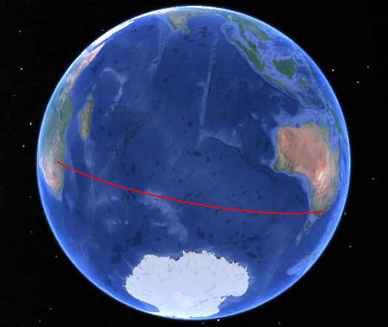
Johanesbourg-Sydney

Slide 25
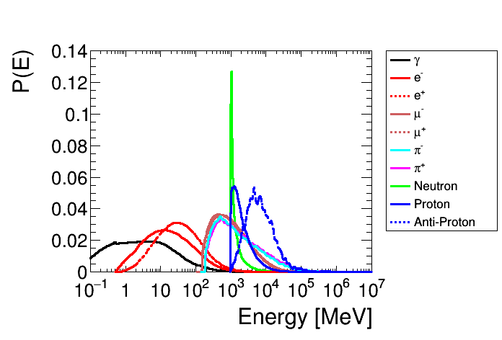
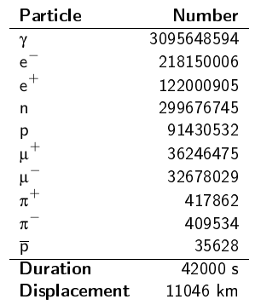
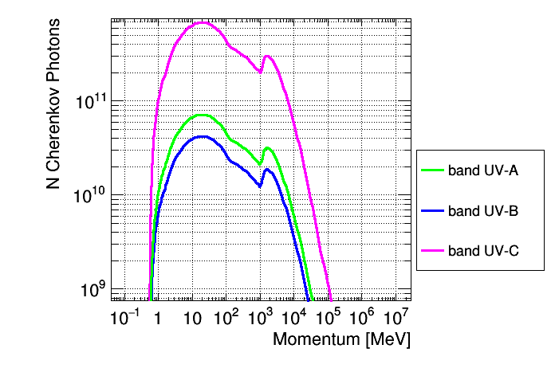
Johanesbourg-Sydney

Slide 26
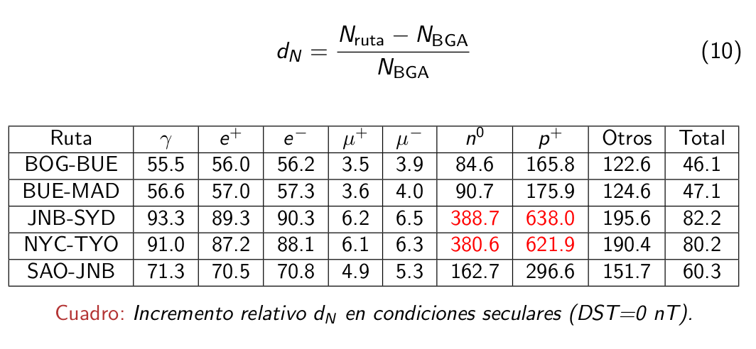
Same exposure time at secular GMF conditions

Slide 27
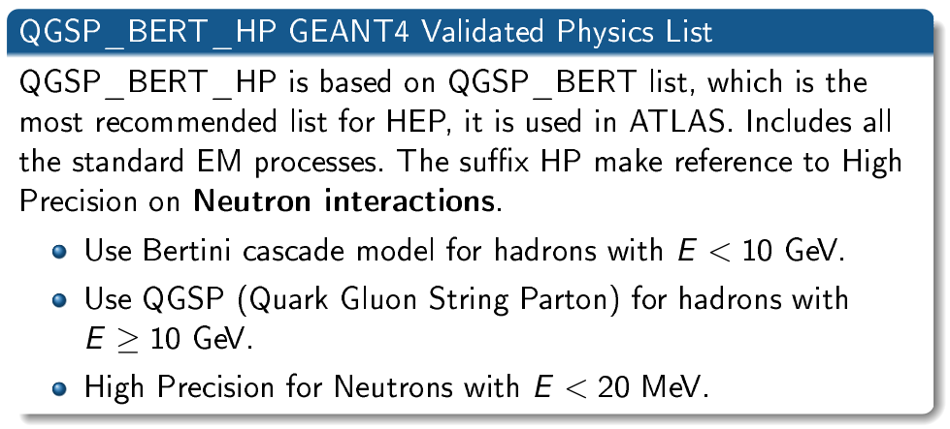

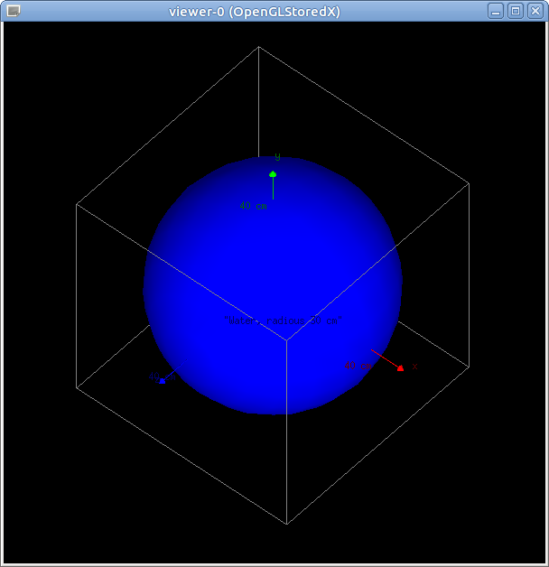
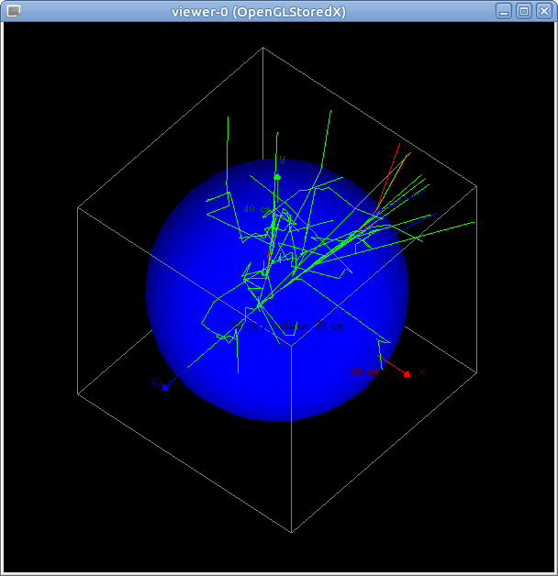
OpenGATE, a GEANT4 implementation for RT

Slide 28
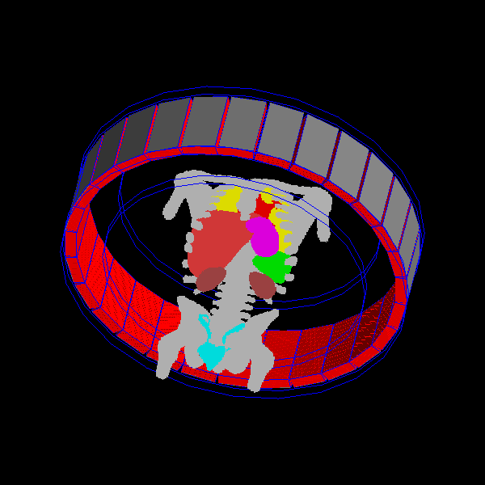
Extreme simulations for extreme calculations
Work in progress: improve aircraft shielding, improve phantom, detailed studies of resulting Bragg curves, ...
Very preliminary results (last week!) indicates equivalent dose could reach mSv level under certain space weather conditions
Results were validated at ground
level using Water Cherenkov
detectors. Need to validate at
flight level using portable
detectors
Starting to work on RT and
protontherapý Geant4 simulations
(CPU and GPU parallelization)

Slide 29
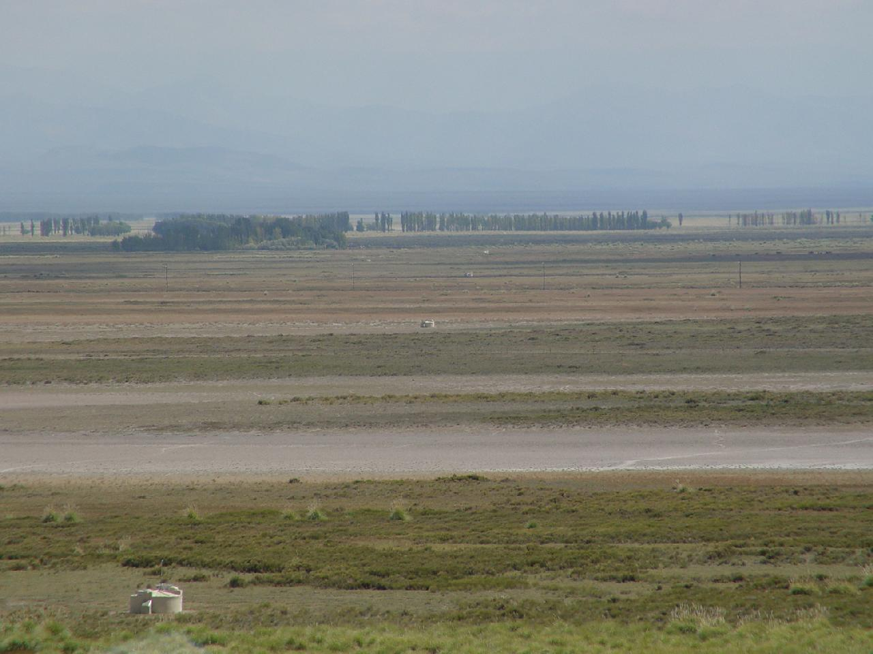
Extreme detectors for extreme physics
1.5 km
Pierre Auger Observatory Surface Detector

Slide 30
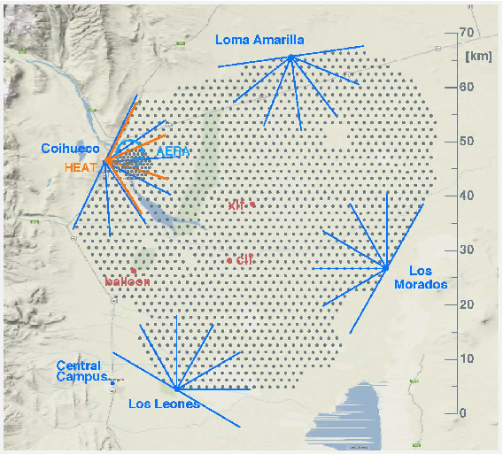
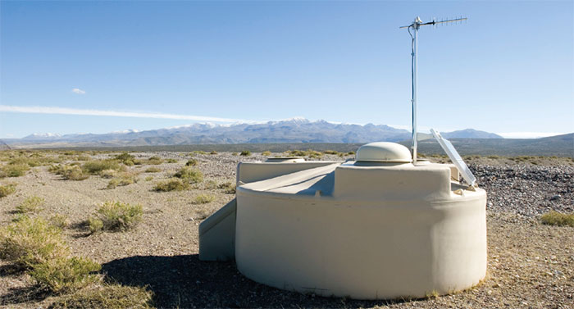
~ (50x60) km = 3000 km² instrumented area
1660 Water Cherenkov detectors (16600 m² detection area)
27 Fluorescence telescopes surounding the array

Slide 31
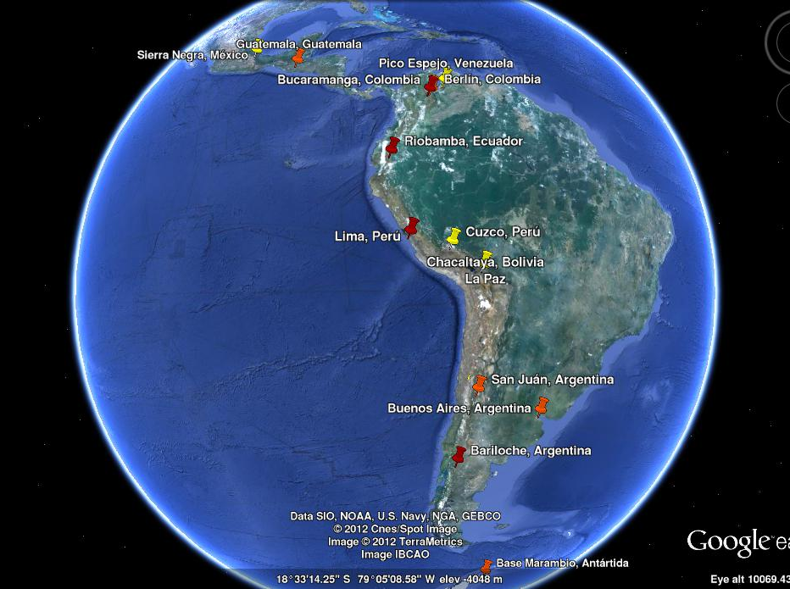
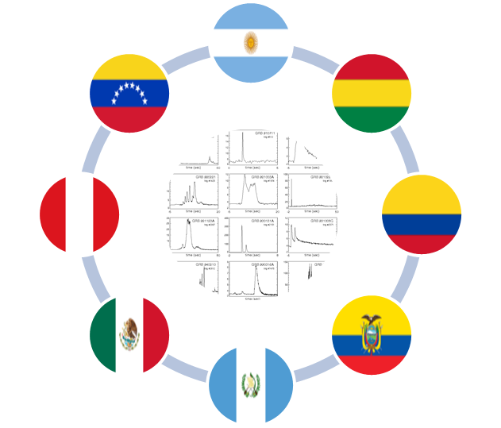
LAGO: The Latin American Giant Observatory
Nine LA countries + Spain
LAGO Collaboration: first astroparticle newtork at LA (80 members, 25 institutions)
A very long baseline array of Water Cherenkov Detectors
From Mexico to Antarctica

Slide 32
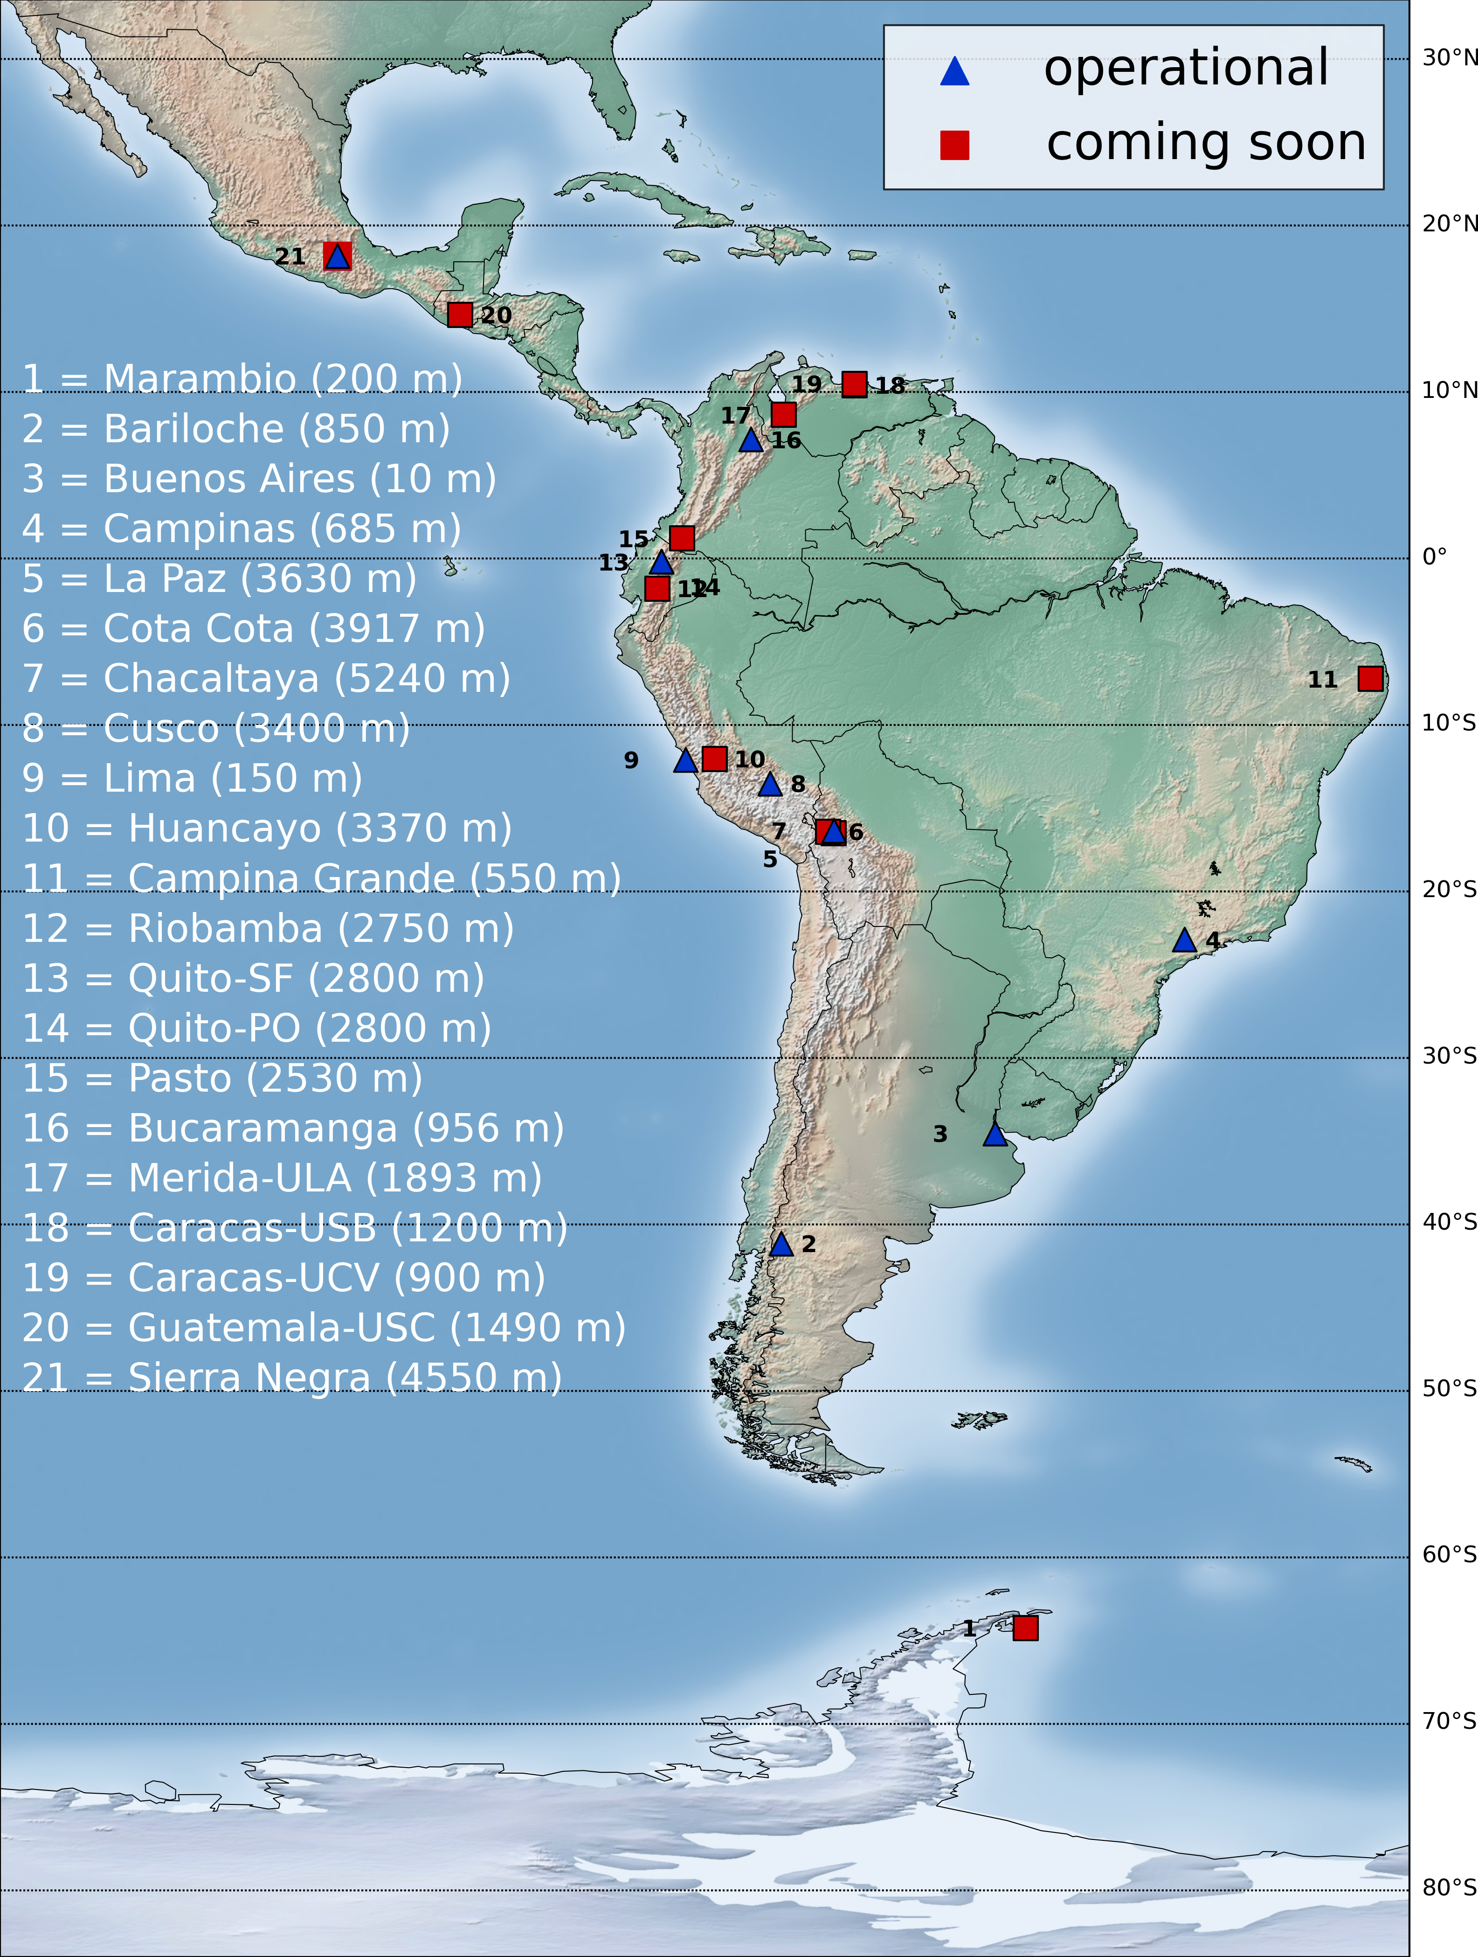
Present status and future perspectives

Slide 33

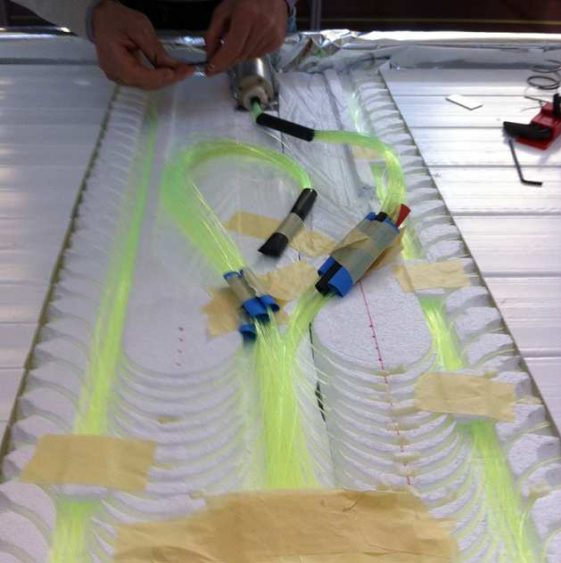
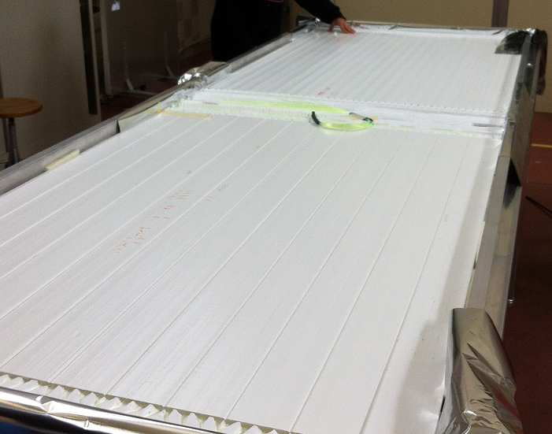
SSD, The Auger Upgrade: plastic scintillators

Slide 34
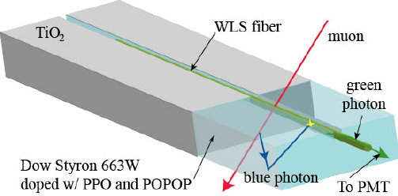
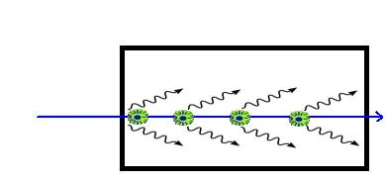

Plastic scintillators
Polystyrene dopped with PPO (organic scintillator & PoPop (Wavelenght shifter)
New materials improve usage at high radiation environments

Slide 35
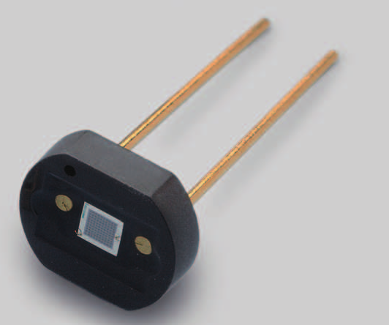
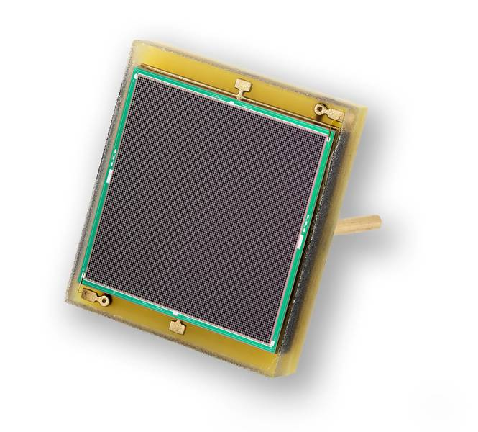
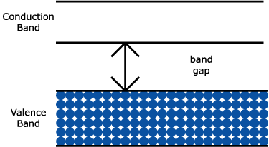
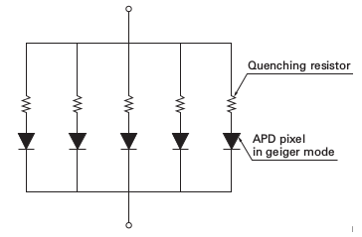
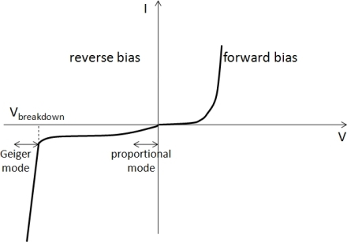
Multi-pixel Silicon PhotoMultiplier (MPPC SiPM)
Semiconductor based
~ 3600
Multiple pixel
Works as a reversed
polarized diode
Notes:
El otro componente principal del experimento es el llamado Silicon Photomultiplier, o SiPM como le voy a decir a partir de ahora. Se trata de unos bichitos como el que se ve en la primera foto, de un centímetro de largo aproximadamente. La zona de detección es el cuadrado que se ve en la segunda, que está compuesto por muchas celdas, del orden de 3600, cada una de 50 micrones de lado. La idea es que el conjunto de celdas funciona como un conjunto de diodos en paralelo polarizados en inversa. Los SiPM son semiconductores que ven promovido un electrón de la banda de valencia a la de conducción cuando lo atraviesa un fotón. Los SiPM son esencialmente diodos, optimizados para trabajar en la zona de ruptura. Algo importante a remarcar son estas tres tensiones que aparecen acá, la de breakdown o ruptura, que es la tensión a la cual el diodo empieza a conducir. La de bias, que es la que uno aplica sobre el SiPM. Se define entonces la tensión de overvoltage como la diferencia entre ellas, y es importante porque características del sistema de medición como la ganancia y el ruido dependen fuertemente de ella. Entonces se tiene la tensión de breakdown, y uno aplica una tensión de bias mayor de modo que conduzca todo el tiempo, pero cuando pasa un fotón conduce mucho más con pequeños cambios de tensión, debido a que estamos en el régimen de ruptura.

Slide 36
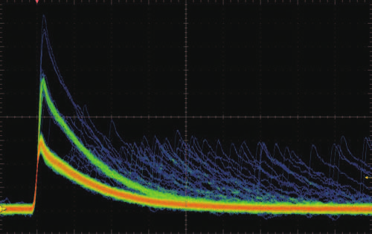
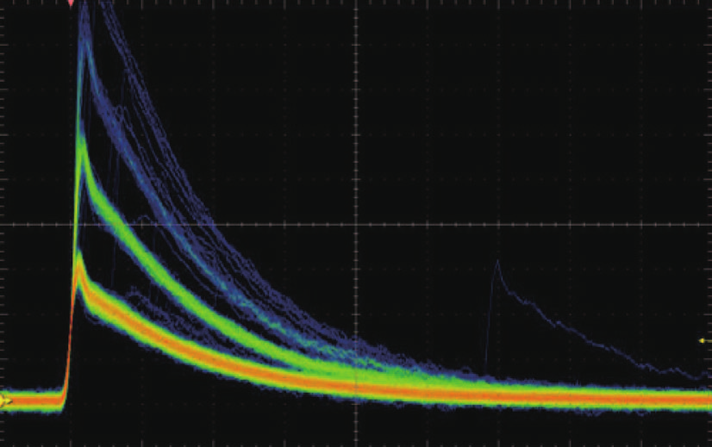
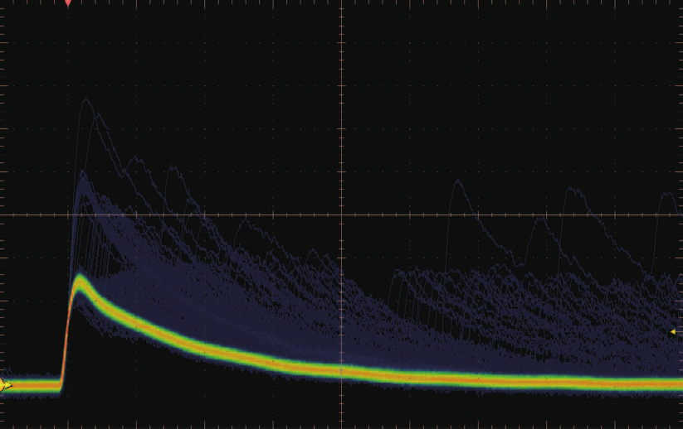
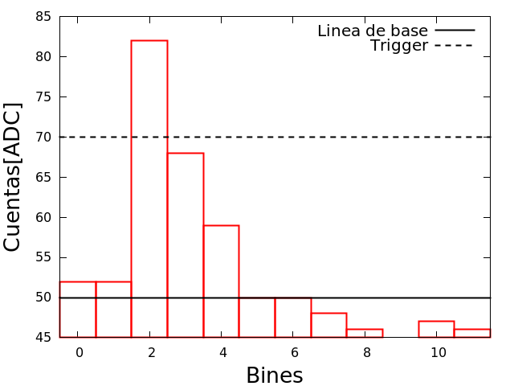
Output
S11
S12 (corr. afterpulse)
3
2
Datasheet
1
1
S13 (corr. crosstalk)
Discretized
Trigger
Data
Línea de base
Notes:
El resultado a la salida del circuito son pulsos como los que se ve acá, es decir cuando pasa un muón llegan de repente muchos fotones, y decaen con un tiempo característico que tiene que ver con cuánto tiempo tardan en llegar. Estos pulsos salen del circuito anterior y llegan a la placa de LAGO, de donde salen discretizados en valores de 1023 ADC. Hay un valor de trigger que tienen que superar los pulsos para ser registrados, que está puesto en 70 ADC, además de una línea de base que es respecto a la cual se mide la tensión discretizada.

Slide 37
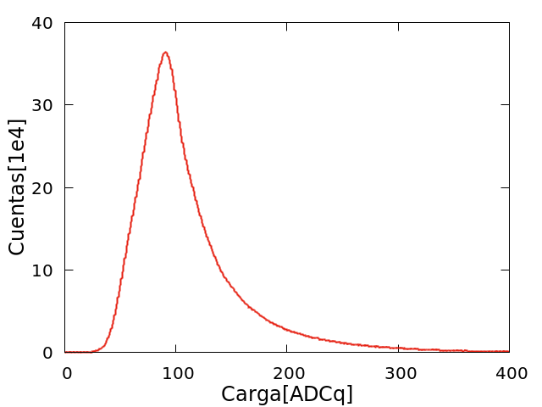



Pulse charge histogram: single photon counts
Pulso 1
Pulso 2
Notes:
Que parece no decir mucho en principio, pero luego de las mejoras en la respuesta de la electrónica se ve que cambia significativamente la forma cualitativa de la curva. A cada pico se le puede asociar la llegada de una cantidad dada de fotones, en particular para este histograma empieza en 2 fotones. Es decir, llega un fotón al SiPM y produce una corriente, que deja un pulso. El área de ese pulso es proporcional a la cantidad de fotones, y eso es lo que vemos.

Slide 38

We want to take a look to volcanoes interior...

Slide 39

High energy atmospheric muons
4000 m a.s.l. HE (E>800 GeV) secondaries simulated flux (1 m², 1 month)

Slide 40

Muon range in some standard materials
Etna
Porous rock
2 km depth
Water
Std. rock

Slide 41

Muon radiography → “Muongraphy”
Suppose you have an object with an unknown density profile, then...
  … measure the directional muon flux through this object
  … and compare with the muon reference flux
    → you get the directional opacity of this object [g/cm²]
Additionally...
  … obtain the external geometry of the object
    → and calculate the directional interaction distance [cm]
Finally, from...
  directional opacity
  directional interaction distances
    → you get the internal density profile along muon propagation direction

Slide 42

Muon directional flux measurement

Slide 43


Volcanoes Muongraphy: Mt. Iwodake (Japan)
Tanaka et al., Geophys. Res. Let. 36, L01304, 2009

Slide 44

MuTe/MuBar: Muon Telescope for muongraphy

Slide 45
Muon Camera
Two planes of “Minos” like polyestyrene plastic scintillator
  (PoP+PoPoP) organic scintillator mixture
Claded and wavelength shifter optical fiber at strip centre
120 SiPM (Hamamatsu MPPC)
Raspberry-Arduino based atmospheric monitoring system
CITIROC based electronic
Programmable and configurable on board self trigger using FPGA
Low power automatic and autonomous system
30 (4x1)cm plastic scintillator strips
→ 900 pixels (XY plane)
Two XY planes separated by 2 m
One water Cherenkov detector in between to obtain a high energy electromagnetic veto

Slide 46


MuTe (Muon Telescope)
Innovative:
  Use a WCD as an active absorbant
  1.2m water → ~ 5 X_{EM}
Local measurement of atmospheric muon flux
SiPM instead of multi-anode pixel
  No crostalk
  Lower budget
  Lower power consuption
  Simple global design

Slide 47


Now replace “water” by “warm salt water”… and use, eg, amorphous Silicon flat panels

Slide 48




Ionizing radiation detection using commercial CMOS COTS
José Lipovetzky¹, Martín Perez¹, Fabricio Alcalde Bessia¹, Miguel Sofo Haro², Iván Sidelnik³, Juan Jerónimo Blostein³, Aureliano Tartaglione^{3*},
Mariano Gómez Berisso ¹
¹ División Bajas Temperaturas, CAB, CNEA, CONICET
² Laboratorio de Detección de Partículas y Radiación, CAB, CNEA, CONICET
³ Departamento de Física de Neutrones, CAB, CNEA, CONICET
*previamente

Slide 49



CMOS?
  Improved sensitivity, consumtion, speed and cost, when compared with CCD
  System on chip: amplifier, signal conversion and prosesing in a single chip
  Camera universality → don’t blame us of Instagram cat pictures

Slide 50





Typical commercial imaging sensors
CMOS COTS
Sensor Color:
APTINA MT9V011
0.25” 640 x 480 pixels,
5.6µm pitch
Sensor ByN:
OmniVision OV5116N
0.25” 320x240 pixels
11μm pitch

Slide 51


Ionizing particle detection
Fixed points (FPN)
We can see
1- Events
2- Fixed points
3- Non zero Background (average dark current)

Slide 52


Fixed Pattern Noise
Defective pixels and thermal noise introduce a non-zero background
(fixed pattern noise, FPN)
Auto-regresive filter: fast and low computational cost. Can be easily implemented on FPGA systems

Slide 53

Fixed Pattern Noise
Extremely reduced false-positives pixels
Pixels with signals above a low threshold can be considered as a real (physics) event

Slide 54



Particle response
Different particle sources irradiation:
β, γ ¹³⁷Cs
X-ray ⁵⁵ Fe
β ¹⁵²Eu
γ ⁶⁰Co, ¹³³Ba
α, γ ²⁴¹Am and ²³⁵U

Slide 55

Particle response

Slide 56


Pixel clusterization
Radius (px)
Deposited charge

Slide 57

Detections threshold optimization
Robustness vs sensitivity Tradeoff

Slide 58






RA6 experiment tests
[NIMA 2016]

Slide 59

Particle identification
q>3000adc counts
radii > 2.5
max>125
0.4% false-positive (gammas instead of alpha)

Slide 60
Thermal neutron detection
Thermal neutrons
Conversion material
BPSG
/ SiO₂
n+
n+
n+
p ⁻ ⁻ epi
Charged particles deposit energy
p⁻ substrate
Boron and Gadolinium conversion
BNCT, neutrography, space weather, homeland security safeguard

Slide 61



Gadolinium oxide (Gd₂O₃) response
Signal amplification
with Gd
without Gd

Slide 62

Integrated dose damage: ⁶⁰Co source
(PISI-CNEA)
B&W camera, 2hs exposure at 200Gy/h.
180Gy: dark current increase
280Gy: Column saturation
400Gy: Sync issues

Slide 63

Own CMOS development for high radiation environments

Slide 64



Extreme electronics for extreme detectors
OMEGA based IN2P3 multi-channel ADC (MAROC, CITIROC)
FPGA based electronics & “sensor as a peripheral concept”
(Ultra) fast electronic response (> 100 Mhz)
Commercial on-the-shelves adquisition and control modules: WiFi, Bluetooth, Linux, C++ & Python, low cost, low power consumtion

Slide 65

Why translational 1?
“Much of the problem we have in comprehending specialists in any field is in understanding their jargon, and not in understanding their ideas. This is particularly true for medicine. Much of medical jargon of interest to us is the terminology used in anatomy, and much of that in anatomy relates to directions and positions”
La medicina es descriptiva

Slide 66

Why translational 2?
“By a direct translation of the solutions (of course the same mathematical equations must have the same solutions) it is possible to solve problems in other fields with the same ease—or with the same difficulty—as in electrostatics”
Richard Feymann, Lectures, Vol II p 12-1

Slide 67

Why translational 3?

Slide 68
This is what your University did to your brain
Sue them!

Slide 69
Extreme questions for extreme diseases
Can we (physicists) help people
who are really suffering a serious
disease (such as cancer)?
Yes!
Let’s do it together
Thank you very much

