Slide 1

Argumentation Agent Architecture
Outline
  Introduction and motivation for argumentation platform
  Related work
  Agent Architecture and communication protocol
  Future extensions

Slide 2
Introduction
argumentation field extended to CS
  AI and MAS
  Decision support systems
  Educational platforms
Motivation
  Create a stable, standard agent-based argumentation platform
  Use it to try out argumentation based collaborative decision support, negotiation etc
  Use it to try out different argumentation system acceptability rules

Slide 3
Related work
Argumentation Dialogue games
  Different types of dialogue
    Information-Seeking
    Inquiry
    Persuasion
  Primitives
    Assert
    Challenge
    Accept
  Rationality, update and dialogue rules

Slide 4
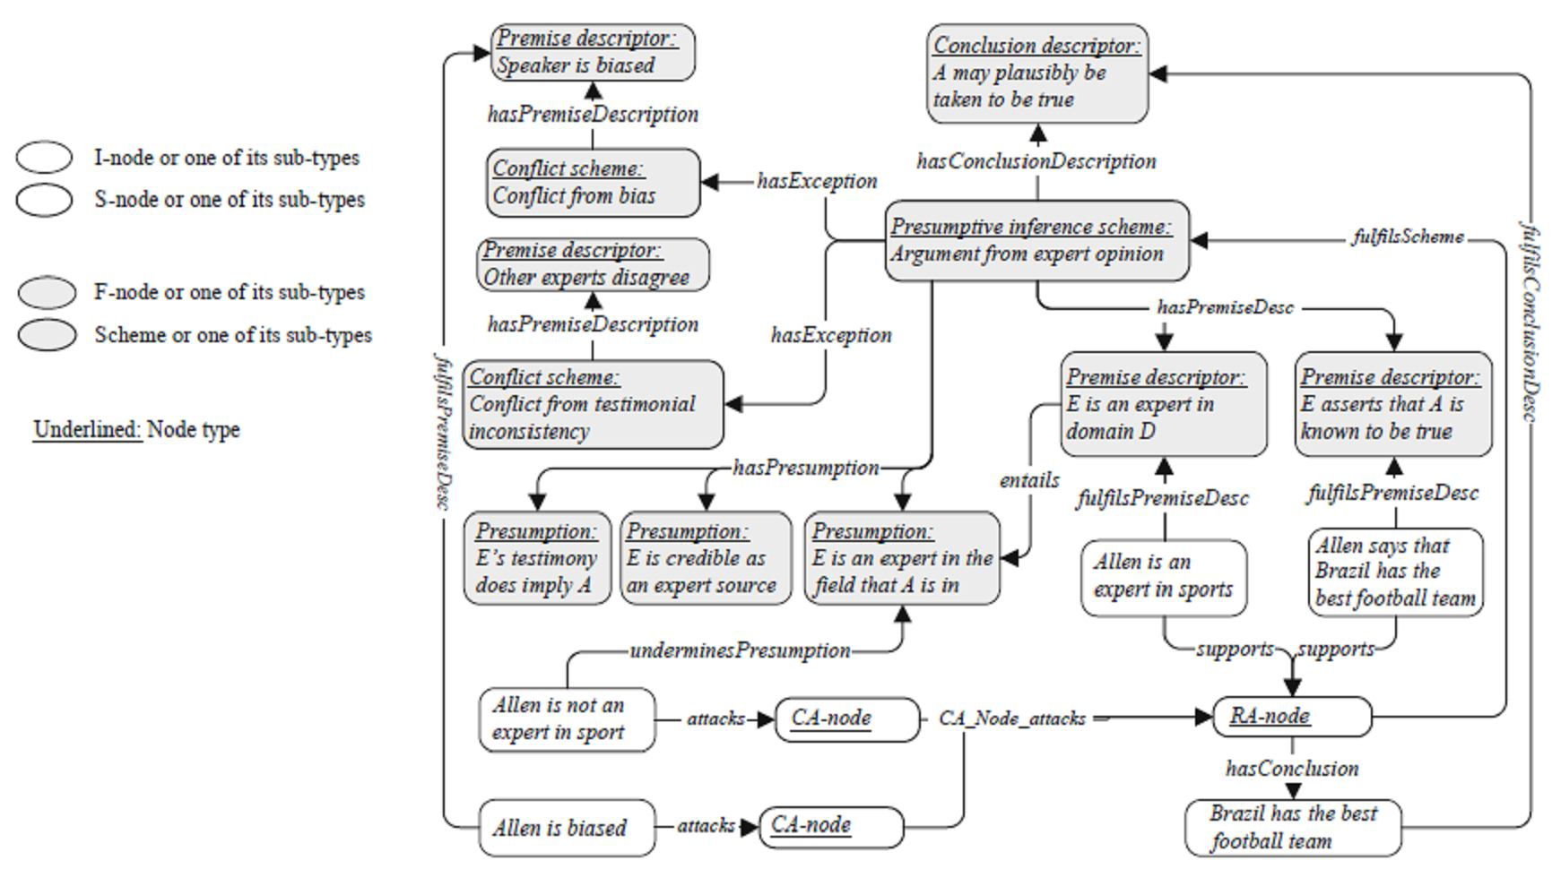
Related work (2)
AIF and its extensions

Slide 5
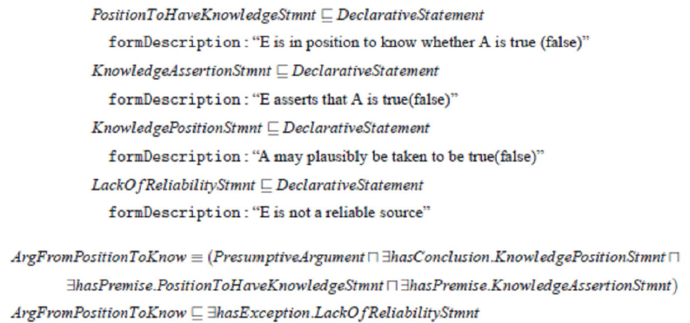
Related work (3)

Slide 6
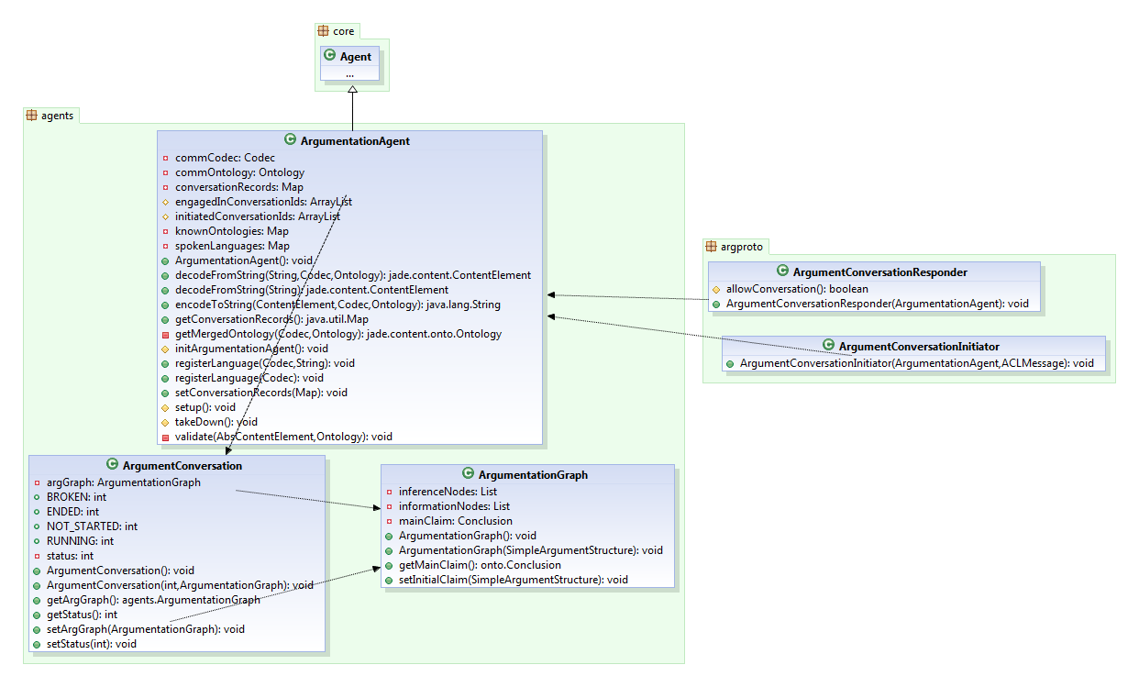
Jade Agent Architecture

Slide 7
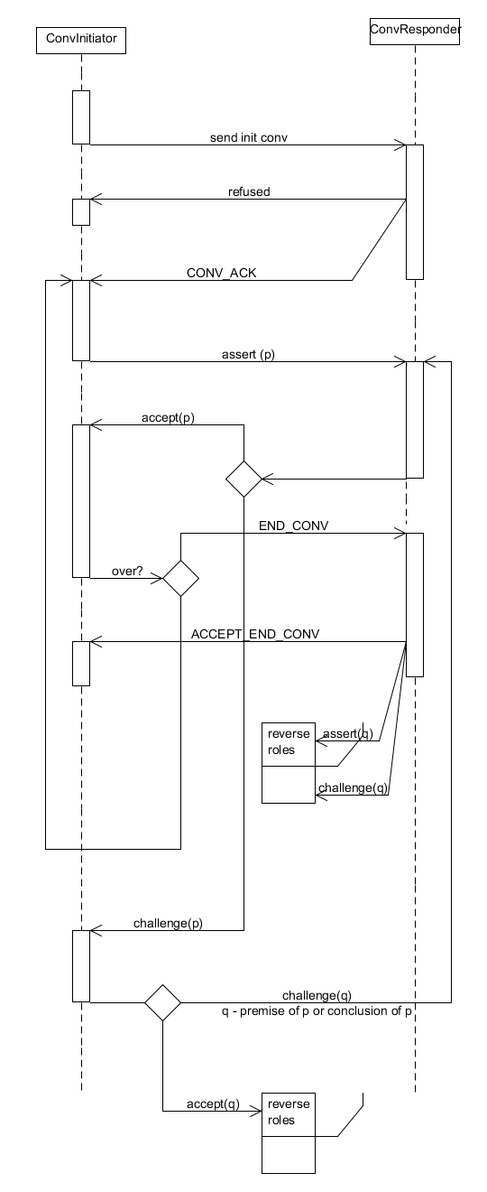
Communication Protocol

Slide 8
Model Extensions
Properly define rule, conflict and preference schemes using the constructs of the ArgDF
couple the argumentation agent with an inference engine
  understand an argument given the domain ontology
  use argumentation scheme and generate a response accordingly
  very hard problem – needs a lot of research
view argument networks in external visualization tools

Slide 9
Thank you.
Q & A.

