Slide 1
Multi-Threaded
Answer Set
Pathfinding
Adam Sosa

Slide 2
Problem:
-Automated warehouse full of robots (agents)
-Agents must move products around warehouse (tasks)
-Extremely large warehouse
-Agents may have limited memory

Slide 3
Why Multithreaded Solving?
-As data requirements become larger and larger, we will struggle to find scalable algorithms
-Apply a divide and conquer approach to pathfinding
-Can split memory requirements across multiple devices

Slide 4
Goals
-Split search space into smaller pieces
-Traverse each of the smaller search spaces
In parallel
-Allows each agent to be ignorant about the overall search space, only needs to know it’s section

Slide 5
Obstacles
-Need a way to pass agents between
sections of the search space
- Need a way to pass goals between sections of the search space
-Need to able to run multiple search spaces in parallel without conflicts

Slide 6
Search Space
-Map consisting of vertices and edges
-Tasks are identified by a task ID, and
A vertice
-Edges are bi-directional

Slide 7
Search Space cont.
-Agents are assigned 0 to many tasks to complete
-Tasks goals may or may not be in it’s search space
-Agents often must switch portions of the search space
To complete their tasks

Slide 8
Program Layout:
-Inner portion is written in Clingo, performs pathfinding
-Multiple inner portions run in parallel, one per piece of the search space, referred to as a “server”
-Outer portion is written in Python, runs and swaps information between Servers

Slide 9
Answer Set Programming
- Known for solving NP hard
problems
-Rarely used in real world
Applications
-Search problems turned into a
Search for stable models

Slide 10
Inputs
-The program takes an input file, consisting of a list of agent files, and a list of map files.
I.e.
1.agents 2.agents 3.agents
1.map 2.map 3.map
Call example:
Python pythonshell.py input.txt

Slide 11
Agent Files
-The agent files consist of agents and task
Agent atoms:
agent(W, X, Y, Z) : Where W is the agent ID,
X is the Server ID,
Y is the agent starting location,
Z is the type (unused)

Slide 12
Agent Files cont.
Task atoms:
task(U, V, W, X, Y, Z) :
Where U is the task ID,
V is the server ID
W is the goal server,
X is the group (unused)
Y is the goal vertice
Z is the agent type (unused)

Slide 13
Map Files
-Map files consist of vertices and edges
Vertice atoms:
vertice(X, Y) : Where X is the server,
Y is the vertice ID
Edge atoms:
edge(X, Y, Z): Where X is the destination server,
Y is the starting vertice,
Z is the destination vertice

Slide 14
Outputs
-The program outputs the solutions to the first
Round of solving, server by server, then to
The second round, server by server
I.e
TODO INSERT IMAGE

Slide 15
Implementation
-The inner portion is implemented in multi-shot Clingo solving
-Split into sections: Base, check, and step portions
-Base portion is performed once, consists of the initial setup to the solver
-Check portion is our stopping case, is performed after each iteration
-Step portion is the iterative step, continues executing until it hits a stop condition or is unsatisfiable

Slide 16
Base Portion
-places agents in their starting locations
at(ID, X, 0) :- agent(ID, _, X, _).

Slide 17
Check Portion
-Program isn’t finished until all tasska are “done”
:- not done(TID, t), goal(TID, _, AID, GOAL, _, _), querty(t)
-Two ways for a task to be considered done:
-it has reached it’s goal
-it’s goal is outside of it’s server and it has
Reached an edge to a new server

Slide 18
Step portion
-Where the solving actually takes place
-Actions that can be taken by each agent at each time step:
move(ID, X, Y, t): moves the agent along an edge to a new ID,
Two agents cannot move to the same vertice or
Along the same edge
stay(ID, X, t): keeps the agent at it’s current location

Slide 19
Step Portion cont
-Notable atoms in the step portion:
-Swaps are created when an agent’s goal is outside of it’s server
-It contains all the information to create an appropriate agent
And goal in the new server it’s being swapped to
-Used to pass information between servers
swap(R,S,T,U,V,W,X,Y,Z): Where R is the task ID,
S is the server, T is the agent,
U is the goal, V is the group,
W is the location,
X is the destination server,
Y is the goal server,
Z is the time the swap is created

Slide 20
Step Portion cont
-Goals are created from tasks and assigned to agents
-Goals must reach done state in order for solver to be satisfied
Goal(U, V, W, X, Y, Z): Where U is the task ID,
V server
W is the agent ID,
X is the goal,
Y is the group,
Z is the goal server

Slide 21
Outer Portion
-Implemented in Python
-Initializes servers
-Passes information between servers
-Runs servers with the new information

Slide 22
Step One
-Find the number of servers

Slide 23
Step One cont
-Open input file, read in our agent list and map list
-Find the number of servers we’re using
-Find the number of agents per server
-Run first round of solver (in parallel)
Clingo iterative.lp mapi.txt agenti.txt

Slide 24
Step Two

Slide 25
Step Two cont
-Prune excess output (Clingo solver information, version information, etc.)
-Process output for each server:
-Update the agents to correct location (updatagents method)
-Process and update swaps (Processswap and updateswap methods)
-Write processed output to new input files

Slide 26
UpdateAgents method
-Inputs: the output of one of our servers
-Output: A string containing all the agents in the server with updated locations
-For each agent, search output for last move action, make a
New agent atom with starting location equal to it’s last destination vertice
-add the new agent items to the string

Slide 27
ProcessSwap method
-Inputs: The output of one of our servers
-Outputs: A two element list with the processed swaps at index zero,
And the destination server of the swap at index one
-Search our output for “swap(” substring
-If found, take swap information, turn it into a list
-use the list to turn the swap into a new agent and goal atom, find the destination server of the new atoms
-add new atoms to the return list

Slide 28
UpdateSwap Method
-Inputs: the output of one of our servers, an agent list, the server ID,
The agent offset
-Outputs: a list of length numservers with the outputs swaps converted
Agent and goal atoms
-For each swap:
-Find the index of a swap
-If found, call process swap to convert it into new atoms
-Remove any previous instances of the agent from the agent list
-Add the new atoms to the output list at index servernum
-remove the swap

Slide 29
Updating Atoms
-Create a list of size servers
-For each server:
-Update agents
-Process swap

Slide 30
End Result
-list of lists, each of size numserver
-outer index is the current server number
-inner index is the destination server of the atoms at that index
I.e.
Server two’s results are:
[1][2] + [2][2] + [3][2]........+ [i][2]

Slide 31
Create new Input
-For each server:
-Create a new agent file
-Add the updated atoms for that server to the file

Slide 32
Step Three

Slide 33
Step Three cont
-Use the new agent files as input for a new round of servers
-Find solutions

Slide 34
Testing
-Map consisting of four strongly connected quadrants
-Forty vertices per quadrant
-Three agents per quadrant
-Six tasks per quadrant

Slide 35
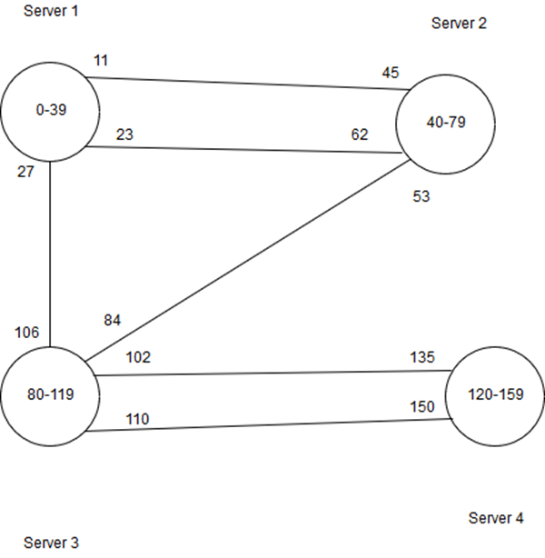
Search Space

Slide 36
Testing cont
-Split the map into one, two, and four servers
-two server run combined quadrants one and two (six agents, twelve tasks), and servers three and four (six agents, twelve tasks)
-one server: 5.585 seconds
-two servers: 48.551 seconds
-four servers: 5.25 seconds

Slide 37
Results
-Most notable results in the two server run
-Increased overhead of managing servers, servers still too large
-Four server run shows marginal increase over one server
-Further splitting the search space may lead to more significant gains

Slide 38
Limitations
-Servers must be strongly connected
-Tasks cannot be more than two server jumps away from starting point

Slide 39
Future Work
-Make the program “truly” parallel
-Implement some form of visited list
-Detect agent collisions between servers

Slide 40
The End

