Slide 1
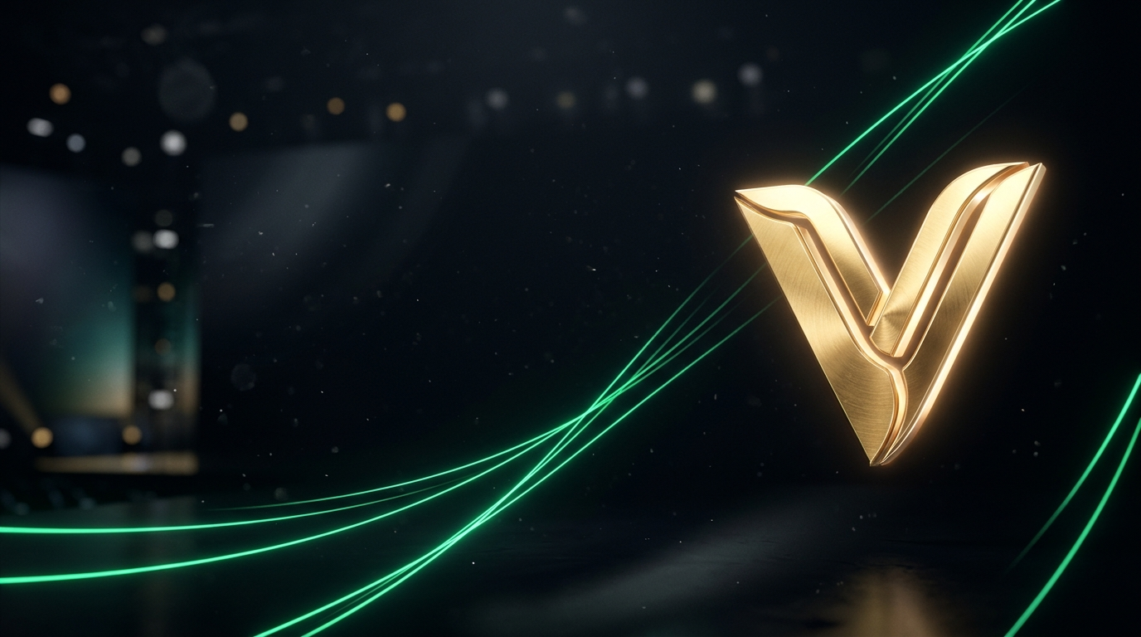

No Open-Source Tool Gives You
Beautiful Editable Slides.
Vwoosh does.
JSON in. Native, editable .pptx out. MIT-licensed.

Slide 2
The problem: editable, yes. Beautiful, no.
Editable? Yes.
python-pptx and friends CAN produce real, editable slides. The format was never the blocker.
Beautiful? No.
Out of the box, open-source output is flat: default fonts, no layout sense, zero art direction.
Closed tools? A trap.
Slick output, but expensive APIs or uneditable image dumps. You rent pixels you can't touch.
Source: authors' smoke test over 18 agent decision contracts, Nov 2026.

Slide 3
Built in one 12-hour sprint. Zero hand-written lines.
12 hours
Idea to working API + frontend, agents doing architecture, code, debug, docs.
0 lines
Zero hand-written code. We prompted, reviewed, and shipped.
100% editable
Every slide is native PPTX — text, shapes, charts. Nothing rasterized.
• Muse Code did the coding with muse-spark-1.3-contributor (thanks to Meta credits).
• Vwoosh wrote the specs and orchestrated Muse Code with muse-spark-open (thanks to Baseten).
• We only navigated.

Slide 4
Live proof: this file was never in PowerPoint.
Minutes from prompt to finished .pptx, measured on this repo:
How it works:
1. Chat the brief, get a structured outline.
2. Outline renders to native PPTX in memory.
3. Download, open, edit everything.
JSON → Vwoosh → .pptx — the file you are reading is the demo.
Source: repo-local timing, single run, Nov 2026. Hand-coded = authors' estimate for this deck.

Slide 5
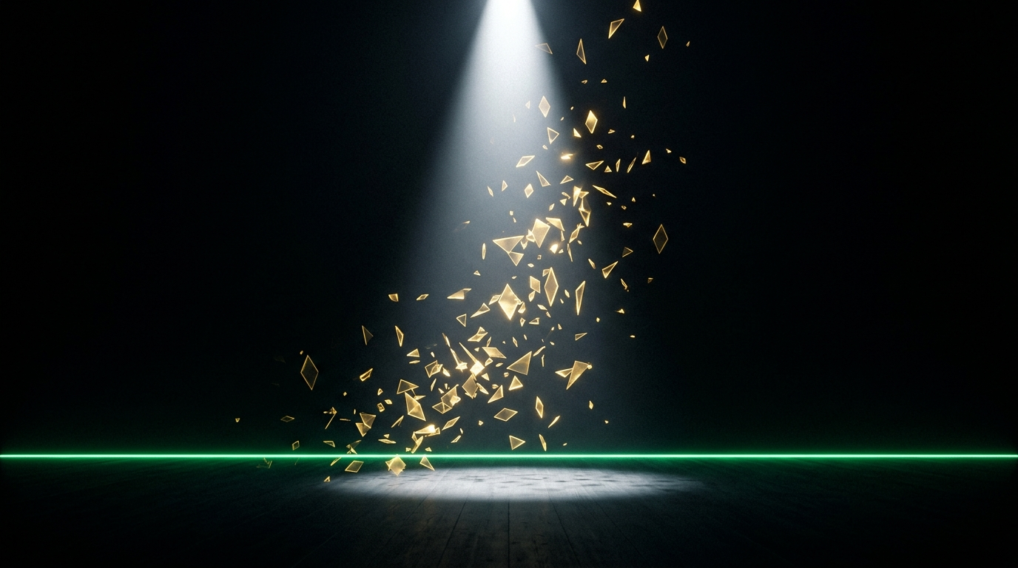
Star it. Fork it.
Ship it tonight.
MIT-licensed, open source.
github.com/asoshnin/vwoosh-presentation-maker

Slide 6
Appendix: what's next.
• Per-slide art direction: upload, fetch, or generate images outside the dialogue.
• Session image library with license tags; PNG preview per slide before full render.
• Validated layout geometry (no overlaps, in-bounds) + text auto-fit before every render.
• Structured pack first: action titles, source lines, one exhibit per slide.
• The geometry validator already ships in this repo. The engine is next.
P.S. This demo was crafted by AI. AI hallucinates. Only humans can be held accountable.

