Slide 1
Entertainment Buster
Segment Two: Dashboard

Slide 2
Dashboard Requirements for Segment Two
A blueprint for the dashboard is created and includes all of the following:
✓ Storyboard on Google Slide(s)
✓ Description of the tool(s) that will be used to create final dashboard
✓ Description of interactive element(s)

Slide 3
✓ Storyboard on Google Slide(s)
Introduce audience to number of Netflix titles under analysis
Display Pie Chart to show proportion of TV Shows vs. Movies
Display bar graph of average IMDb ratings by Genre of Netflix Titles
Display bar graph of average IMDb ratings by Genre of Netflix TV Shows
Display bar graph of average IMDb ratings by Genre of Netflix Movies
Display area chart of number of titles based on their year of release
Display bubble chart showing which years had the most titles added to Netflix based on year added
Display interactive world map with filters showing countries and their Netflix title count along with filtering on their release year for more customizable data insights

Slide 4
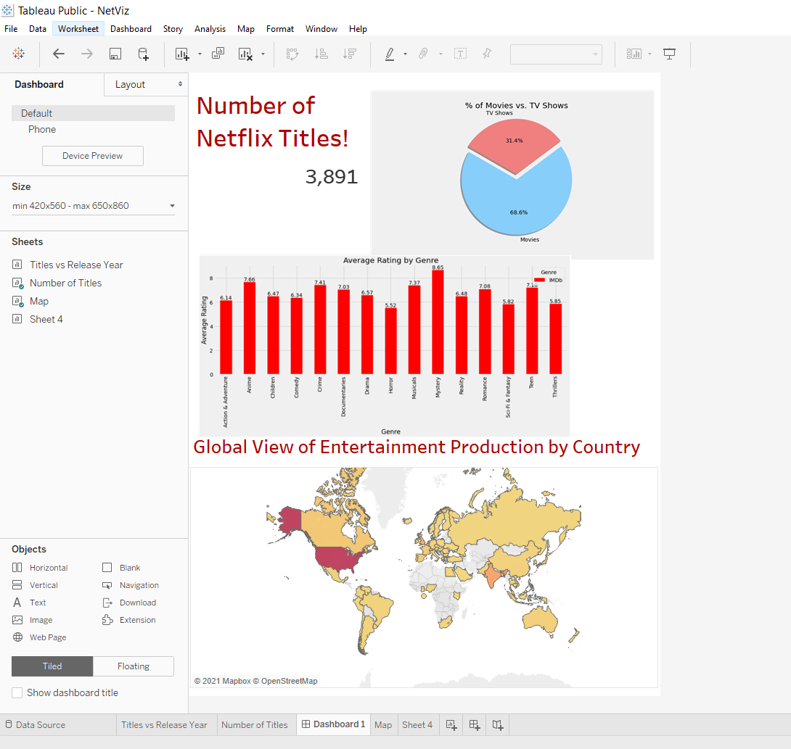
Dashboard Preview:

Slide 5

✓ Description of the tool(s) that will be used to create final dashboard
Tool(s) used:
Tableau

Slide 6
Tableau Public Published Link to Dashboard and Story
https://public.tableau.com/profile/stacy.chandisingh#!/vizhome/NetViz/EBStory?publish=yes

Slide 7
✓ Description of interactive element(s)
Interactive elements include:
A slider as a legend to analyze: Number of Titles by Year of Release
A slider to change a range of years for the “Year Added” and a filter on the world map to filter by country. These interactive element will help the audience focus on specific data insights.
When filtered on a country within the world map, the area chart, pie chart and number of titles are also filtered depending on the country selected.

