Slide 1


Slide 2
REAL PROBLEM

Slide 3
GLoBAL TENDENCY

Slide 4
ECOSYSTEM
Car Manifacturers
EMSP
BANKS
People
Energy Producer
Charging Network
Billing and Settlers

Slide 5
Complexity
Car Manifacturers
EMSP
BANKS
People
NIGHTMARE
Energy Producer
Charging Network
Billing and Settlers

Slide 6
WE present the EMt (electric mobility token)
Car Manifacturers
EMSP
BANKS
People
X
Energy Producer
Charging Network
Billing and Settlers

Slide 7


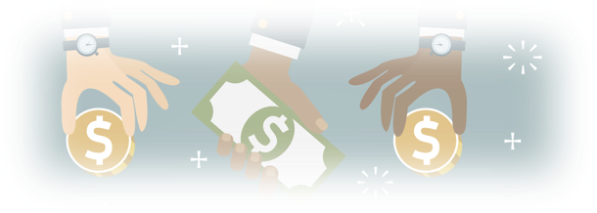
CHARGING
Car Manifacturers
Car Manifacturers
EMSP
EMSP
BANKS
BANKS
People
People
X
Energy Producer
Energy Producer
Charging Network
Charging Network
Billing and Settlers

Slide 8


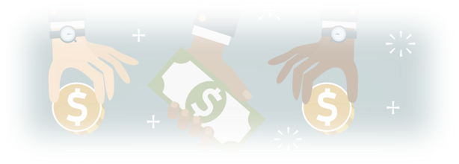
LEASING
Car Manifacturers
Car Manifacturers
EMSP
EMSP
BANKS
BANKS
People
People
X
Energy Producer
Charging Network
Charging Network
Billing and Settlers

Slide 9

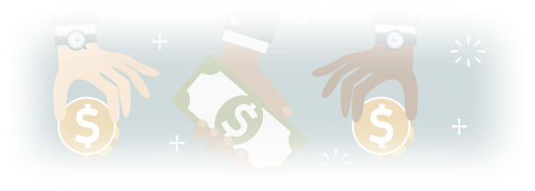
SETTLEMENT
Car Manifacturers
Car Manifacturers
EMSP
EMSP
BANKS
BANKS
People
People
X
Energy Producer
Energy Producer
Charging Network
Charging Network
Billing and Settlers

Slide 10

START BY VERIFYING
Car Manifacturers
EMSP
BANKS
People
Energy Producer
Charging Network
BLOCKCHAIN
VERIFIED

Slide 11

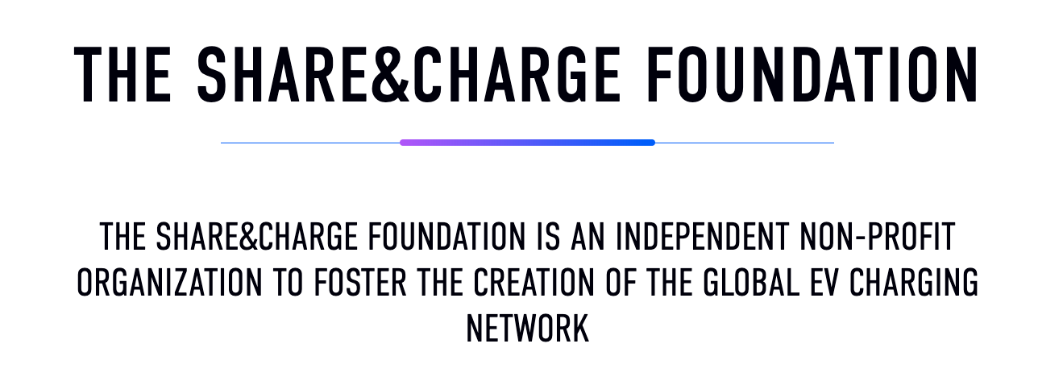
IT IS ALREADY HAPPENING

Slide 12
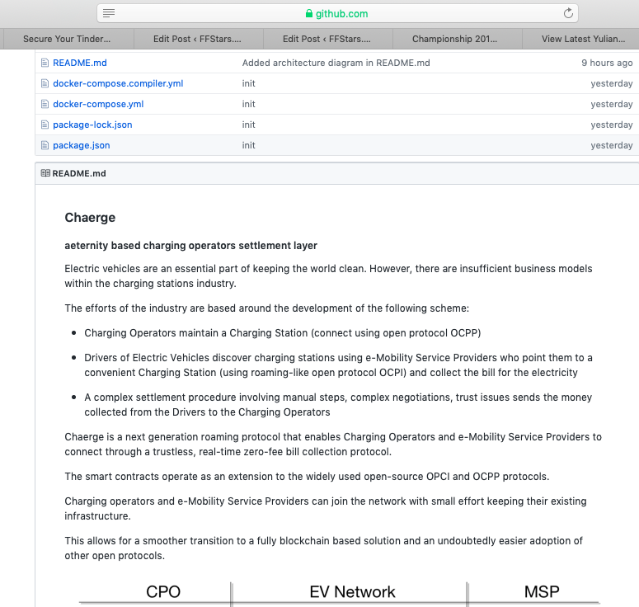
https://github.com/asotirov/chaerge-aeternity-haeckathon-2019

