Slide 1
Fifty Shades (Years) of Database Technology

Slide 2
Topics
Relational Databases
Entities
Relationships
OLAP Versus OLTP
Transactions
Analytics
Cluster Computing
Big Data
Spark
NOSQL
Graph Databases
Aggregation is Out
Connection is In

Slide 3
What is a database?
Wikipedia says:
“A database is an organized collection of data. The data are typically organized to model relevant aspects of reality in a way that supports processes requiring this information.”

Slide 4
Database Design
What are the data entities of the system?
What are the attributes of each entity?
What are the constraints on the attributes of the entities?
What can be used to uniquely identify entities in the system?
How are the different entities related?

Slide 5
Entities
A person, place or thing about which we want to collect and store multiple instances of data.
Similar to an Object in Object Oriented Design
Think of Entities as nouns
These will be the tables in your database

Slide 6
Attributes
Data that describes the Entities.
These will be the columns of each table in your database.

Slide 7
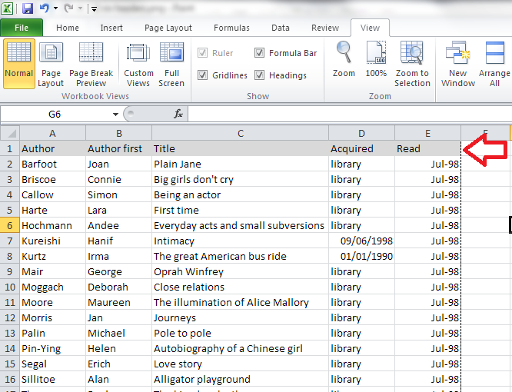
Familiar concept?

Slide 8
Constraints
Specific rules for the Attributes.
Make sure that the data is consistent.
In SQL:
NOT NULL
UNIQUE
CHECK
DEFAULT

Slide 9
How to access a record?
Primary Key: attribute or combination of attributes that uniquely identify each row in the table.

Slide 10
Relationships
Entities have some relationship to other entities in the system
Illustrates an association between two entities.
Cardinality Constraints:
Zero or More
One or More
One and only One
Zero or One

Slide 11
ERD
Entity-Relationship Diagram
Data Model to describe a database in an abstract way
Visually shows the relationships of data within the system
We will use Crow’s Foot Notation, because that is what real-world professionals use

Slide 12
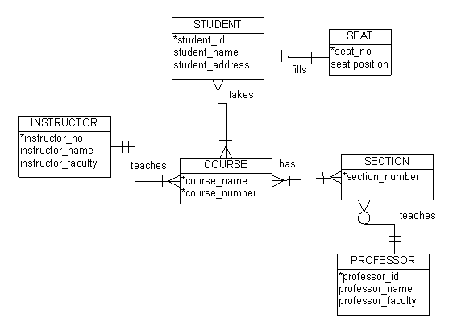
ERD Example
Can I code this exactly as is??

Slide 13
CREATE TABLE Student (
student_id INT,
student_name VARCHAR(30),
student_address VARCHAR(40),
PRIMARY KEY (student_id)
)
CREATE TABLE Course (
course_name VARCHAR(20),
course_number INT,
PRIMARY KEY (course_name, course_number)
)

Slide 14
CREATE TABLE Enrollment (
student_id INT,
course_name VARCHAR(20),
course_number INT,
PRIMARY KEY
(student_id, course_name, course_number),
FOREIGN KEY (student_id)
REFERENCES Student(student_id),
FOREIGN KEY (course_name, course_number)
REFERENCES Course(course_name, course_number)
)

Slide 15
Example
Think about a system that keeps track of doctor appointments scheduled by patients.
What would the entities (tables) be?
What would be the attributes (fields/columns) of each entity?
What uniquely identifies the entities? (primary keys)
How are the entities related?
Notes:
write on board….

Slide 16
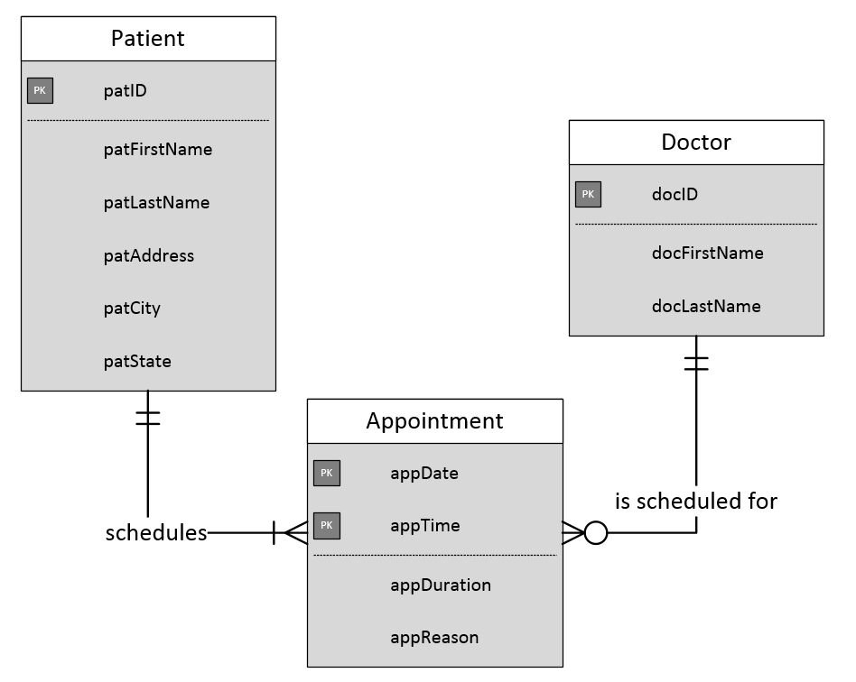

Slide 17
Fifty Shades (Years) of Database Technology
Video Two

Slide 18
Data Warehouses
Relational : Often Online Transaction Processing (OLTP)
High volume inputs
Data organized to avoid redundancy
Data Warehouses: Often Online Analytical Processing (OLAP)
Decision Support
Designed for Analytical Speed
Notes:
write on board….

Slide 19
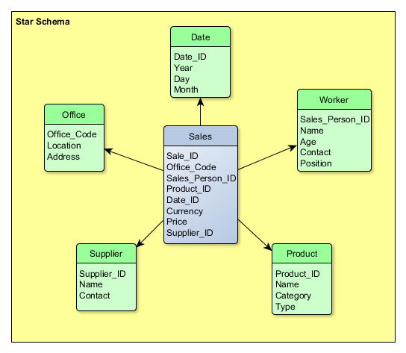
OLAP Database Design: Star Schema
Notes:
write on board….

Slide 21
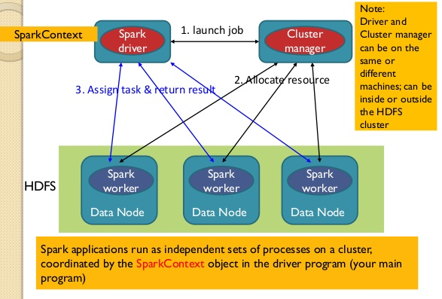
Big Data: Distributed Computing on Clusters
Notes:
write on board….

Slide 22
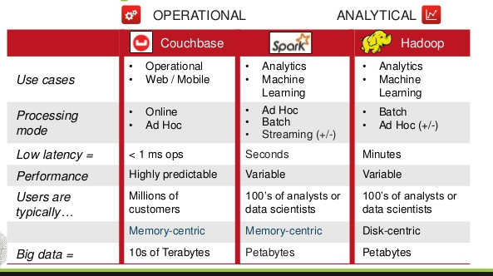
Big Data: Distributed Computing on Clusters
Notes:
write on board….

Slide 23
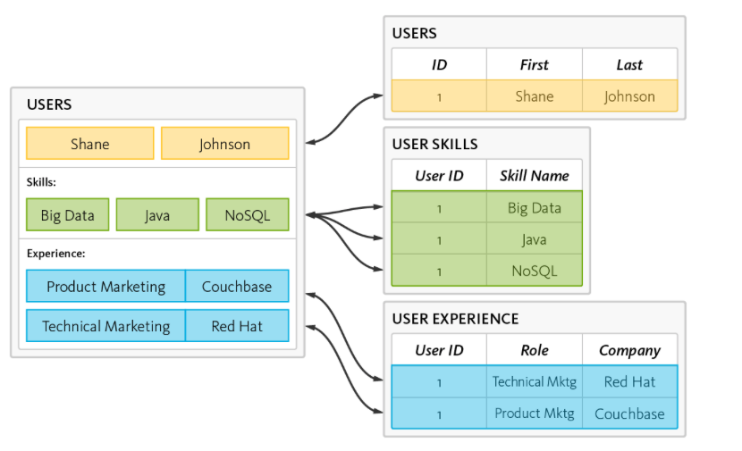
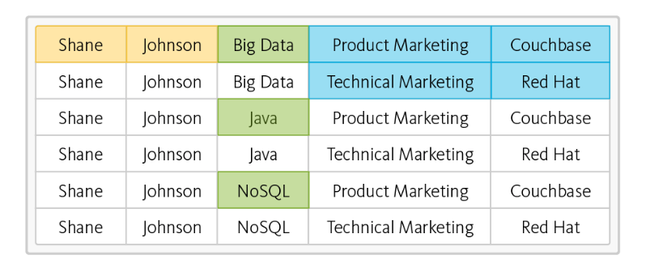
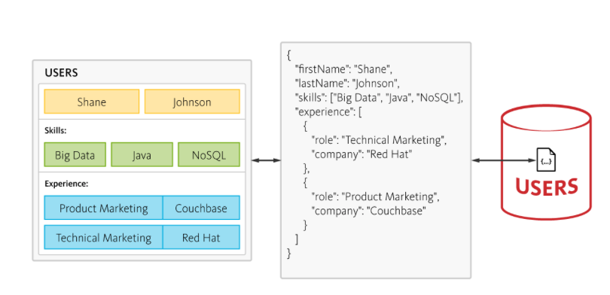
NOSQL
Notes:
write on board….

Slide 24
Fifty Shades (Years) of Database Technology
Video Three

Slide 25
Fifty Years of Database Technology
OLTP / OLAP: Long History, Built on a relational model
NOSQL / Spark: High Volume Inputs, Distributed Processing
Graph Databases: Combining OLTP & OLAP Performance Characteristics in One Technology

Slide 26
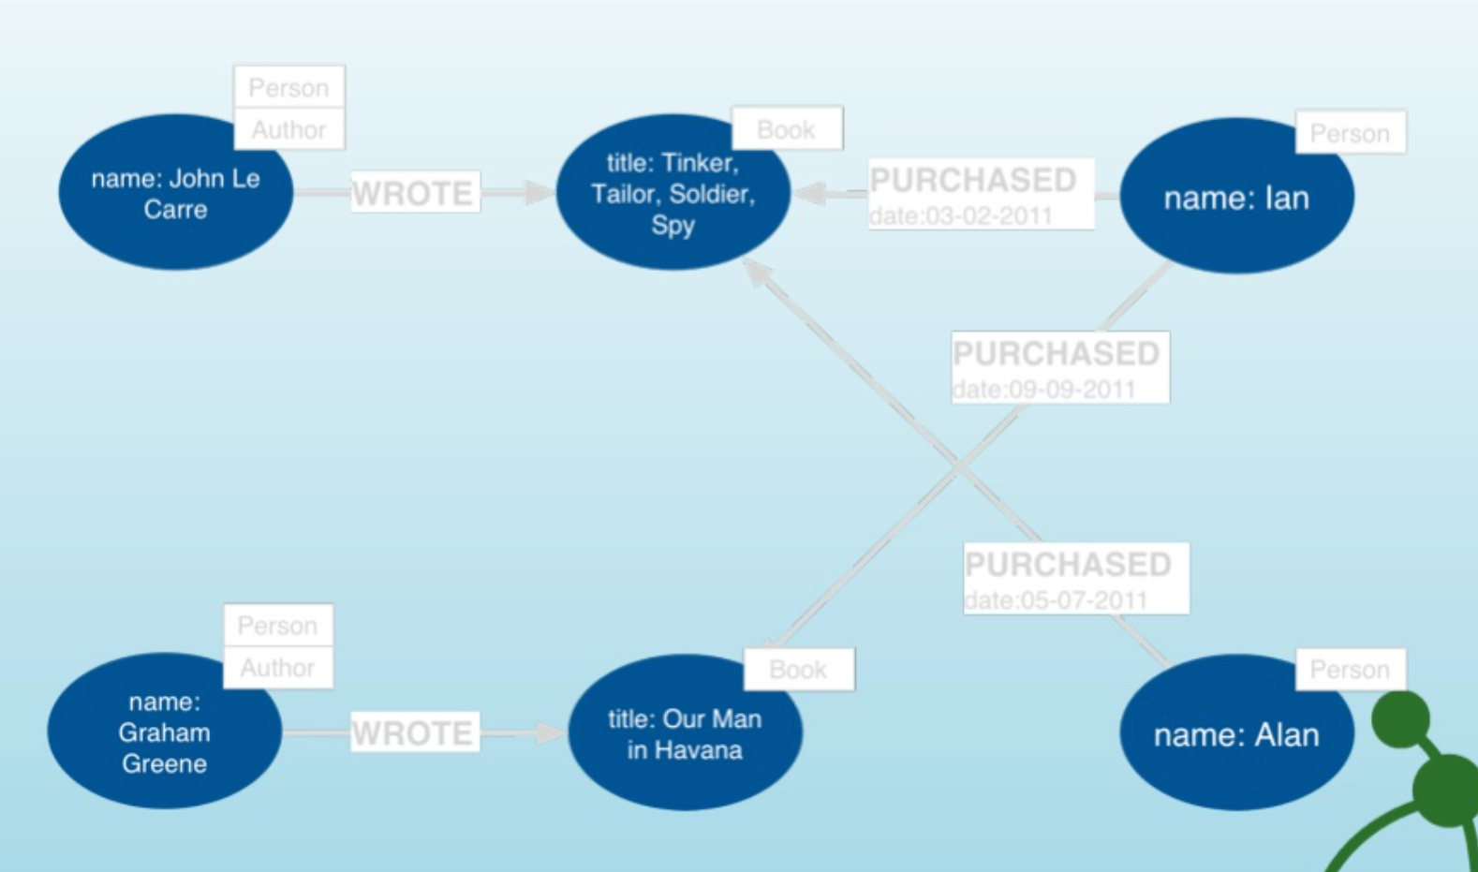
Graph Databases
Aggregate v Connected Models: OLAP & OLTP are both “Aggregate” focused. Graph Databases are “Connection Focused”
Graph Building Blocks
Nodes
Entities (tables)
Relationships
Connect to Structure
Properties
Attributes and metadata
Labels
Group Nodes by Role
Notes:
write on board….

Slide 27
Graph Databases
Aggregate v Connected Models: OLAP & OLTP are both “Aggregate” focused. Graph Databases are “Connection Focused”
Graph Building Blocks
Nodes
Entities (tables)
Relationships
Connect to Structure
Properties
Attributes and metadata
Labels
Group Nodes by Role
Notes:
write on board….

Slide 28
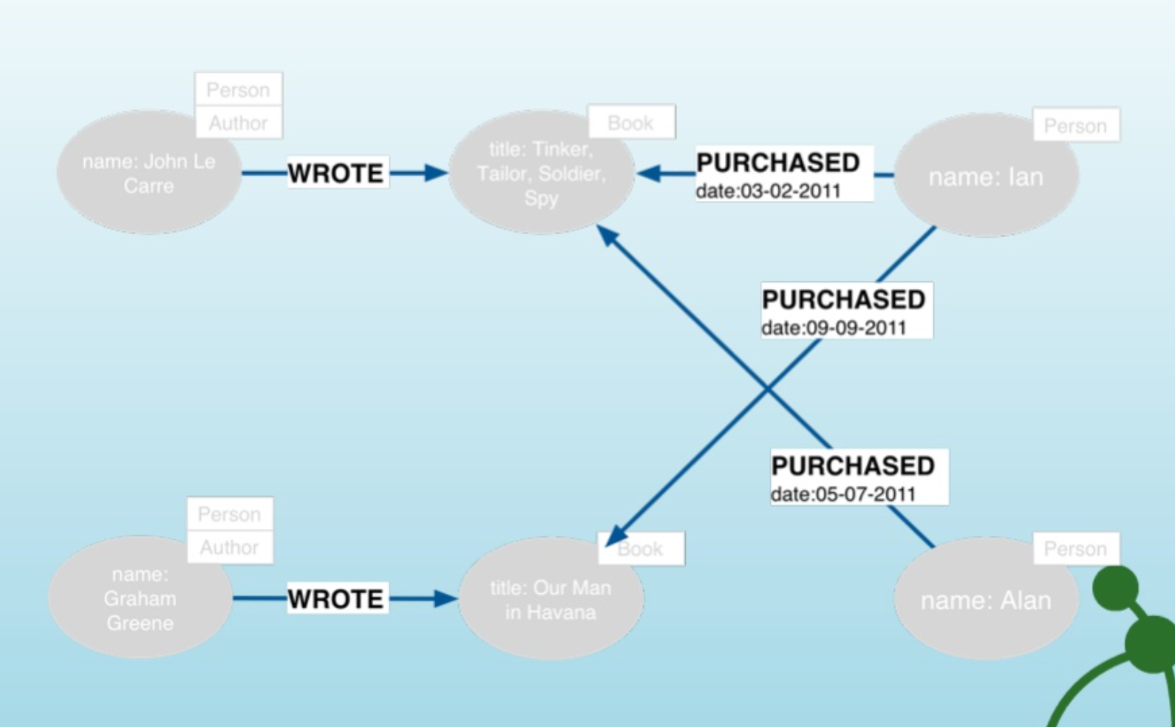
Graph Databases
Aggregate v Connected Models: OLAP & OLTP are both “Aggregate” focused. Graph Databases are “Connection Focused”
Graph Building Blocks
Nodes
Entities (tables)
Relationships
Connect to Structure
Properties
Attributes and metadata
Labels
Group Nodes by Role
Notes:
write on board….

Slide 29
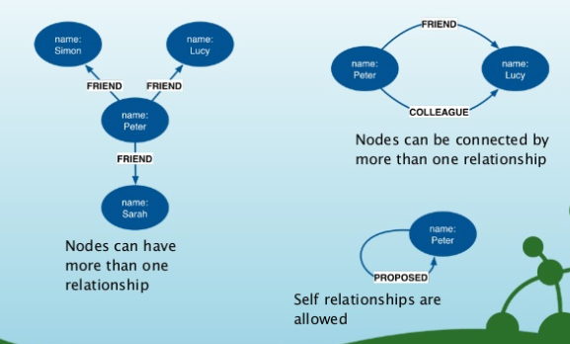
Graph Databases
Aggregate v Connected Models: OLAP & OLTP are both “Aggregate” focused. Graph Databases are “Connection Focused”
Graph Building Blocks
Nodes
Entities (tables)
Relationships
Connect to Structure
Properties
Attributes and metadata
Labels
Group Nodes by Role
Notes:
write on board….

Slide 30
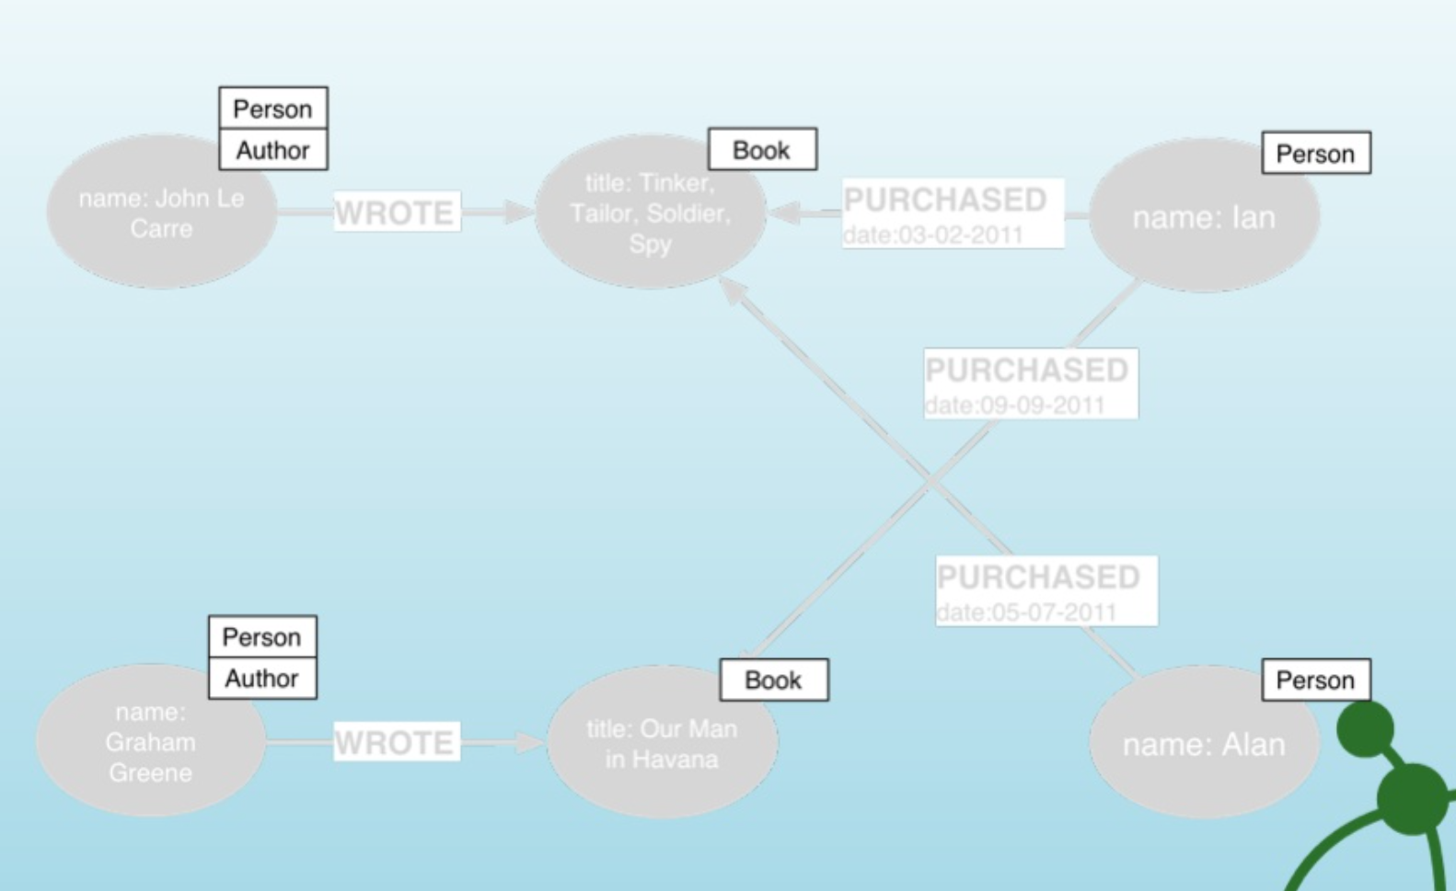
Graph Databases
Aggregate v Connected Models: OLAP & OLTP are both “Aggregate” focused. Graph Databases are “Connection Focused”
Graph Building Blocks
Nodes
Entities (tables)
Relationships
Connect to Structure
Properties
Attributes and metadata
Labels
Group Nodes by Role
Notes:
write on board….

Slide 32
DData

