Slide 1


Introduction to Database and Cloud Computing
University of Missouri
Course Introduction

Slide 3
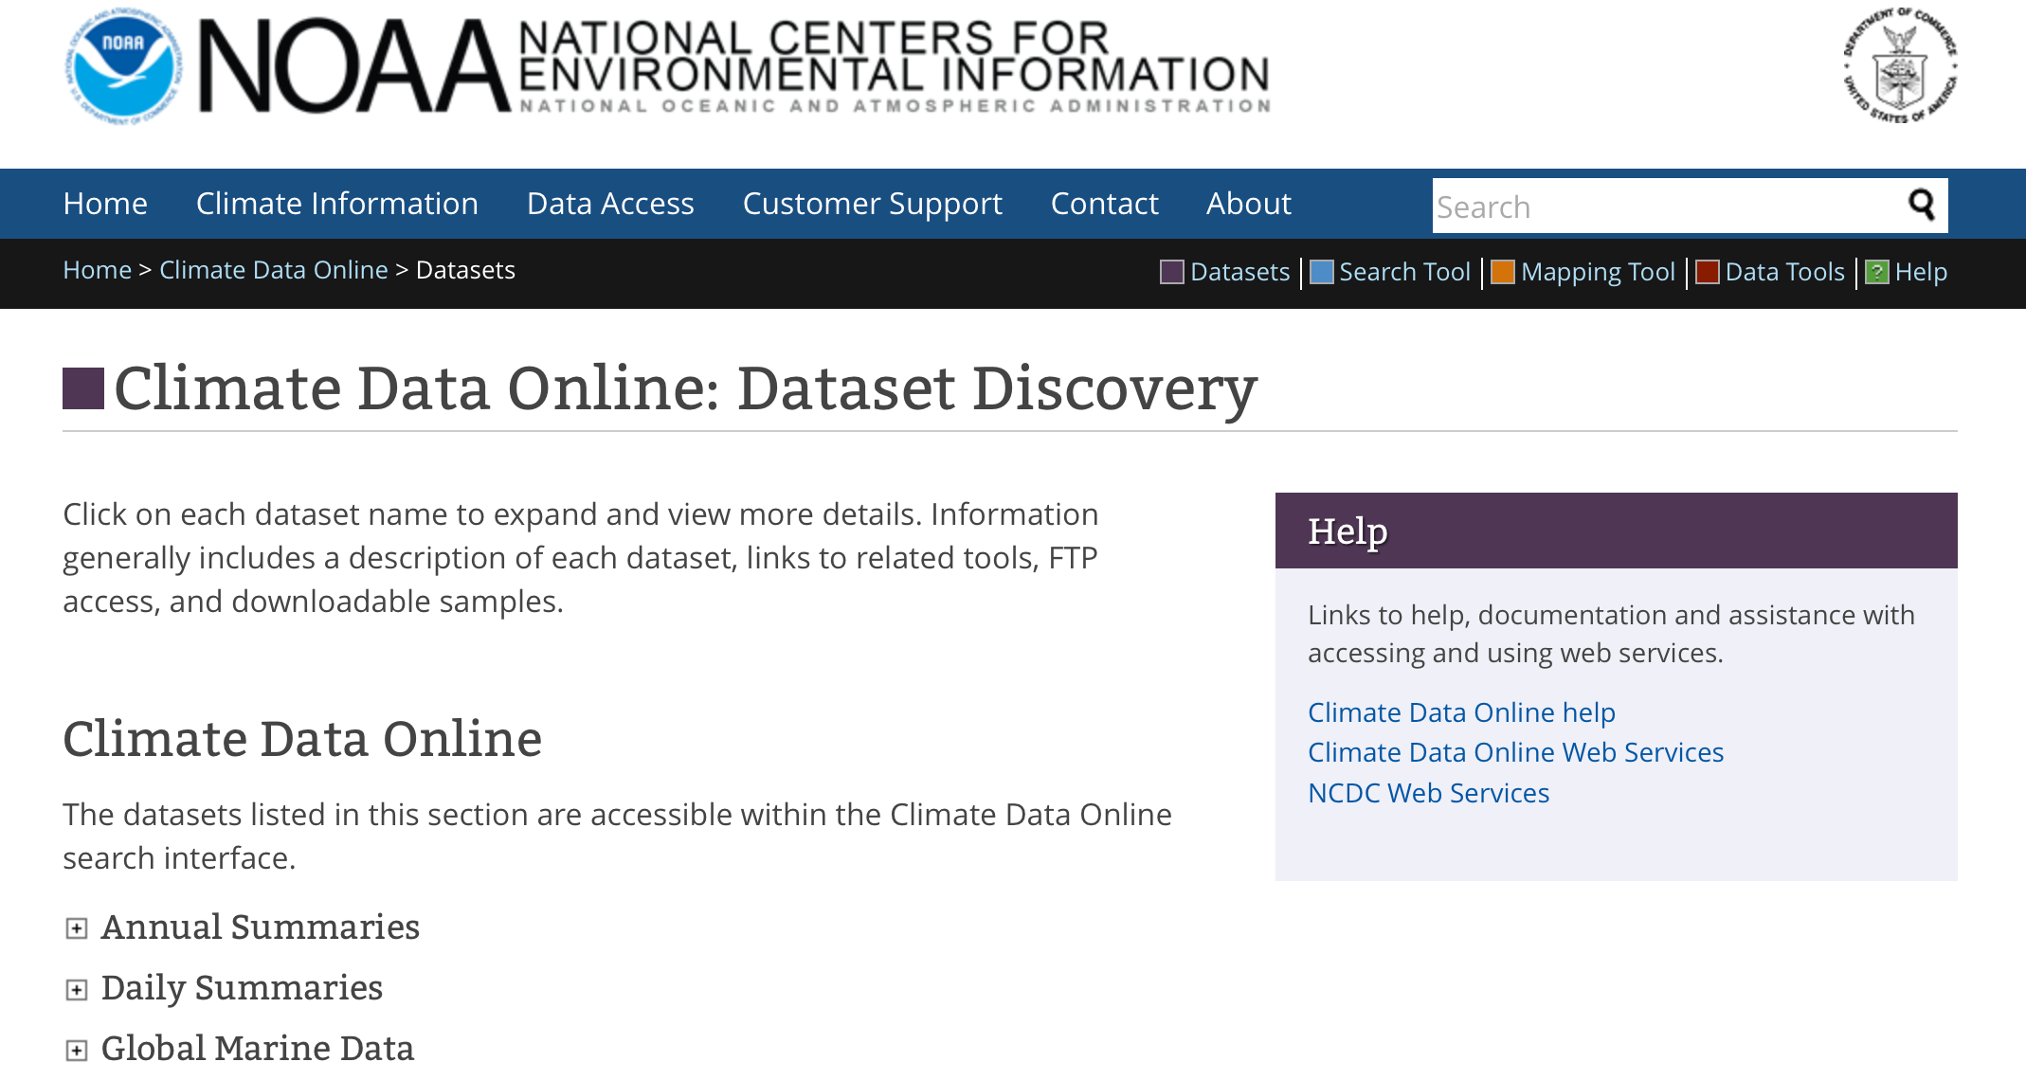
Objectives
Students will be able to compare multiple data sets and identify the strengths and weaknesses of each data set in terms of data quality and suitability for answering a particular set of questions.

Slide 4
Objectives
Students will be able to identify software tools and algorithms appropriate for analyzing large data sets

Slide 5
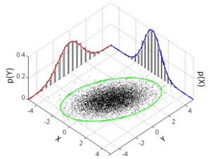
Objectives
Students will be able to integrate data sets from multiple sources, using appropriate software and data storage technologies.

Slide 6
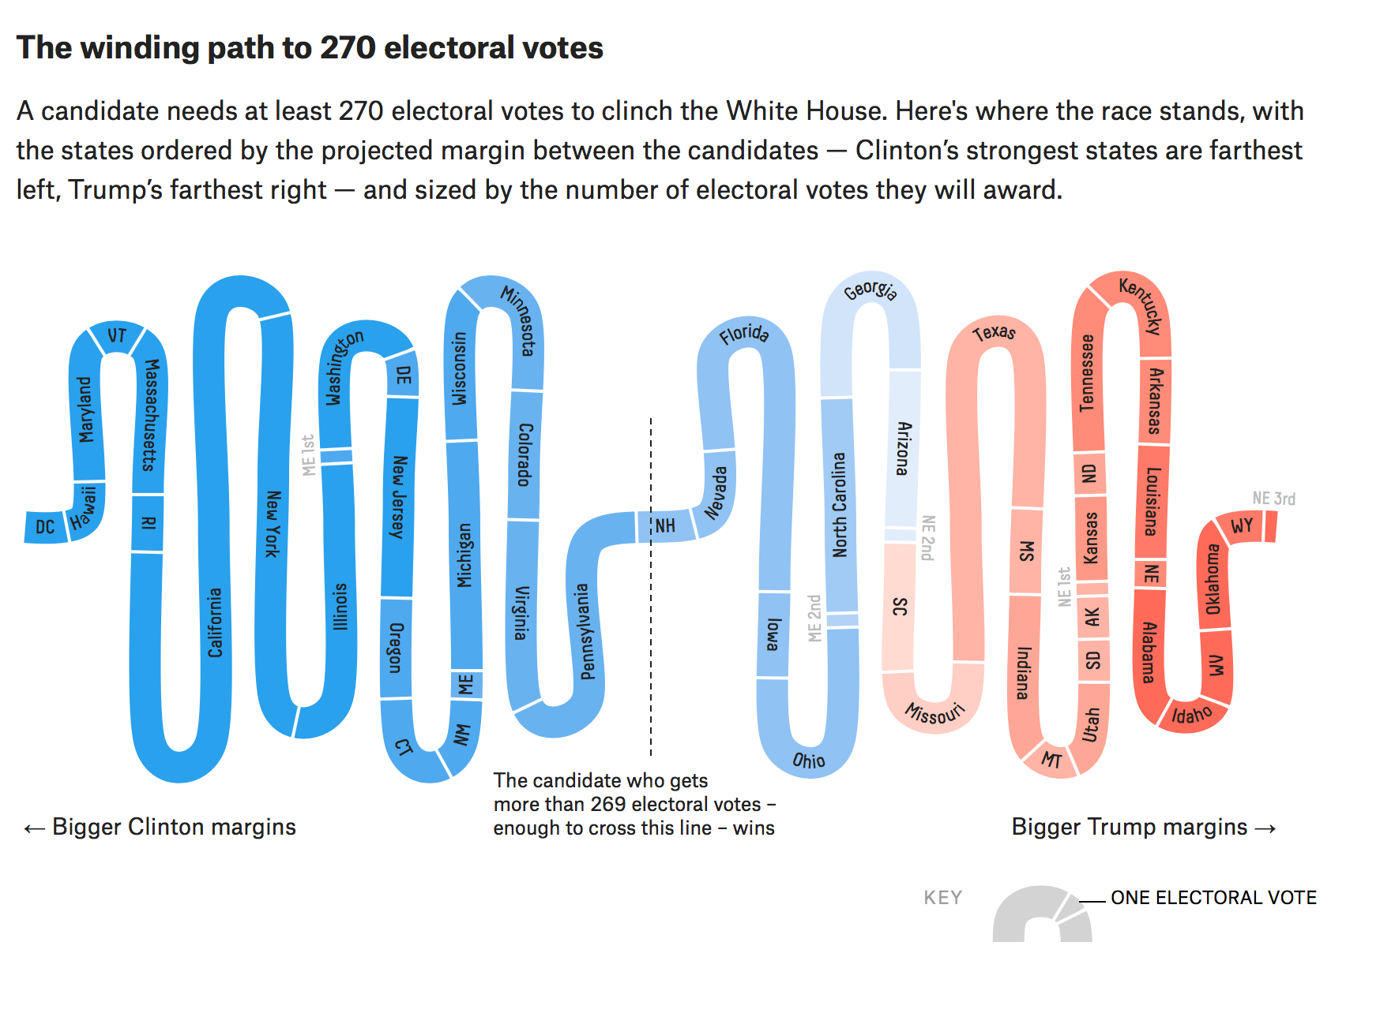
Objectives
Students will be able to develop visualizations that use domain relevant indicators to illustrate categorical differences in sets of data.

Slide 7
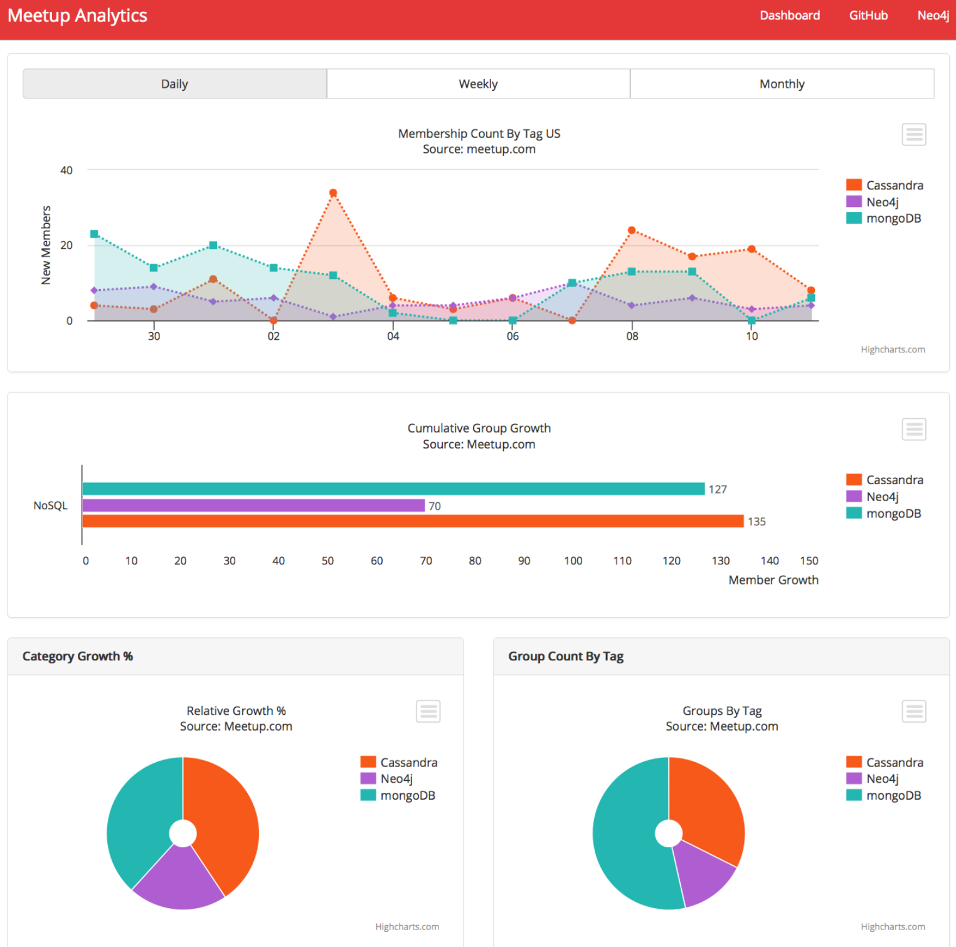
Objectives
Students will demonstrate the ability to apply data, data preparation techniques, machine learning, visualization and computational modeling to tell compelling stories to consumers of their analysis.

