Slide 1
Data Mining:
Concepts and Techniques
Mining Text Data

Slide 2
Mining Text and Web Data
Text mining, natural language processing and information extraction: An Introduction
Text categorization methods

Slide 3




Mining Text Data: An Introduction
Data Mining / Knowledge Discovery
Structured Data Multimedia Free Text Hypertext
HomeLoan (
Loanee: Frank Rizzo
Lender: MWF
Agency: Lake View
Amount: $200,000
Term: 15 years
)
Frank Rizzo bought
his home from Lake
View Real Estate in
1992.
He paid $200,000
under a15-year loan
from MW Financial.
<a href>Frank Rizzo
</a> Bought
<a hef>this home</a>
from <a href>Lake
View Real Estate</a>
In <b>1992</b>.
<p>...
Loans($200K,[map],...)
Notes:
Throughout this course we have been discussing Data Mining over a variety of data types.
Two former types we covered were Structured Data (relational) and multimedia data.
Today and in the last class we have been discussing Data Mining over free text,
and our next section will cover hypertext, such as web pages.
Text mining is well motivated, due to the fact that much of the world’s data can be
found in free text form (newspaper articles, emails, literature, etc.). There is a
lot of information available to mine.
While mining free text has the same goals as data mining in general
(extracting useful knowledge/stats/trends), text mining must overcome
a major difficulty – there is no explicit structure.
Machines can reason will relational data well since schemas are explicitly available.
Free text, however, encodes all semantic information within natural language. Our
text mining algorithms, then, must make some sense out of this natural language
representation. Humans are great at doing this, but this has proved to be a problem for machines.

Slide 4
Bag-of-Tokens Approaches
Documents
Token Sets
Four score and seven years ago our fathers brought forth on this continent, a new nation, conceived in Liberty, and dedicated to the proposition that all men are created equal.
Now we are engaged in a great civil war, testing whether that nation, or …
nation – 5
civil - 1
war – 2
men – 2
died – 4
people – 5
Liberty – 1
God – 1
…
Feature
Extraction
Loses all order-specific information!
Severely limits context!
Notes:
The previous text mining presentations “made sense” out of free text by
viewing text as a bag-of-tokens (words, n-grams). This is the same approach as IR.
Under that model we can already summarize, classify, cluster, and compute co-occurrence stats over free text.
These are quite useful for mining and managing large volumes of free text.
However, there is a potential to do much more. The BOT approach loses a LOT of information
contained in text, such as word order, sentence structure, and context. These are precisely the
features that humans use to interpret text.
Thus the natural question is can we do better?

Slide 5

Natural Language Processing
A dog is chasing a boy on the playground
Lexical
analysis
(part-of-speech
tagging)
Det
Noun
Aux
Verb
Det
Noun
Prep
Det
Noun
Noun Phrase
Noun Phrase
Complex Verb
Noun Phrase
Prep Phrase
Semantic analysis
Verb Phrase
Syntactic analysis
(Parsing)
Dog(d1).
Boy(b1).
Playground(p1).
Chasing(d1,b1,p1).
Verb Phrase
+
Sentence
Scared(x) if Chasing(_,x,_).
A person saying this may
be reminding another person to
get the dog back…
Scared(b1)
Inference
Pragmatic analysis
(speech act)
(Taken from ChengXiang Zhai, CS 397cxz – Fall 2003)
Notes:
NLP, or Computational Linguistics, is an entire field dedicated to the study
of automatically understanding free text. This field has been active since the 50’s.
General NLP attempts to understand document completely (at the level of a human reader).
There are several steps involved in NLP.
…Blah…

Slide 6
General NLP—Too Difficult!
Word-level ambiguity
  “design” can be a noun or a verb (Ambiguous POS)
  “root” has multiple meanings (Ambiguous sense)
Syntactic ambiguity
  “natural language processing” (Modification)
  “A man saw a boy with a telescope.” (PP Attachment)
Anaphora resolution
  “John persuaded Bill to buy a TV for himself.”
  (himself = John or Bill?)
Presupposition
  “He has quit smoking.” implies that he smoked before.
Humans rely on context to interpret (when possible).
This context may extend beyond a given document!
(Taken from ChengXiang Zhai, CS 397cxz – Fall 2003)
Notes:
General NLP has proven to be too difficult. It is dubbed “AI-Complete”, meaning that such a
program would basically have to have near-human intelligence (i.e. solve AI).
The reason NLP in general is so difficult is that text is highly ambiguous. NL is meant for
human consumption and often contains ambiguities under the assumption that humans
will be able to develop context and interpret the intended meaning.
For instance [rewind], in this example the sentence could mean that either the dog, or the boy, or both
are on the playground. As a human we know that it is probably both, but that is due to our
knowledge that a dog is probably chasing close behind the boy, playgrounds are large,
they are probably playing, and a playground is a place to play. This background knowledge
probably is not contained in a document containing this sentence.
Despite such obstacles, computational linguists have made great progress on several subproblems.
We will now talk about four of these subproblems.

Slide 7
Shallow Linguistics
Progress on Useful Sub-Goals:
  English Lexicon
  Part-of-Speech Tagging
  Word Sense Disambiguation
  Phrase Detection / Parsing
Notes:
Several subgoals to NLP have been addressed to derive more info than just bag-of-tokens view.
English lexicon, POS Tagging, WSD, Parsing
Even with imperfect performance, these solutions already open the door for more intelligent text processing.

Slide 8
WordNet
An extensive lexical network for the English language
Contains over 138,838 words.
Several graphs, one for each part-of-speech.
Synsets (synonym sets), each defining a semantic sense.
Relationship information (antonym, hyponym, meronym …)
Downloadable for free (UNIX, Windows)
Expanding to other languages (Global WordNet Association)
Funded >$3 million, mainly government (translation interest)
Founder George Miller, National Medal of Science, 1991.
watery
parched
moist
wet
dry
arid
synonym
antonym
damp
anhydrous
Notes:
WordNet is an extensive lexical network for the human language.
Consists of a graph of synsets for each part of speech. Contains synonym and antonym relationships.
(hyponym=isa/subset, maple is a tree -> maple is a hyponym of tree)
(meronym=hasa, tree has a leaf -> leaf is a meronym of tree)
As will see, this is useful throughout NLP/ShallowLinguistics.
This encodes some of the lexicon that humans carry with them when interpreting text.

Slide 9
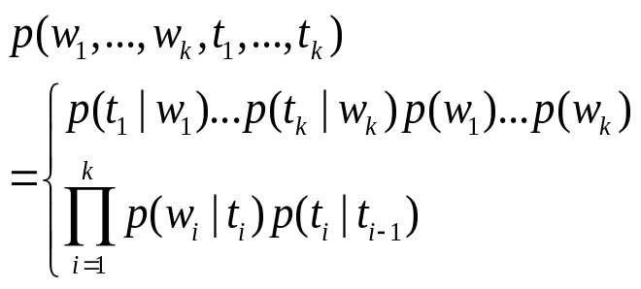
Part-of-Speech Tagging
Training data (Annotated text)
This sentence serves as an example of annotated text…
Det N V1 P Det N P V2 N
“This is a new sentence.”
POS Tagger
This is a new sentence.
Det Aux Det Adj N
Pick the most likely tag sequence.
Independent assignment
Most common tag
Partial dependency
(HMM)
Notes:
POS Tagging attempts to label each word with the appropriate part of speech.
Past approaches were rule-based (manual, then learned). Current trend, however, is toward statistical approaches (HMM).
This shift is common throughout NLP, due to the ability of statistical approaches to robustly handle noise and/or unexpected events.
Conceptually statistical approaches are more fitting due to the fact that uncertainty is sometimes unavoidable (ambiguity).
Current algorithms (Brill’s Tagger, CLAWS taggers) report accuracy in the 97% range.

Slide 10
Word Sense Disambiguation
?
“The difficulties of computational linguistics are rooted in ambiguity.”
N Aux V P N
Supervised Learning
Features:
  Neighboring POS tags (N Aux V P N)
  Neighboring words (linguistics are rooted in ambiguity)
  Stemmed form (root)
  Dictionary/Thesaurus entries of neighboring words
  High co-occurrence words (plant, tree, origin,…)
  Other senses of word within discourse
Algorithms:
  Rule-based Learning (e.g. IG guided)
  Statistical Learning (i.e. Naïve Bayes)
  Unsupervised Learning (i.e. Nearest Neighbor)
Notes:
WSD attempts to resolve ambiguity by labeling each word with a precise sense, as intended in the document.
This is typically performed after POS tagging, since POS tags are quite useful for WSD.
Current approaches address this as a supervised learning problem.
Features include neighboring words w/ POS tags, stemmed form of word, high co-occurrence words (with stem).
Quite a few supervised learning algorithms have been applied (rule-lists, bayesian, NN).
Performance depends heavily upon the particular text, but from what I’ve read 90%+ accuracy is common.

Slide 11
Parsing
Choose most likely parse tree…
S
Probability of this tree=0.000015
Probabilistic CFG
NP
VP
S→ NP VP
NP → Det BNP
NP → BNP
NP→ NP PP
BNP→ N
VP → V
VP → Aux V NP
VP → VP PP
PP → P NP
V → chasing
Aux→ is
N → dog
N → boy
N→ playground
Det→ the
Det→ a
P → on
Det
1.0
BNP
VP
PP
0.3
0.4
0.3
A
N
Aux
V
NP
P
NP
Grammar
dog
is
chasing
on
…
a boy
.
the playground
.
…
.
S
Probability of this tree=0.000011
1.0
NP
VP
0.01
Det
BNP
Aux
V
NP
PP
0.003
A
N
is
chasing
NP
Lexicon
P
NP
…
dog
a boy
on
…
the playground
Notes:
Parsing attempts to infer the precise grammatical relationships between different words in a given sentence.
For example, POS are grouped into phrases and phrases are combined into sentences.
Approaches include parsing with probabilistic CFG’s, “link dictionaries”, and tree adjoining techniques (super-tagging).
Current techniques can only parse at the sentence level, in some cases reporting accuracy in the 90% range.
Again, the performance heavily depends upon the grammatical correctness and the degree of ambiguity of the text.

Slide 12
Mining Text and Web Data
Text mining, natural language processing and information extraction: An Introduction
Text information system and information retrieval
Text categorization methods
Mining Web linkage structures
Summary

Slide 13
Text Databases and IR
Text databases (document databases)
  Large collections of documents from various sources: news articles, research papers, books, digital libraries, e-mail messages, and Web pages, library database, etc.
  Data stored is usually semi-structured
  Traditional information retrieval techniques become inadequate for the increasingly vast amounts of text data
Information retrieval
  A field developed in parallel with database systems
  Information is organized into (a large number of) documents
  Information retrieval problem: locating relevant documents based on user input, such as keywords or example documents

Slide 14
Information Retrieval
Typical IR systems
  Online library catalogs
  Online document management systems
Information retrieval vs. database systems
  Some DB problems are not present in IR, e.g., update, transaction management, complex objects
  Some IR problems are not addressed well in DBMS, e.g., unstructured documents, approximate search using keywords and relevance

Slide 15
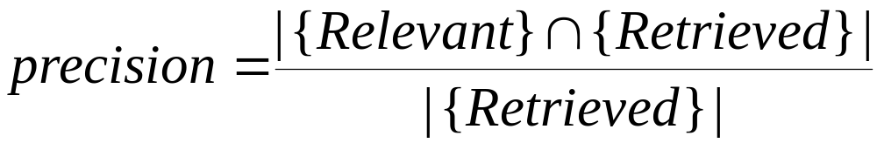
Basic Measures for Text Retrieval
Relevant
Relevant & Retrieved
Retrieved
All Documents
Precision: the percentage of retrieved documents that are in fact relevant to the query (i.e., “correct” responses)
Recall: the percentage of documents that are relevant to the query and were, in fact, retrieved
|
{
Relevant
}
∩
{
Retrieved
}
|
Recall
=
|
{
Relevant
}
|

Slide 16
Information Retrieval Techniques
Basic Concepts
  A document can be described by a set of representative keywords called index terms.
  Different index terms have varying relevance when used to describe document contents.
  This effect is captured through the assignment of numerical weights to each index term of a document. (e.g.: frequency, tf-idf)
DBMS Analogy
  Index Terms → Attributes
  Weights → Attribute Values

Slide 17
Information Retrieval Techniques
Index Terms (Attribute) Selection:
  Stop list
  Word stem
  Index terms weighting methods
Terms  Documents Frequency Matrices
Information Retrieval Models:
  Boolean Model
  Vector Model
  Probabilistic Model

Slide 18
Boolean Model
Consider that index terms are either present or absent in a document
As a result, the index term weights are assumed to be all binaries
A query is composed of index terms linked by three connectives: not, and, and or
  e.g.: car and repair, plane or airplane
The Boolean model predicts that each document is either relevant or non-relevant based on the match of a document to the query

Slide 19
Keyword-Based Retrieval
A document is represented by a string, which can be identified by a set of keywords
Queries may use expressions of keywords
  E.g., car and repair shop, tea or coffee, DBMS but not Oracle
  Queries and retrieval should consider synonyms, e.g., repair and maintenance
Major difficulties of the model
  Synonymy: A keyword T does not appear anywhere in the document, even though the document is closely related to T, e.g., data mining
  Polysemy: The same keyword may mean different things in different contexts, e.g., mining

Slide 20
Similarity-Based Retrieval in Text Data
Finds similar documents based on a set of common keywords
Answer should be based on the degree of relevance based on the nearness of the keywords, relative frequency of the keywords, etc.
Basic techniques
Stop list
    Set of words that are deemed “irrelevant”, even though they may appear frequently
    E.g., a, the, of, for, to, with, etc.
    Stop lists may vary when document set varies

Slide 21
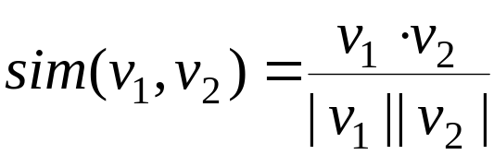
Similarity-Based Retrieval in Text Data
  Word stem
    Several words are small syntactic variants of each other since they share a common word stem
    E.g., drug, drugs, drugged
  A term frequency table
    Each entry frequent_table(i, j) = # of occurrences of the word t_{i} in document d_{i}
    Usually, the ratio instead of the absolute number of occurrences is used
  Similarity metrics: measure the closeness of a document to a query (a set of keywords)
    Relative term occurrences
    Cosine distance:

Slide 22
Indexing Techniques
Inverted index
  Maintains two hash- or B+-tree indexed tables:
    document_table: a set of document records <doc_id, postings_list>
    term_table: a set of term records, <term, postings_list>
  Answer query: Find all docs associated with one or a set of terms
  + easy to implement
  – do not handle well synonymy and polysemy, and posting lists could be too long (storage could be very large)
Signature file
  Associate a signature with each document
  A signature is a representation of an ordered list of terms that describe the document
  Order is obtained by frequency analysis, stemming and stop lists

Slide 23
Types of Text Data Mining
Keyword-based association analysis
Automatic document classification
Similarity detection
  Cluster documents by a common author
  Cluster documents containing information from a common source
Link analysis: unusual correlation between entities
Sequence analysis: predicting a recurring event
Anomaly detection: find information that violates usual patterns
Hypertext analysis
  Patterns in anchors/links
    Anchor text correlations with linked objects

Slide 24
Keyword-Based Association Analysis
Motivation
  Collect sets of keywords or terms that occur frequently together and then find the association or correlation relationships among them
Association Analysis Process
  Preprocess the text data by parsing, stemming, removing stop words, etc.
  Evoke association mining algorithms
    Consider each document as a transaction
    View a set of keywords in the document as a set of items in the transaction
  Term level association mining
    No need for human effort in tagging documents
    The number of meaningless results and the execution time is greatly reduced

Slide 25
Text Classification
Motivation
  Automatic classification for the large number of on-line text documents (Web pages, e-mails, corporate intranets, etc.)
Classification Process
  Data preprocessing
  Definition of training set and test sets
  Creation of the classification model using the selected classification algorithm
  Classification model validation
  Classification of new/unknown text documents
Text document classification differs from the classification of relational data
  Document databases are not structured according to attribute-value pairs

Slide 26
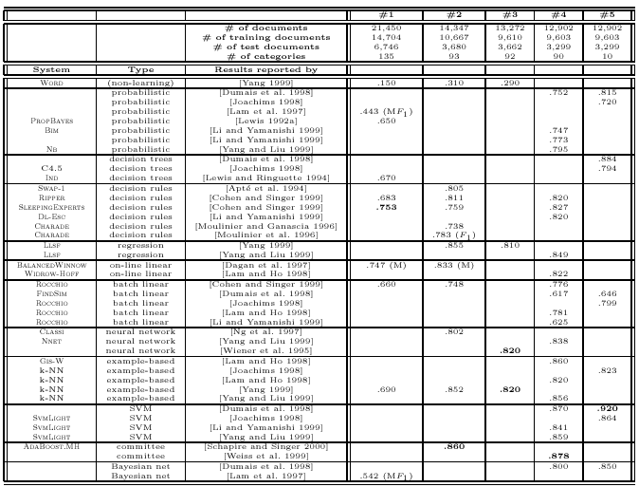
Text Classification(2)
Classification Algorithms:
  Support Vector Machines
  K-Nearest Neighbors
  Naïve Bayes
  Neural Networks
  Decision Trees
  Association rule-based
  Boosting

Slide 27
Document Clustering
Motivation
  Automatically group related documents based on their contents
  No predetermined training sets or taxonomies
  Generate a taxonomy at runtime
Clustering Process
  Data preprocessing: remove stop words, stem, feature extraction, lexical analysis, etc.
  Hierarchical clustering: compute similarities applying clustering algorithms.
  Model-Based clustering (Neural Network Approach): clusters are represented by “exemplars”. (e.g.: SOM)

Slide 28
Text Categorization
Pre-given categories and labeled document examples (Categories may form hierarchy)
Classify new documents
A standard classification (supervised learning ) problem
Sports
Business
Education
Science
Categorization
System
…
…
Sports
Business
Education

Slide 29
Applications
News article classification
Automatic email filtering
Webpage classification
Word sense disambiguation
… …

Slide 30
Categorization Methods
Manual: Typically rule-based
  Does not scale up (labor-intensive, rule inconsistency)
  May be appropriate for special data on a particular domain
Automatic: Typically exploiting machine learning techniques
  Vector space model based
    Prototype-based (Rocchio)
    K-nearest neighbor (KNN)
    Decision-tree (learn rules)
    Neural Networks (learn non-linear classifier)
    Support Vector Machines (SVM)
  Probabilistic or generative model based
    Naïve Bayes classifier

Slide 31
Vector Space Model
Represent a doc by a term vector
  Term: basic concept, e.g., word or phrase
  Each term defines one dimension
  N terms define a N-dimensional space
  Element of vector corresponds to term weight
  E.g., d = (x₁,…,x_{N}), x_{i} is “importance” of term i
New document is assigned to the most likely category based on vector similarity.

Slide 32
VS Model: Illustration
Starbucks
C₂
Category 2
Category 3
C₃
Java
new doc
Microsoft
C₁
Category 1

Slide 33
What VS Model Does Not Specify
How to select terms to capture “basic concepts”
  Word stopping
    e.g. “a”, “the”, “always”, “along”
  Word stemming
    e.g. “computer”, “computing”, “computerize” => “compute”
  Latent semantic indexing
How to assign weights
  Not all words are equally important: Some are more indicative than others
    e.g. “algebra” vs. “science”
How to measure the similarity

Slide 34
How to Assign Weights
Two-fold heuristics based on frequency
  TF (Term frequency)
    More frequent within a document → more relevant to semantics
    e.g., “query” vs. “commercial”
  IDF (Inverse document frequency)
    Less frequent among documents → more discriminative
    e.g. “algebra” vs. “science”

Slide 35

TF Weighting
Weighting:
  More frequent => more relevant to topic
    e.g. “query” vs. “commercial”
    Raw TF= f(t,d): how many times term t appears in doc d
Normalization:
  Document length varies => relative frequency preferred
    e.g., Maximum frequency normalization

Slide 36



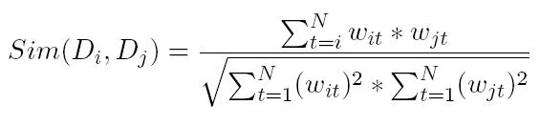
How to Measure Similarity?
Given two document
Similarity definition
  dot product
  normalized dot product (or cosine)

Slide 37
Illustrative Example
text
mining
search
engine
text
doc1
Sim(newdoc,doc1)=4.8*2.4+4.5*4.5
Sim(newdoc,doc2)=2.4*2.4
Sim(newdoc,doc3)=0
To whom is newdoc more similar?
travel
text
map
travel
doc2
text mining travel map search engine govern president congress
IDF(faked) 2.4 4.5 2.8 3.3 2.1 5.4 2.2 3.2 4.3
doc1 2(4.8) 1(4.5) 1(2.1) 1(5.4)
doc2 1(2.4 ) 2 (5.6) 1(3.3)
doc3 1 (2.2) 1(3.2) 1(4.3)
newdoc 1(2.4) 1(4.5)
government
president
congress
doc3
……

