Slide 1
gtrace
Gaussian beam ray-TRACE package
for Python
Yoichi Aso
University of Tokyo

Slide 2
Programmatically Optimize Optical Layouts

Slide 3
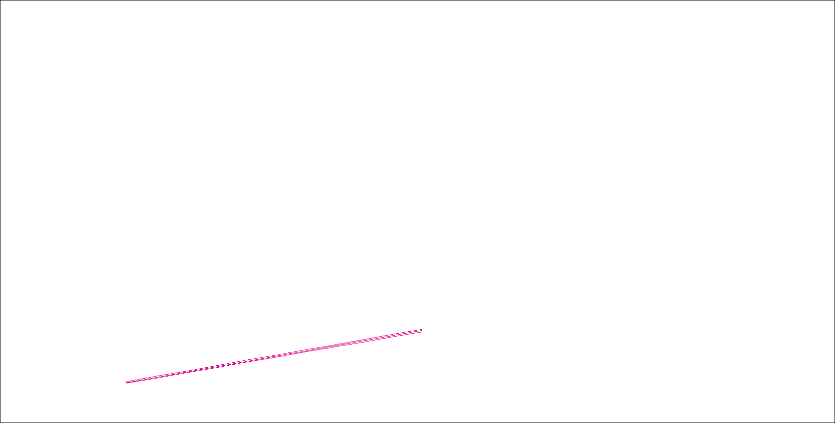

Slide 4
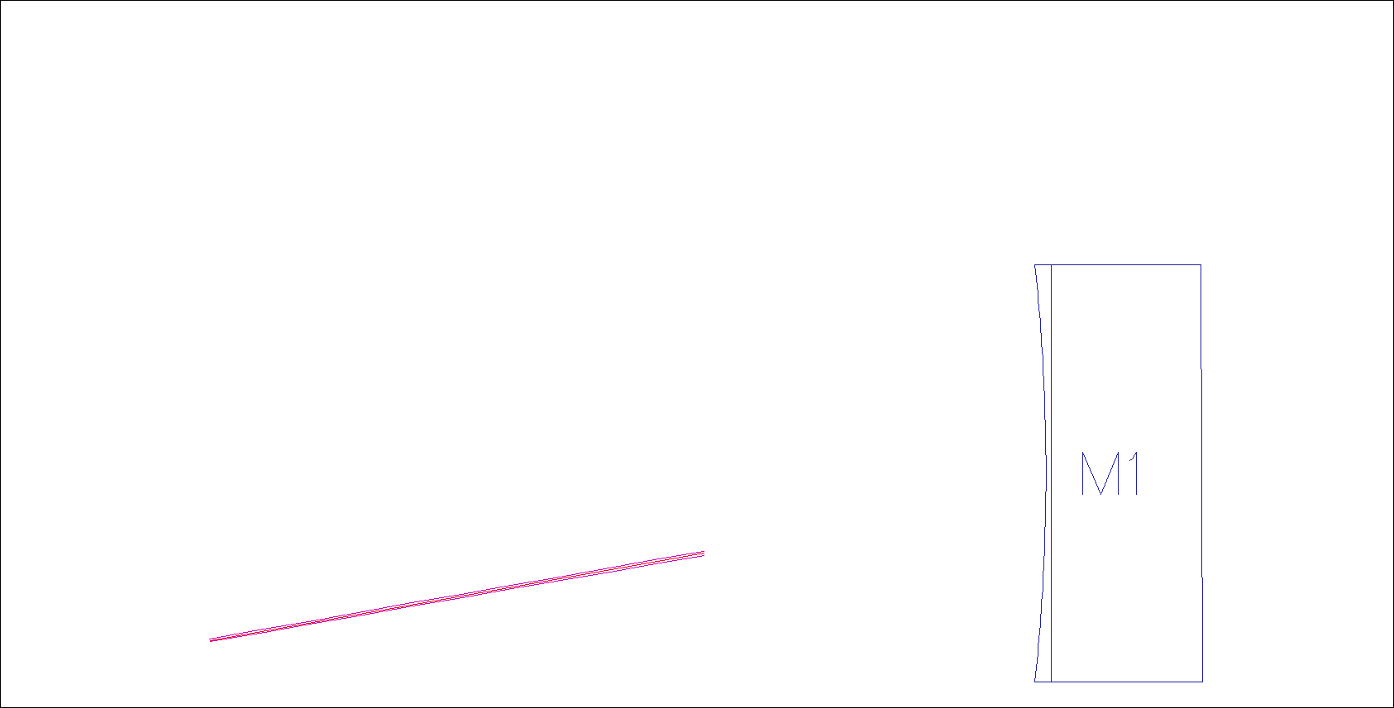

Slide 5
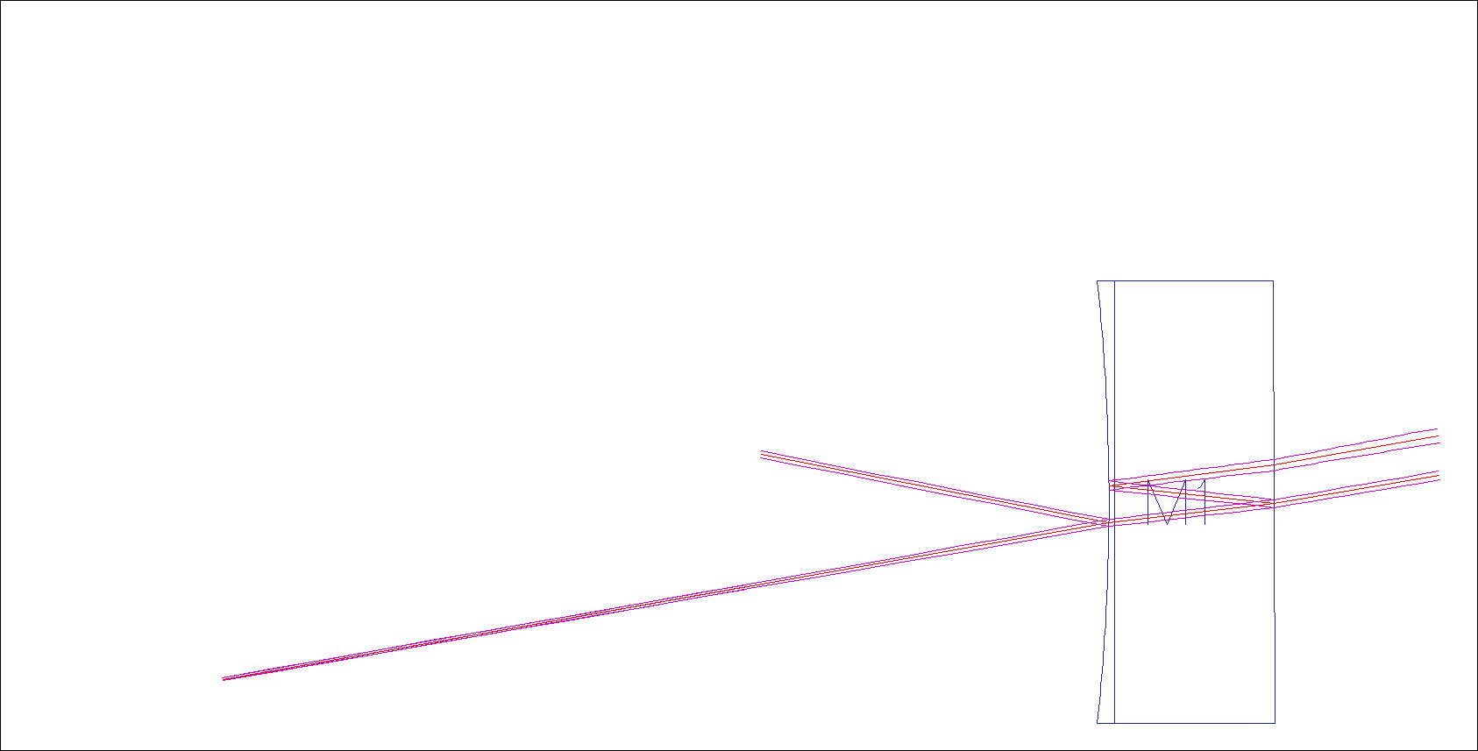

Slide 6
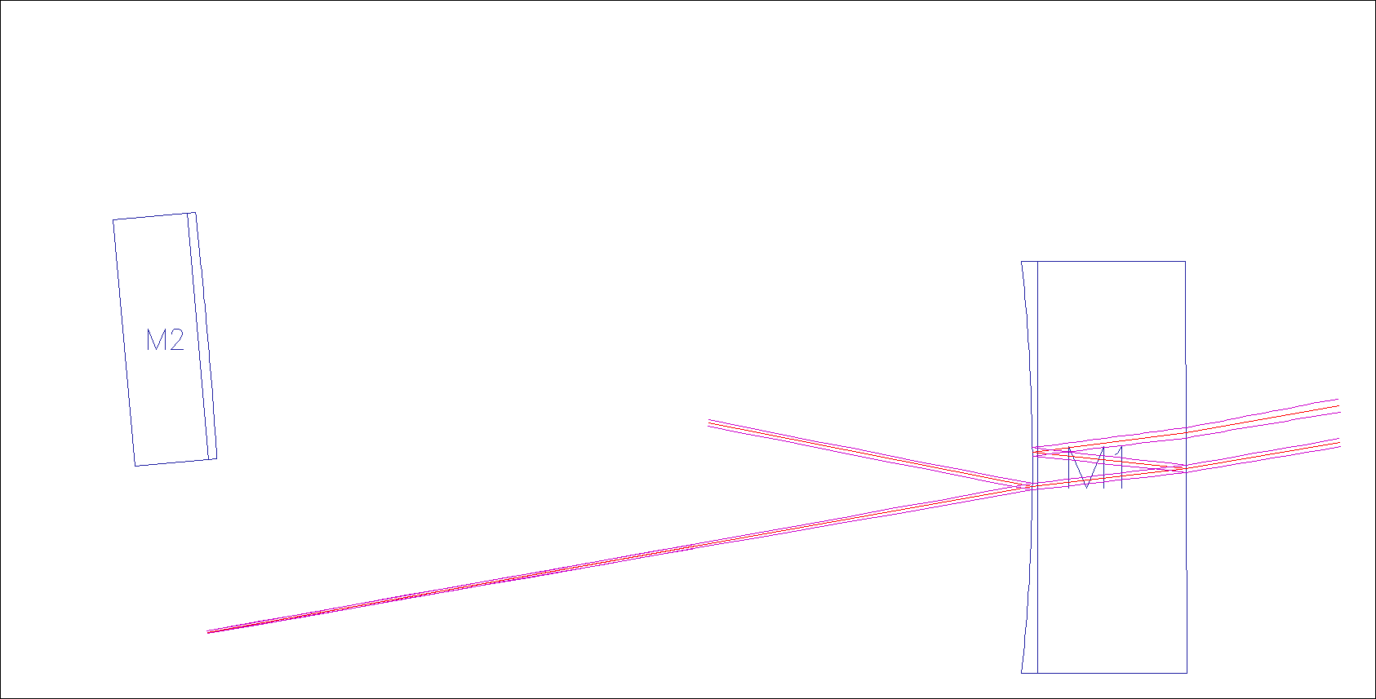

Slide 7
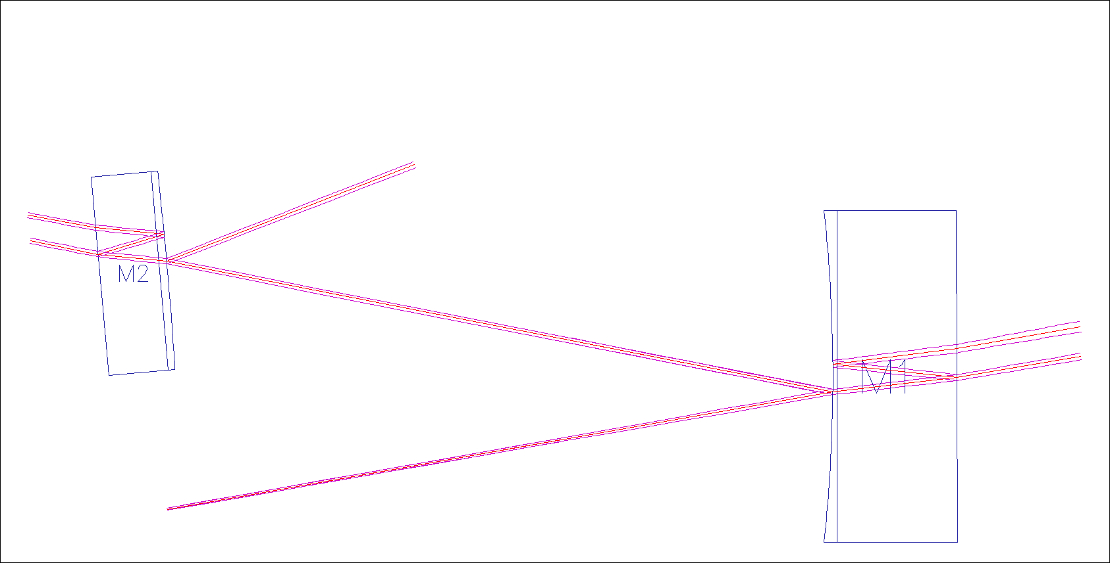

Slide 8
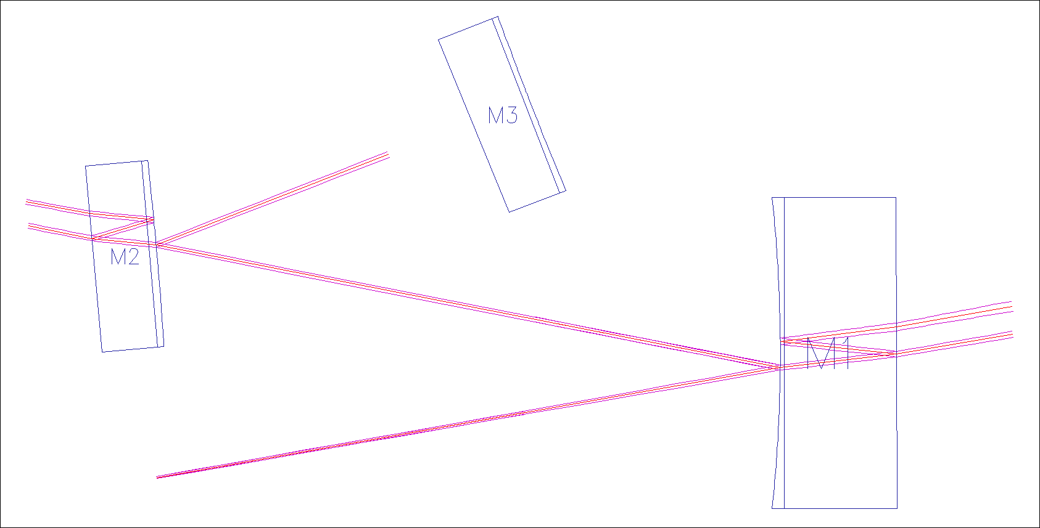

Slide 9
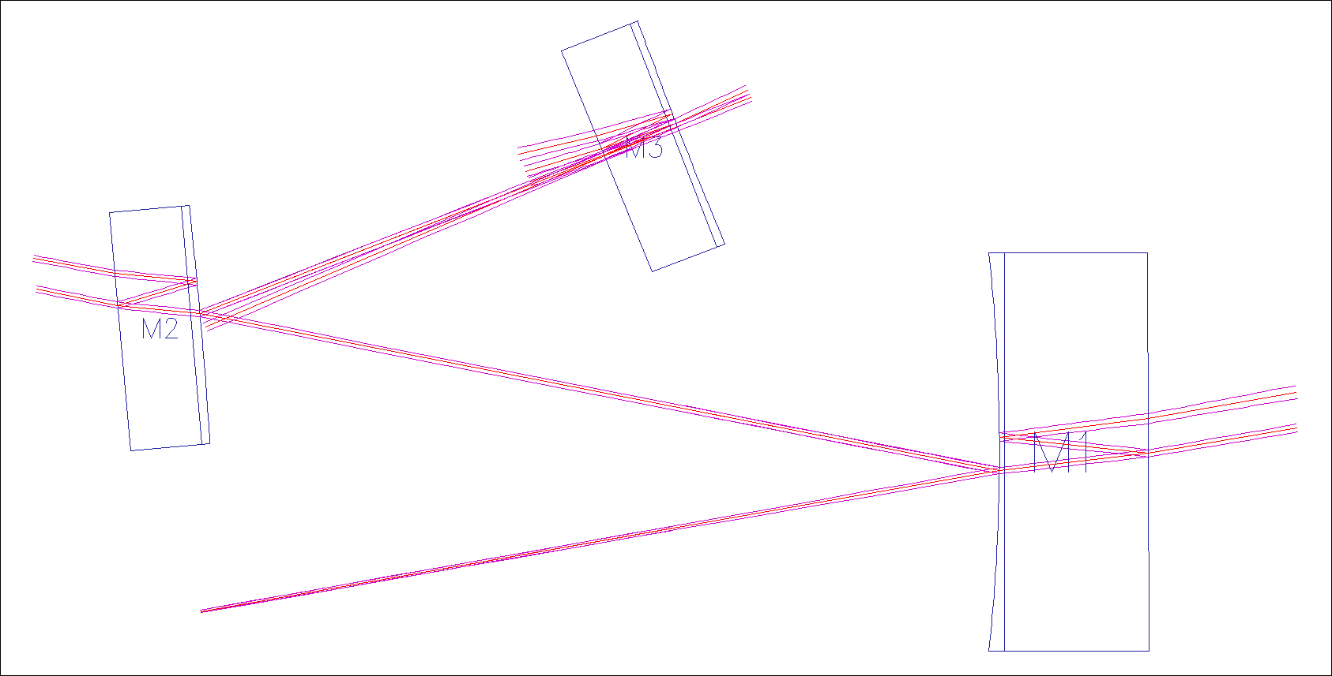

Slide 10
Useful for the main beam path
ETMY
PRM
PR2
ITMY
From MC
ITMX
ETMX
BS
PR3
SR2
SR3
SRM

Slide 11
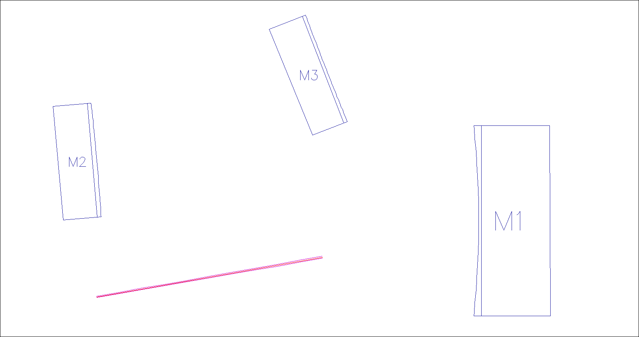

Slide 12
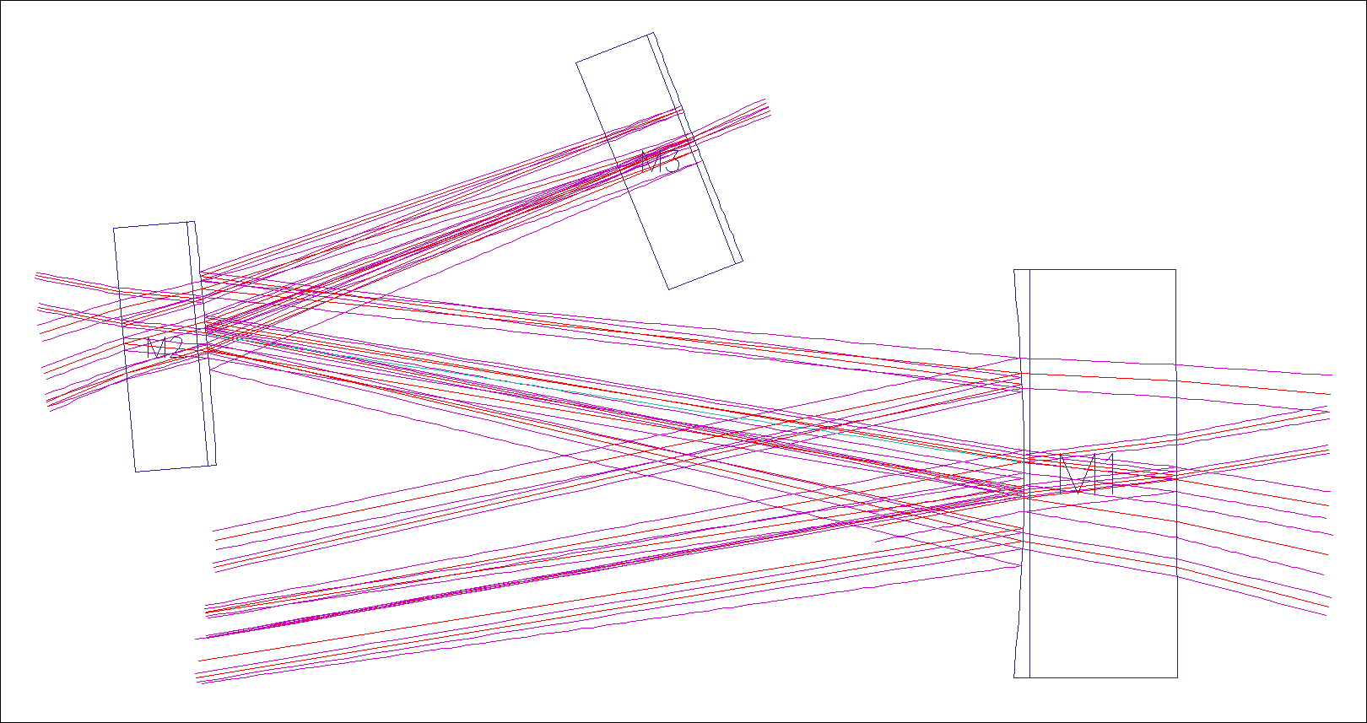

Slide 13
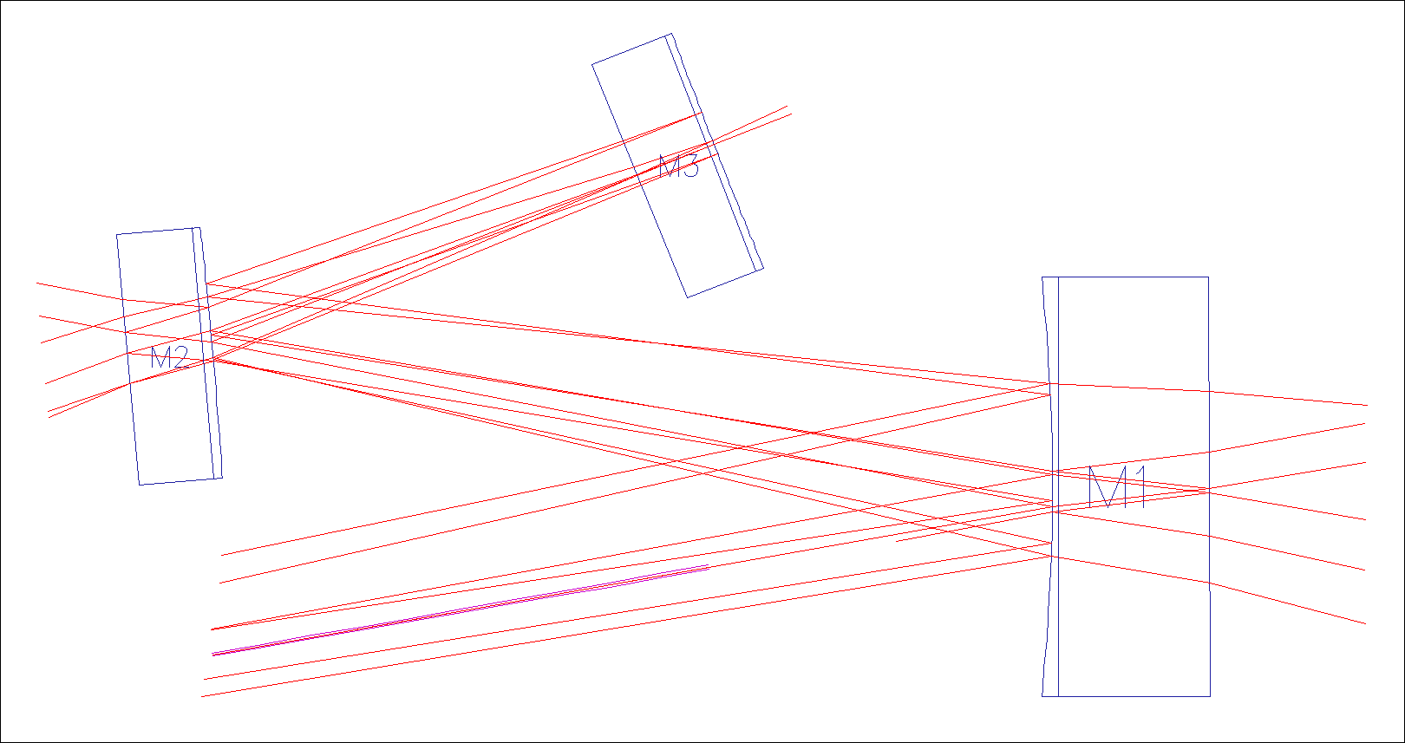

Slide 14
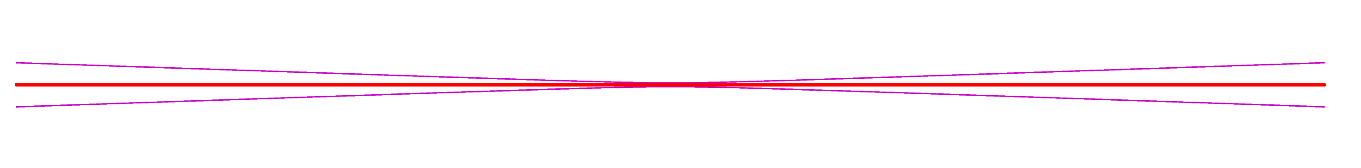
Gaussian Beam Propagation

Slide 15
ABCD Matrix
Reflection
Refraction

Slide 16

Astigmatism
Elliptic Beams

Slide 17
Keeping Track of
Gouy phase
Optical distance
Optical Power

Slide 18
Define a Gaussian Beam Object
#q-parameter of the beam
q0 = gauss.Rw2q(ROC=np.inf, w=0.3*mm)
#Create a GaussianBeam object.
b1 = beam.GaussianBeam(q0=q0, wl=1064*nm, length=30*cm, P=1.0)
#Set the direction angle of the beam to 10deg from the global x-axis.
b1.dirAngle = deg2rad(10)
#Set the position of the origin of the beam
b1.pos = (0.0, 0.0)

Slide 20
Define a Mirror Object
M1 = opt.Mirror(HRcenter=[50*cm, 10*cm], normAngleHR=pi,
diameter=25*cm, thickness=10*cm,
wedgeAngle=deg2rad(0.25), inv_ROC_HR=1./(120*cm),
inv_ROC_AR=0,
Refl_HR=0.9, Trans_HR=1-0.9,
Refl_AR=500*ppm, Trans_AR=1-500*ppm,
n=1.45, name='M1')

Slide 22
Hit the Mirror
>>>beams1 = M1.hitFromHR(b1, order=2)
>>>beams1
{'input': <gtrace.beam.GaussianBeam at 0x39bab90>,
'r1': <gtrace.beam.GaussianBeam at 0x39bae30>,
's1': <gtrace.beam.GaussianBeam at 0x39badd0>,
's2': <gtrace.beam.GaussianBeam at 0x39baf50>,
's3': <gtrace.beam.GaussianBeam at 0x39d5050>,
't1': <gtrace.beam.GaussianBeam at 0x39baef0>,
't2': <gtrace.beam.GaussianBeam at 0x39bae90>}

Slide 23
r1
s2
t2
s3
s1
t1
input

Slide 24
Non-Sequential Trace
>>>beams = non_seq_trace([M1,M2,M3], b1,
order=30, power_threshold=1e-6)
>>>beams
<gtrace.beam.GaussianBeam at 0x39d52f0>,
<gtrace.beam.GaussianBeam at 0x39d5230>,
<gtrace.beam.GaussianBeam at 0x39d50b0>,
<gtrace.beam.GaussianBeam at 0x39bad10>,
<gtrace.beam.GaussianBeam at 0x39d5650>,
<gtrace.beam.GaussianBeam at 0x39d5590>,
<gtrace.beam.GaussianBeam at 0x39d5470>,
<gtrace.beam.GaussianBeam at 0x39d5350>,
<gtrace.beam.GaussianBeam at 0x39d59b0>,
<gtrace.beam.GaussianBeam at 0x39d58f0>, …

Slide 26
DXF Output
#Create a canvas object
cnv = draw.Canvas()
#Draw all beams
drawAllBeams(cnv, beams, drawWidth=True, sigma=3.0,
drawPower=False, drawROC=False, drawGouy=False,
drawOptDist=False, layer='main_beam',
fontSize=0.01)
#Draw the mirror
drawAllOptics(cnv, [M1,M2,M3])
#Save the result as a DXF file
renderer.renderDXF(cnv, 'NonSeq.dxf')

Slide 27
Why did I create this ?

Slide 28
Many Constraints

Slide 29
Many Constraints

Slide 31
Optical Distance

Slide 32
Mode Matching
ROC Error Tolerance

Slide 33
POX

Slide 34
Unwanted
POX

