Slide 1
Data Visualization of Bird Strikes between 2000 – 2011
Projects - 1
Python Notebook Link
https://colab.research.google.com/drive/1QekgE-CsSEyGM-zzcHNStFrCHU76fYmR?usp=sharing
Tableau Dashboard Link
https://public.tableau.com/views/DataVisualizationofBirdStrikes-1/Dashboard1?:language=en-GB&:display_count=n&:origin=viz_share_link
https://public.tableau.com/views/DataVisualizationofBirdStrikes-2/Dashboard2?:language=en-GB&:display_count=n&:origin=viz_share_link
https://public.tableau.com/views/DataVisualizationofBirdStrikes-3/Dashboard3?:language=en-GB&:display_count=n&:origin=viz_share_link

Slide 2
Problem Statement
Transport and communication face environmental and safety challenges, especially in urban areas. Artificial intelligence, like multi-agent systems (MAS), helps address these concerns. Bird strikes pose a significant threat to aviation safety, causing damage and potential accidents. FAA collects data on bird strikes to understand and mitigate this problem.
Objective : Analyzing bird strikes at US airports and their impact on cost and damages.

Slide 3
Details of Data
The dataset provided is related to sales and includes information such as the flight phase, precipitation, total cost, whether the pilot was warned of birds or wildlife, the number of people injured, the altitude above ground, flight date, and the impact on the flight.

Slide 4
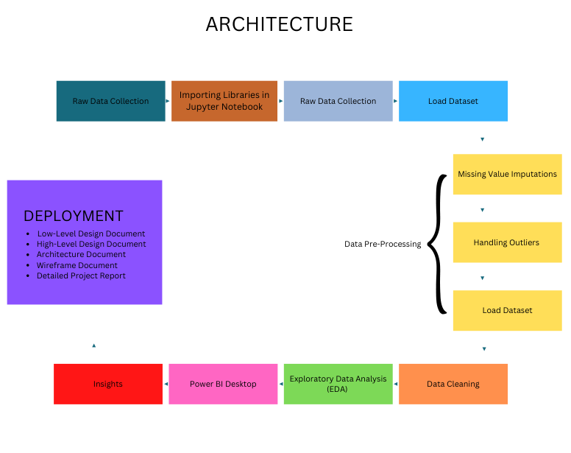

Slide 5
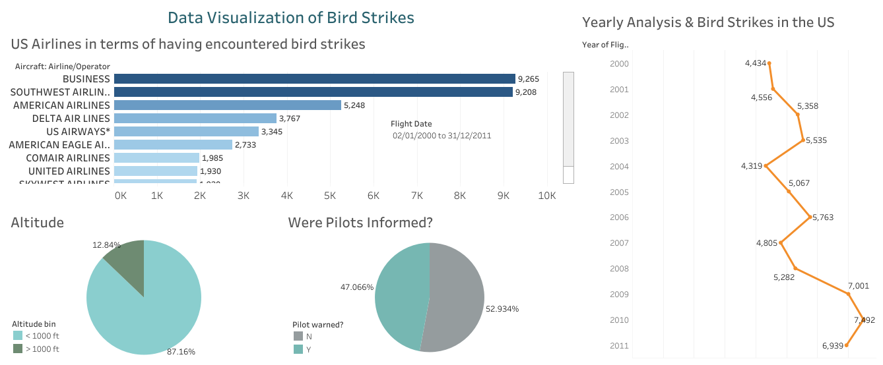
Dashboard

Slide 6
Total number if bird strikes is around 25 thousand in the span of 11 years which resulted in the repair cost of 136 million dollar.
In 52 % cases pilots were not informed or were unaware of the possible bird strikes where as in 47 percent cases they were informed prior to the strikes
Number of bird strikes continue to increase yearly from 2000 to 2011.
Airlines namely, Business , Southwest Airlines , American Airlines, Delta Air Airlines, US Airlines are more involved in bird strikes than other airlines.
87 percent of the planes were flying at an altitude <1000 while 13 percent of the planes were at altitude >1000 when the strikes occurred.

Slide 7
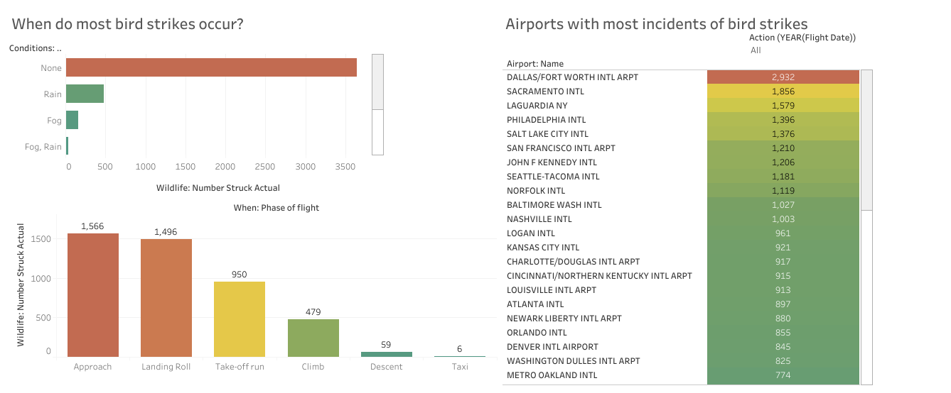

Slide 8
DALLAS/FORT WORTH INTL AIRPORT has the highest number of birds strikes than any other airport .it received 2932 strikes, followed by SACRAMENTO INTL with 1856 strikes .
Rain, Fog or Snow has little to no relation with respect to bird strikes and its seen in most of the cases when strike occurred, the weather was fine.
A high number of strikes occurred when the plane was approaching the runway.
Strikes also occurred when the planes were taking off, landing, climbing to altitude or descent.
Almost no strikes were reported when planes were either parked or being taxied.

Slide 9
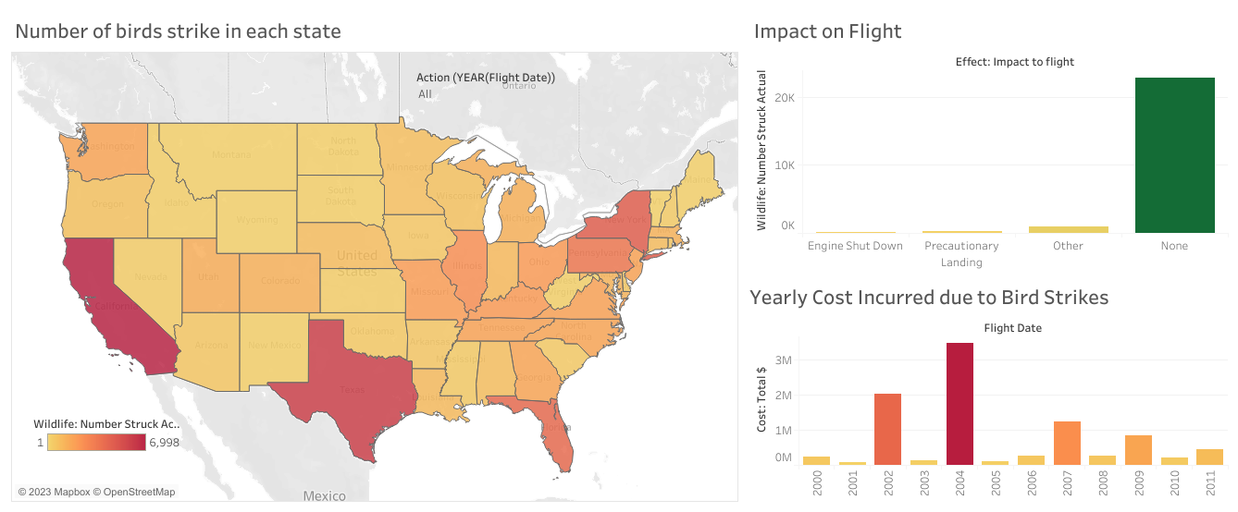

Slide 10
The state of California is involved with most number of bird strikes in all of the USA at 6998 strikes , followed by Taxes with 5983.
States like Montana received a comparatively low number of strikes.
81 % bird strikes results in no damage to the plane or the flight schedule.
9.59% bird strikes resulted in precautionary landing of the flight.
3.21 % bird strikes resulted in Take-off being aborted.
2.21% bird strikes caused engine shut down.

Slide 11
Thank you

