Slide 1
Can depthwise separable convolution make neural style transfer more lightweight?
Group 37
Notes:
This is Group thirty-seven.
Our project is running experiments to test if depthwise seperable convolution make neural style transfer more lightweight.

Slide 2
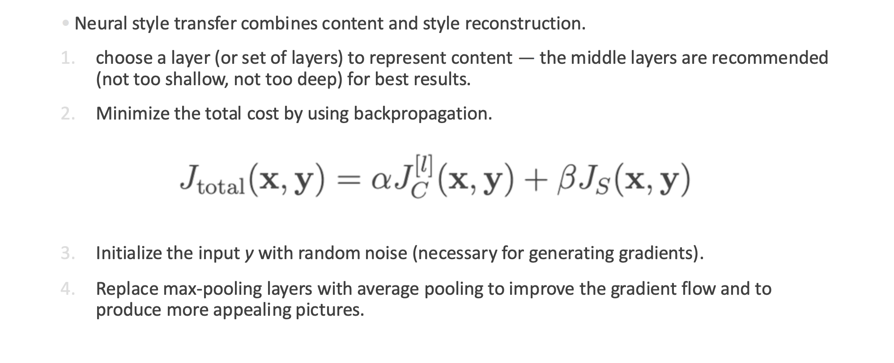
Neural Style Transfer – Original Method
SLOW
Slides from lecture 10 – Visualizing and Understanding CNNs
Notes:
We already learned an backpropagation-based approach from Lecture ten.
However, the backpropagation may take very long time.

Slide 3
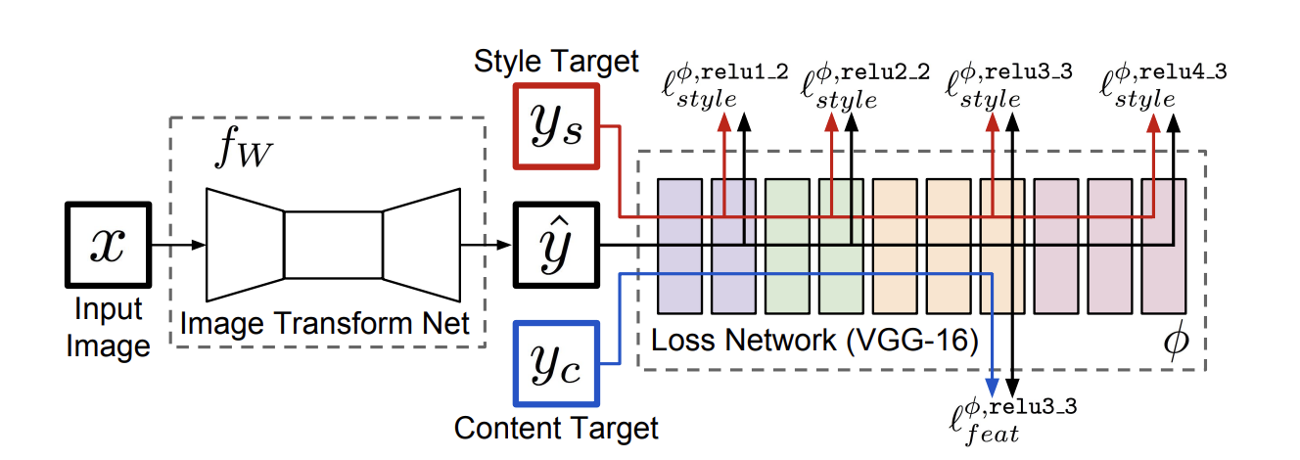
Neural Style Transfer – Johnson’s Method
Encoder
Decoder
Residual
Notes:
To address this problem, Johnson replaces the iterative backpropagation process of the original method with a pre-trained feed-forward network, enabling style transfer to run in real-time.
It includs encoder and decoder, and residual blocks between them.
It’s very similar to an auto-encoder, but trained with a different loss function to take style into account.

Slide 4
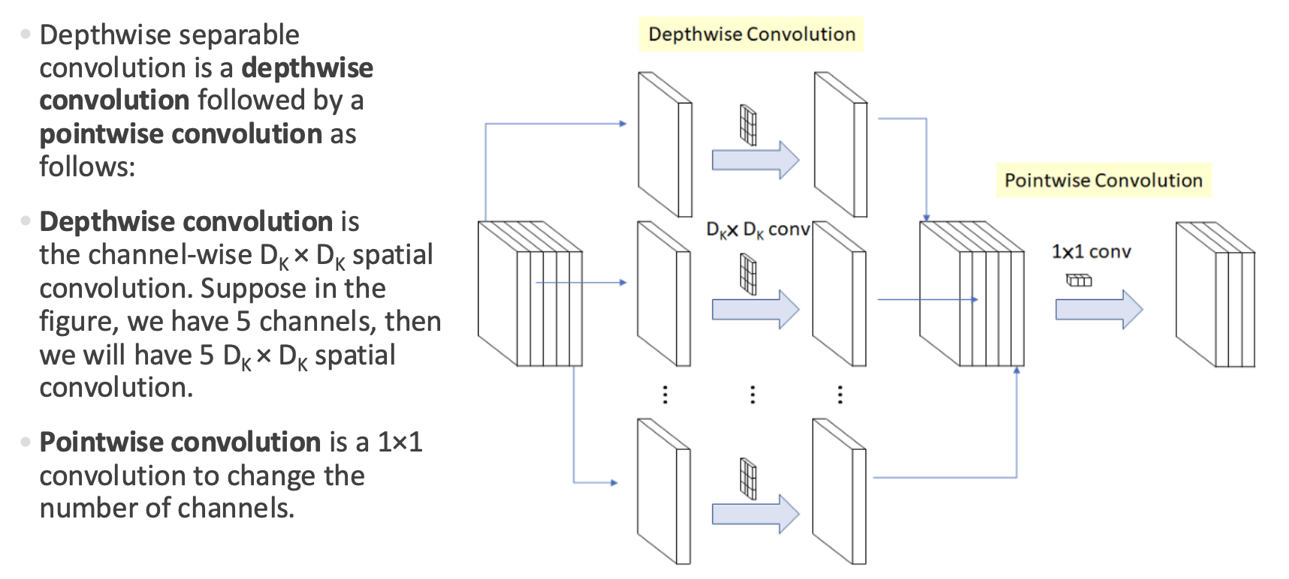
Depthwise Separable Convolution (DSC)
Slides from lecture 7 – CNN architectures
Notes:
We also learned depthwise separable convolution from lecture seven.
This is a lightweight CNN architecture.

Slide 5
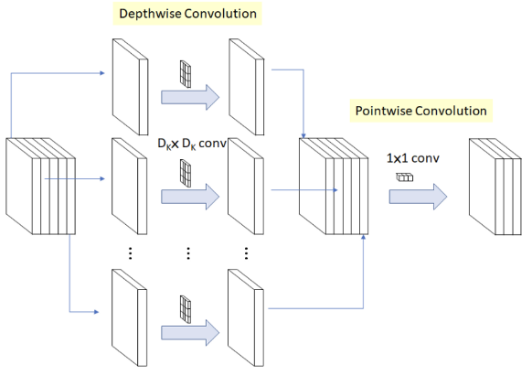
Our Hypothesis
+
=
More Lightweight Neural Style Transfer ?
Notes:
So, can we replace Johnson’s network with Depth Sepable Convolution, making neural style transfer even more lightweight?

Slide 6
Methods
Baseline :
Encoder + Residual + Decoder
Encoder
Decoder
Residual
Notes:
So we built 4 networks to compare them.
The baseline one is exactly the same as Johnson’s network.

Slide 7
Methods
Lightweight-v1 :
Encoder + Lightweight Residual + Decoder
Encoder
Decoder
Residual
Notes:
Version-one replace the residual layers with depthwise separable convolution.

Slide 8
Methods
Lightweight-v2 :
Lightweight Encoder + Lightweight Residual + Decoder
Encoder
Decoder
Residual
Notes:
Version-two also replace the encoder

Slide 9
Methods
Lightweight-v3 :
Lightweight Encoder + Lightweight Residual + Lightweight Decoder
Encoder
Decoder
Residual
Notes:
Version-three replace all

Slide 10
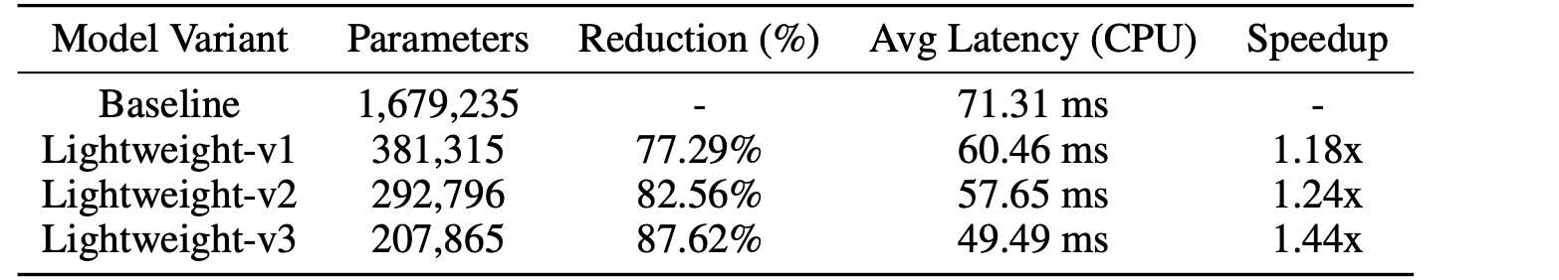
Results
Notes:
And the results turns out that all lightweight versions reduce parameter size,
And computes faster on CPU.

Slide 11
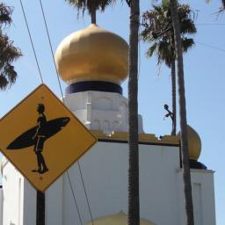
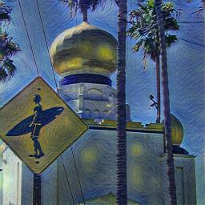
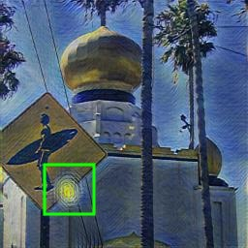
Results
Original
Baseline
Lightweight-v3
Notes:
And the quality of output image are very similar.
But lightweight versions are more likely to produce checkerboard-distributed red spots in yellow circle areas.

Slide 12
Thanks
Group 37
Notes:
For more details, please refer to the report.
Thank you!

