Slide 1


SLK SOFTWARE

Slide 2
Our Trainer
Upasana
Our Team
Adithya S Patil
Akshata Putlekar
Prajwal B M
Pratibha Ishwar Bhat
Shravani P

Slide 3
OBECTIVES
To become a full stack developer by gaining all the skills required to work with front end and back end web technologies.
To be confident in all the concepts and become a successful product .

Slide 4
WHERE DO WE STAND?
Earlier | Now
Basic theoretical and less practical knowledge | Practical knowledge in java
OOPs basics | Angular 7
 | Spring boot
 | DBMS
 | HTML, CSS, Bootstrap
 | J2EE, JSP
 | Agile Methodology, Junit, GitHub, Maven, Tomcat, Jenkins.

Slide 5
PROBLEM STATEMENT
This project is a web based shopping system for an existing shop.
Online shopping is the process whereby consumers directly buy goods or. services from a seller in real- time, without an intermediary service, over.

Slide 6

OUR LEARNINGS
5th week
Java script
ES5,ES6
Angular7
UML diagrams.
1st week
Database concepts and SQL
3rd week
Project banking
application.
JDBC and WEB design
fundamentals
7th week
JSP Servlet
Spring REST( Core & MVC)
myBatis
2nd week
Object oriented programming concepts
Data structures.
Java programming
4th week
HTML
CSS
Bootstrap
AJAX
6th week
Architecture and framework of angular
JEE Architecture
8th week
Agile
Methodology
JUnit
GitHub
Maven
Tomcat
Jenkins
Project Completion

Slide 7



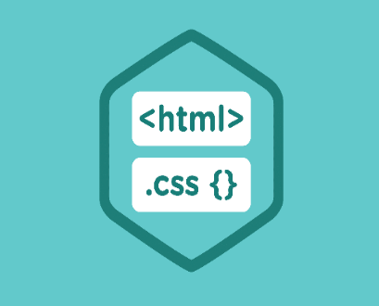








TOOLS USED
FRONTEND
BACKEND
DEVOPS
DATA

Slide 8
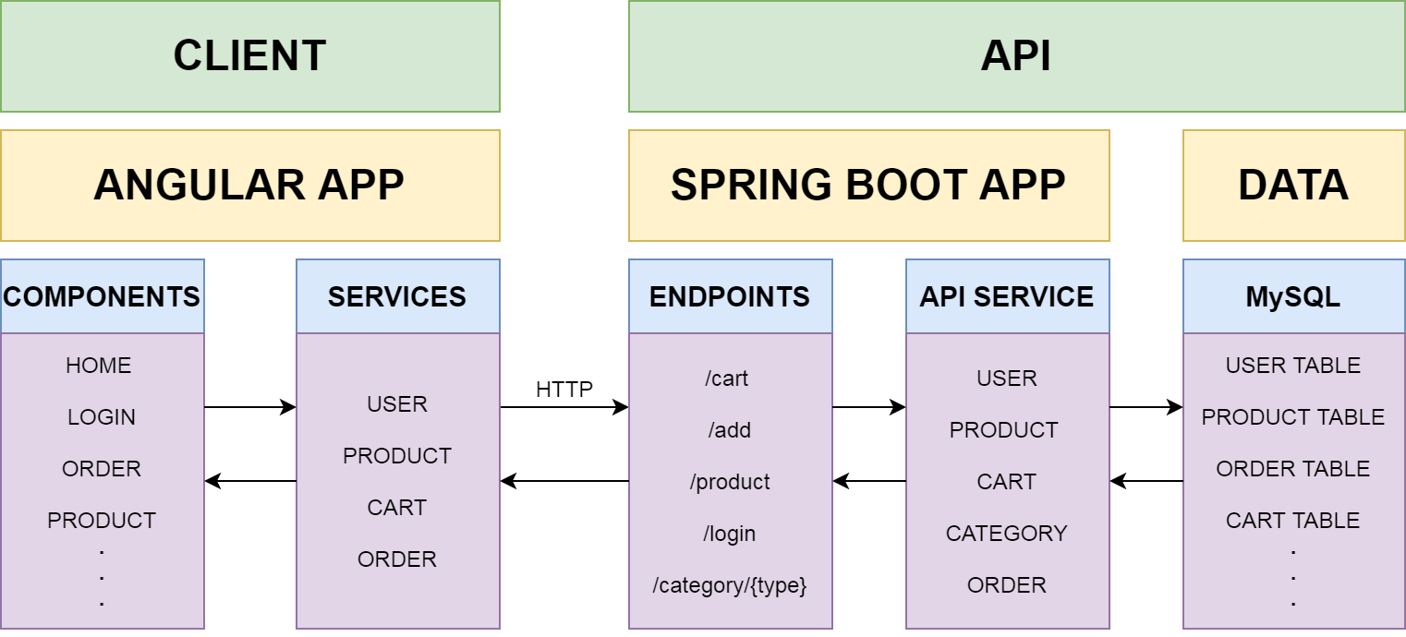
STRUCTURE OF THE PROJECT

Slide 9
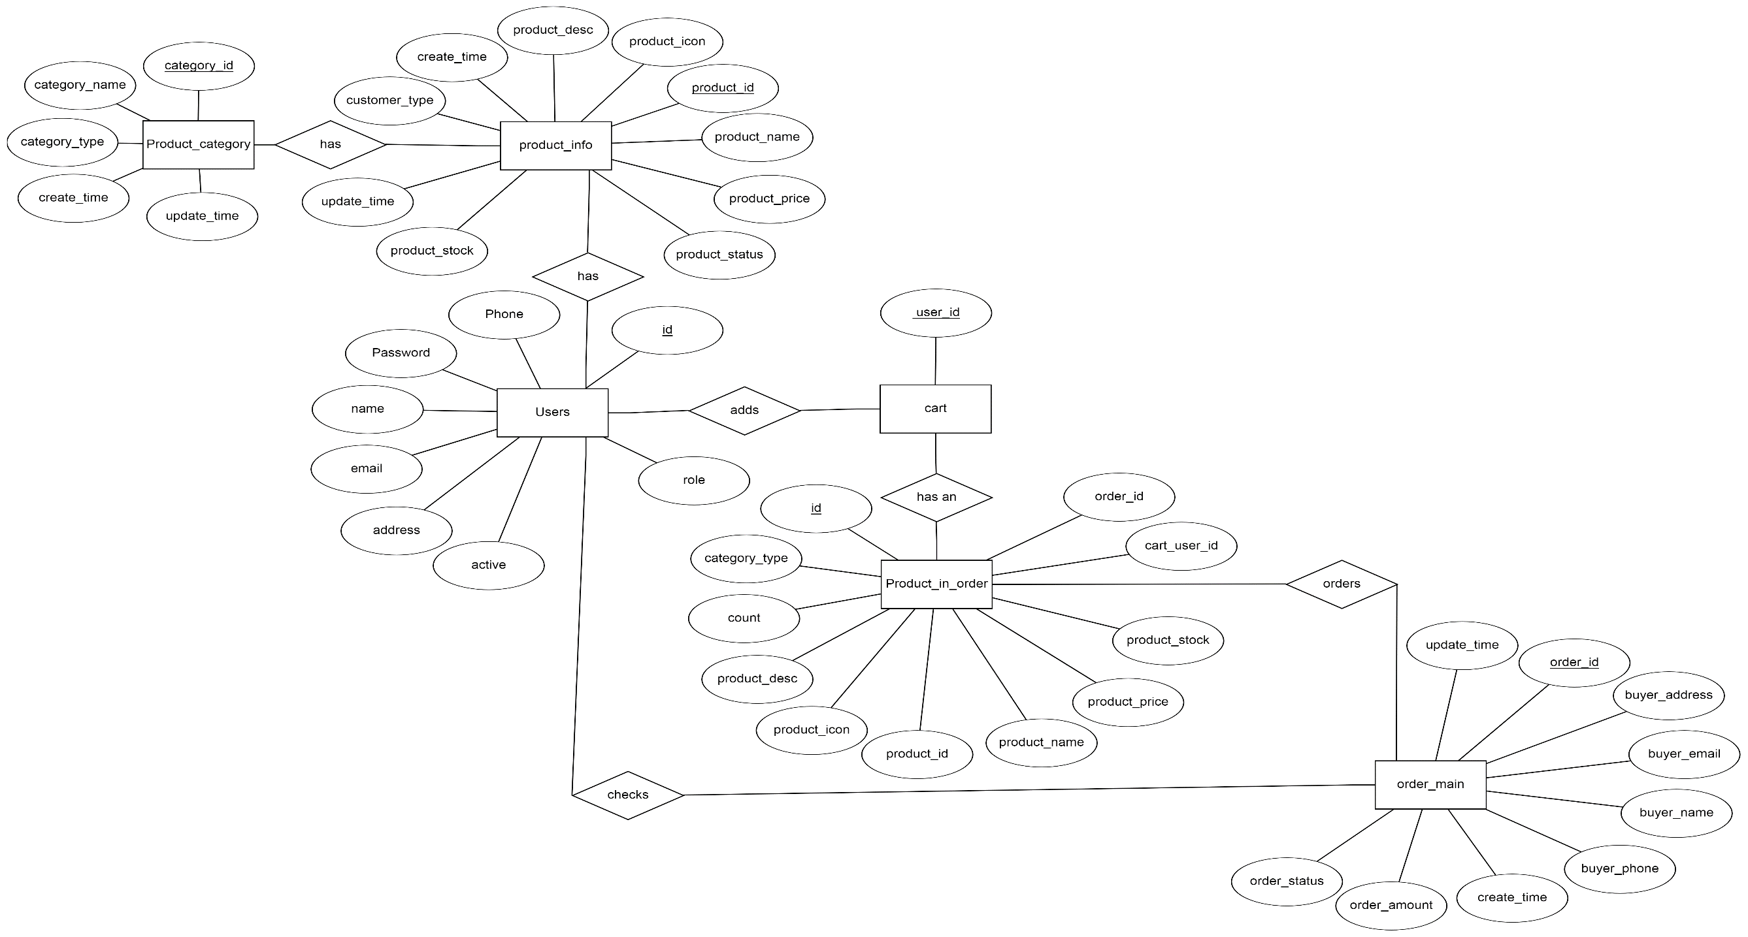
ER DIAGRAM

Slide 10
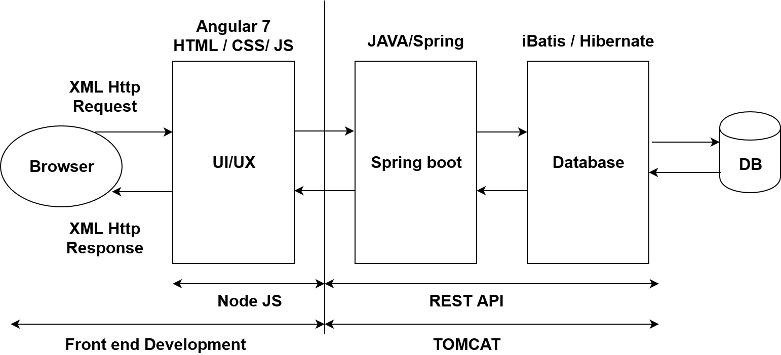
FULL STACK ARCHITECTURE

Slide 11
SCOPE AND CONCLUSION
Scope:
The project can be implemented in commercial transactions – ordering ,
Delivery, payments, etc.
Conclusion:
This shopping cart application will allow the customers to search and buy the products they want.

Slide 12

SNAPSHOTS

Slide 13
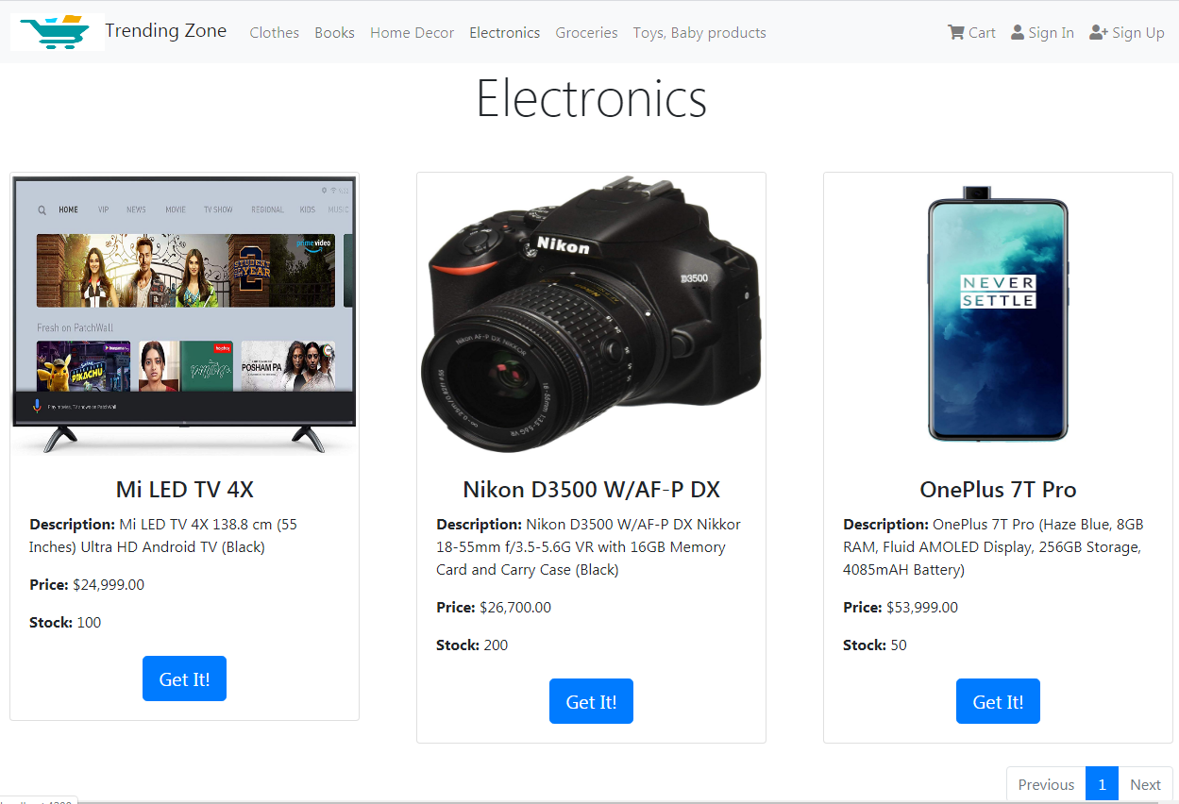

Slide 14
THANK
YOU

