Slide 1


SLK SOFTWARE

Slide 2
Our Trainer
Upasana
Our Team
Adithya S Patil
Akshata Putlekar
Prajwal B M
Pratibha Ishwar Bhat
Shravani P

Slide 3
Problem statement
The system provides the basic banking services to manage bank accounts by using the facility of debiting and crediting with the help of login Id’s and passwords.

Slide 4

OUR LEARNINGS
5th week
Java script
ES5,ES6
Angular7
UML diagrams.
1st week
Database concepts and SQL
3rd week
Project banking
application.
JDBC and WEB design
fundamentals
7th week
JSP Servlet
Spring REST( Core & MVC)
myBatis
2nd week
Object oriented programming concepts
Data structures.
Java programming
4th week
HTML
CSS
Bootstrap
AJAX
6th week
Architecture and framework of angular
JEE Architecture
8th week
Agile
Methodology
JUnit
GitHub
Maven
Tomcat
Jenkins
Project Completion

Slide 5











Tools used
FRONTEND
BACKEND
DEVOPS
DATA

Slide 6
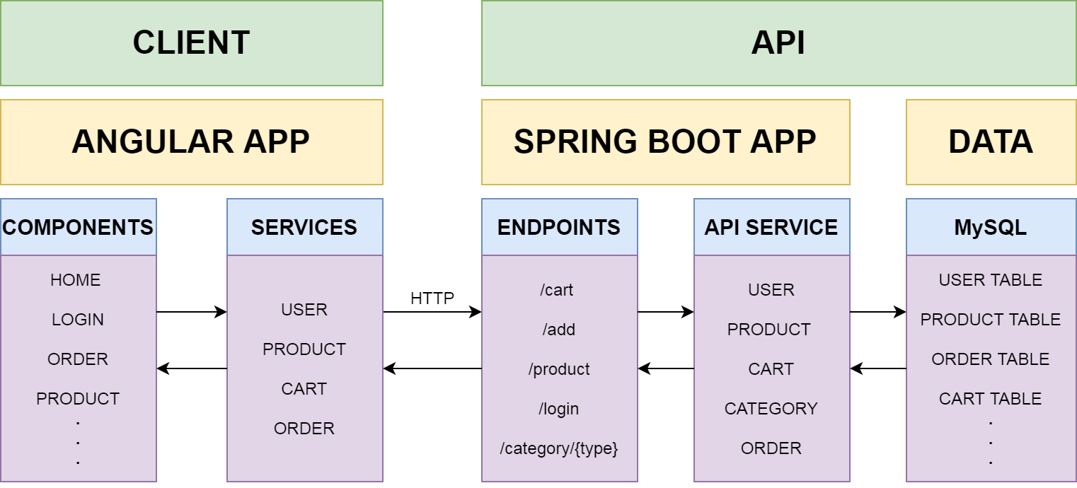
STRUCTURE OF THE PROJECT

Slide 7
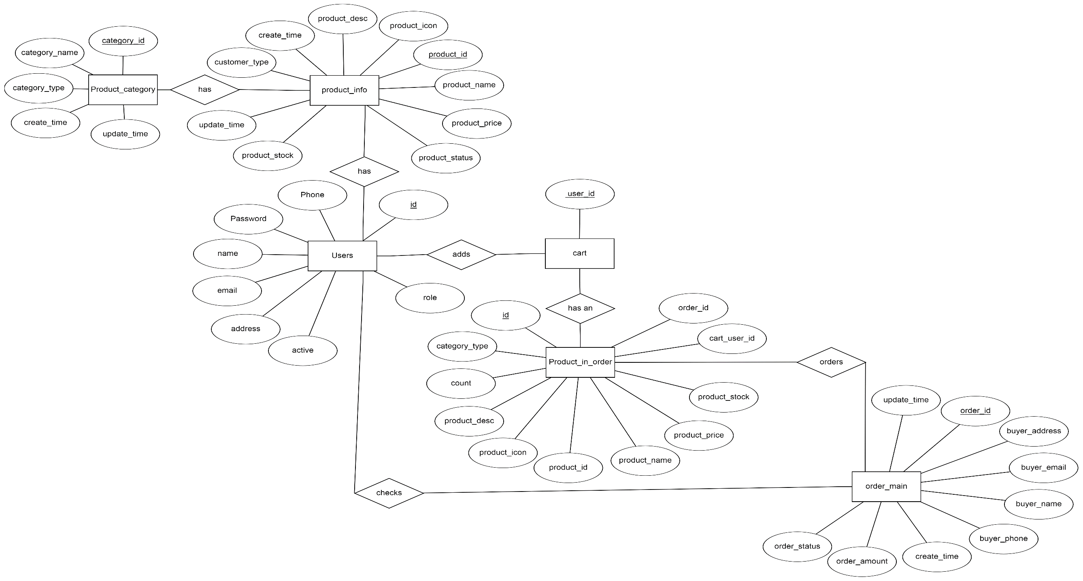
ER DIAGRAM

