Slide 1
JSON
The x in Ajax
Douglas Crockford
Yahoo! Inc.

Slide 2
Data Interchange
The key idea in Ajax.
An alternative to page replacement.
Applications delivered as pages.
How should the data be delivered?

Slide 3
History of Data Formats
Ad Hoc
Database Model
Document Model
Programming Language Model

Slide 4
JSON
JavaScript Object Notation
Minimal
Textual
Subset of JavaScript

Slide 5
JSON
A Subset of ECMA-262 Third Edition.
Language Independent.
Text-based.
Light-weight.
Easy to parse.

Slide 6
JSON Is Not...
JSON is not a document format.
JSON is not a markup language.
JSON is not a general serialization format.
  No cyclical/recurring structures.
  No invisible structures.
  No functions.

Slide 7
History
1999 ECMAScript Third Edition
2001 State Software, Inc.
2002 JSON.org
2005 Ajax
2006 RFC 4627

Slide 8

Languages
Chinese
English
French
German
Italian
Japanese
Korean

Slide 9
Languages
ActionScript
C / C++
C#
Cold Fusion
Delphi
E
Erlang
Java
Lisp
Perl
Objective-C
Objective CAML
PHP
Python
Rebol
Ruby
Scheme
Squeak

Slide 10
Object Quasi-Literals
JavaScript
Python
NewtonScript

Slide 11
Values
Strings
Numbers
Booleans
Objects
Arrays
null

Slide 12
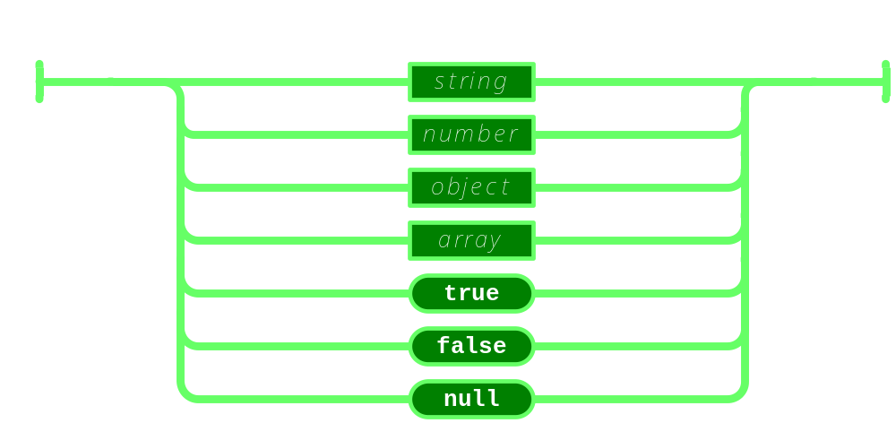
Value

Slide 13
Strings
Sequence of 0 or more Unicode characters
No separate character type
  A character is represented as a string with a length of 1
Wrapped in "double quotes"
Backslash escapement

Slide 14
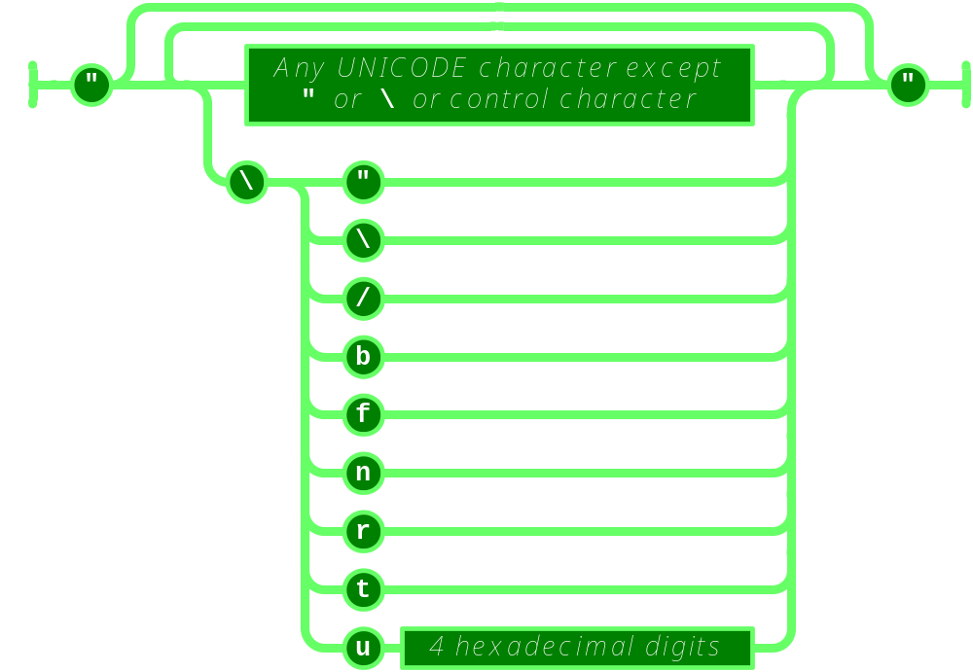
String

Slide 15
Numbers
Integer
Real
Scientific
No octal or hex
No NaN or Infinity
  Use null instead

Slide 16
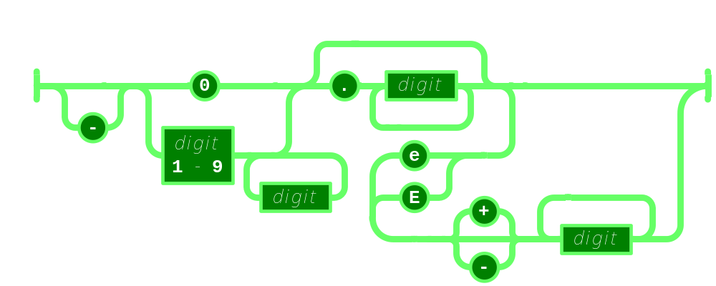
Number

Slide 17
Booleans
true
false

Slide 18
null
A value that isn't anything

Slide 19
Object
Objects are unordered containers of key/value pairs
Objects are wrapped in { }
, separates key/value pairs
: separates keys and values
Keys are strings
Values are JSON values
  struct, record, hashtable, object

Slide 20
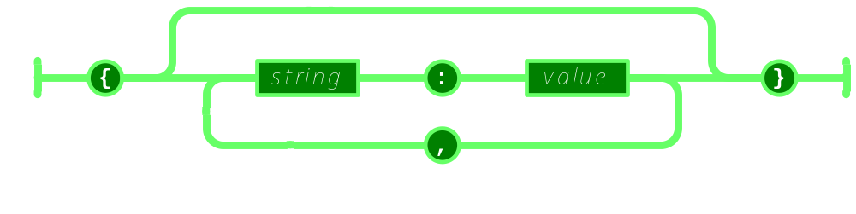
Object

Slide 21
Object
{"name":"Jack B. Nimble","at large": true,"grade":"A","level":3, "format":{"type":"rect","width":1920, "height":1080,"interlace":false, "framerate":24}}

Slide 22
Object
{
"name": "Jack B. Nimble",
"at large": true,
"grade": "A",
"format": {
"type": "rect",
"width": 1920,
"height": 1080,
"interlace": false,
"framerate": 24
}
}

Slide 23
Array
Arrays are ordered sequences of values
Arrays are wrapped in []
, separates values
JSON does not talk about indexing.
  An implementation can start array indexing at 0 or 1.

Slide 24
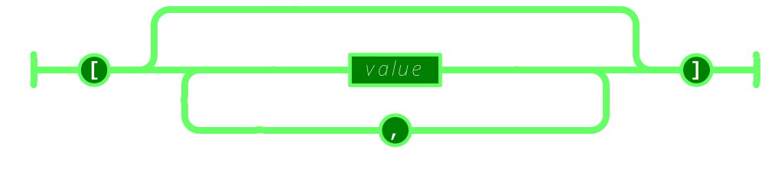
Array

Slide 25
Array
["Sunday", "Monday", "Tuesday", "Wednesday", "Thursday", "Friday", "Saturday"]
[
  [0, -1, 0],
  [1, 0, 0],
  [0, 0, 1]
]

Slide 26
Arrays vs Objects
Use objects when the key names are arbitrary strings.
Use arrays when the key names are sequential integers.
Don't get confused by the term Associative Array.

Slide 27
MIME Media Type
application/json

Slide 28
Character Encoding
Strictly UNICODE.
Default: UTF-8.
UTF-16 and UTF-32 are allowed.

Slide 29
Versionless
JSON has no version number.
No revisions to the JSON grammar are anticipated.
JSON is very stable.

Slide 30
Rules
A JSON decoder must accept all well-formed JSON text.
A JSON decoder may also accept non-JSON text.
A JSON encoder must only produce well-formed JSON text.
Be conservative in what you do, be liberal in what you accept from others.

Slide 31
Supersets
YAML is a superset of JSON.
  A YAML decoder is a JSON decoder.
JavaScript is a superset of JSON.
  A JavaScript compiler is a JSON decoder.
New programming languages based on JSON.

Slide 32
JSON is the X in Ajax

Slide 33
JSON in Ajax
HTML Delivery.
JSON data is built into the page.
  <html>...
  <script>
  var data = { ... JSONdata ... };
  </script>...
  </html>

Slide 34
JSON in Ajax
XMLHttpRequest
  Obtain responseText
  Parse the responseText
    responseData = eval(
    '(' + responseText + ')');
    responseData =
    responseText.parseJSON();

Slide 35
JSON in Ajax
Is it safe to use eval with XMLHttpRequest?
The JSON data comes from the same server that vended the page. eval of the data is no less secure than the original html.
If in doubt, use string.parseJSON instead of eval.

Slide 36
JSON in Ajax
Secret <iframe>
Request data using form.submit to the <iframe> target.
The server sends the JSON text embedded in a script in a document.
  <html><head><script>
  document.domain = 'penzance.com';
  parent.deliver({ ... JSONtext ... });
  </script></head></html>
The function deliver is passed the value.

Slide 37
JSON in Ajax
Dynamic script tag hack.
Create a script node. The src url makes the request.
The server sends the JSON text embedded in a script.
  deliver({ ... JSONtext ... });
The function deliver is passed the value.
The dynamic script tag hack is insecure.

Slide 38
JSONRequest
A new facility.
Two way data interchange between any page and any server.
Exempt from the Same Origin Policy.
Campaign to make a standard feature of all browsers.

Slide 39
JSONRequest
function done(requestNr, value, exception) {
...
}
var request =
JSONRequest.post(url, data, done);
var request =
JSONRequest.get(url, done);
No messing with headers.
No cookies.
No implied authentication.

Slide 40
JSONRequest
Requests are transmitted in order.
Requests can have timeouts.
Requests can be cancelled.
Connections are in addition to the browser's ordinary two connections per host.
Support for asynchronous, full duplex connections.

Slide 41
JSONRequest
Tell your favorite browser maker
I want JSONRequest!
http://www.JSON.org/JSONRequest.html

Slide 42
ECMAScript Fourth Ed.
New Methods:
  Object.prototype.toJSONString
  String.prototype.parseJSON
Available now: JSON.org/json.js

Slide 43
supplant
var template = '<table border="{border}">' +
'<tr><th>Last</th><td>{last}</td></tr>' +
'<tr><th>First</th><td>{first}</td></tr>' +
'</table>';
var data = {
"first": "Carl",
"last": "Hollywood",
"border": 2
};
mydiv.innerHTML = template.supplant(data);

Slide 44
supplant
String.prototype.supplant = function (o) {
return this.replace(/{([^{}]*)}/g,
function (a, b) {
var r = o[b];
return typeof r === 'string' ?
r : a;
}
);
};

Slide 45
JSONT
var rules = {
  self:
'<svg><{closed} stroke="{color}" points="{points}" /></svg>',
  closed: function (x) {return x ? 'polygon' : 'polyline';},
  'points[*][*]': '{$} '
};
var data = {
  "color": "blue",
  "closed": true,
  "points": [[10,10], [20,10], [20,20], [10,20]]
};
jsonT(data, rules)
<svg><polygon stroke="blue"
points="10 10 20 10 20 20 10 20 " /></svg>

Slide 46
http://goessner.net/articles/jsont/
function jsonT(self, rules) {
var T = {
output: false,
init: function () {
for (var rule in rules) if (rule.substr(0,4) != "self") rules["self." + rule] = rules[rule];
return this;
},
apply: function(expr) {
var trf = function (s) {
return s.replace(/{([A-Za-z0-9_\$\.\[\]\'@\(\)]+)}/g, function ($0, $1){
return T.processArg($1, expr);
})
}, x = expr.replace(/\[[0-9]+\]/g, "[*]"), res;
if (x in rules) {
if (typeof(rules[x]) == "string") res = trf(rules[x]);
else if (typeof(rules[x]) == "function") res = trf(rules[x](eval(expr)).toString());
} else res = T.eval(expr);
return res;
},
processArg: function (arg, parentExpr) {
var expand = function (a, e) {
return (e = a.replace(/^\$/,e)).substr(0, 4) != "self" ? ("self." + e) : e;
}, res = "";
T.output = true;
if (arg.charAt(0) == "@") res = eval(arg.replace(/@([A-za-z0-9_]+)\(([A-Za-z0-9_\$\.\[\]\']+)\)/, function($0, $1, $2){
return "rules['self." + $1 + "'](" + expand($2,parentExpr) + ")";
}));
else if (arg != "$") res = T.apply(expand(arg, parentExpr));
else res = T.eval(parentExpr);
T.output = false;
return res;
},
eval: function (expr) {
var v = eval(expr), res = "";
if (typeof(v) != "undefined") {
if (v instanceof Array) {
for (var i = 0; i < v.length; i++) if (typeof(v[i]) != "undefined") res += T.apply(expr + "[" + i + "]");
} else if (typeof(v) == "object") {
for (var m in v) if (typeof(v[m]) != "undefined") res += T.apply(expr+"."+m);
} else if (T.output) res += v;
}
return res;
}
};
return T.init().apply("self");
}

Slide 47
Some features that make it well-suited for data transfer
It's simultaneously human- and machine-readable format;
It has support for Unicode, allowing almost any information in any human language to be communicated;
The self-documenting format that describes structure and field names as well as specific values;
The strict syntax and parsing requirements that allow the necessary parsing algorithms to remain simple, efficient, and consistent;
The ability to represent the most general computer science data structures: records, lists and trees.

Slide 48
JSON Looks Like Data
JSON's simple values are the same as used in programming languages.
No restructuring is required: JSON's structures look like conventional programming language structures.
JSON's object is record, struct, object, dictionary, hash, associate array...
JSON's array is array, vector, sequence, list...

Slide 49
Arguments against JSON
JSON Doesn't Have Namespaces.
JSON Has No Validator.
JSON Is Not Extensible.
JSON Is Not XML.

Slide 50
JSON Doesn't Have Namespaces
Every object is a namespace. Its set of keys is independent of all other objects, even exclusive of nesting.
JSON uses context to avoid ambiguity, just as programming languages do.

Slide 51
Namespace
http://www.w3c.org/TR/REC-xml-names/
In this example, there are three occurrences of the name title within the markup, and the name alone clearly provides insufficient information to allow correct processing by a software module.
<section>
<title>Book-Signing Event</title>
<signing>
<author title="Mr" name="Vikram Seth" />
<book title="A Suitable Boy" price="$22.95" />
</signing>
<signing>
<author title="Dr" name="Oliver Sacks" />
<book title="The Island of the Color-Blind"
price="$12.95" />
</signing>
</section>

Slide 52
Namespace
{"section":
"title": "Book-Signing Event",
"signing": [
{
"author": { "title": "Mr", "name": "Vikram Seth" },
"book": { "title": "A Suitable Boy",
"price": "$22.95" }
}, {
"author": { "title": "Dr", "name": "Oliver Sacks" },
"book": { "title": "The Island of the Color-Blind",
"price": "$12.95" }
}
]
}}
section.title
section.signing[0].author.title
section.signing[1].book.title

Slide 53
JSON Has No Validator
Being well-formed and valid is not the same as being correct and relevant.
Ultimately, every application is responsible for validating its inputs. This cannot be delegated.
A YAML validator can be used.

Slide 54
JSON is Not Extensible
It does not need to be.
It can represent any non-recurrent data structure as is.
JSON is flexible. New fields can be added to existing structures without obsoleting existing programs.

Slide 55
JSON Is Not XML
objects
arrays
strings
numbers
booleans
null
element
attribute
attribute string
content
<![CDATA[ ]]>
entities
declarations
schema
stylesheets
comments
version
namespace

Slide 56
Data Interchange
JSON is a simple, common representation of data.
Communication between servers and browser clients.
Communication between peers.
Language independent data interchange.

Slide 57
Why the Name?
XML is not a good data interchange format, but it is a document standard.
Having a standard to refer to eliminates a lot of squabbling.

Slide 58
Going Meta
By adding one level of meta-encoding, JSON can be made to do the things that JSON can't do.
Recurrent and recursive structures.
Values beyond the ordinary base values.

Slide 59
Going Meta
Simply replace the troublesome structures and values with an object which describes them.
{
"$META$": meta-type,
"value": meta-value
}

Slide 60
Going Meta
Possible meta-types:
"label" | Label a structure for reuse.
"ref" | Reuse a structure.
"class" | Associate a class with a structure.
"type" | Associate a special type, such as Date, with a structure.

Slide 61
Browser Innovation
During the Browser War, innovation was driven by the browser makers.
In the Ajax Age, innovation is being driven by application developers.
The browser makers are falling behind.

Slide 62
The Mashup Security Problem
Mashups are an interesting new way to build applications.
Mashups do not work when any of the modules or widgets contains information that is private or represents a connection which is private.

Slide 63
The Mashup Security Problem
JavaScript and the DOM provide completely inadequate levels of security.
Mashups require a security model that provides cooperation under mutual suspicion.

Slide 64
The Mashup Security Solution
<module id="NAME" href="URL" style="STYLE" />
A module is like a restricted iframe. The parent script is not allowed access to the module's window object. The module's script is not allowed access to the parent's window object.

Slide 65
The Mashup Security Solution
<module id="NAME" href="URL" style="STYLE" />
The module node presents a send method which allows for sending a JSON string to the module script.
The module node can accept a receive method which allows for receiving a JSON string from the module script.

Slide 66
The Mashup Security Solution
<module id="NAME" href="URL" style="STYLE" />
Inside the module, there is a global send function which allows for sending a JSON string to the outer document's script.
Inside the module, you can define a receive method which allows for receiving a JSON string from the outer document's script.

Slide 67
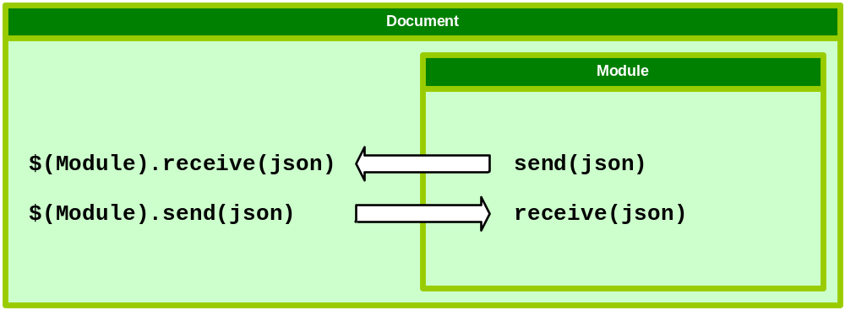
The Mashup Security Solution
<module id="NAME" href="URL" style="STYLE" />

Slide 68
The Mashup Security Solution
<module id="NAME" href="URL" style="STYLE" />
Communiciation is permitted only through cooperating send and receive functions.
The module is exempt from the Same Origin Policy.

Slide 69
The Mashup Security Solution
<module id="NAME" href="URL" style="STYLE" />
Ask your favorite browser maker for the <module> tag.

Slide 70
www.JSON.org

