Slide 1

Predicting the health of trees in New York City
Silvia Maione
Springboard Data Science Career Track

Slide 2
Outline
Project goals Questions
Dataset
Data wrangling
EDA
Model
Conclusions

Slide 3
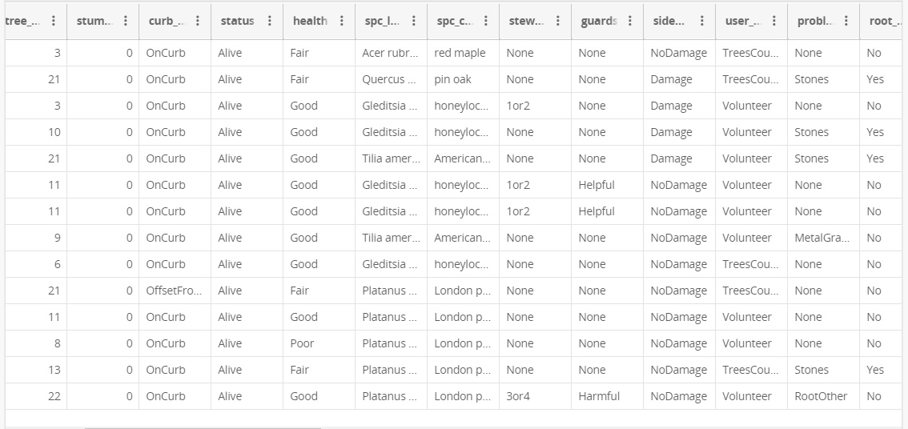
Dataset
https://data.cityofnewyork.us/Environment/2015-Street-Tree-Census-Tree-Data/uvpi-gqnh

Slide 4
Dataset Description
2015 New York City trees survey
Almost 700k observations
45 features/columns, mostly categorical (species, health, branch/trunk/roots problems, etc.), plus tree’s diameter
Geographical information also available (borough, latitude, longitude)

Slide 5
Project Questions and Goals
How many trees?
What’s the average diameter?
What’s the most common species?
Where are most of the trees?
Is it possible to predict a tree’s health (good, fair or poor) knowing the location, the diameter, and the presence of any problems?

Slide 6
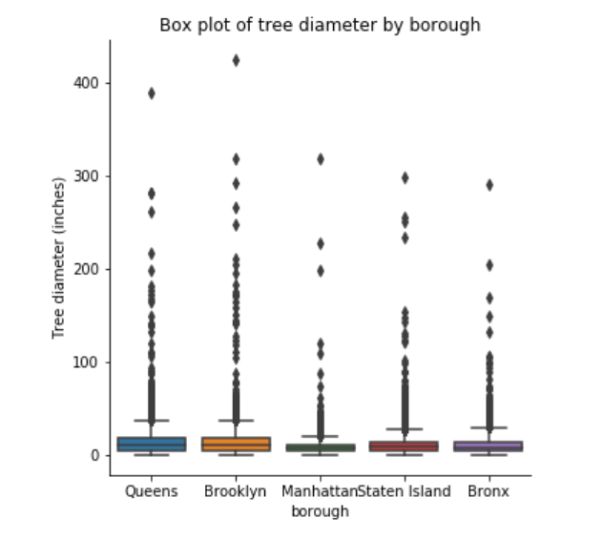
Data Wrangling
Missing entries are removed (not many)
Some entries have a very large diameter (not many)!
Categorical variables need to be encoded

Slide 7
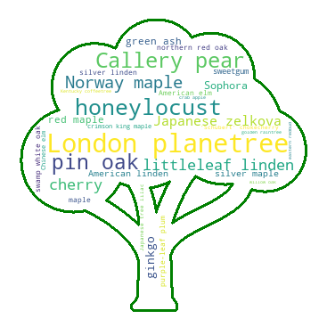
EDA – Species
There are 132 unique species in New York City!
The most common species is the London planetree
(87000 individuals)
The least common species is the Virginia pine (only 10!)

Slide 8
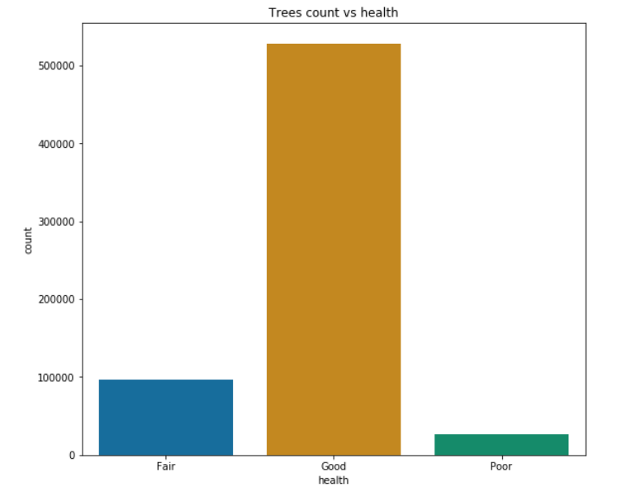
EDA – Health
The dataset is skewed, most trees are classified as healthy (85%)
Balancing techniques or weights in the models

Slide 9
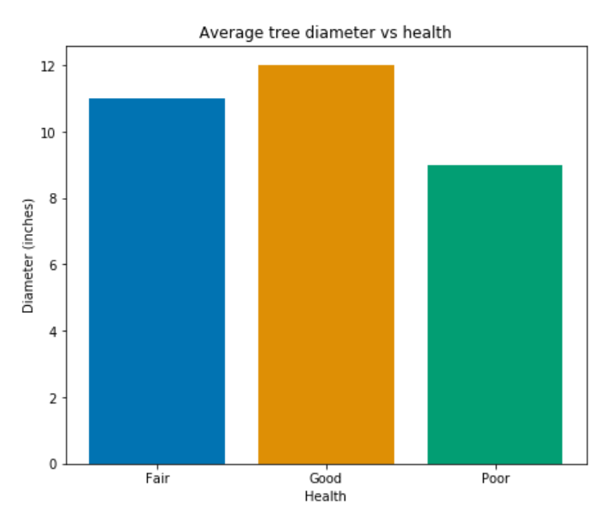
EDA – Health
Healthier trees have larger diameter
The diameter is a feature that can be used in the model

Slide 10
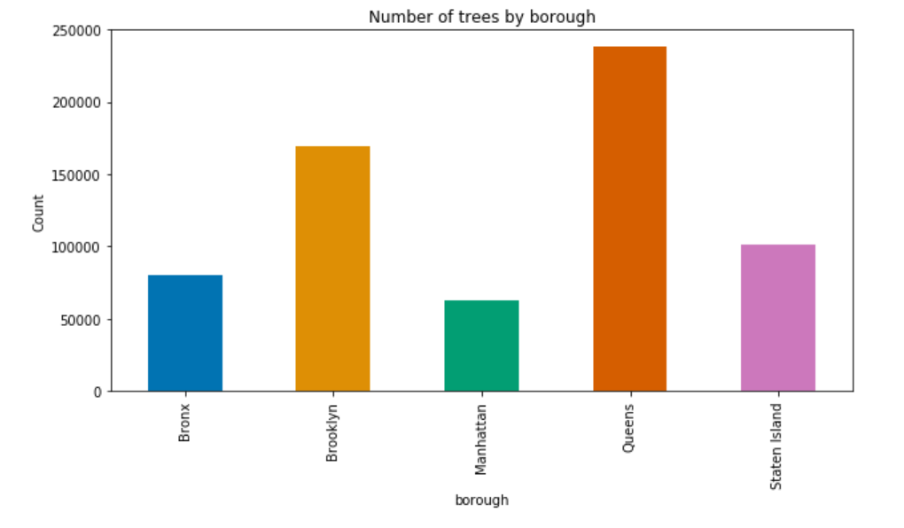
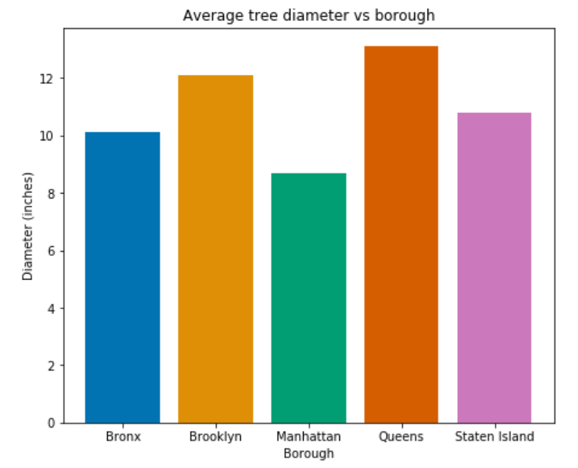
EDA – Tree Diameter
Where there are more trees, their diameter is bigger

Slide 11
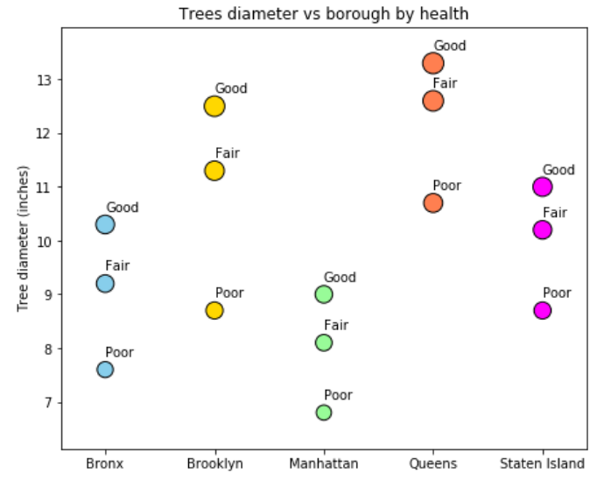
EDA – Tree Diameter
Trees with similar diameter but locates in different areas are classified differently
Location is important, the model is fit separately for each borough or the borough information is included if only one model is generated

Slide 12
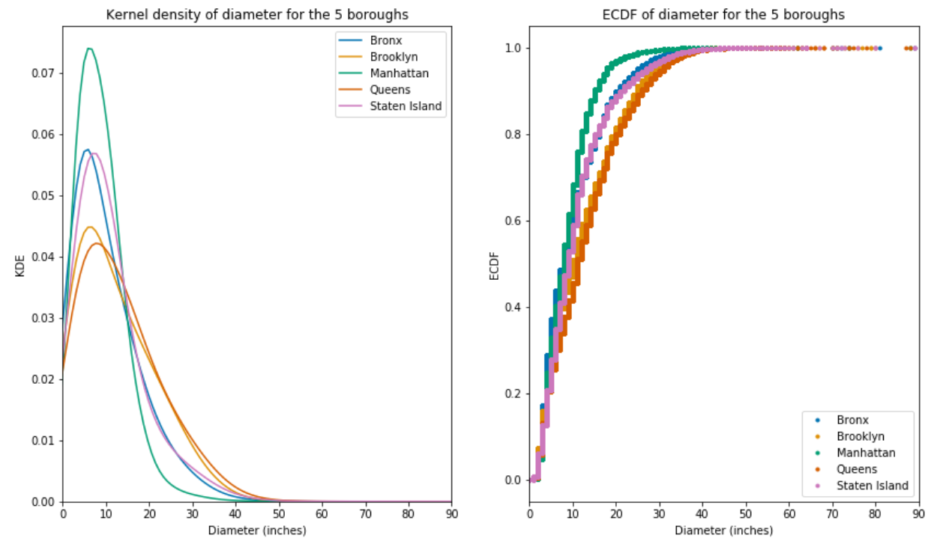
Statistical Analysis
The trees diameter isn’t normally distributed, and the distribution depends on the location

Slide 13
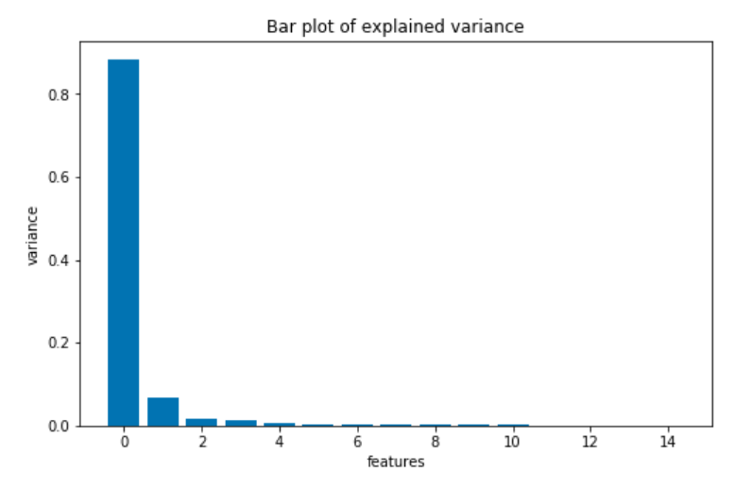
Predictive Model – Features Selection
Various methods used to select features (PCA, SelectKbest, RFE)
The tree diameter is the most important feature, but it isn’t enough, so other features are also used

Slide 14
Predictive Model – Description
The variable to predict is the tree health (fair, good, poor) -> multi-class classification problem
Random Forest and K-Nearest Neighbors algorithms are considered to build a model
The models are fit using different predictors (the diameter is always included)
The used metrics are precision, recall and f1 score, ROC and AUC are also evaluated (macro average)
Different classifiers are trained for the different boroughs, or only one classifier is used, but in this case the location information is also included as a feature

Slide 15
Predictive Model – Development
Various sampling techniques are tested to balance the dataset (custom, SMOTEE & Edited Nearest Neighbour from Python “imblearn” package)
The initial fit gives very good results (too good!) on cross validated training set but not on the test set, the model seems to be overfitting.
Different weights to the classes and thresholds have also been tried, but the results on the test set don’t look great
Although features analysis indicates that 2 features at most are relevant, more attempts considering all the encoded variables are made, in order to improve the model (ROC AUC is worse if only 2 features are used)

Slide 16
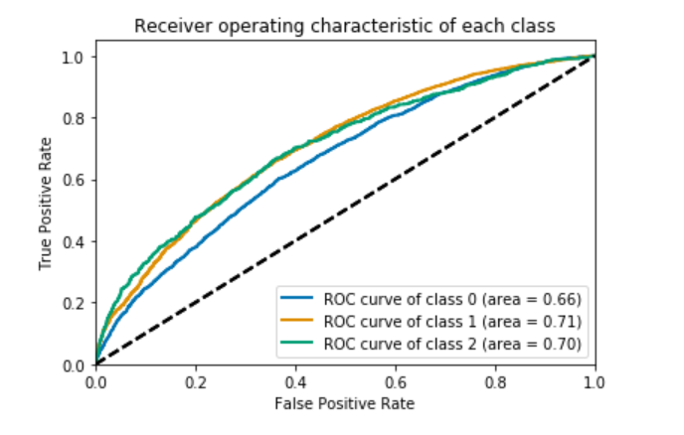
Predictive Model – ROC Curves (Manhattan)
Random Forest Model
Micro average AUC: 0.78
Macro average AUC: 0.69

Slide 17
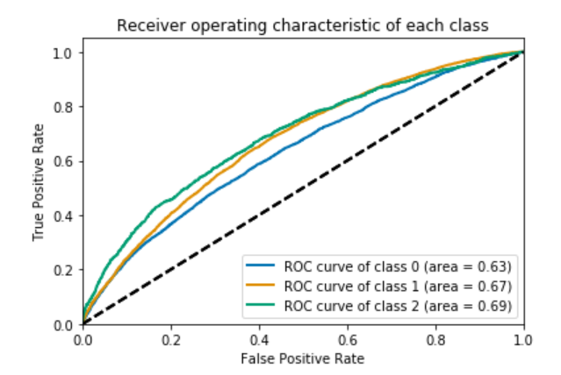
Predictive Model – ROC Curves (Brooklyn)
Random Forest Model
Micro average AUC: 0.74
Macro average AUC: 0.67

Slide 18
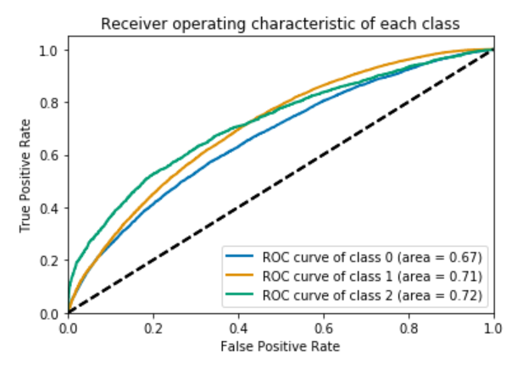
Predictive Model – ROC Curves (Queens)
Random Forest Model
Micro average AUC: 0.80
Macro average AUC: 0.70

Slide 19
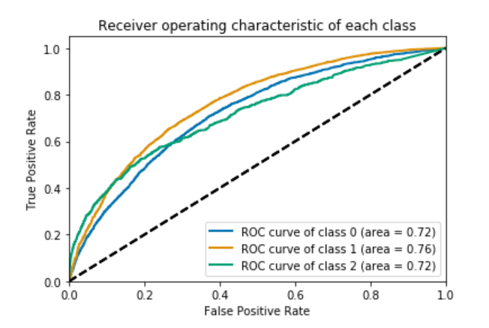
Predictive Model – ROC Curves (Staten Island)
Random Forest Model
Micro average AUC: 0.82
Macro average AUC: 0.73

Slide 20
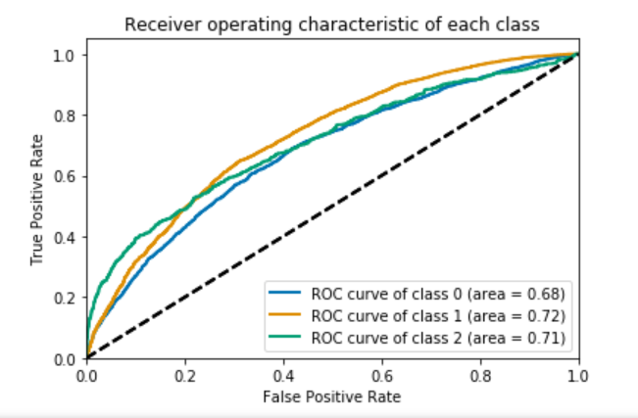
Predictive Model – ROC Curves (Bronx)
Random Forest Model
Micro average AUC: 0.86
Macro average AUC: 0.70

Slide 21
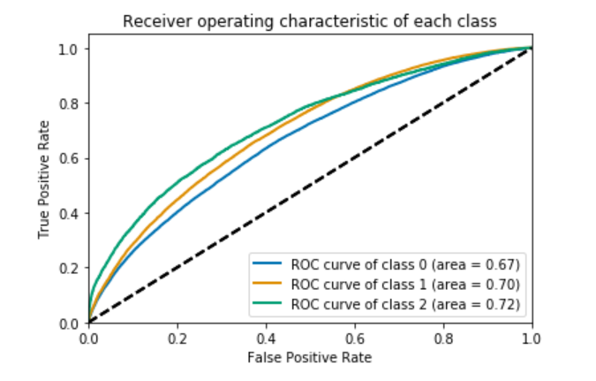
Predictive Model – ROC Curves (all boroughs)
Random Forest Model
Micro average AUC: 0.77
Macro average AUC: 0.70

Slide 22
Model Results – Summary
With the chosen sampler and features, Random Forest performs better then K-Nearest Neighbors
The model can’t predict the minority classes with high precision, recall is also low
The best recall case for the “fair” health class is 0.53 in Staten Island and 0.44 in Brooklyn for the “poor” health class
Precision is below 0.3 for the minority classes, above 0.8 for the majority class

Slide 23
Open Questions
Can the features be better selected? Can correlations be better identified?
Can 2 classes be combined?
Can a search be implemented to optimize scores per class (instead of average)?
Should the problem be reformulated as anomaly detection?

