Slide 1

Predicting the health of trees in New York City
Silvia Maione
Springboard Data Science Career Track

Slide 2
Outline
Project goals Questions
Dataset
Data wrangling
EDA
Model
Conclusions

Slide 3
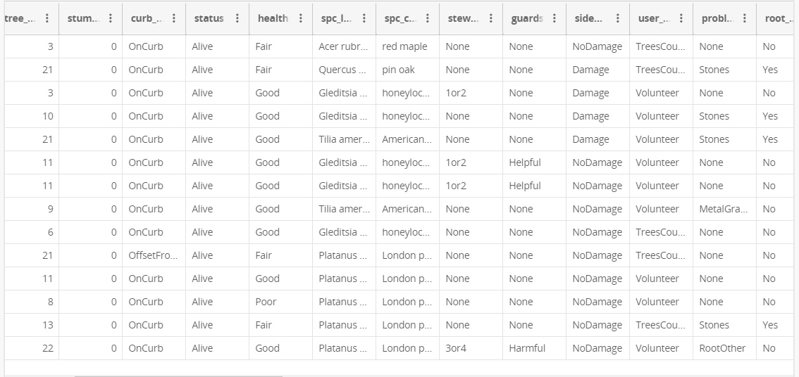
Dataset
https://data.cityofnewyork.us/Environment/2015-Street-Tree-Census-Tree-Data/uvpi-gqnh

Slide 4
Dataset Description
2015 New York City trees survey
Almost 700k observations
45 features/columns, mostly categorical (species, health, branch/trunk/roots problems, etc.), plus tree’s diameter
Geographical information also available (borough, latitude, longitude)

Slide 5
Project Questions and Goals
How many trees?
What’s the average diameter?
What’s the most common species?
Where are most of the trees?
Is it possible to predict a tree’s health (good, fair or poor) knowing the location, the diameter, and the presence of any problems?

Slide 6
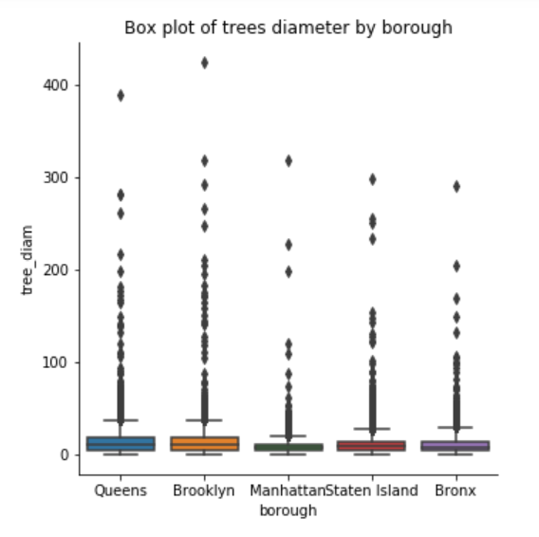
Data Wrangling
Missing entries are removed (not many)
Some entries have a very large diameter (not many)!
Categorical variables need to be encoded

Slide 7
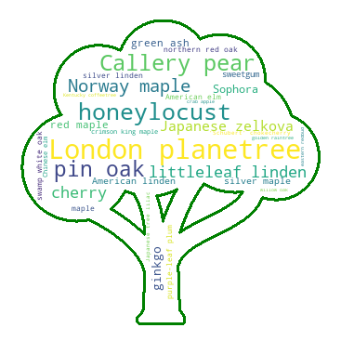
EDA – Species
There are 132 unique species in New York City!
The most common species is the London planetree
(over 87000 individuals)
The least common species is the Virginia pine (only 10!)

Slide 8
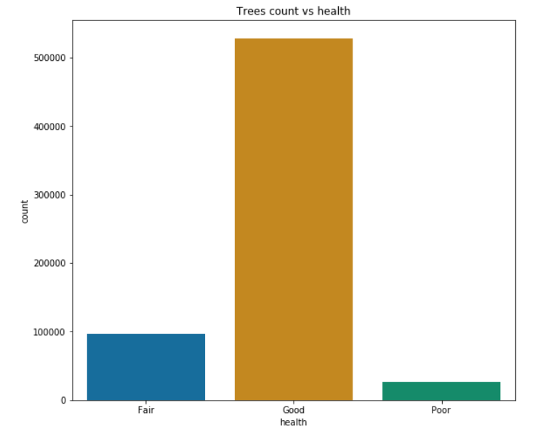
EDA – Health
The dataset is skewed, most trees are classified as healthy
Balancing techniques or weights in the models

Slide 9
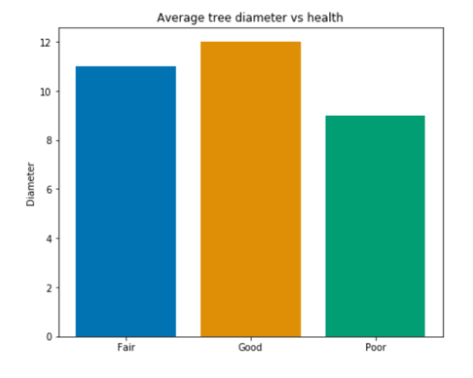
EDA – Health
Healthier trees have larger diameter
The diameter is a feature that can be used in the model

Slide 10
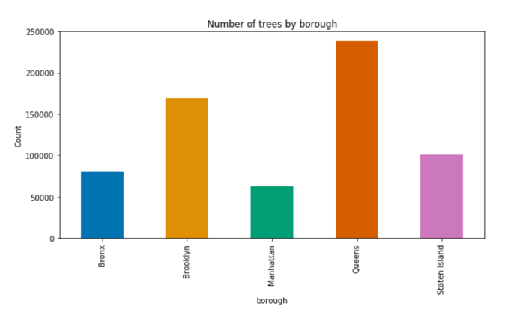
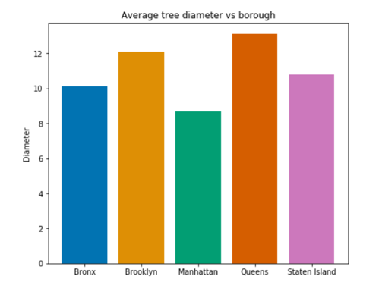
EDA – Tree Diameter
Where there are more trees, their diameter is bigger

Slide 11
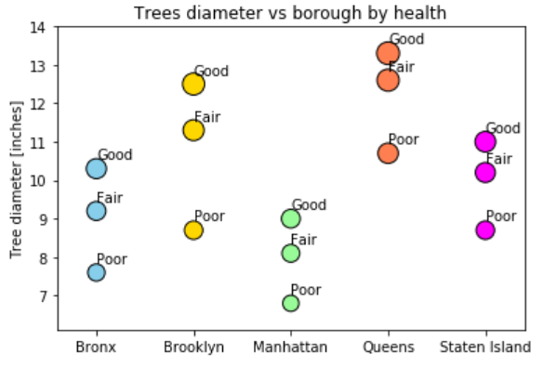
EDA – Tree Diameter
Trees with similar diameter but locates in different areas are classified differently
Location is important, the model is fit separately for each borough or the borough information is included

Slide 12
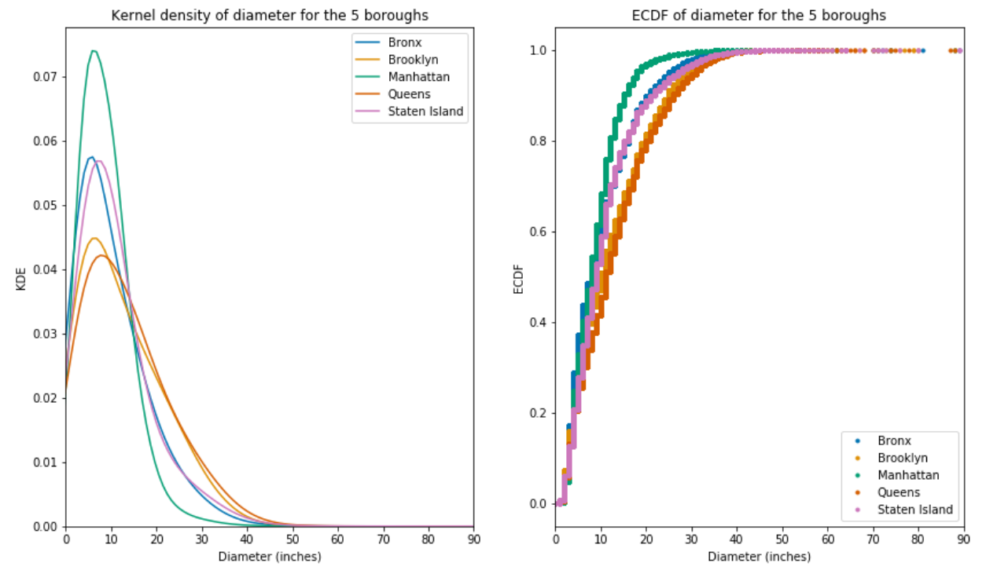
Statistical Analysis
The trees diameter isn’t normally distributed, and the distribution depends on the location

Slide 13
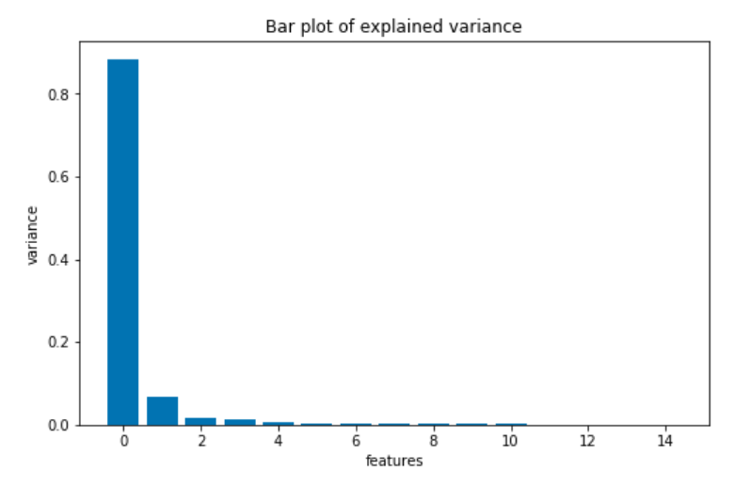
Predictive Model – Features Selection
Various methods used to select features (PCA, SelectKbest, RFE)
The tree diameter is the most important feature, but it isn’t enough, so an extra features, “problems”, is used

Slide 14
Predictive Model Description
Random Forest and K-Nearest Neighbors are considered
The variable to predict is the tree health (fair, good, poor)
The predictors are the diameter and the “problems”
The used metrics are precision, recall and f1 score
Different classifiers for the different boroughs

Slide 15
Model Results
Random Forest and K-Nearest Neighbors give similar results
None of the models can predict the minority classes with high precision, recall is also very low
The best recall case for the minority classes is about 0.5 in the Brooklyn and Queens boroughs
Precision is below 0.2 for the minority classes, above 0.8 for the majority class

Slide 16
Open Questions
Can the features be better selected? Can correlations be better identified?
Can 2 classes be combined?
Can a search be implemented to optimize scores per class (instead of average)?
Should the problem be reformulated as anomaly detection?

