Slide 1
How Does a Bike-Share Navigate Speedy Success?
Athena Pelfrey, Ph.D.
June 28, 2023
Google Data Analytics Capstone: Complete a Case Study
From Coursera

Slide 2

Task
Company Goal: Design marketing strategies aimed at converting casual riders into annual members.
Questions: Three questions will guide the future marketing program:
How do annual members and casual riders use Cyclistic bikes differently?
Why would casual riders buy Cyclistic annual memberships?
How can Cyclistic use digital media to influence casual riders to become members?
Today’s Goal: Determine trends in how annual members and casual riders use bikes.

Slide 3
Data Sources
Overview:
User data from 2019 (collected quarterly).
Includes information regarding staring/ending time of trips, trip duration, type of membership, and staring/ending station information.
Files:
Divvy_Trips_2019_Q1.csv
Divvy_Trips_2019_Q2.csv
Divvy_Trips_2019_Q3.csv
Divvy_Trips_2019_Q4.csv

Slide 4
Data Cleaning & Manipulation
Column Name | Type | Description
trip_id | Integer | Unique id per ride
start_time | Datetime | Starting time of ride
end_time | Datetime | Ending time of ride
trip_duration | Float | Duration of ride in seconds
user_type | Categorical | User type: “member” or “casual”
month | Integer | Month of year [1,12]
hour | Categorical | Hour of day [0,23]
day_of_week | Categorical | Day of Week
Renamed columns and changed data types as necessary to join tables
Changed the user types:
“Subscriber” → “member”
“Customer” → “casual”
Removed irrelevant columns (see right)
Created new columns: month, hour, day_of_week
Filtered out trips that lasted more than 24 hours (see appendix)

Slide 5
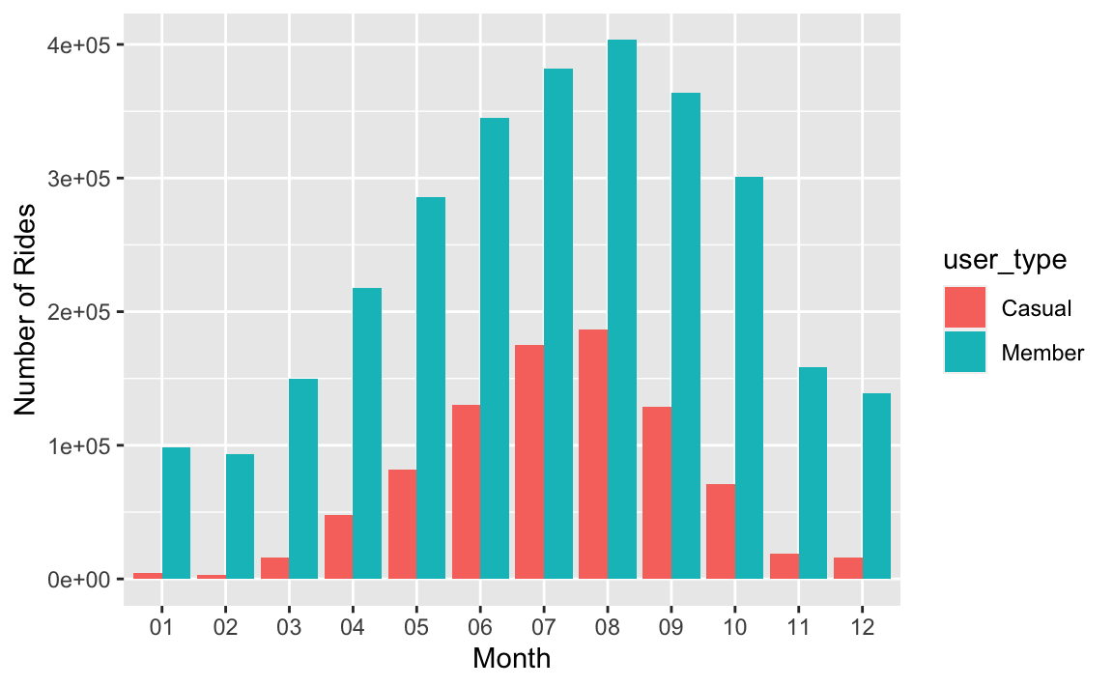
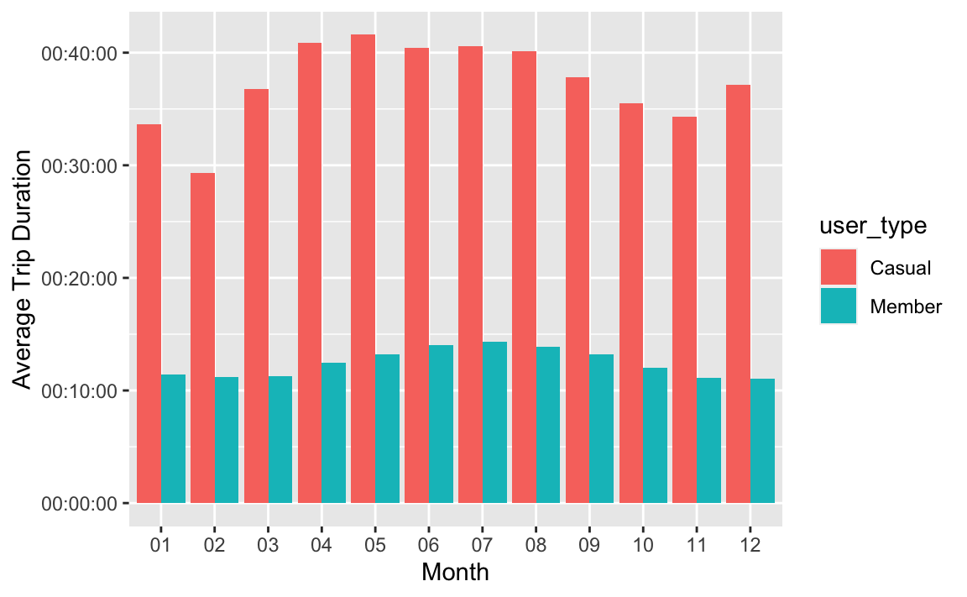
Data Analysis: Month of Year
Number of Rides
average Trip Duration
Number of trips and average trip duration peak during the summer for both members and casual users.

Slide 6
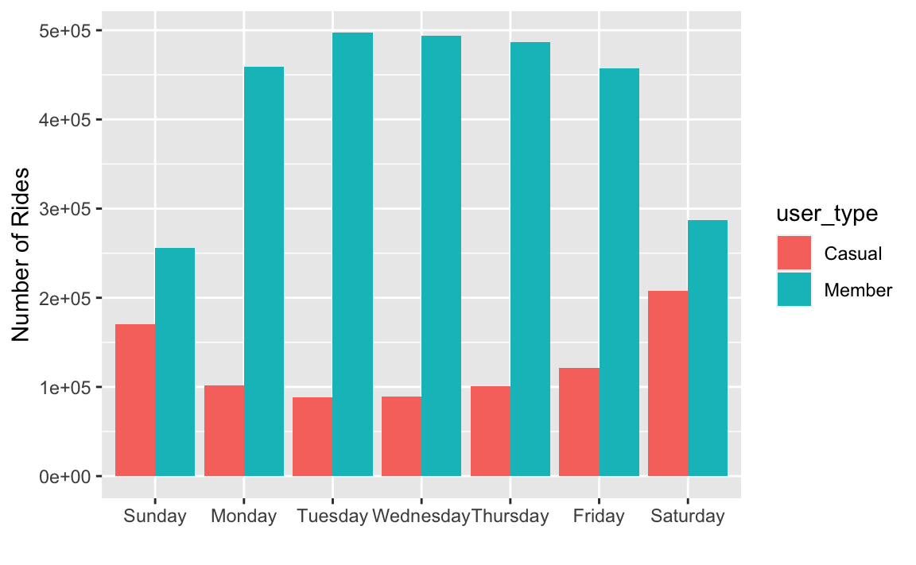
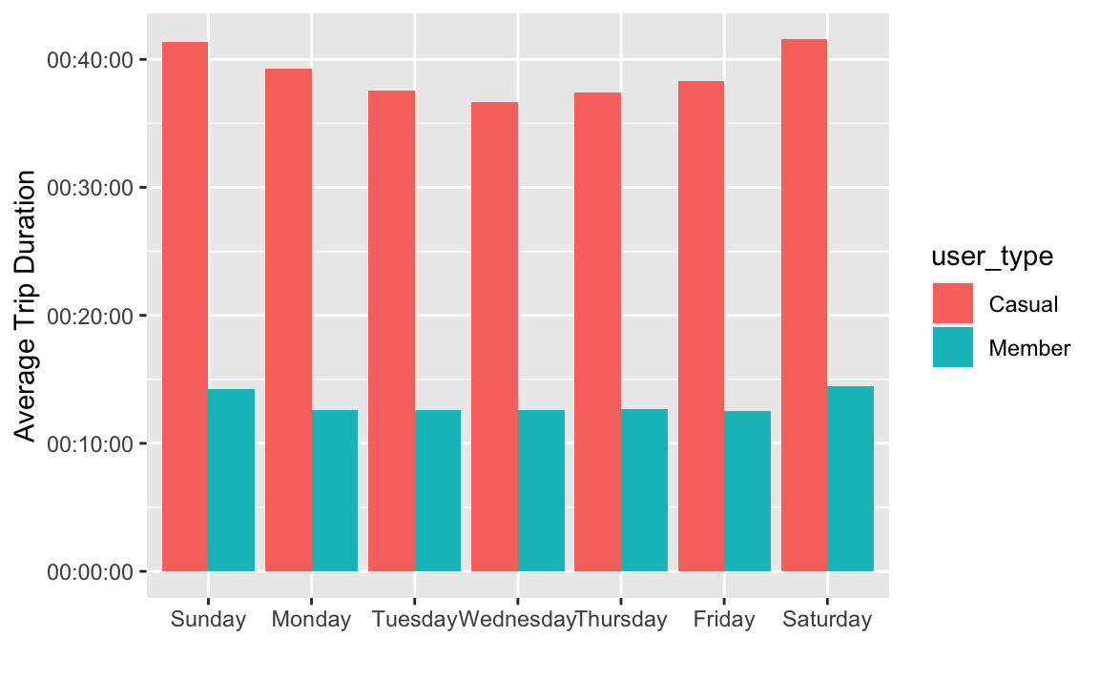
Data Analysis: Day of Week
Number of Rides
average Trip Duration
Members use the bikes more frequently during the weekdays whereas casual users use the bikes more often on the weekend. There is no significant different in trip durations throughout the week.

Slide 7
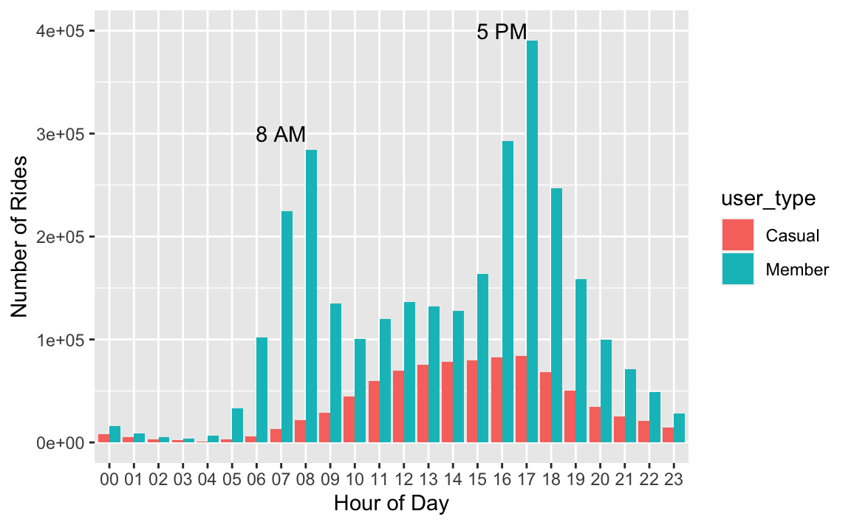
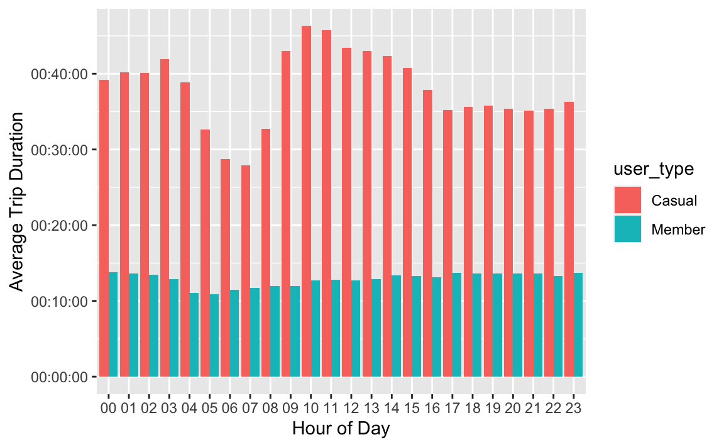
Data Analysis: Time of Day
Number of Rides
average Trip Duration
Members’ bike use peaks at 8 AM and 5 PM (beginning and end of the workday) whereas casual users’ bike use is fairly normally distributed with a peak around 4 PM. There is no significant different in trip durations throughout the day.

Slide 8
Take-Aways & Next steps
Casual Users
Members
Recommendations to convert casual users to members:
Offer incentive for riding on weekends for members.
Offer incentive for trips longer than 30 minutes for members.
Offer incentive for midday trips for members.
* Incentives could include (reduced rates, free ride at a certain point, etc.)
Weekend Riders
Peak mid afternoon
Peak usage during summer months
Weekday Riders
Peak start & end of workdays
Average
Trip ~40 mins
Average
Trip ~13 mins

Slide 9
More Questions
Questions:
How many casual users are one-time vs repeat customers?
Are some of the trips that lasted more than 24 hours legitimate?
Where there any changes to memberships in 2019 that may have impacted the number of casual users vs members?
Do users ride together in groups? How often?
Are some stations more popular for the different user types?

Slide 10
Appendix

Slide 11
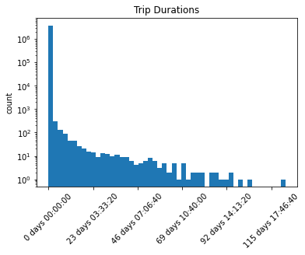
Filtering by Trip Duration
Total.Trips | Trips.less.24.hrs | Percentage
2937367 | 2936866 | 0.9998294
880637 | 879290 | 0.9984704
Kept 99.95% of all data
Summaries of Trip Duration
Raw Data
user_type | Casual | Member
count | 880637 | 2937367
mean | 00:57:00.885729 | 00:14:19.383275
max | 2952:20:00 | 2515:43:53
After Filtering
user_type | Casual | Member
count | 879290 | 2936866
mean | 00:39:25.535000 | 00:12:55.632406
max | 24:00:00 | 23:59:45

