Slide 1
Team 6 Final Presentation
Aisha, Hibah, Sean, Liam, Alec, Joy, Sydney & Amy

Slide 2
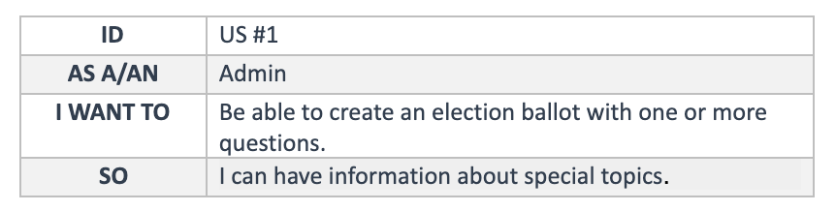
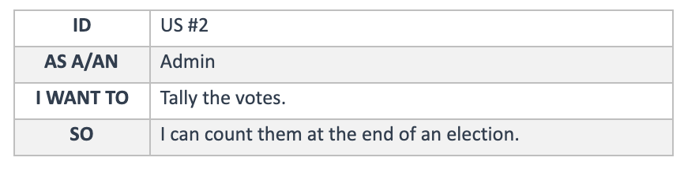
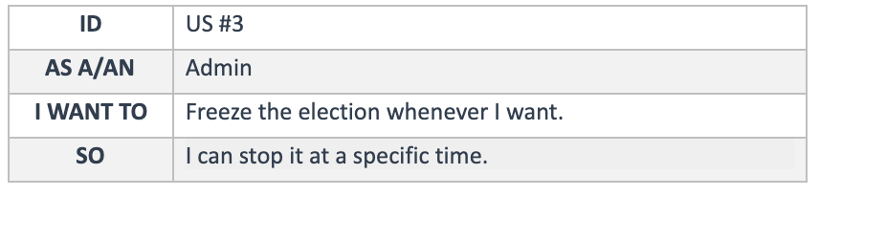
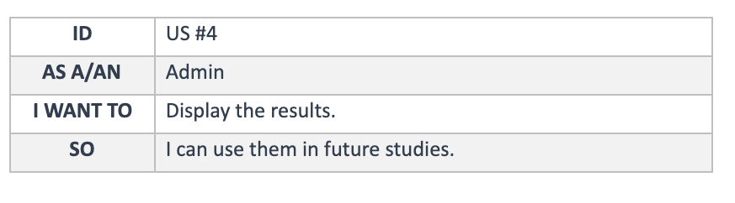
Project Overview
Notes:
Create an election ballot with one or more questions
Tally the votes
Freeze the election
Display the results

Slide 3
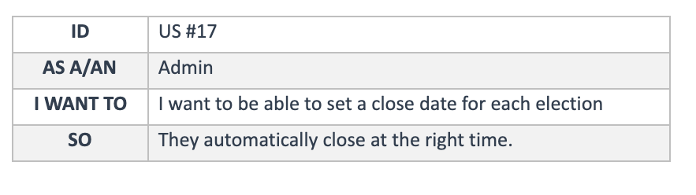
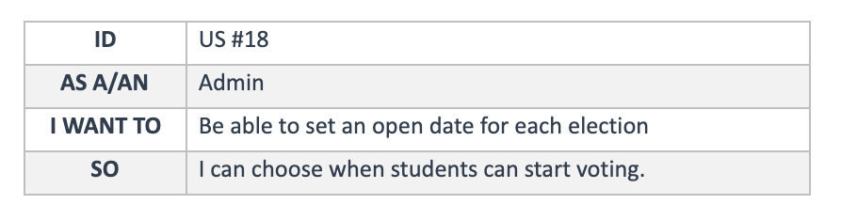
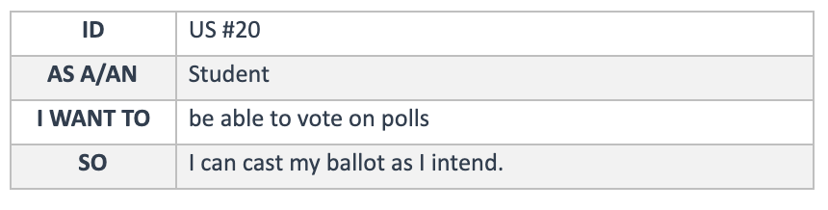
Project Overview
Notes:
Set a close date for each election
Set an open date
Be able to vote on polls

Slide 4
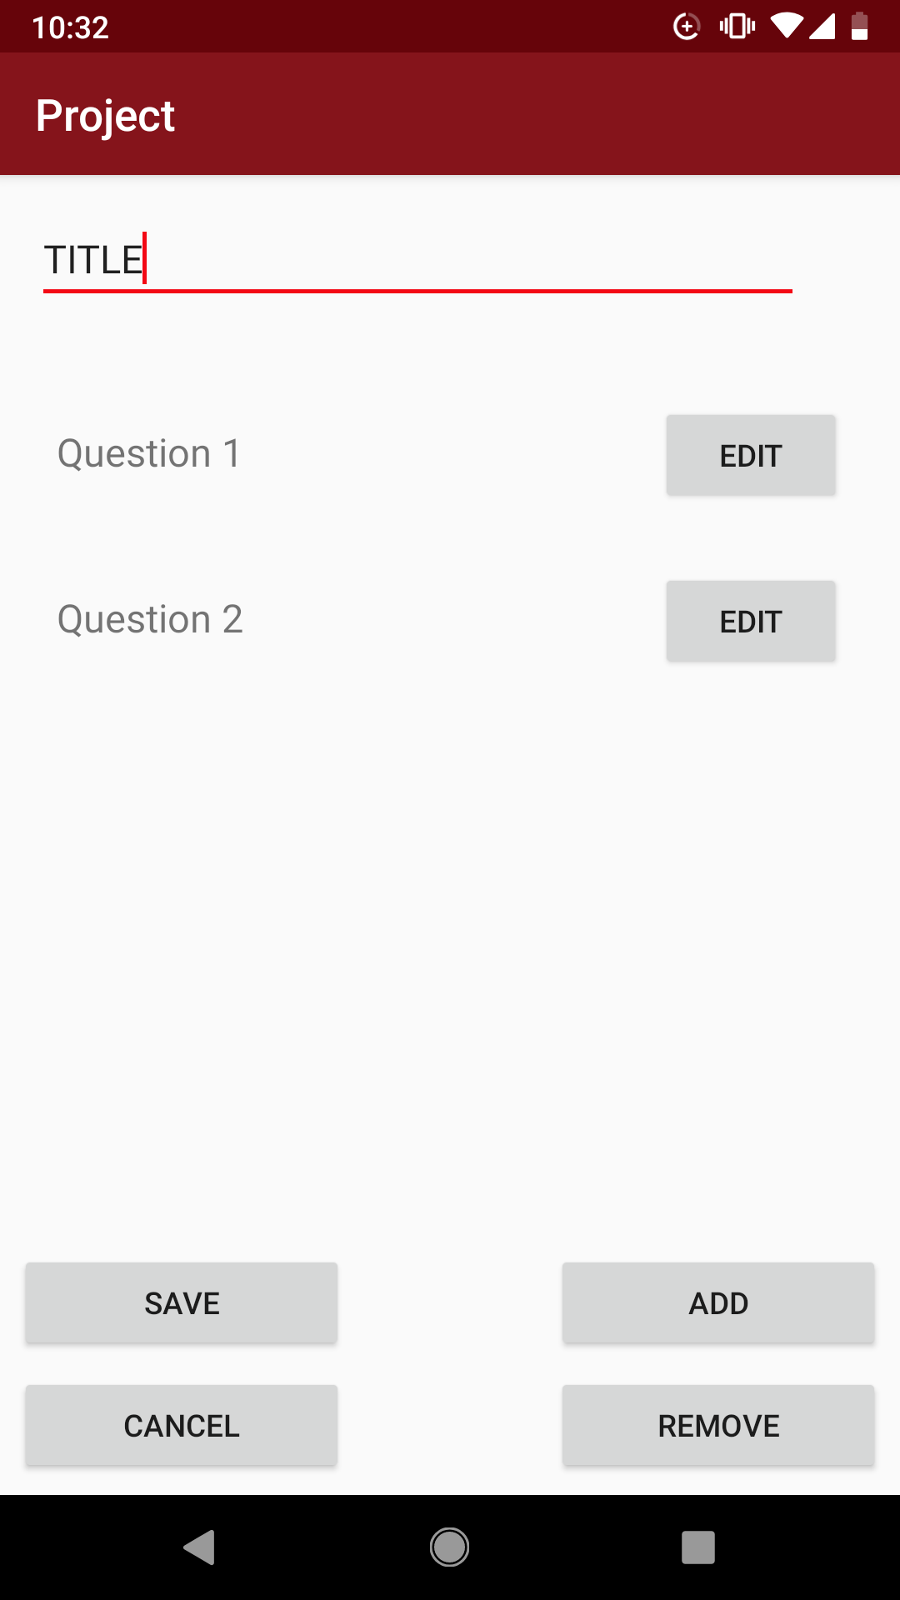
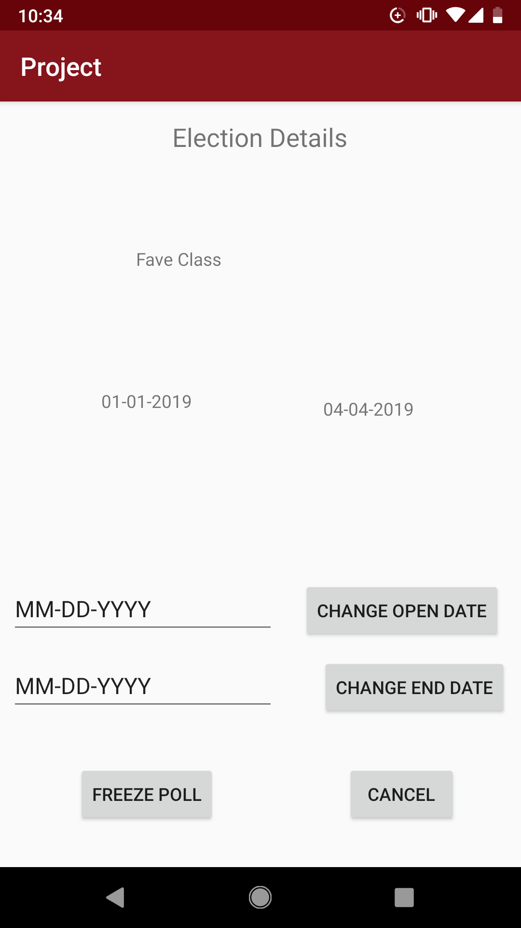
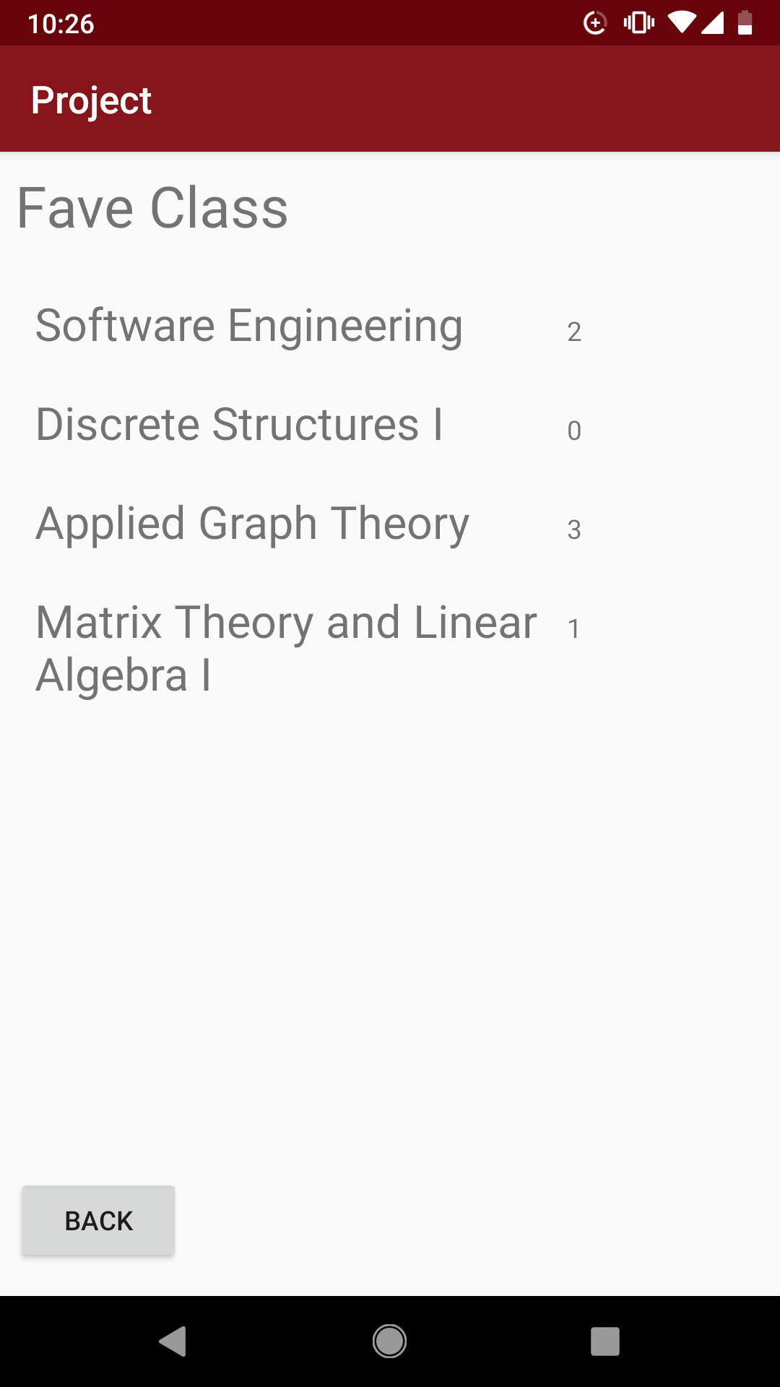
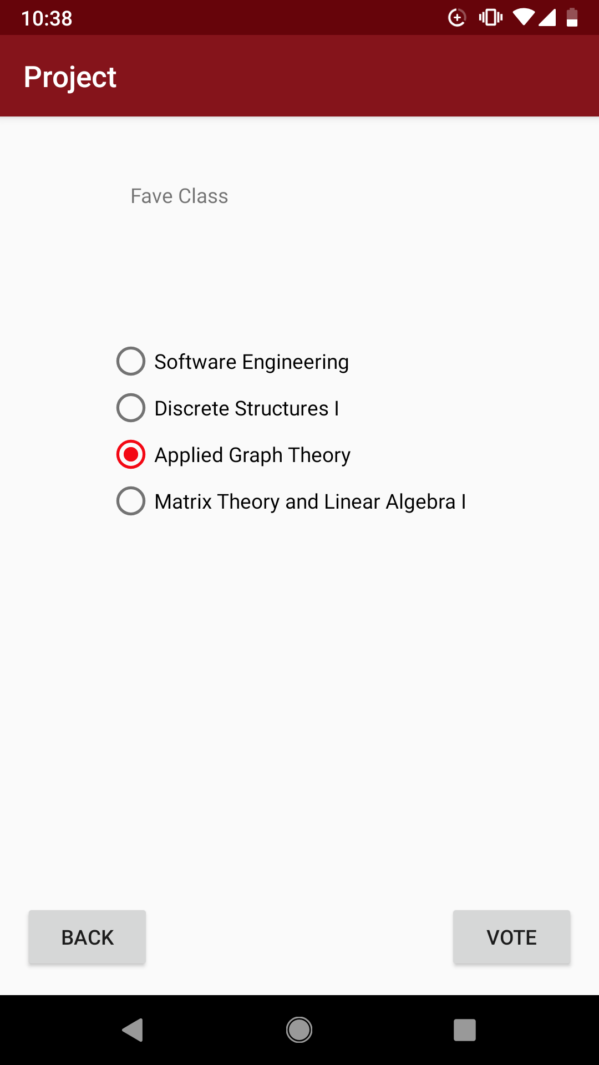
Final Outcome
Notes:
Admin Functionality:
Create polls with multiple questions and multiple options.
Customize open and close dates for polls as well as freezing a poll at a given moment.
View the results of a poll prior to and following a close date.
Student Functionality
View available polls and vote on them
View the results of a poll prior to and following a close date.

Slide 5
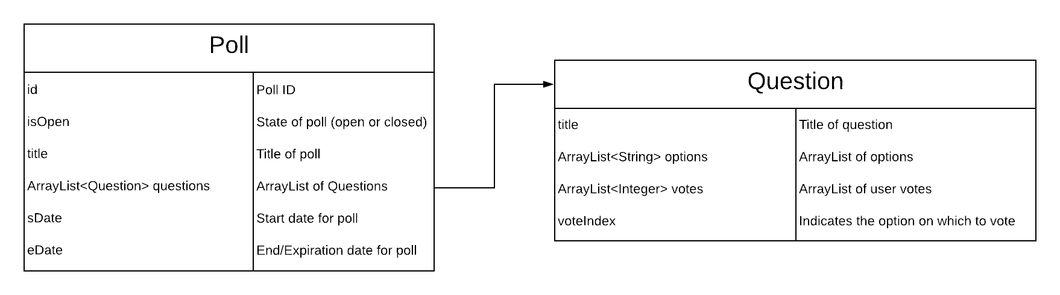
Implementation Success - Poll Hierarchy
Notes:
One of our greatest successes with regard to Implementation was the Poll -> Question hierarchy.
An effective example of interconnected objects allowing for multiple questions to be added to a poll.
Each poll can have more than 1 question each with their own individual options and questions.
Votes are handled within the question classes
The isOpen variable defines the state in which a poll is in open or closed
The sDate and eDate describe the start and end date for the poll

Slide 6
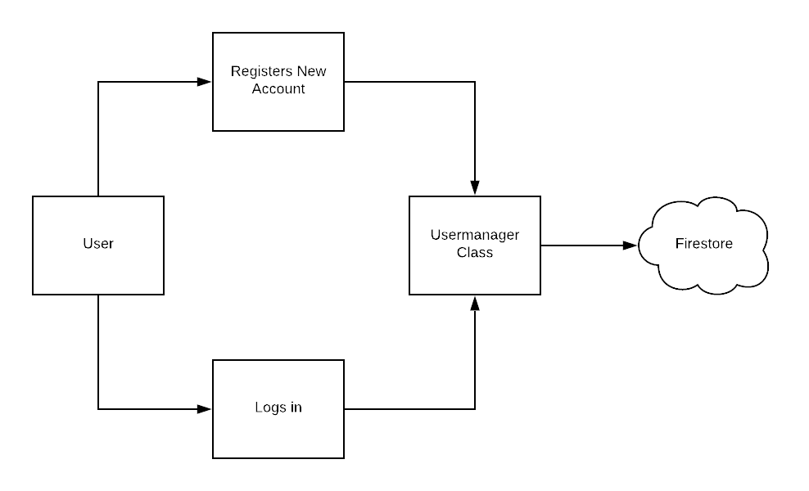
Implementation Challenge - Login
Notes:
unable to have a class act as the modifier for user credentials
wanted to have one class process the reading and writing of users to the firestore db
due to some unforeseen problems he was unable to choose this method of implementing a login and registration to the application

Slide 7

Software Process Success - Code Merges
Notes:
Code integration
Branch merge to the Master
Not breaking the code

Slide 8

Software Process Challenge - Communication
Notes:
Team Communications
Discord issues
Facebook chat as well
Team meetings - sometimes folks couldn’t attend
Busy schedule outside of course

Slide 9
Questions?

