Slide 1


Big Data Analytics Symposium - Summer 2020
Analytics Project:
Traditional vs. Advanced Statistics
and the NBA Regular Season MVP
Award
Team:
Alex Spence
Data Science, NYU GSAS
ajs811@nyu.edu
Mike Urciuoli
Computer Science, NYU GSAS
mlu216@nyu.edu
Notes:
Good evening, my name is Mike Urciuoli.
And my name is Alex Spence.
In our project we take a look at both traditional and advanced NBA statistics to see which correlate most with the regular season MVP award.

Slide 2
Traditional vs. Advanced Statistics and MVP
Agenda
Abstract
Motivation
Goodness
Data Sources
Data Samples
Design Diagram
Code Challenges
Results
Obstacles
Summary
Future Works
Acknowledgements
References
Notes:
Mike
Here is the agenda for this presentation <pause for 5 seconds>

Slide 3
Traditional vs. Advanced Statistics and MVP
Abstract
Traditional NBA player statistics have been collected since the onset of the NBA in 1946.
Advanced stats started being collected in the 1990s.
Which statistics are most correlated with the MVP award?
The seasons used for comparison were 2002-03 to 2016-17.
Tools used were Hadoop MapReduce and Apache Impala
“Estimated wins added”, “value added” and “player efficiency rating” (all advanced statistics) were determined to be most correlated.
Able to predict MVP using most correlated statistics for 10/16 seasons
More reliable during later seasons
Notes:
Alex
Traditional NBA stats have been around since 1946, while advanced stats came to light in the 1990s.
Explain seasons for analysis, tools used (MR for cleaning and profiling) Impala for analytic
Analytic result is that EWA, va and per were most informative. and the average ranking for these three corretly predicted MVP for 10/16 seasons.
Abstract:
Traditional NBA player statistics have been collected since the onset of the NBA in 1946. The development of advanced player statistics have grown in the NBA from the 1990s through today. This project looks to answer the question which statistics (advanced or traditional) correlate most to the regular season MVP award. The seasons used for comparison were 2002-03 to 2016-17. It was determined that on average, the metrics which most correlated to the regular season MVP were estimated wins added, value added and player efficiency rating (all advanced statistics). For further study, it is recommended to analyze more seasons and apply machine learning techniques on the most informative statistics to develop regular season MVP prediction models.
Platform(s) where the application runs:
< NYU Dumbo (Hadoop MapReduce, Apache Impala)>

Slide 4
Traditional vs. Advanced Statistics and MVP
Motivation
Who are the users?
NBA franchises
NBA players
Media
Who will benefit?
The above
Also fans
Why is this analytic important?
Provides an objective assessment of player performance as it relates to the regular season MVP
Determines which statistics are most informative
Notes:
Alex
NBA Franchies - deciding in free agency whether to sign a player or not
NBA players - can use the analytic to inform what skills they should work on in order maximize their MVP chances
MEdia - can use the analytic for MVP selection criteria
All these three benefit, plus fans if analytic can provide an objective assesment of player performance
Motivation
Who are the users of this analytic?
NBA franchises and players, and the media
Who will benefit from this analytic?
same as above, plus NBA fans
Why is this analytic important?
This analytic is important to provide an objective assessment of player performance as it relates to the regular season MVP, and to determine which statistics are most informative.

Slide 5
Traditional vs. Advanced Statistics and MVP
Goodness
What steps were taken to assess the ‘goodness’ of the analytic?
Simple statistics and rankings of typical player statistics are performed per season.
Data readily available from sites like ESPN.com and NBA.com are used to spot check calculations
Domain knowledge allows personal assessment of goodness
Actual MVP winners are predicted using this analytic
Notes:
Mike
What steps were taken to assess the ‘goodness’ of the analytic?
The results of our analytic are correct and can be trusted because we are performing simple statistics and rankings of typical player statistics per season. This data is readily available on sources such as ESPN.com and NBA.com and was used to spot check the calculations. In addition, domain knowledge and the results of the data profiling were used to assess the goodness of the analytic. We also predicted the mvp winners for each season based on the results of the analytic.

Slide 6
Traditional vs. Advanced Statistics and MVP
Data Sources
Advanced Player Statistics
2002-03 to 2017-18 seasons
NBA advanced player statistics organized by season
Ex) “Player efficiency rating”, “estimated wins added”
Size: 0.6 MB
Traditional Player Statistics
1949-50 to 2016-2017 seasons
NBA traditional player statistics organized by season
Ex) Points scored, rebounds, assists
Size: 5.1 MB
Regular Season MVPs
1949-50 to 2018-19 seasons
NBA MVPs organized by season
Size of data: 4 KB
Notes:
Mike
Data Sources
Name: Advanced Player Statistics (2002-03 to 2017-18)
Description: NBA advanced player statistics organized by season such as PER, EWA, TS%
Size of data: 0.6 MB
Name: Traditional Player Statistics (1949-50 to 2016-17)
Description: NBA traditional player statistics organized by season such as pts, rbs, asts
Size of data: 5.1 MB
Name: Regular Season MVPs (1949-50 to 2018-19(
Description: NBA MVPs organized by season
Size of data: 4 KB

Slide 7
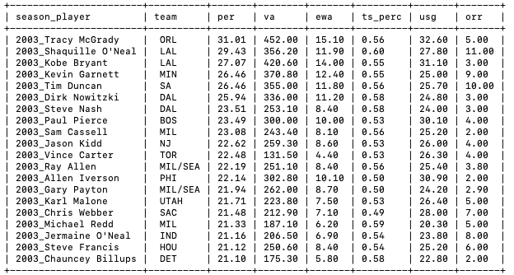
Traditional vs. Advanced Statistics and MVP
Data Sample - Advanced Player Statistics
Notes:
Alex
This is a sample of the advanced player statistics. Mix of string and float values. ORganized by season_player and team. JOin with other teables on season_player

Slide 8
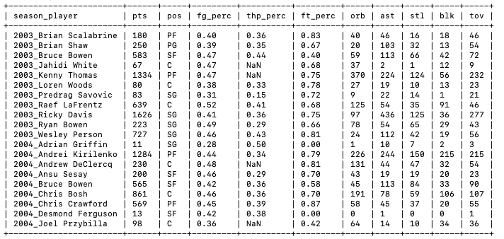
Traditional vs. Advanced Statistics and MVP
Data Sample - Traditional Player Statistics
Notes:
Mike

Slide 9
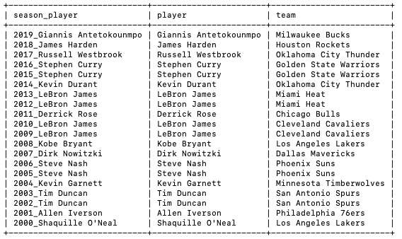
Traditional vs. Advanced Statistics and MVP
Data Sample - Regular Season MVPs
Notes:
Alex
Just lists the MVP winners for each season

Slide 10
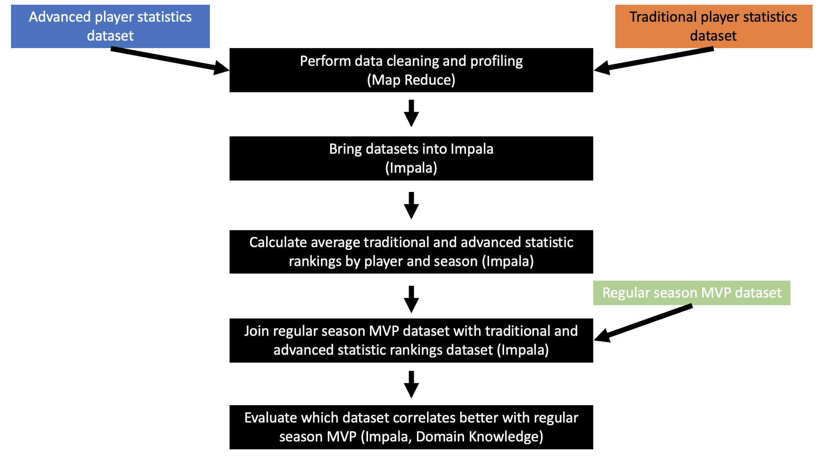
Traditional vs. Advanced Statistics and MVP
Design Diagram
Traditional vs. Advanced Statistics and the NBA Regular Season MVP Award
Notes:
Mike

Slide 11
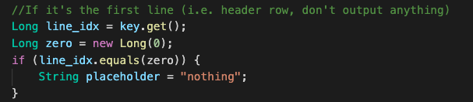


Traditional vs. Advanced Statistics and MVP
Code Challenge 1
MapReduce (Cleaning)
Ignoring the header row of data
Converting YYY1-YYY2 to YYY2
Impala (Developing Analytic)
Develop rank code
Notes:
Use the input key to ignore the header row of the data. Challenging b/c we never used the input row in the hws
Figure out how to take the season in 2003-2004 and convert to 2004 - used substring to take first four values and added one int oan int
rank code in impala - trank() function, partiion by season, order by fg_perc desc
Code Challenge 1 (Alex)
MapReduce (Cleaning)
Ignoring the header
row of data
Converting
YYY1-YYY2 to YYY2
Impala (Developing Analytic)
Develop rank code
Staying organized with long queries with many columns and joins (see next page)!

Slide 12
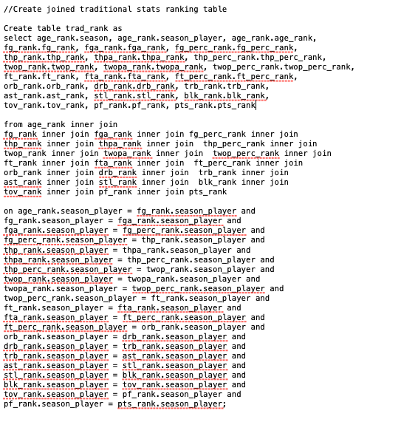
Traditional vs. Advanced Statistics and MVP
Code Challenge 2
Impala (Developing Analytic)
Staying organized with long queries with many columns and joins!
Notes:
Self explanatory - long queries can result in syntax or semantic errors. Have to stay organize and persistent to limit both.
Code Challenge 1 (Alex)
MapReduce (Cleaning)
Ignoring the header
row of data
Converting
YYY1-YYY2 to YYY2
Impala (Developing Analytic)
Develop rank code
Staying organized with long queries with many columns and joins (see next page)!

Slide 13
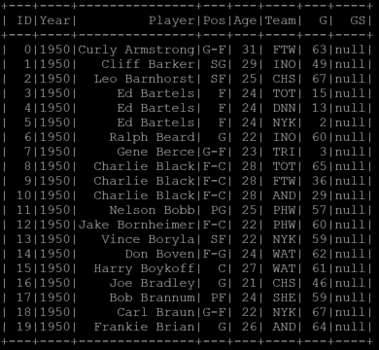
Traditional vs. Advanced Statistics and MVP
Code Challenge 3
MapReduce (Cleaning)
In the traditional stats dataset, players who were transferred from one team to another during the same season appeared more than once, with their stats split between the different teams
There were also instances of multiple players with the same name in one season
Solution
Concatenate year, player, and age during map to send unique player records to reduce phase
Notes:
Mike
MapReduce (Cleaning)
Ignoring the header
row of data
Converting
YYY1-YYY2 to YYY2
Impala (Developing Analytic)
Develop rank code
Staying organized with long queries with many columns and joins (see next page)!

Slide 14
Traditional vs. Advanced Statistics and MVP
Results - Definitions
Advanced Statistics
EWA: estimated wins added
VA: value added
PER: player efficiency rating
USG: usage rating
TS%: true shooting %
Traditional Statistics
PTS: points
FG: field goals made
TOV: turnovers
FT: free throws made
AST: assists
Notes:
Mike

Slide 15
Traditional vs. Advanced Statistics and MVP
Results
Most informative advanced statistics by average MVP ranks
EWA (3.8) / VA (3.8) / PER (4.1) / USG (10.6) / TS% (35.9)
Most informative traditional statistics by average MVP ranks
PTS (12.6) / FG (12.67) / TOV (15.2) / FT (17.1) / AST (17.6)
Composite advanced statistics are the most informative overall
EWA, VA, PER
Notes:
Mike

Slide 16
Traditional vs. Advanced Statistics and MVP
Results
Advanced statistics seem to be valued less in earlier years
2003 to 2010 average MVP EWA (5.75 rank / 593 value)
2009 to 2017 average MVP EWA (1.67 rank / 810 value)
2012 to 2018 MVP EWA rank is 1 for 5/7 seasons
2005 and 2006 has the lowest ranked MVP EWA
Steve Nash (18 rank, 15 rank)
Using average rank of EWA, VA, and PER accurately predicts the MVP in 10/16 seasons from 2003 to 2018
Notes:
Alex
Stress that we presume that advanced statistics took time to be accepted into the mainstream. Therefore they seem to be valued less in earlier years, shown by the average EWA rank for the first 7 years of data vs. the last 7 years. Took three most informative advanced stats to predict MVP and deevelop the analytic - accurate for 10/16 seasons.

Slide 17
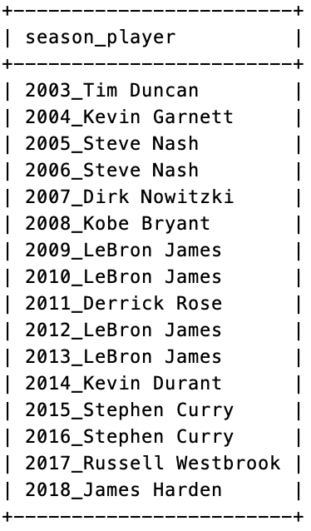
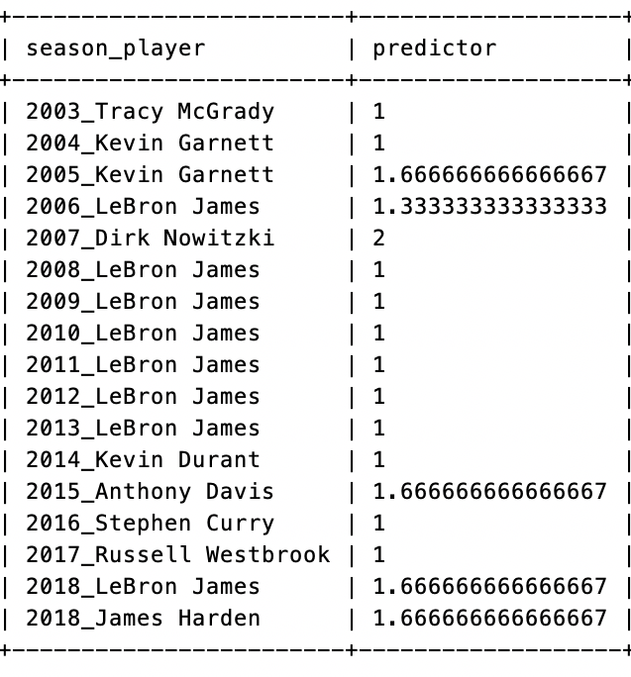
Traditional vs. Advanced Statistics and MVP
Results
Notes:
Alex
These are the results of the analytic. ON the left are the actual winners and on the right are the predicted winners based on the average ranking of EWA, VA, and PER. AS you can see it’s right for 10/16 seasons.

Slide 18
Traditional vs. Advanced Statistics and MVP
Obstacles
More players provided in traditional than advanced dataset per year
Solution: treat datasets independently
Join on the MVP dataset for final average rank calculations
Distinguishing between string and integer fields in the profile reducer
Solution: Use try and except clauses
Connecting Impala tables to Tableau
Notes:
Mike

Slide 19
Traditional vs. Advanced Statistics and MVP
Summary
Hadoop MapReduce and Apache Impala used to compare traditional and advanced statistics and evaluate the correlation to the NBA regular season MVP award.
During 2002-03 to 2016-17 seasons:
Most correlated advanced statistic
EWA, VA, and PER
Most correlated traditional statistics
PTS, FG, and TOV
Overall EWA, VA, and PER are most useful
Able to predict MVP in 10/16 seasons when average of values is taken
Better predictor in most recent years
Notes:
Mike

Slide 20
Traditional vs. Advanced Statistics and MVP
Future Works
Include more years using NBA API or Basketball-Reference API
Develop machine learning model with the most informative statistics to predict current regular season MVP
Utilize Tableau for visualizations
Develop analytics for other awards
Defensive player of the year
Rookie of the Year
Etc.
Notes:
Alex
More data can be used to confirm the results of the analytic and potentially refine the results
ML could provide more insights and develop a stronger model
Tableau could illustrate results better.
Could apply methodology for the other season awards and develop analytics for those

Slide 21
Traditional vs. Advanced Statistics and MVP
Acknowledgements
Thank you to Prof. McIntosh for answering our analysis questions!
Thank you to Kaggle for compiling the data sets!
Thank you to HPC for providing the technology to make this project possible!
Thank you to the NBA for providing a medium for professional basketball!

Slide 22
Traditional vs. Advanced Statistics and MVP
References
A Neural Network Model of the NBA Most Valued Player Selection Prediction (Chen, Dai, Zhang)
Key Game Indicators in NBA Players’ Performance Profiles (Dehesa, Vaquera, Goncalves, Mateus, Gomez-Ruano, Sampaio)
Predicting Per Game Performance Through Per Minute Performance in Basketball (Martinez)
Game-to-Game Prediction of NBA Players’ Points in Relation to Their Season Average (Zovak, Šarčević, Pintar)
Revisiting the Correlation of Basketball Stats and Match Outcome Prediction (Li)
Sports analytics— Evaluation of basketball players and team performance (Sarlis, Tjortjis)

Slide 23
Traditional vs. Advanced Statistics and MVP
Questions?

Slide 24
Big Data Analytics Symposium - Summer 2020
Analytics Project:
Traditional vs. Advanced Statistics
and the NBA Regular Season MVP
Award
Team:
Alex Spence
Data Science, NYU GSAS
ajs811@nyu.edu
Mike Urciuoli
Computer Science, NYU GSAS
mlu216@nyu.edu
THANK YOU!

