Slide 1
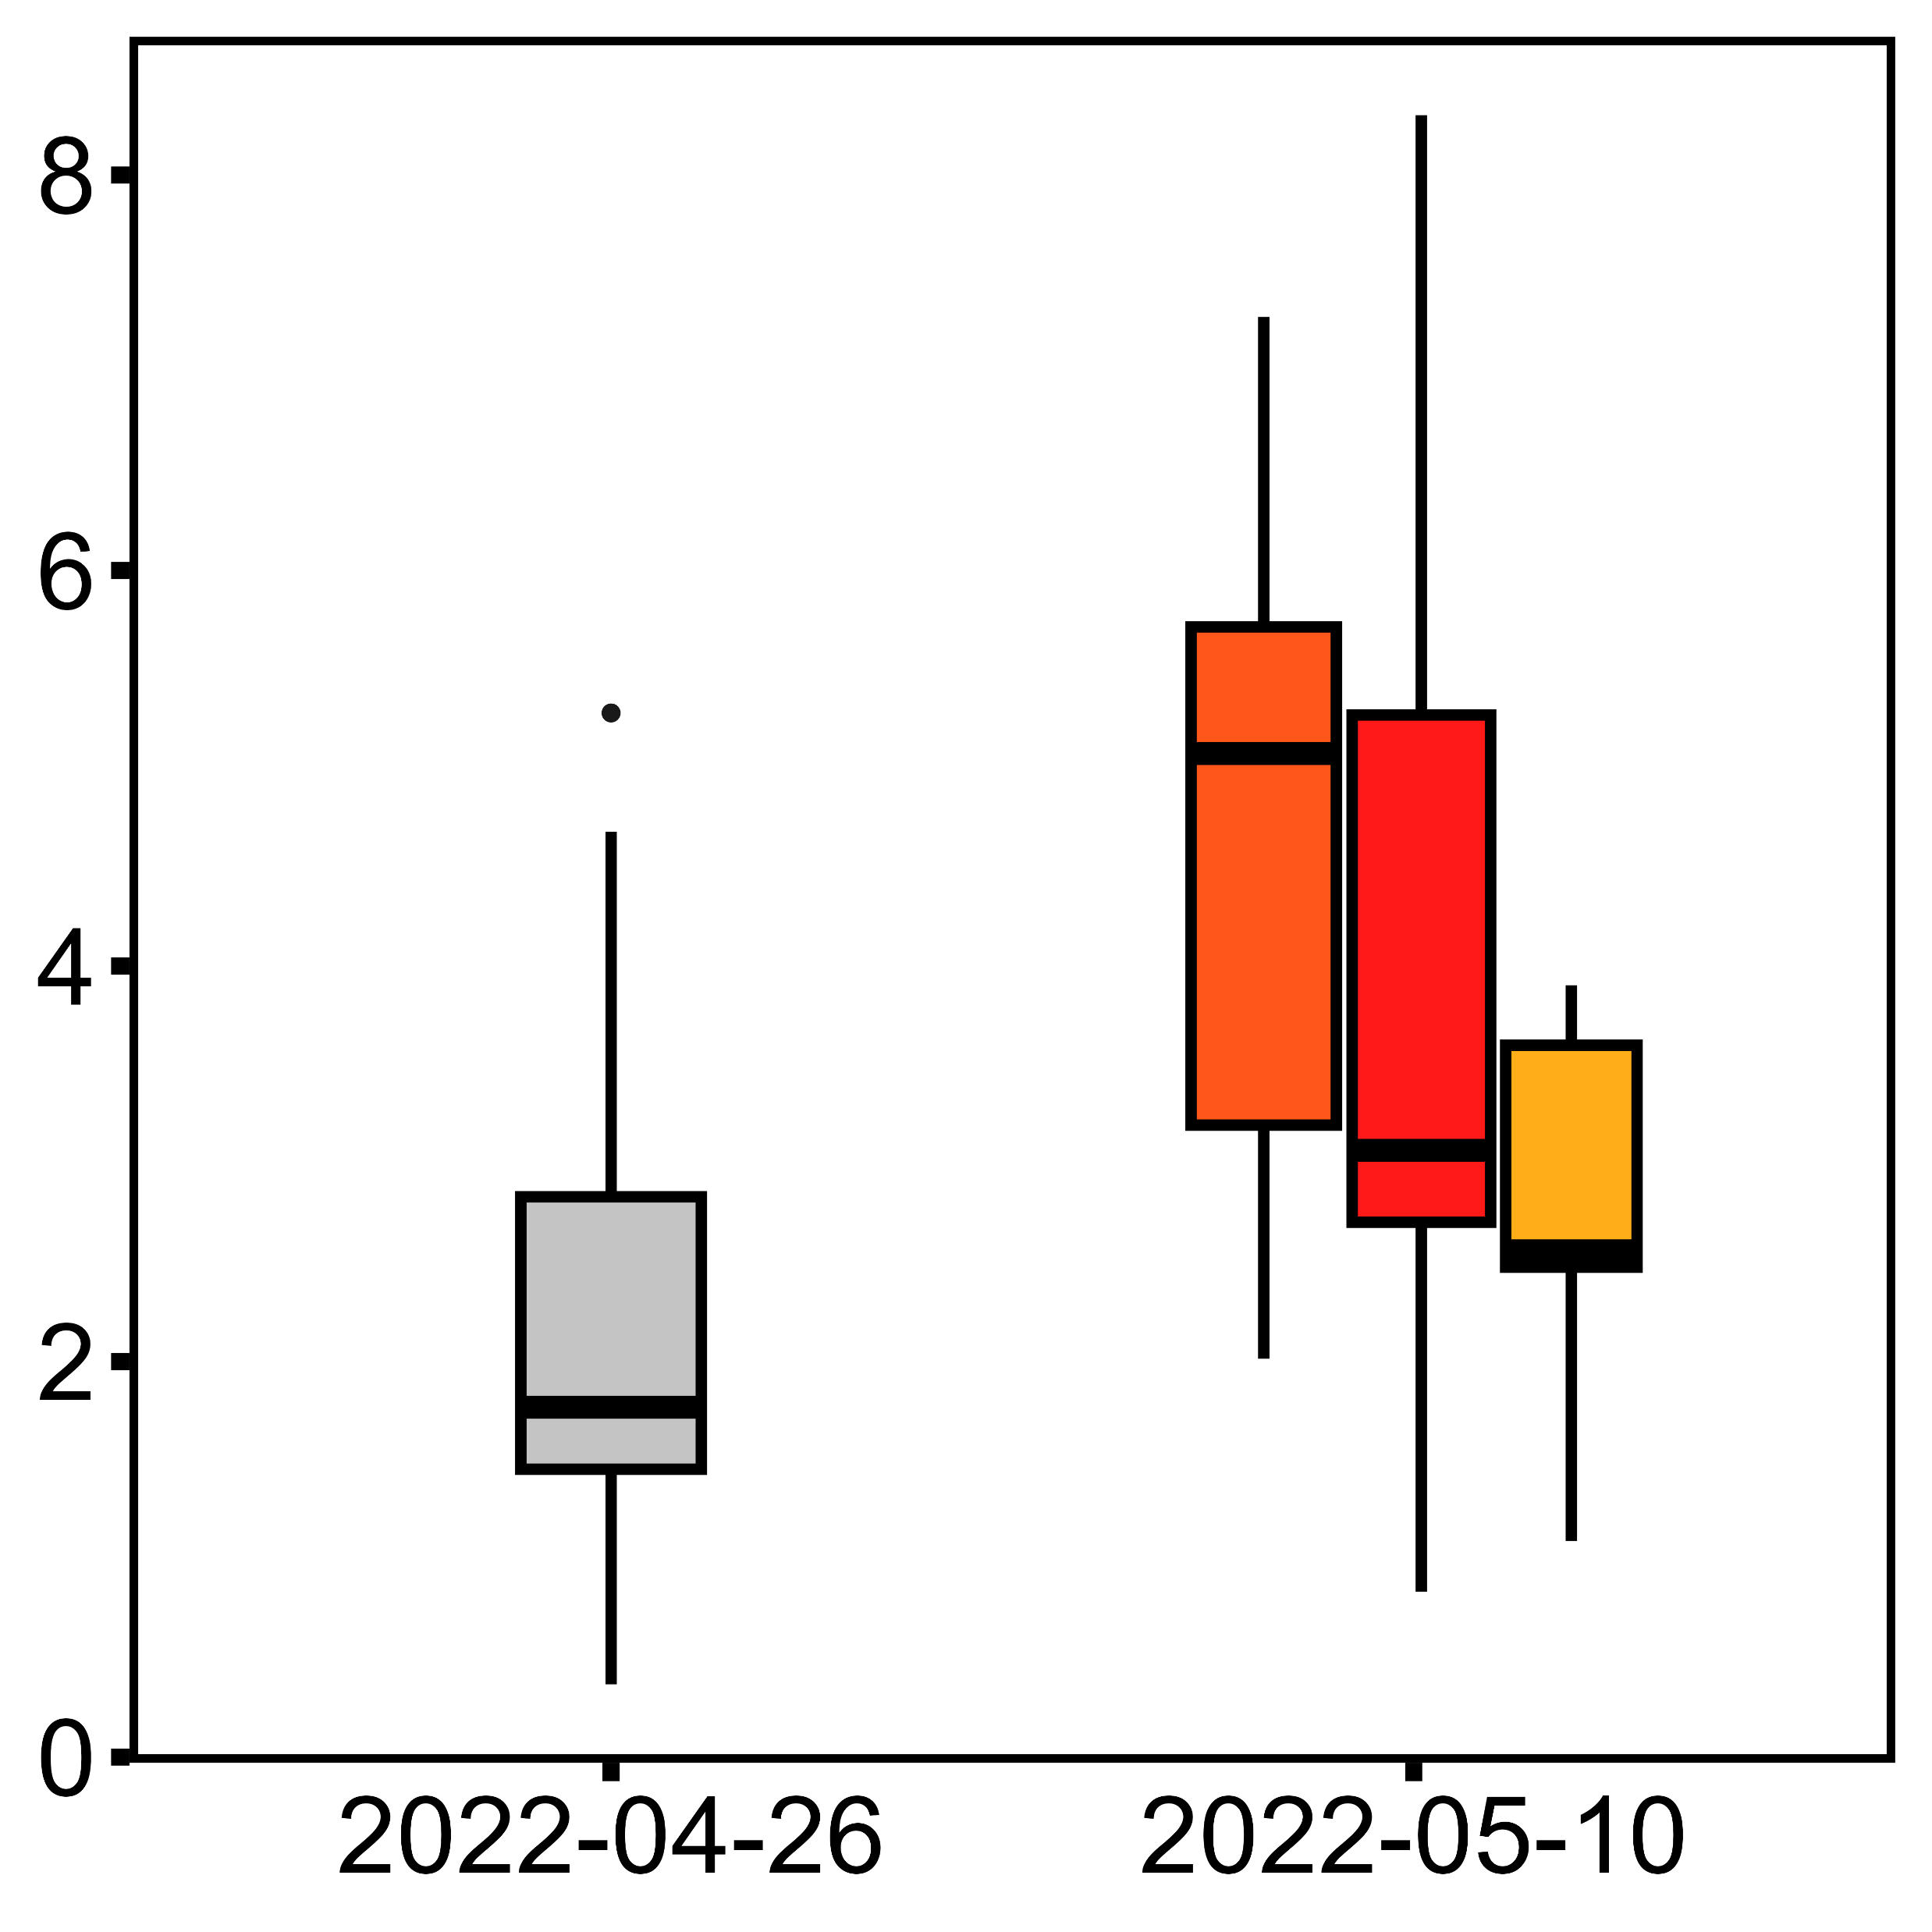
Treatment
Temperature: p<0.001
Treatment: p=0.09
Control
Acute
Standard Metabolic Rate (µmol O₂ h⁻¹ g⁻¹)
Chronic
Variable
12°C
18°C
Temperature

