Slide 1
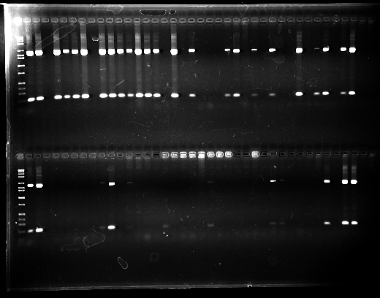
18S long & short loci PCRs from C. bairdi blood samples taken in Stephens Passage, 2007.
1
20
Double-combed agarose gel stained with ethidium bromide. Size standards in lanes 1 & 40.
1682 bp
187 bp
40
50
BCS positive samples have two bands per lane, e.g., lanes 20 & 50.

