Slide 1
Example 1

Slide 2
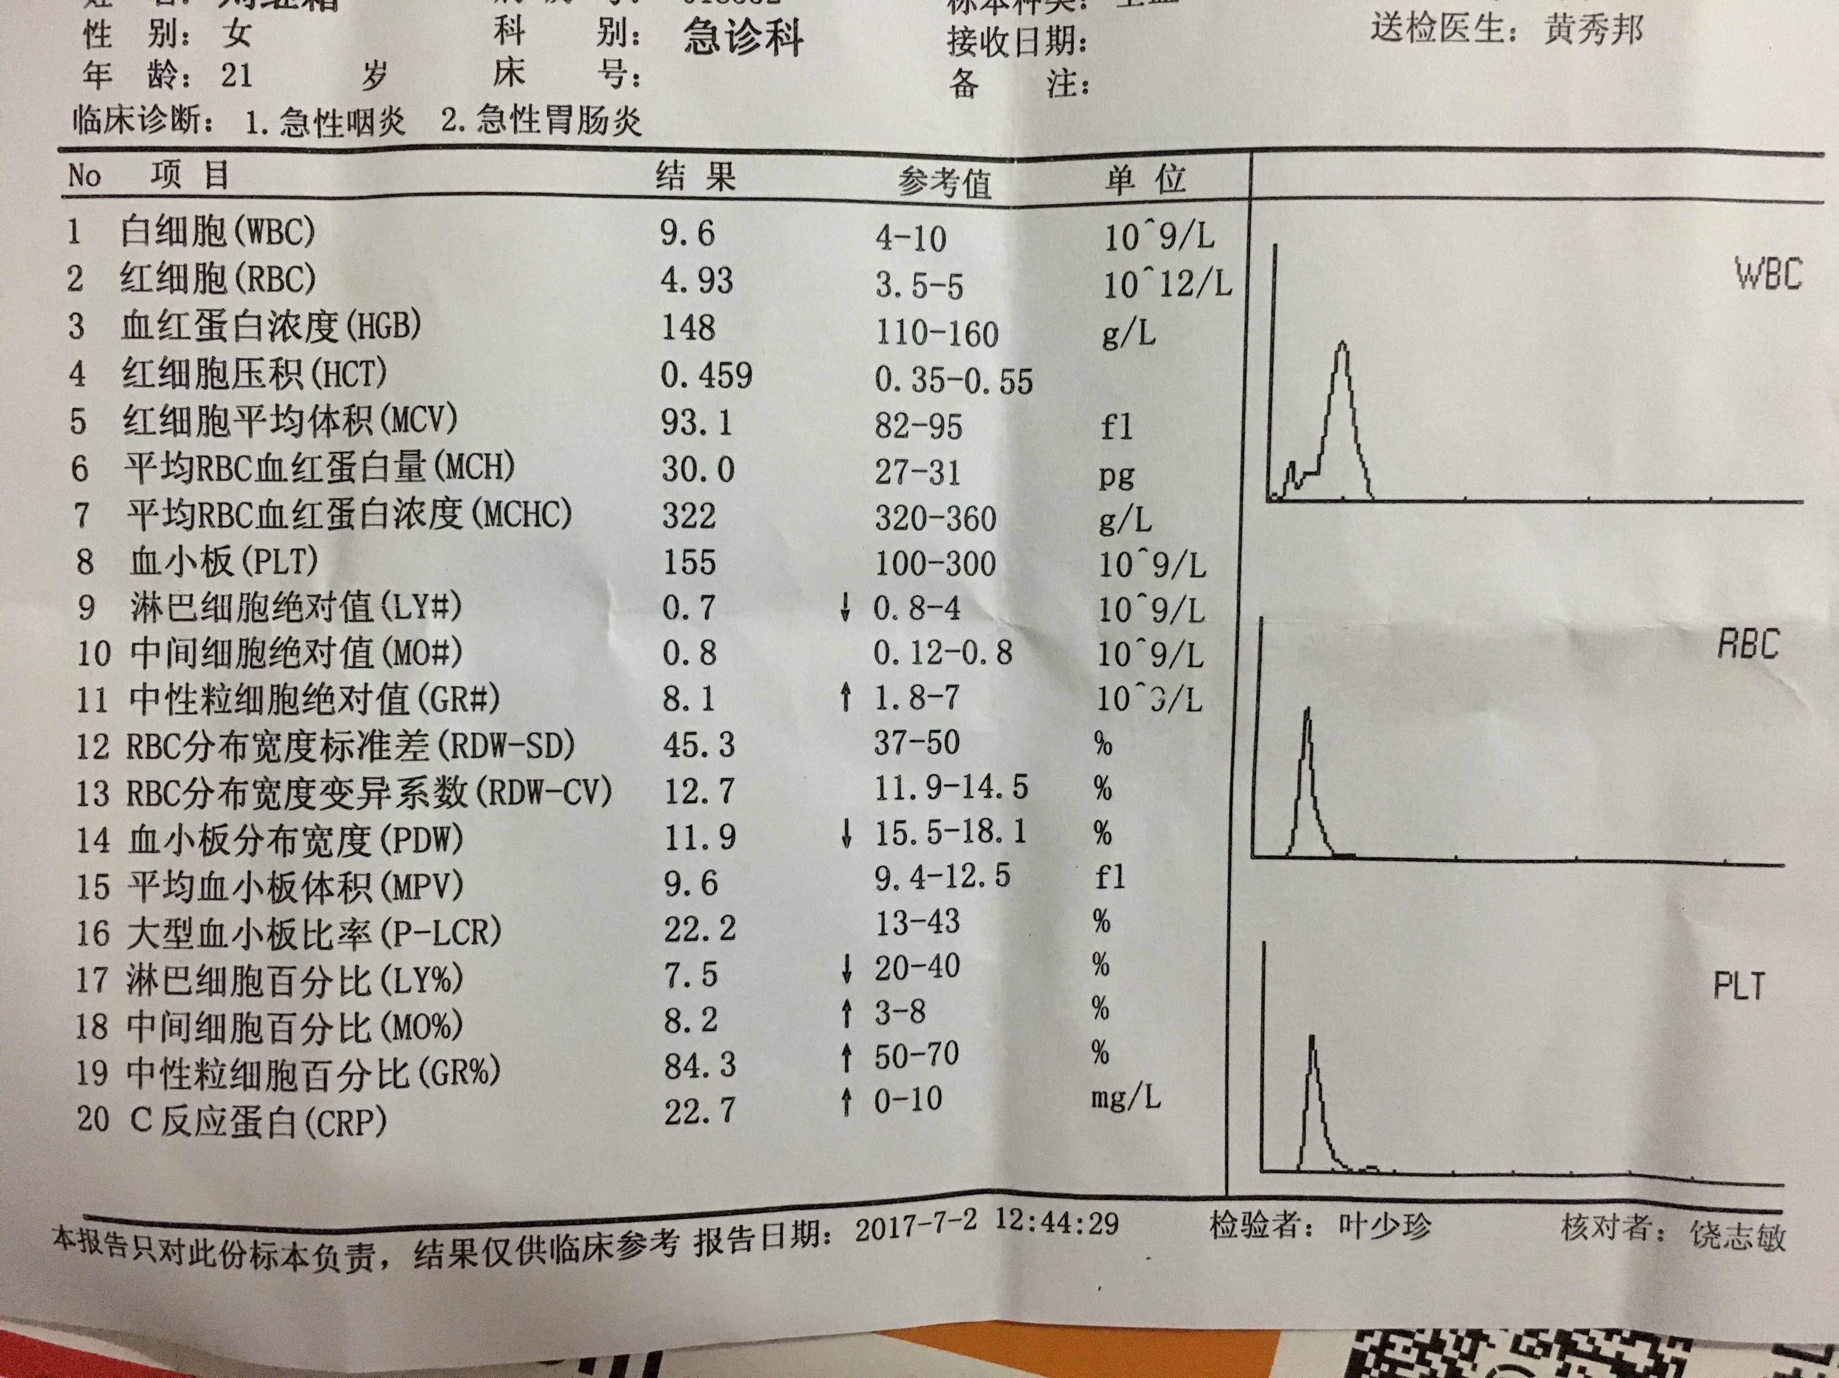

Slide 3
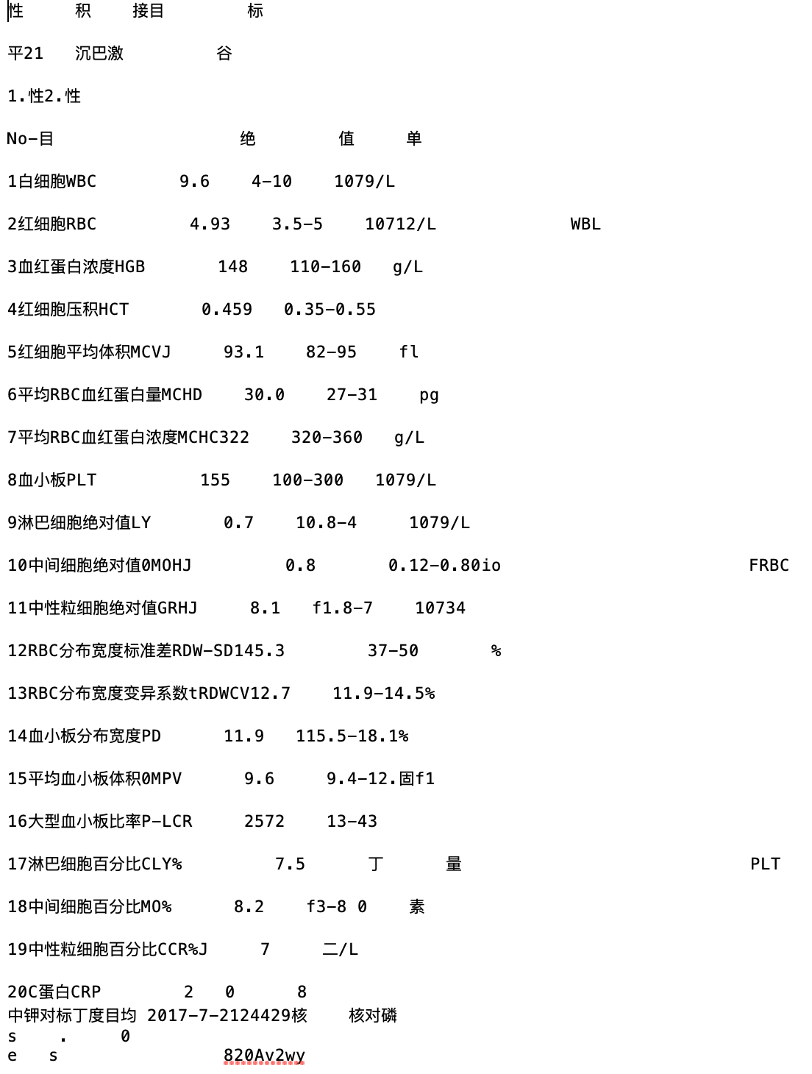
Tesseract result
Highlighted are where tesseract
made a mistake about the values

Slide 4
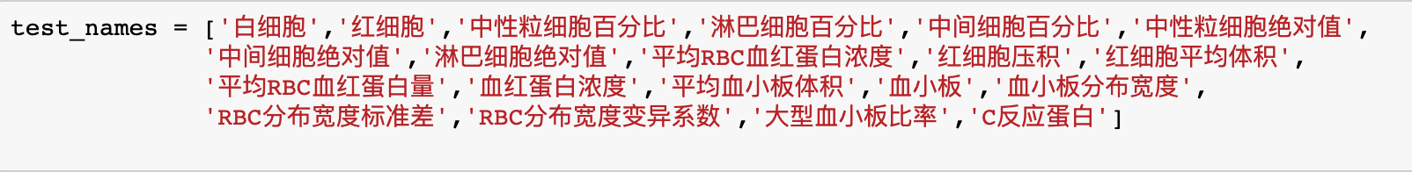
Make a dictionary of test names (manually) referring to the test names in the image

Slide 5
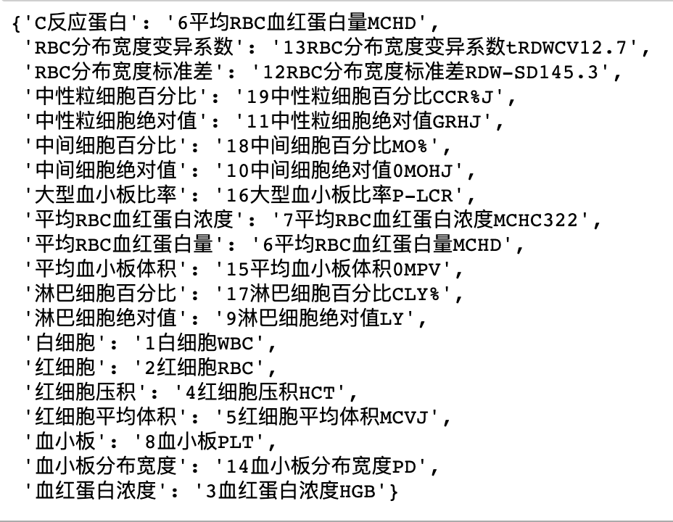
Map test names in the previous slide (correct ones) with results from tesseract (not necessarily correct)
Highlighted is where mapping didn’t give a good result

Slide 6
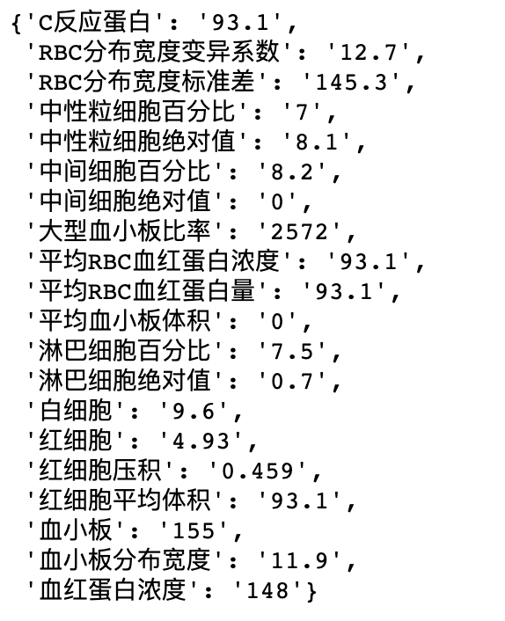
Extract values from tesseract result
Accuracy 60%
Highlighted are where the values are wrong

Slide 7
Example 2

Slide 8
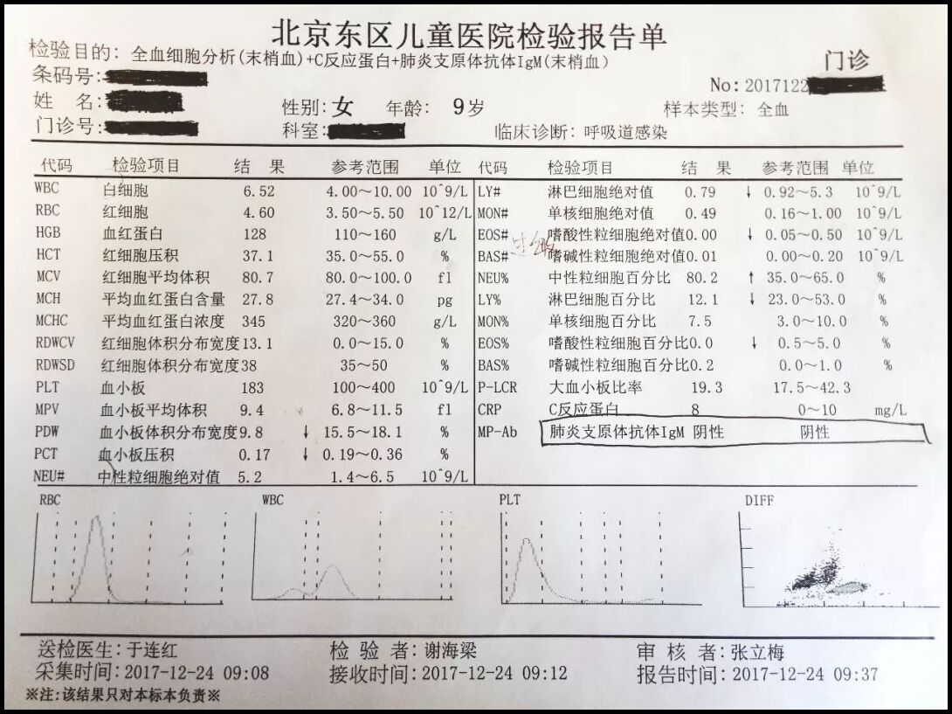

Slide 9
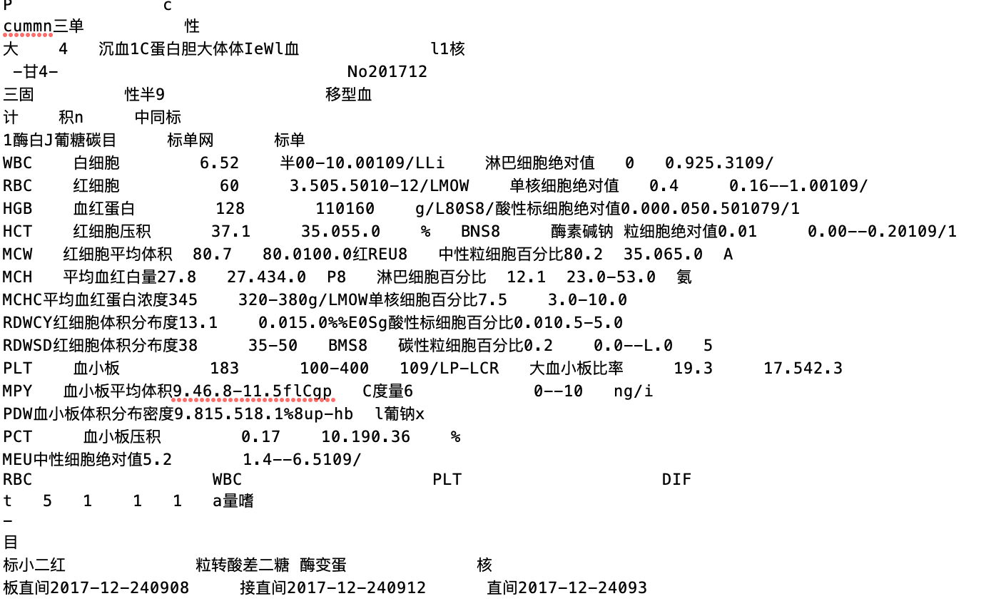
Tesseract result

Slide 10
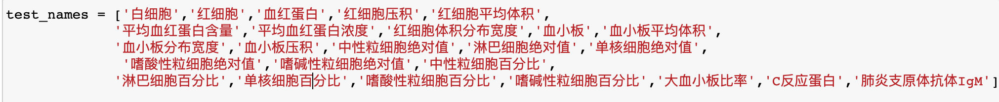
List of test name made manually referring to the image in previous slides

Slide 11
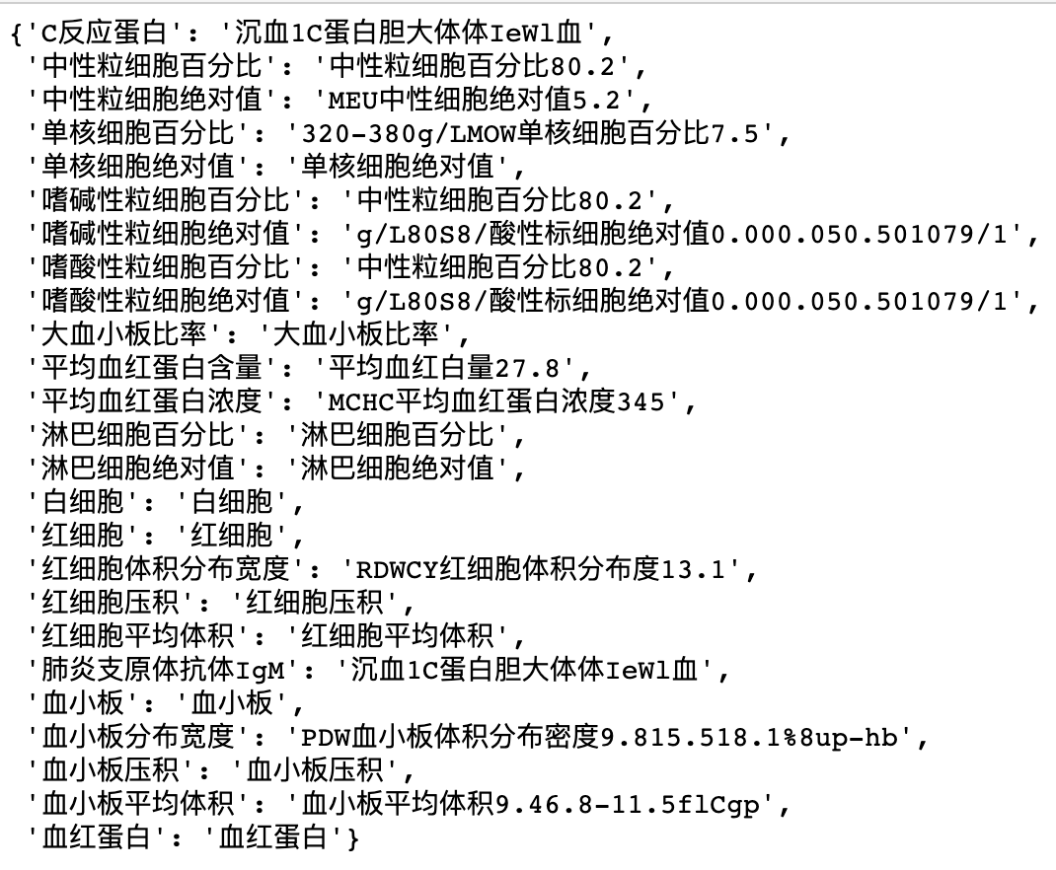
map test names in
previous slide with result
from tesseract

Slide 12
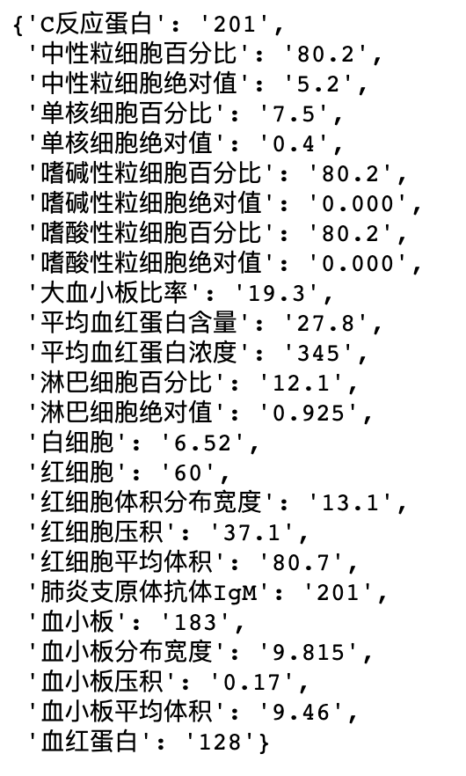
extract values from tesseract for
different test names
Accuracy 72%

Slide 13
Comments:
1, Test names are created manually here because there’s no criteria about which name to use, different hospitals can have different names for them, for example, 白细胞，白细胞计数，白细胞绝对值 all refer to the same thing in a blood test. According to BA team, we also don’t have a consistent name for these measurements.
2, Accuracy can be higher if image quality is higher, meaning high resolution and flat.

