Slide 1

DualStack Networking Istio on AWS
Josh Tischer / Aspen Mesh

Slide 2
Prerequisites
To create a successful dual-stack cluster you need to be aware of the Kubernetes version its capabilities and the physical and virtual networking layers.
Kubernetes 1.20 started allowing the simultaneous assignment of both IPv4 and IPv6 addresses to Services.
Underlay networking - refers to the physical network infrastructure
Bare Metal
Cloud Hosting (AWS, Azure, …)
Overlay networking – refers to the software driven virtualized networking, in this case Kubernetes network plugin or CNI
CNI that support IPv6 (Calico, OVNKubernetes, EKS**) EKS can support either IPv4 or IPv6 as of Jan 2022, not both
Application modifications to respond on IPv6 requests

Slide 3
Istio Dual Stack
Aspen Mesh has been working on dual-stack features for Istio for the past year and is working with the community to open source this work.
For the majority of our development and testing effort we chose OpenShift as our platform.
We tested (and learned a lot about) the following
Kubernetes Clusters
Openshift 4.8+
Kind
KubeAdm
Environments
BareMetal
AWS
Azure

Slide 4
OpenShift Setup on AWS
There are several ways to setup OpenShift. We are focused on the Installer Provisioned Infrastructure deployed from their installer and client tools.
Our scripts work with awscli and the OpenShift installer to modify your AWS environment and OpenShift cluster
All scripts mentioned can be found in our github.com/aspenmesh/open-source repo.
Notes:
DELETE ME??

Slide 5
How to setup a Dual Stack OpenShift cluster in AWS
Clone our repo: git clone git@github.com:aspenmesh/open-source
Change your directory: cd open-source/aws-dual-stack
Download the OpenShift Installer, Client and Pull-Secret to the _install_ directory
./openshift-cluster.sh <cluster-name>
This script creates the IPv4 AWS infrastructure and Kubernetes cluster on AWS
./openshift-upgrade-aws.sh <cluster-name>
The current installer creates an ipv4 cluster and AWS infrastructure. This scripts upgrades the underlay network in AWS for Dual Stack networking. ** see AWS guide
./openshift-upgrade-cluster.sh <cluster-name>
Converts the Kubernetes cluster ipv4 network add IPv6 ** see OpenShift docs
./openshift-delete-cluster.sh
Uses metadata.json file in the _install_ directory for cluster information

Slide 6
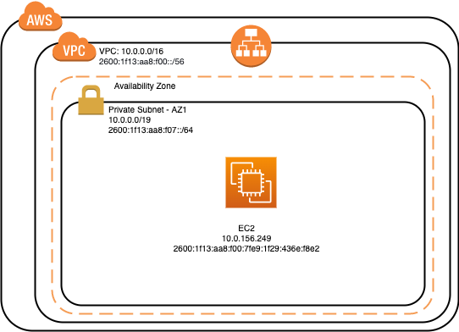
Underlay (Physical) Networking on AWS
How to add IPv6 to an IPv4 network in AWS
Associate VPC and subnets with IPv6 CIDR blocks
Update route tables
Update Security group rules
Upgrade Load Balancer
Update EC2 Instances
Change instance types if needed
Assign IPv6 Address
These steps are scripted for OpenShift but could easily be tweaked to run on any VPC
say for a cluster setup with KubeAdm
./openshift-upgrade-aws.sh test-openshift
AWS Dual-Stack Guide

Slide 7
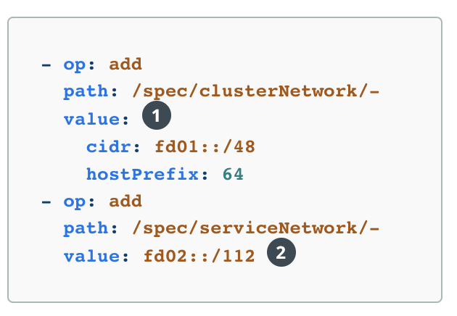
Overlay - Kubernetes Networking
OpenShift
Patch network.config.openshift.io to add IPv6 CIDR
Wait for network changes to roll out `oc wait --for=condition=progressing=false clusteroperators/network`
KubeAdm:
To configure IPv4/IPv6 dual-stack, set dual-stack cluster network assignments.
kube-apiserver: --service-cluster-ip-range=<IPv4 CIDR>,<IPv6 CIDR>
kube-controller-manager:
--cluster-cidr=<IPv4 CIDR>,<IPv6 CIDR>
--service-cluster-ip-range=<IPv4 CIDR>,<IPv6 CIDR>
--node-cidr-mask-size-ipv4|--node-cidr-mask-size-ipv6 defaults to /24 for IPv4 and /64 for IPv6
kube-proxy:
--cluster-cidr=<IPv4 CIDR>,<IPv6 CIDR>
kubelet:
Manually assign .status.addresses for a node

Slide 8
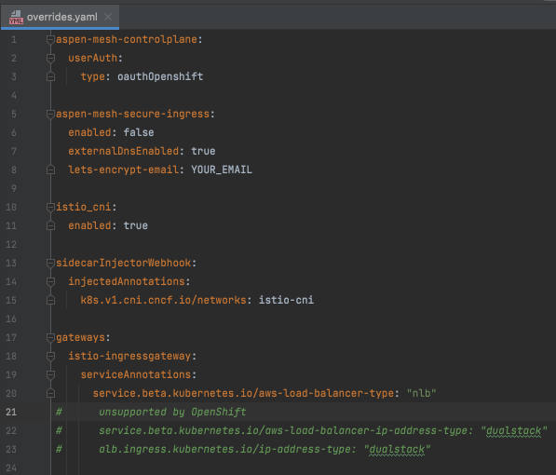
Install Aspen Mesh
Sign up for an account https://aspenmesh.io/invite/
Visit https://my.aspenmesh.io/
Follow the documentation
Install 1.11.8-am2 (Istio + Dual Stack features) ** sample overrides for OpenShift

Slide 9
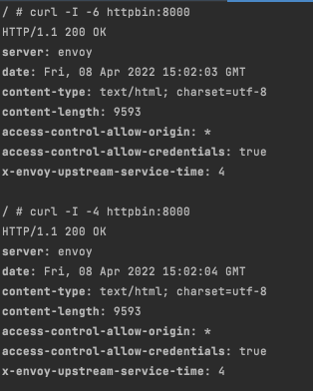
Validate Pod Networking
`./test-dual-stack.sh` Installs a sleep pod and httpbin to dual-stack namespace and configures an istio gateway and virtual service
sleeppod=$(oc get pods --no-headers -o custom-columns=":metadata.name" --selector=app=sleep ) oc exec -it $sleeppod sh
curl -I -6 httpbin:8000 curl -I -4 httpbin:8000

Slide 10
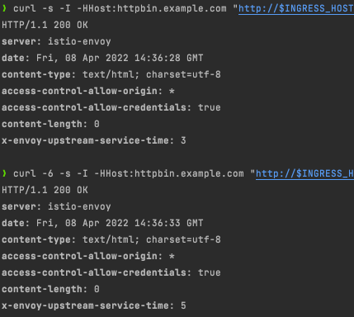
Validate Public Access
export INGRESS_PORT=$(kubectl -n istio-system get service istio-ingressgateway -o jsonpath='{.spec.ports[?(@.name=="http2")].port}’)
export INGRESS_HOST=$(kubectl -n istio-system get service istio-ingressgateway -o jsonpath='{.status.loadBalancer.ingress[0].hostname}’) echo $INGRESS_HOST:$INGRESS_PORT
a92bf429b…..elb.us-west-2.amazonaws.com:80
Also check nslookup -–type=aaaa for ipv6 dns

Slide 11
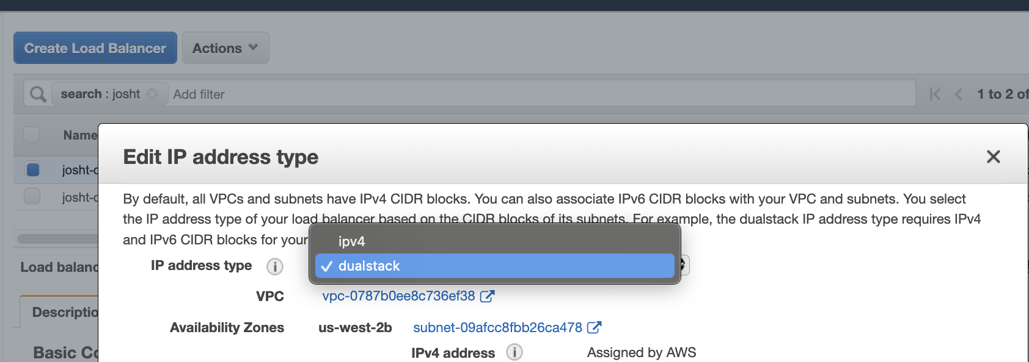
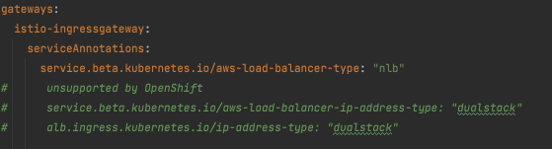
Istio Ingress-Gateway on OpenShift issues
OpenShift creates a Classic LB by default, which does not support dualstack ☹
Istio overrides can change this to an NLB, but the dual stack mode is not yet supported and has to be manually upgraded.

Slide 12
Open Source Istio
Aspen Mesh and Intel are working on implementing dual-stack capability in Istio
We proposed an RFC based on our design, however, we are currently evaluating our next steps based on feedback
We are intending to be making changes in Envoy, but we are still in the (re-)design phase
We are committed to getting dual-stack implemented as it’s important to us and our customers

Slide 13
Thank you!
@Josh Tischer (Aspen Mesh)
https://aspenmesh.io

