Slide 1
Drilling Down the OSI Stack
Preston Maness and Shams Mansoor

Slide 2
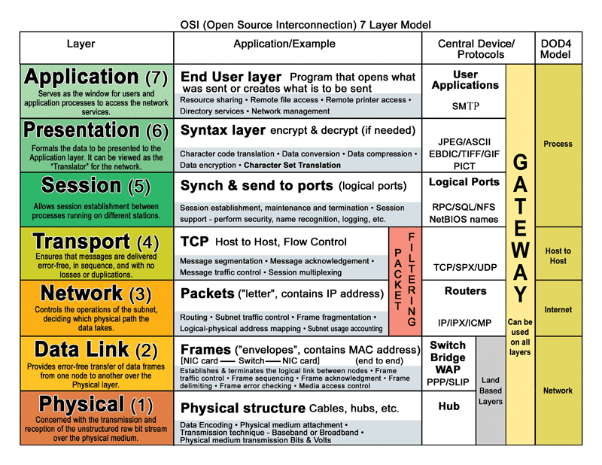
What is the OSI Stack? vvv it's this thing vvv

Slide 3
An Example Use-Case
It's 1630. In half an hour you'll be home free. But in the meantime, you're chained to a corporate culture that insists you keep tapping your keyboard until precisely 1700.
You would jam out to something on Spotify to go along with the solo drum routine that you're subjecting your keyboard-turned-drum-machine to.
Too bad IT won't let you install software on the machine.
Your iPhone 5 S comes to the rescue. Time to jam out.

Slide 4

The Problem
If you could keep typing that would be ggrrrrreat

Slide 5


The Solution

Slide 6

Layer 7 - Application
Spotify develops an iOS app
Spotify submits it to the Apple Overlords App Store QA Team
You download the app
You surreptitiously activate the program when Lumbergh isn't looking
Earbuds to the rescue!
You select your favorite playlist, chock full of this year's top 40 junk and assorted EDM
(Don't worry. I won't judge. Too harshly.)
You hit play

Slide 7
Layer 7 - Application
03:39:57.598 I [ap_connection_impl.cpp:898 ] Connecting to AP ash2-accesspoint-a13.ap.spotify.com:4070
03:39:58.244 I [upnp.cpp:513 ] 192.168.0.1: got external ip 0x[REDACTED]
03:39:58.310 I [upnp.cpp:461 ] 192.168.0.1: mapping add ok
03:39:58.316 I [upnp.cpp:487 ] 192.168.0.1: Port 27020 mapped OK
04:44:56.119 I [file_streamer.cpp:1816 ] Getting CDN url: http://audio2.spotify.com/audio/[LONG-HASH-REDACTED]
04:44:56.467 I [http.cpp:887 ] Result 206 Partial Content
===================================================================
$ netstat -pnt | grep spotify | grep ':27020' | wc -l
39
$ netstat -pnt | grep spotify | grep ':27020' | head -n 1
tcp 0 0 192.168.0.133:27020 75.149.125.217:3199 ESTABLISHED 16956/spotify

Slide 8
Layer 7 - Application
Wow! Spotify is quite a busy bee:
  UPNP
  39 TCP connections to various IPs
  HTTP to CDNs (and ad networks)
And all of this to get some mp3 files, which tosses us to Layer 6!

Slide 9



Layer 6 - Presentation

Slide 10
Layer 6 - Presentation
Technically, the audio codec that Spotify sends varies depending on the platform
Regardless, iOS probably exposes an API –or there exists some other, external library– that the Spotify application can utilize to process these audio codecs; this library is the “layer 6” interface that feeds structured data to the application in “layer 7”
Disclaimer: In practice, these layers often overlap and bunny-hop over each-other.

Slide 11
Layer 5 - Session
Oh goody! This is the part where the kernel really starts to get involved!
Remember all those TCP connections that Spotify opened?
Yeah. The kernel does a lot of the heavy lifting.
Granted, the application might have its own session handlers too.
  Which is probably a separate process or thread that shimmies data between the kernel and the main Spotify application.

Slide 12
Layer 5 - Session
$ netstat -apn | grep spotify | wc -l
95
$ netstat -apn | grep spotify
[A small sample of the output]
tcp 0 0 192.168.0.133:27020 67.84.131.211:57746 ESTABLISHED 16956/spotify
tcp 0 0 192.168.0.133:27020 75.74.194.1:59385 ESTABLISHED 16956/spotify
tcp 0 0 192.168.0.133:27020 208.105.72.142:51236 ESTABLISHED 16956/spotify
tcp 0 0 192.168.0.133:27020 72.28.38.93:54983 ESTABLISHED 16956/spotify
udp 0 0 192.168.0.133:1900 0.0.0.0:* 16956/spotify
udp 0 0 0.0.0.0:57621 0.0.0.0:* 16956/spotify
udp 0 0 192.168.0.133:21328 0.0.0.0:* 16956/spotify
unix 3 [ ] STREAM CONNECTED 1310753 16956/spotify
unix 3 [ ] SEQPACKET CONNECTED 1310737 16956/spotify
unix 3 [ ] STREAM CONNECTED 1311180 16956/spotify
unix 3 [ ] STREAM CONNECTED 1311007 16956/spotify
unix 3 [ ] SEQPACKET CONNECTED 1310736 16956/spotify

Slide 13
Layer 5 - Session
$ pstree 16956
spotify─┬─SpotifyHelper───7*[SpotifyHelper─┬─{Chrome_ChildIOT}]
│ ├─{SignalSender}]
│ ├─{VC manager}]
│ └─2*[{v8:SweeperThrea}]]
├─SpotifyHelper─┬─{Chrome_ChildIOT}
│ ├─{SGI_video_sync}
│ └─{Watchdog}
├─spotify
├─{AsyncKeyValueSt}
├─{AudioThread}
├─2*[{BrowserBlocking}]
├─{Chrome_CacheThr}
├─{Chrome_DBThread}
├─{Chrome_DevTools}
├─{Chrome_FileThre}
├─{Chrome_FileUser}
├─{Chrome_IOThread}
├─{Chrome_ProcessL}
├─{Chrome_WebKitTh}
├─{Dns Thread}
├─{MediaStreamDevi}
├─{NSS SSL ThreadW}
├─{Network Thread}
├─{NetworkChangeNo}
├─{Proxy resolver}
├─{QThread}
├─{WorkerPool/1886}
├─2*[{dispatcher}]
├─{inotify_reader}
├─{spotify}
├─2*[{threaded-ml}]
└─2*[{}]

Slide 14
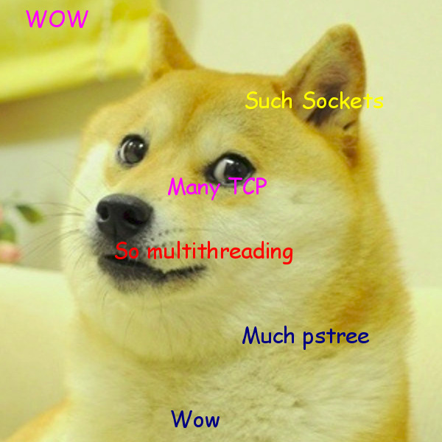
Layer 5 - Session

Slide 15
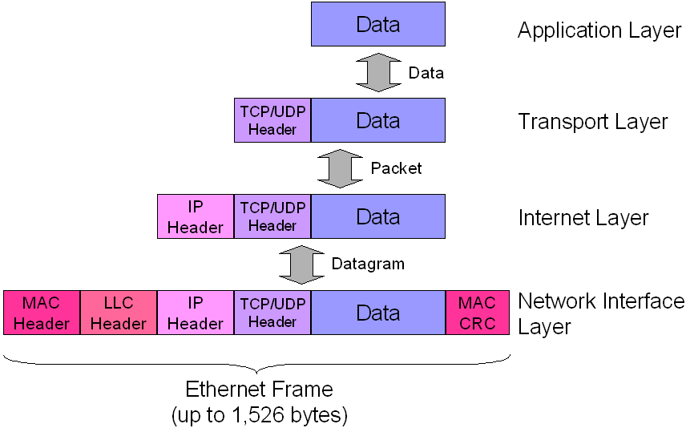
A Useful Aside
The kernel handles lots of the gory details

Slide 16
Layer 4 - Transport
We've already seen that Spotify is busy crafting lots of HTTP requests that get stuffed into TCP datagrams
At layer 4, Spotify –or its helper threads or processes– effectively hands off the TCP datagrams to the kernel, and the kernel passes received TCP datagrams back to Spotify
Kernel tcp modules handle
  network scheduling
  Multiplexing
  Data ordering
Kernel passes off the TCP datagrams to layer three to be packetized with IP address and routed

Slide 17
Layer 3 - Network
BUT WHERE DID IT GET THE IP ADDRESSES?
  TCP requests are bound to unix sockets (remember the netstat output?) ; sockets contain the source and destination IP address info.
  Or Magic.
Kernel constructs IP packet with source/destination IP info and TCP (or UDP) datagram along with routing info
Passes off packets to Link Layer

Slide 18
Layer 2 - Link
Kernel takes packet and makes full ethernet frame. Ships off to NIC firmware via the NICs drivers
In this case, the “NIC” is the 3G/4G modem
Pray that the drivers and firmware are solid

Slide 19


Pray to Firmware Gods

Slide 20
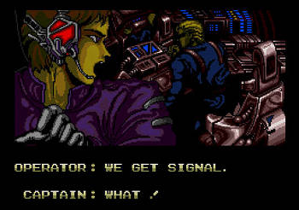
Layer 1 - Physical
And this is the part where the NIC's firmware actually takes the ethernet frame and does its thing, translating the frames into meaningful EM signals the tower can read
And translating received signals back to ethernet frames and sending it all back up the stack

Slide 21

OH OH I ALMOST FORGOT
I'm gonna need you to come in on Sunday too

Slide 22


Slide 23
And that's how your iPhone works.

