Slide 1
1.4. Hardware Random Number Generator
Preston Maness

Slide 2

Motivation

Slide 3
Why?
Familiarize myself with an important aspect of modern cryptographic systems.
Gain experience with signal shaping.
Explore the interface between hardware and software.

Slide 4
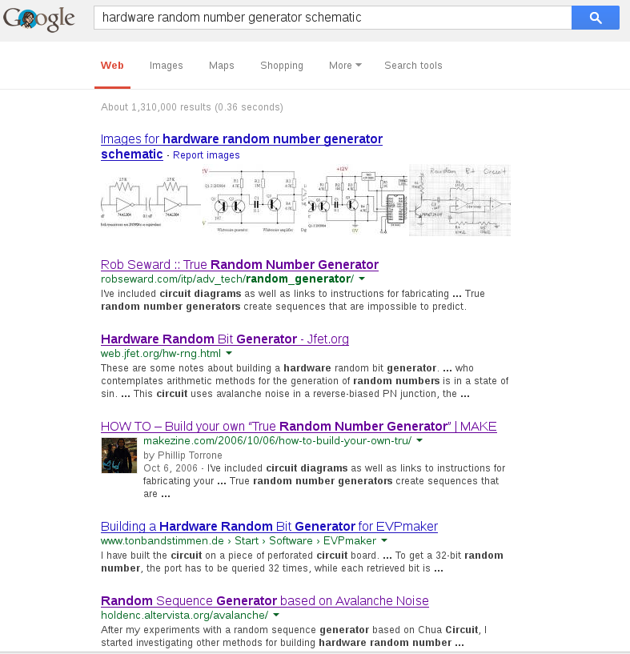
On the Shoulders of Giants

Slide 5
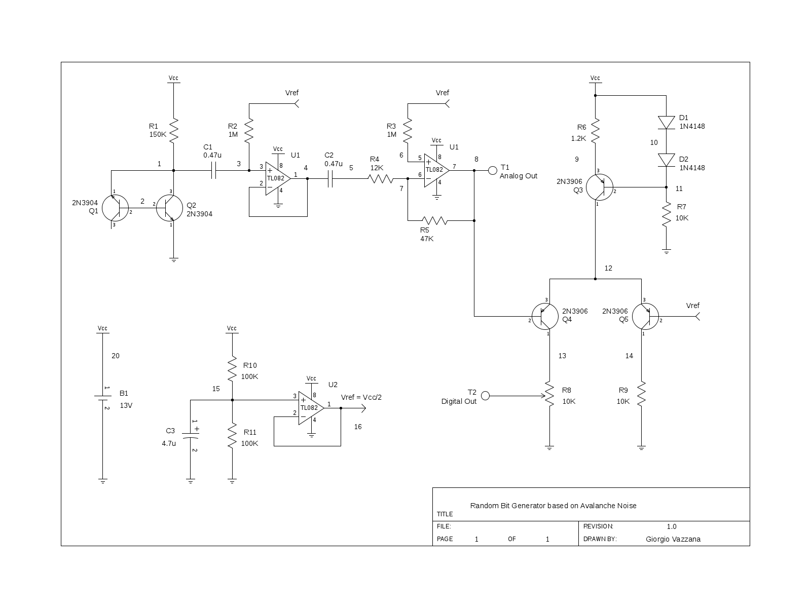
Giorgio Vazzana

Slide 6

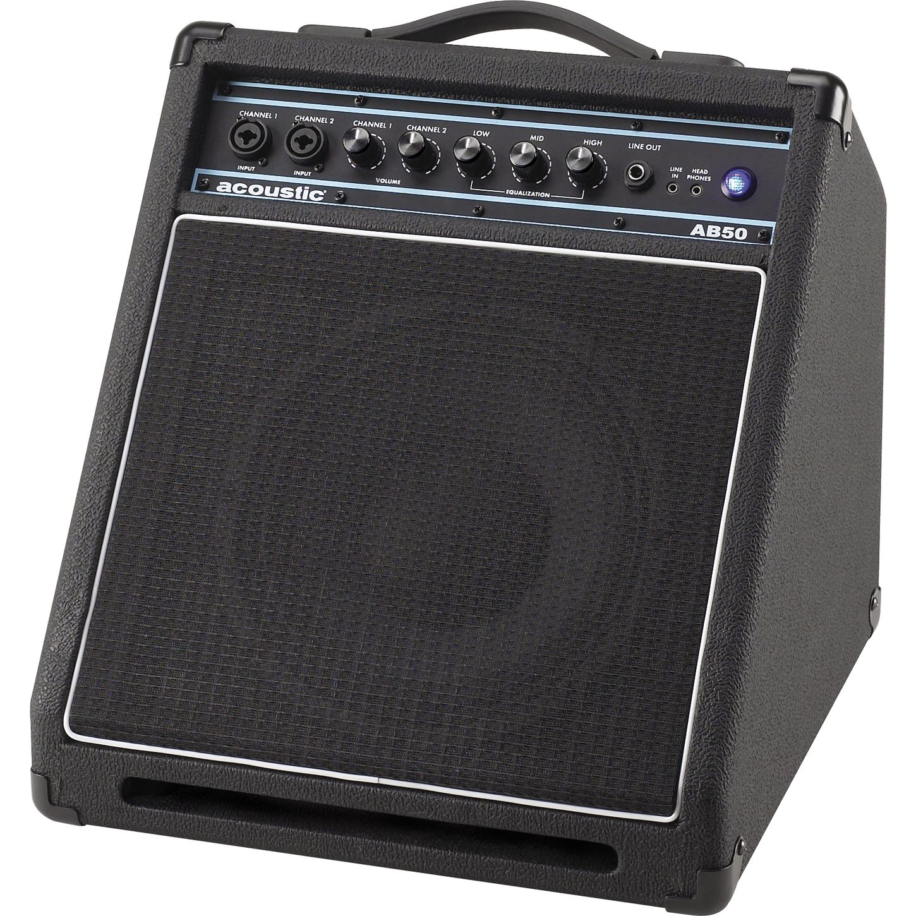
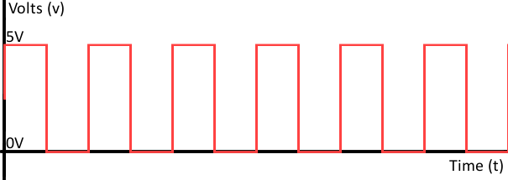
General Principle
Amplify
Digitize

Slide 7
Hardware Stack

Slide 8
Software Stack

Slide 9
Deliverables
Functioning prototype that outputs bits to the host.
Host is able to read this bitstream.
Host tests the randomness of bitstream.
Inclusion of verified bitstream into entropy pool.
Hardware-side verification.
Automated testing.

Slide 10
Timeline
Timeframe | Goals
Continuous | Research, Verify, Research, and Research some more.
By end of September | Verification pipeline determined (dieharder). Hardware to host communication.
By end of October | Verification pipeline functional and providing results of its tests.
By end of semester | Verified bitstream. Automated testing.

Slide 11
Budget
Item | Quantity | Cost

Slide 12
Status

Slide 13
Looking Forward
Inclusion into entropy pool.
Automate testing harness.
Verify with hardware.
Parallelized implementation with rapid sampling of each stream to increase throughput.

