Slide 1
2.9 Hardware Random Number Generator
Preston Maness

Slide 2


Motivations
Dual_EC_DRBG

Slide 3
Background Info - Interfaces
Interface Impacts:
    Environmental: None
    Health: None
    Ethical: None
    Manufacturability: Every noise source is different. Requires customized hardware to condition.
    Social/Safety: Should this hardware be incorporated into cryptographic modules, the safety of the data and those involved are at risk should any bugs be found.

Slide 4
Background Info – Noise Sources
Avalanche Noise (reverse PN junction breakdown)
Thermal Noise (resistors)
Atmospheric Noise

Slide 5
Background Info – Noise Types
White Noise – Equal Power Density Spectrum
Pink Noise (aka 1/f noise) – Power Density Spectrum falls off at 1/f rate (3 dB/dec)
Brown/Red Noise – Power Density Spectrum falls of at 1/f^2 rate (6 dB/dec)
In Practice: Most devices exhibit dominant pink noise at low frequencies before white noise dominates

Slide 6
Chosen Solution
Avalanche Noise via reverse PN junction breakdown
  Previous implementations provide benchmark to compare work against
  Previous experience with BJTs

Slide 7
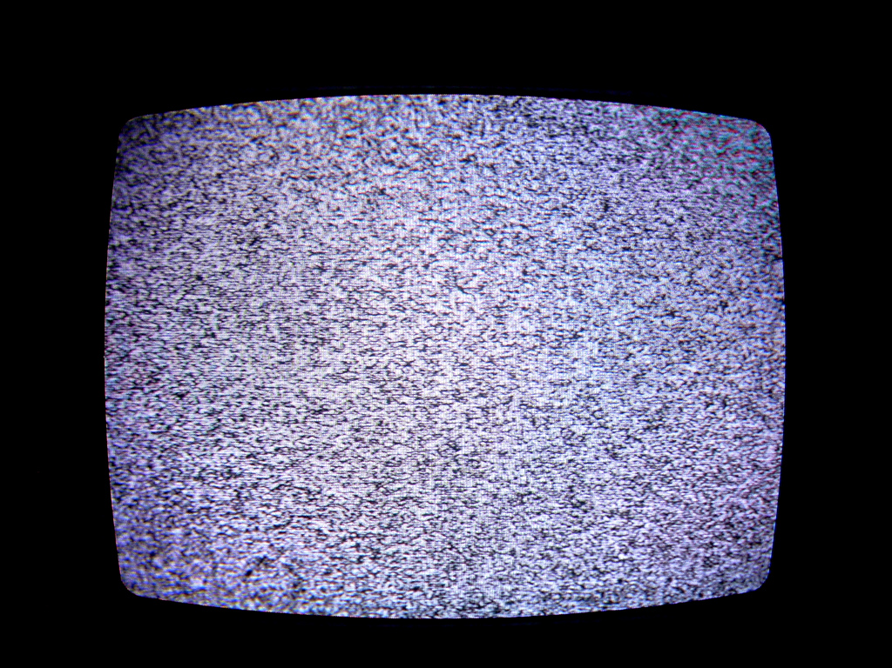
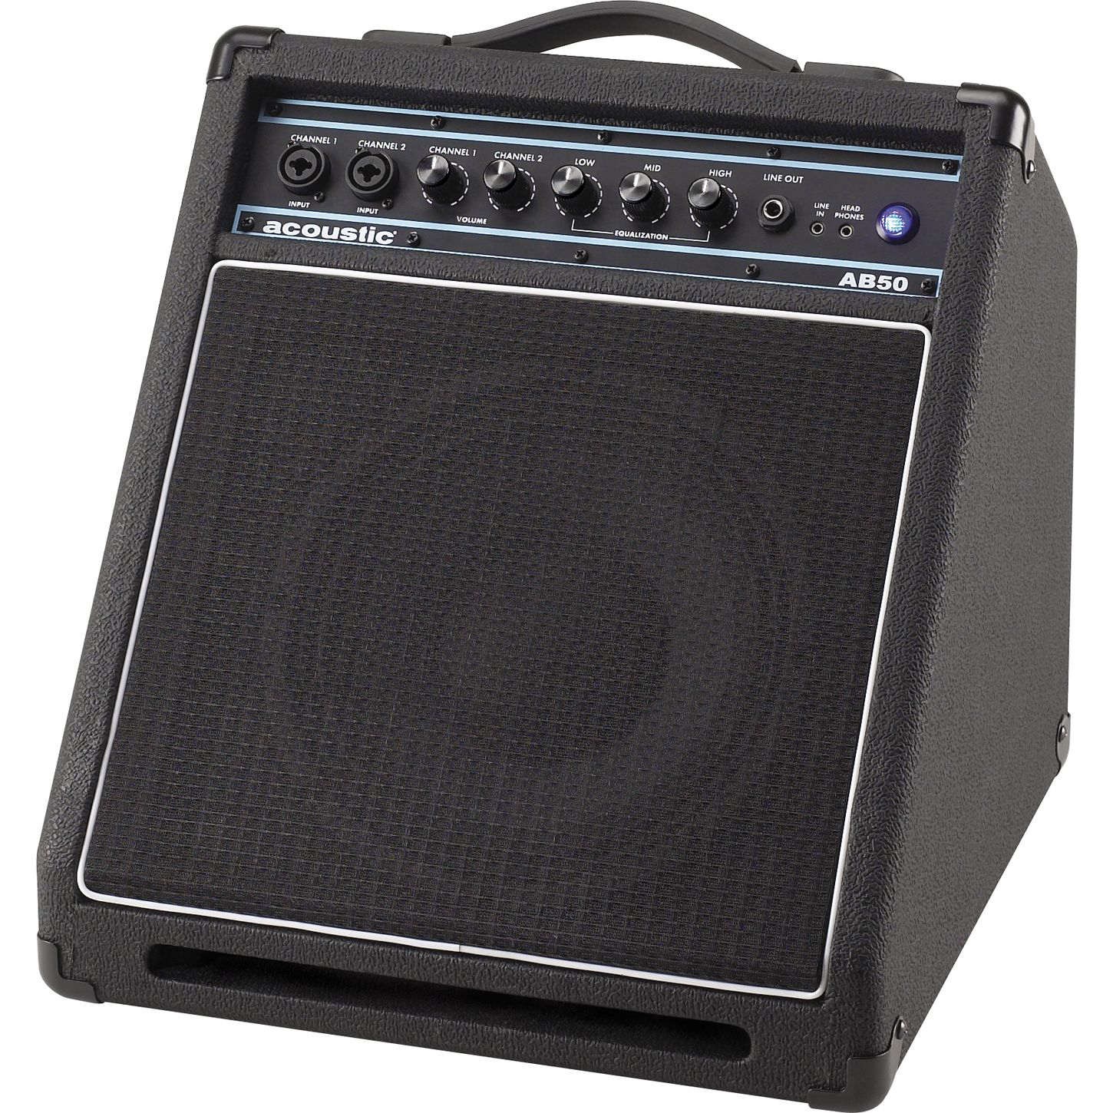
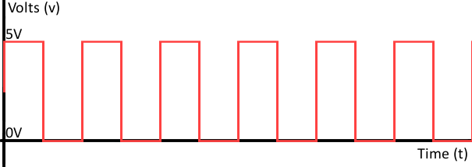
General Principle
Amplify
Digitize

Slide 8
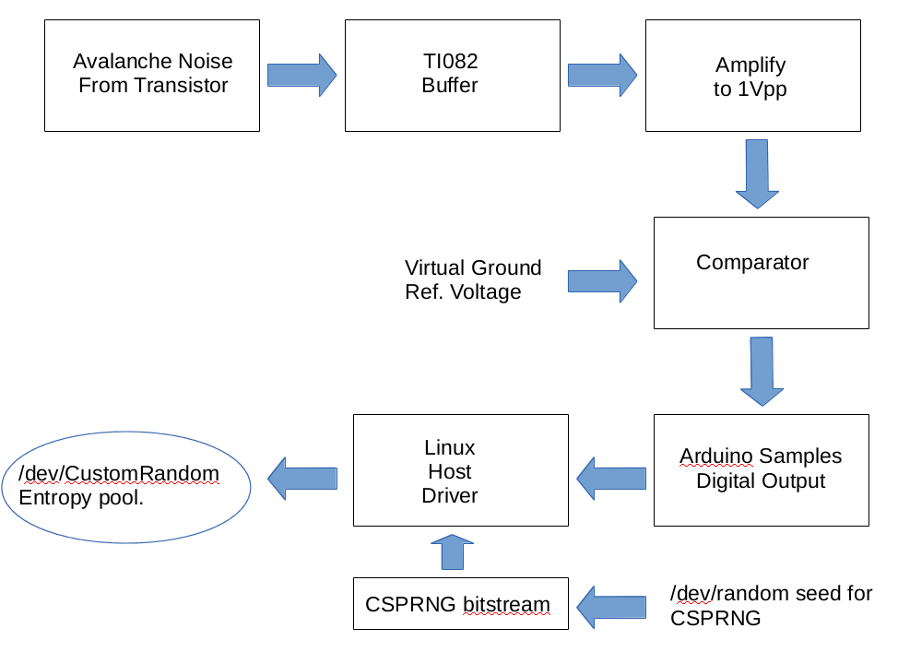
Design Details – Block Diagram

Slide 9
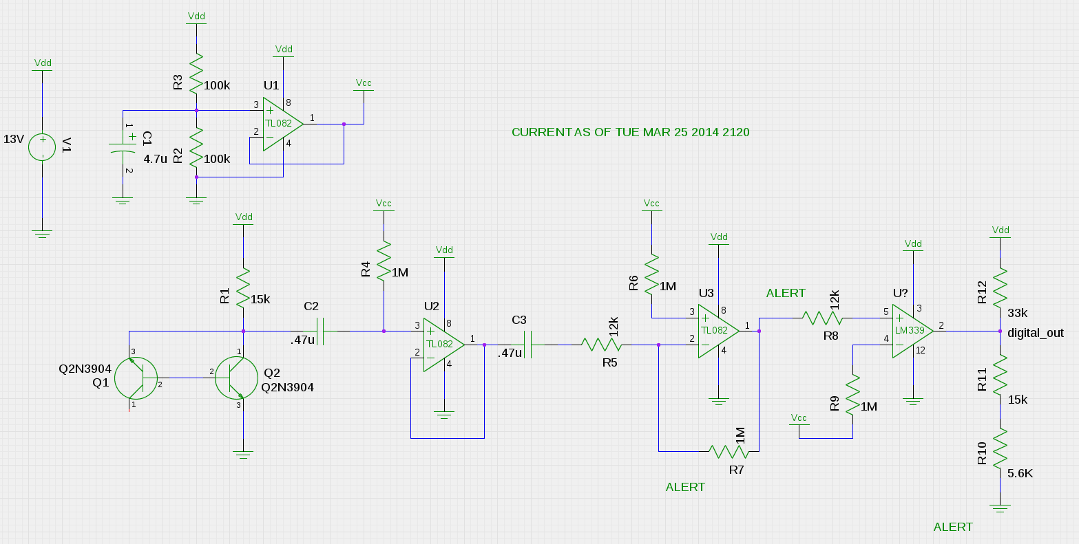
Design Details - Schematic

Slide 10
Validation
Validation Consists of:
    Preliminary tests utilizing `ent` software. Provides chi-squared test for distribution, detects serial correlation, provides a monte-carlo simulation value for pi.
    Extensive tests utilizing `dieharder` software. Provides an extensive battery of tests designed specifically to stress random number generators to conclusive failure.

Slide 11
Schedule and Deliverables
Timeframe | Goals
Continuous | Research, Verify, Research, and Research some more.
By end of February | Resolve comparator issues Resolve mains hum issues
By end of March | Resolve Biasing problems Bitstream that passes tests
By end of April | Move to Protoboard Inclusion into entropy pool Increase throughput via parallelization (Stretch Goal)

Slide 12
Budget/Manufacturability
The devices don't, strictly speaking, lend themselves to mass manufacture at first glance:
    Each noise source has a different peak-to-peak amplitude. This requires modification of the gain for each device, unless...
      A high gain is used regardless of initial noise floor. The design currently implements this strategy, but it is unknown whether it presents any hidden problems.
    Each transistor (utilized in initial amplification) has different beta values. This also requires gain modifications.

Slide 13
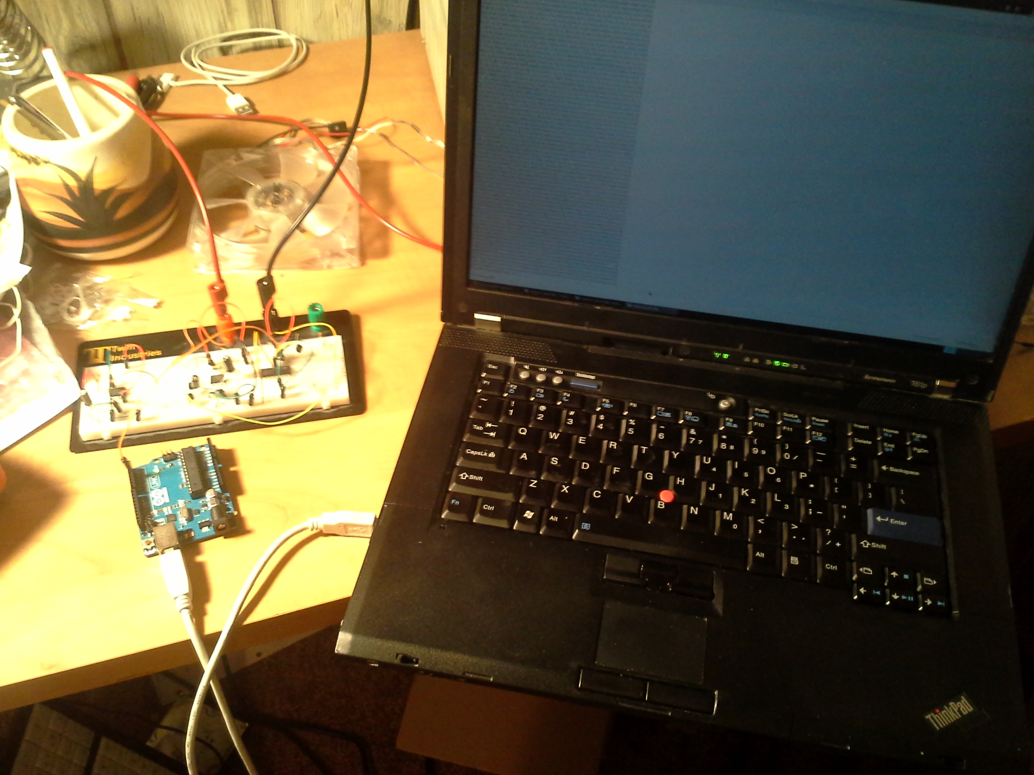
Messy Lab Benches!

Slide 14
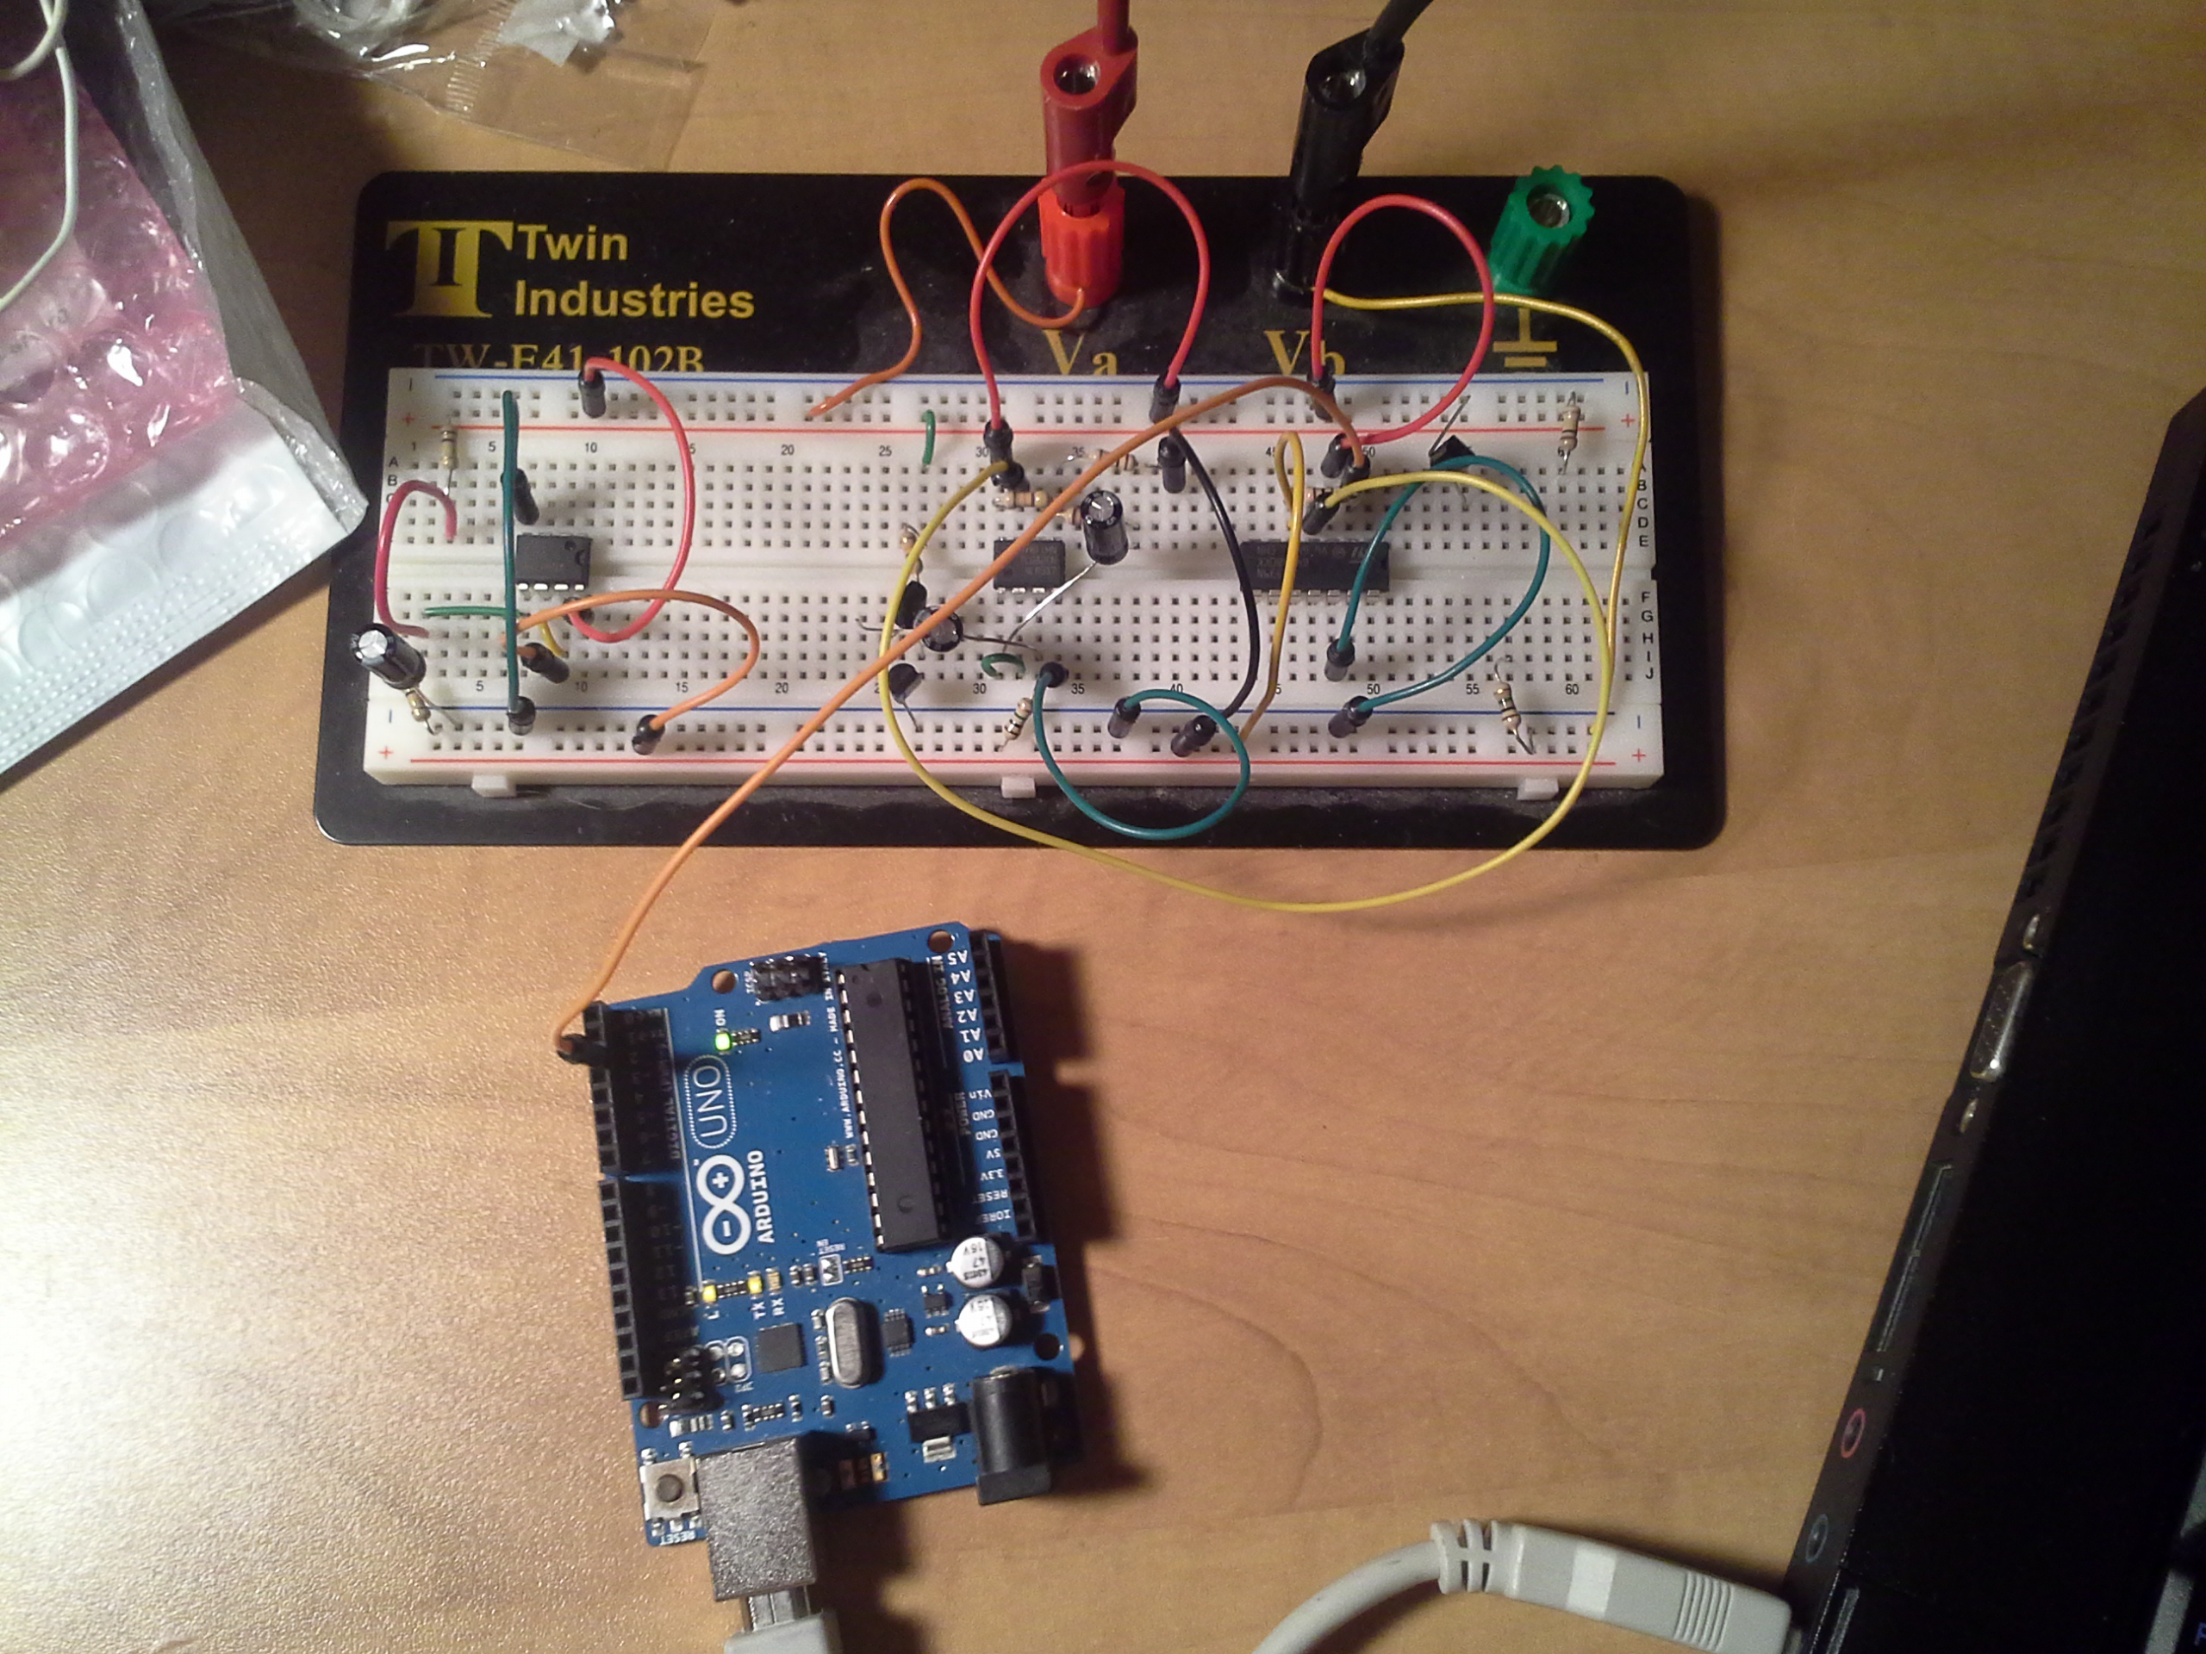
Messy Breadboards!

Slide 15
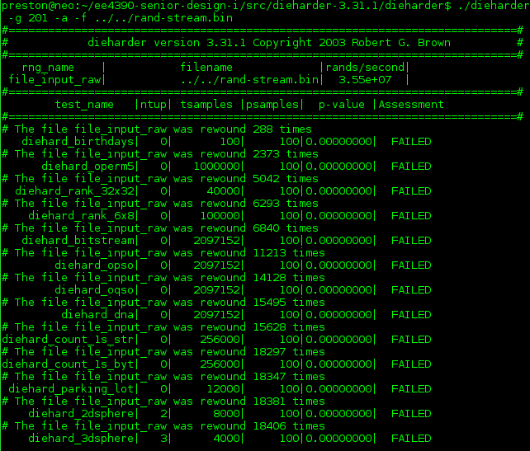


Adversity...

Slide 16
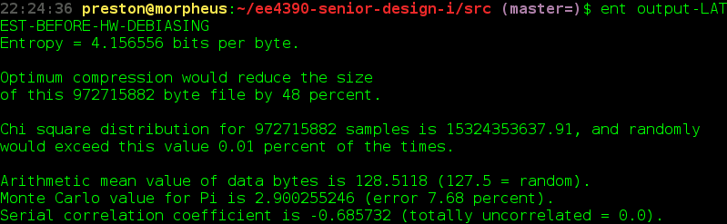



...Adversity...

Slide 17
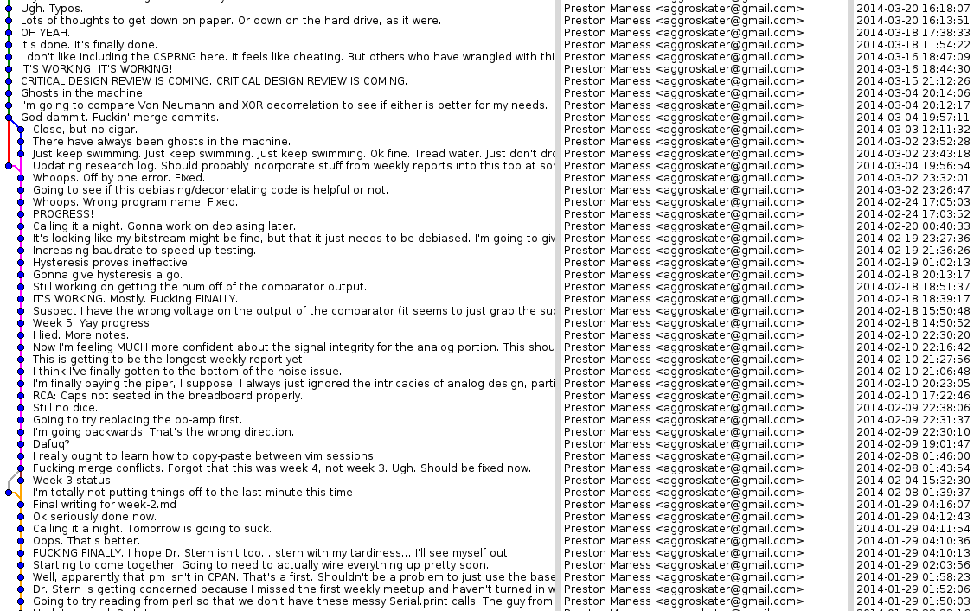
...Weeks and Weeks of Work...

Slide 18

...Kinda Feels Like...

Slide 19
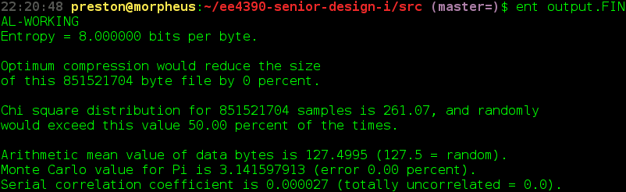
… Triumph...

Slide 20
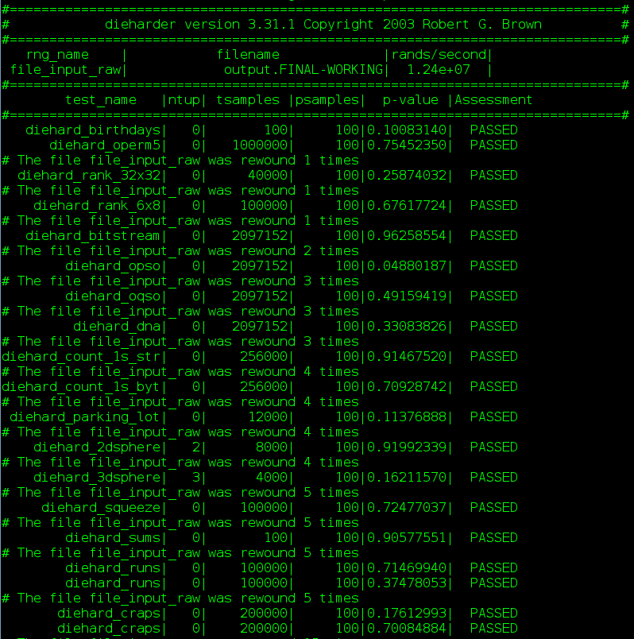
...Triumph.

Slide 21


Slide 22
Conclusions
As of now, the device passes all RNG tests thrown at it:
  Chi-Squared distribution looks good
  No serial correlation
  Good simulated values for pi
  No failures in dieharder
All Minimum Deliverables Met

Slide 23

Stalk The Project Manager!
https://github.com/aggroskater?tab=repositories

