Slide 1
Background Info - Problem
The Problem: Finding sources of random numbers for:
One-time Pads
Key Generation
Monte-Carlo Simulation

Slide 2
Background Info - Solution
The tried and tested solution:
Noise sources such as avalanche noise, shot noise, and thermal noise are appropriately conditioned into a stream of random bits.

Slide 3
Background Info - Interfaces
Interface Impacts:
Environmental: None
Health: None
Ethical: None
Manufacturability: Every noise source is different. Requires customized hardware to condition.
Social/Safety: Should this hardware be incorporated into cryptographic modules, the safety of the data and those involved are at risk should any bugs be found.

Slide 4
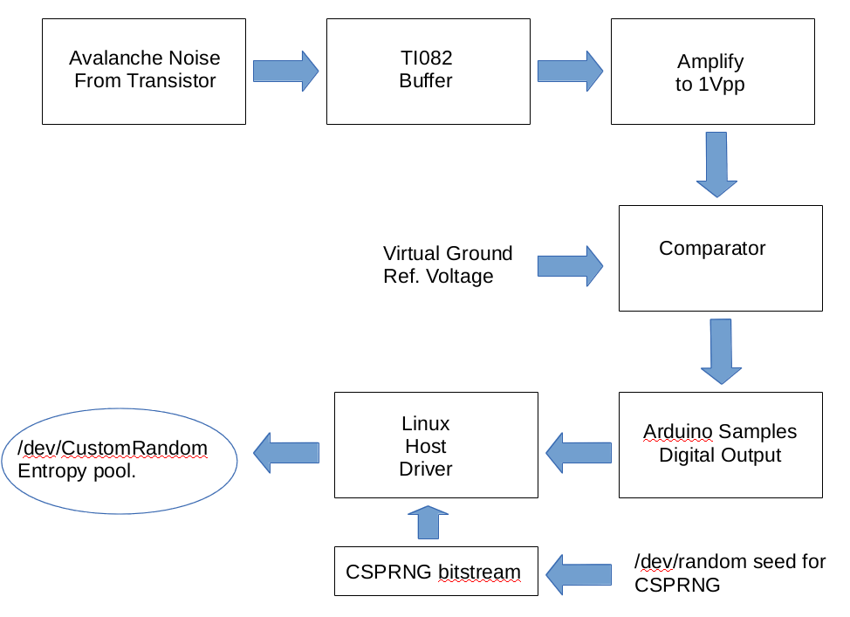
Design Details – Block Diagram

Slide 5
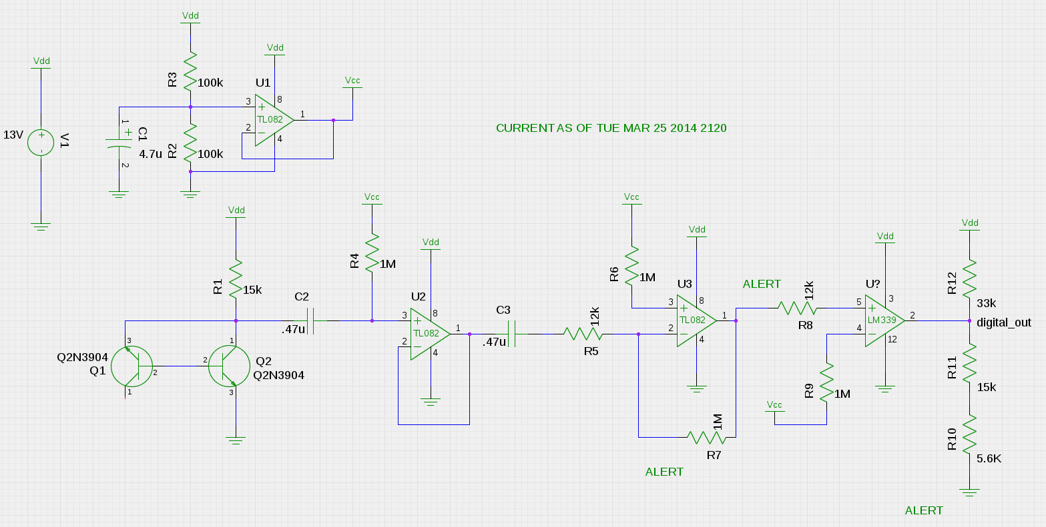
Design Details - Schematic

Slide 6
Design Details – Driver part 1
#!/usr/bin/env perl
use warnings;
use strict;
use Device::SerialPort;
use Bytes::Random::Secure;
# Set up the arduino.
my $arduino = Device::SerialPort->new("/dev/ttyACM0") ||
die "Can't open serial port.\n";
$arduino->baudrate(115200);
$arduino->databits(8);
$arduino->parity('none');
$arduino->stopbits(1);
# Set up the CSPRNG
my $random = Bytes::Random::Secure->new(
Bits => 64,
NonBlocking => 0,
); #Seed with 8 bytes, use /dev/random (or other blocking)

Slide 7
Design Details – Driver Part 2
# Set up the destination file where the raw binary is stored.
my $name = "output";
open(my $outputFile, '>', $name) or die "Can't open: $!";
#if you don't do this then the contents get held in a buffer until the file
#closes.
$outputFile->autoflush(1);
#apparently aquiring /dev/tty.whatever reboots the arduino. should wait
#"a few seconds" for it to be ready.
print "Waiting for arduino to be ready.\n";
sleep(3);

Slide 8
Design Details – Driver Part 3
#Start capturing bytes.
while (1) {
my $byte;
$byte = $arduino->read(1);
if ( defined($byte) && length($byte) ) {
#XOR with byte from CSPRNG
my $csprng_byte = $random->bytes(1);
$byte = $byte ^ $csprng_byte;
print "Value: " , $byte, "\n";
#store the binary in a file. 'a' is just a generic, "string" datatype.
print $outputFile pack('a',$byte);
}
}

Slide 9
Validation
Validation Consists of:
Preliminary tests utilizing `ent` software. Provides chi-squared test for distribution, detects serial correlation, provides a monte-carlo simulation value for pi.
Extensive tests utilizing `dieharder` software. Provides an extensive battery of tests designed specifically to stress random number generators to conclusive failure.
I'd like to show you some of the results of these tests on a laptop after the presentation.

Slide 10
Schedule
As of now, the hardware and software are both functional and validated. The minimum schedule requirements have been met. This leaves...
Polishing hardware. Perhaps solder a few examples onto PCBs.
Polishing software. Get bitstream into a /dev/ file, clean up perl script to use as a driver.
Extra testing. Perhaps investigate parallelizing the implementation. (This was scheduled as part of the initial design, but working out the bugs proved more difficult than anticipated and dealing with correlation of multiple streams in parallel would likely present similar problems that needed to be addressed).

Slide 11
Budget/Manufacturability
The devices don't, strictly speaking, lend themselves to mass manufacture:
Each noise source has a different peak-to-peak amplitude. This requires modification of the gain for each device, unless...
A high gain is used regardless of initial noise floor. The design currently implements this strategy, but it is unknown whether it presents any hidden problems.
Per 1000 device budget TBD.

Slide 12
Notes
Schedule slipped, because getting a debiased output stream proved difficult.
This design needs a Cryptographically Secure Pseudo-Random Number Generator (CSPRNG) bitstream to “mop up” any left-over bias from the random bitstream provided by the hardware.
This project intended to sidestep the need for a PRNG at all, but research has shown that many hardware RNGs perform this “mop up” routine anyway as a matter of properly conditioning the final bitstream.

Slide 13
Conclusions
As of now, the device passes all RNG tests thrown at it:
Chi-Squared distribution looks good
No serial correlation
Good simulated values for pi
No failures in dieharder
Powerpoints are boring. Let's hook this thing up to a scope and look at some pretty waveforms!

